Slide 1
Ghost in the Machine
A Soft Introduction to Puppet and Systems Administration

Slide 2
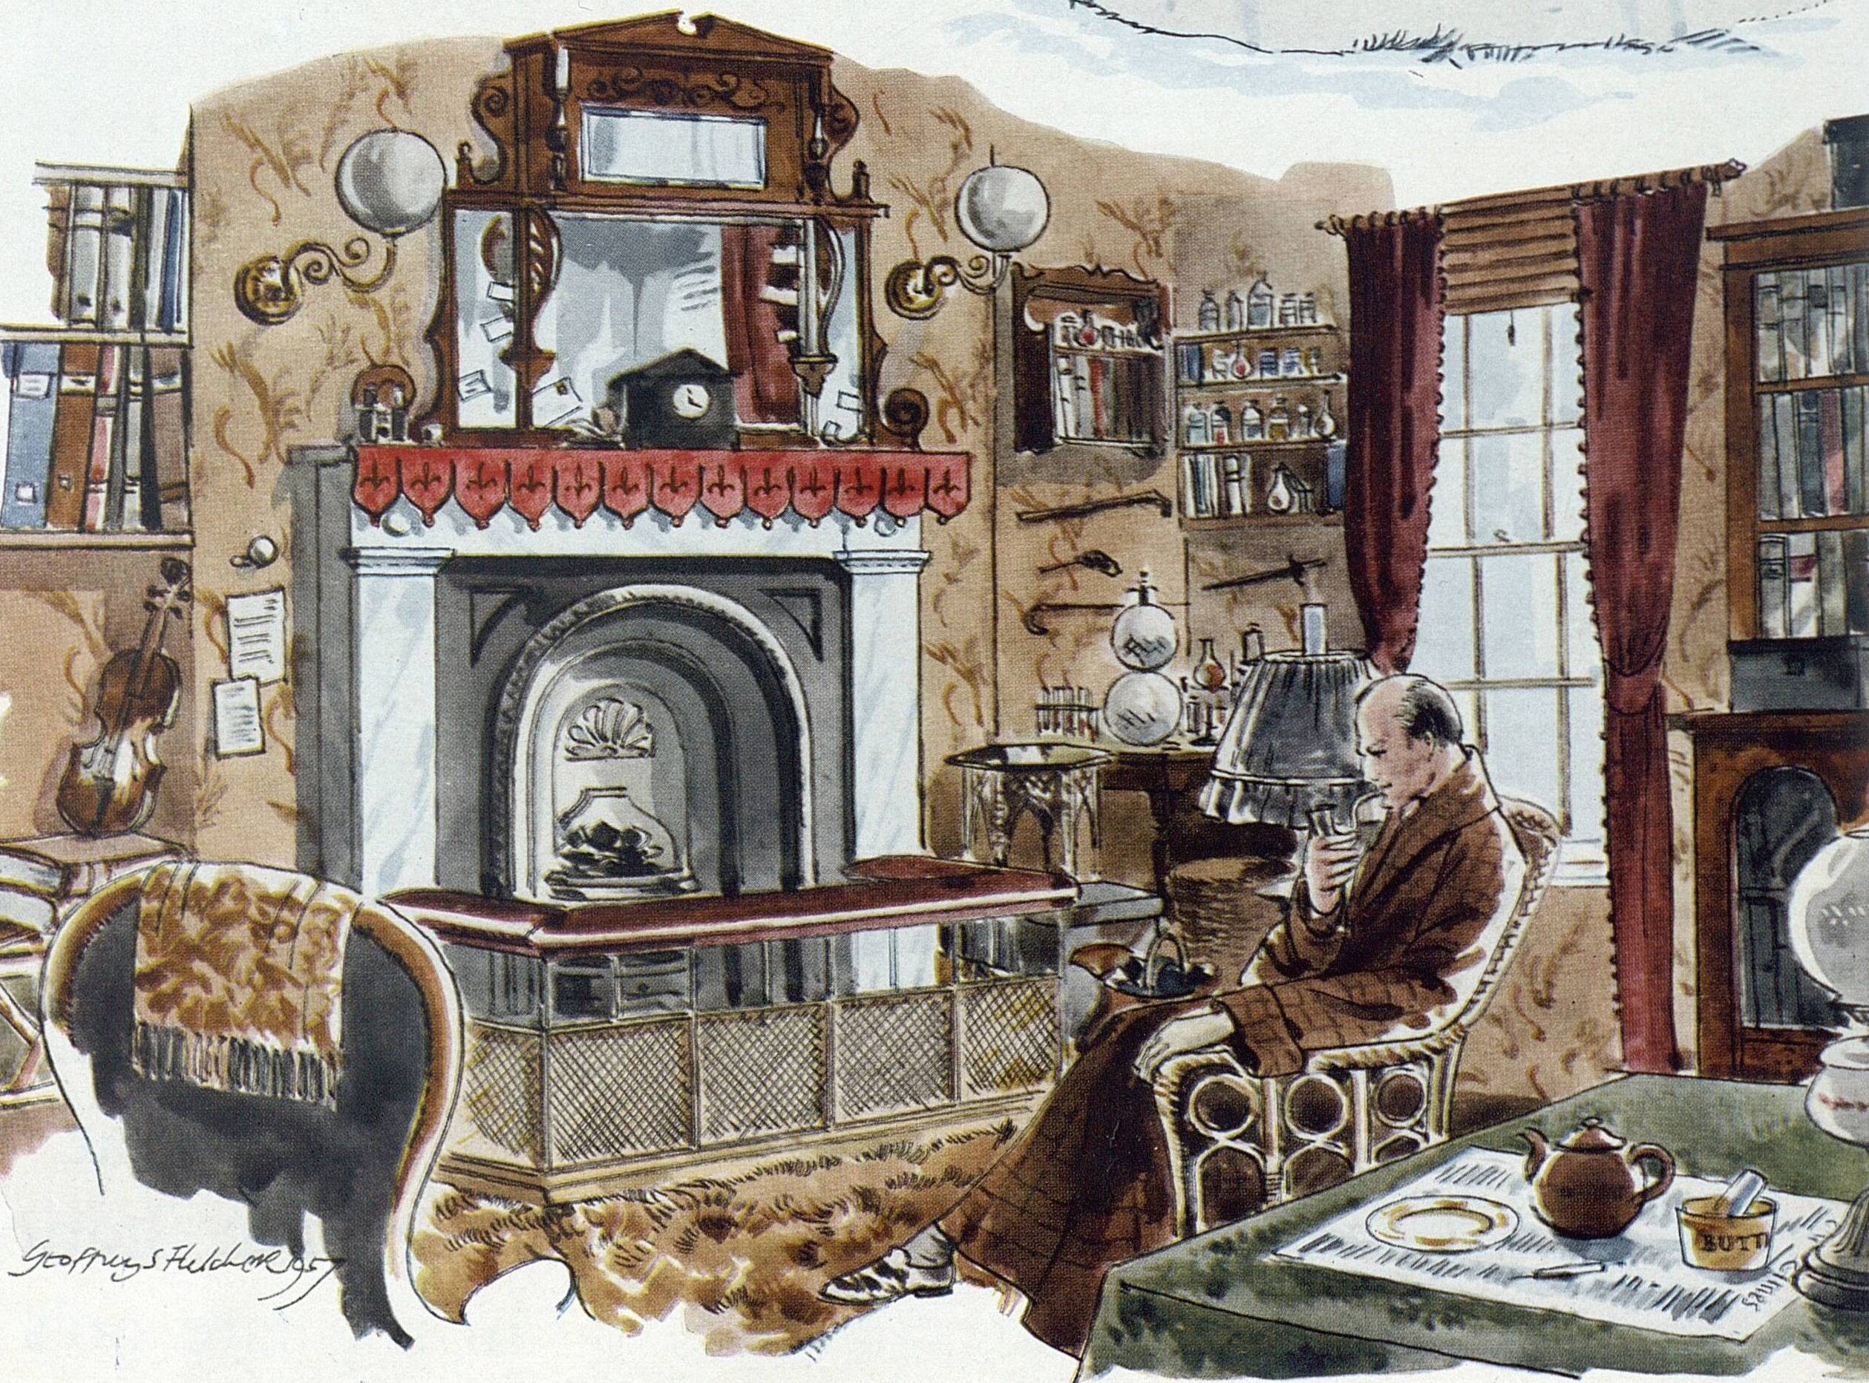
Where we’re going & why
“From a drop of water,” said the writer, “a logician could infer the possibility of an Atlantic or a Niagara without having seen or heard of one or the other. So all life is a great chain, the nature of which is known whenever we are shown a single link of it. Like all other arts, the Science of Deduction and Analysis is one which can only be acquired by long and patient study, nor is life long enough to allow any mortal to attain the highest possible perfection in it. Before turning to those moral and mental aspects of the matter which present the greatest difficulties, let the enquirer begin by mastering more elementary problems. Let him, on meeting a fellow-mortal, learn at a glance to distinguish the history of the man, and the trade or profession to which he belongs. Puerile as such an exercise may seem, it sharpens the faculties of observation, and teaches one where to look and what to look for. By a man’s finger nails, by his coat-sleeve, by his boot, by his trouser knees, by the callosities of his forefinger and thumb, by his expression, by his shirt cuffs—by each of these things a man’s calling is plainly revealed. That all united should fail to enlighten the competent enquirer in any case is almost inconceivable.”

Slide 3


Slide 4
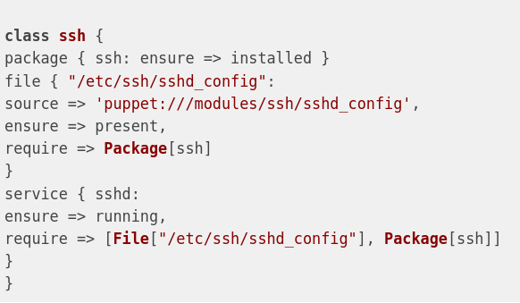
Puppet Resources

Slide 5
Bibliography
Brown, Amy, and Greg Wilson. The Architecture of Open Source Applications. Creative Commons, 2011.
Burgess, Mark. Principles of Network and System Administration. Second ed., Wiley, 2006.
“Comparison of Open-Source Configuration Management Software.” Wikipedia, Wikimedia Foundation, 14 Aug. 2023, en.wikipedia.org/wiki/Comparison_of_open-source_configuration_management_software.
DOYLE, ARTHUR CONAN. A Study in Scarlet. Project Gutenberg, 1995.
Koestler, Arthur, and J. R. Smythies. Beyond Reductionism. Hutchinson, 1969.
Marti, Don. “The Trouble with the Bastard Operator from Hell.” Linux Journal, Slashdot Media, LLC., 1 Dec. 2000, www.linuxjournal.com/article/4373.
Steve, Traugott, and Huddleston Joel. “Bootstrapping an Infrastructure.” Proceedings of the Twelfth Systems Administration Conference, 6 Dec. 1998.
Traugott, Steve, and Lance Brown. “Why Order Matters: Turing Equivalence in Automated Systems Administration.” Proceedings of LISA 2002: 16th Systems Administration Conference, 3 Nov. 2002.
“What Is Configuration Manager?” Microsoft Learn, Microsoft, 1 Mar. 2023, learn.microsoft.com/en-us/mem/configmgr/core/understand/introduction.

