Slide 1
Deployment Pipeline for Odoo
Case Study Presentation
Prajwal N Gowda | 15.07.2025

Slide 2
Problem Statement:
The current process for transferring releases into the production environment every two weeks lacks a robust, secure, reliable, and fast mechanism, potentially leading to deployment delays, security vulnerabilities, and system instability

Slide 3
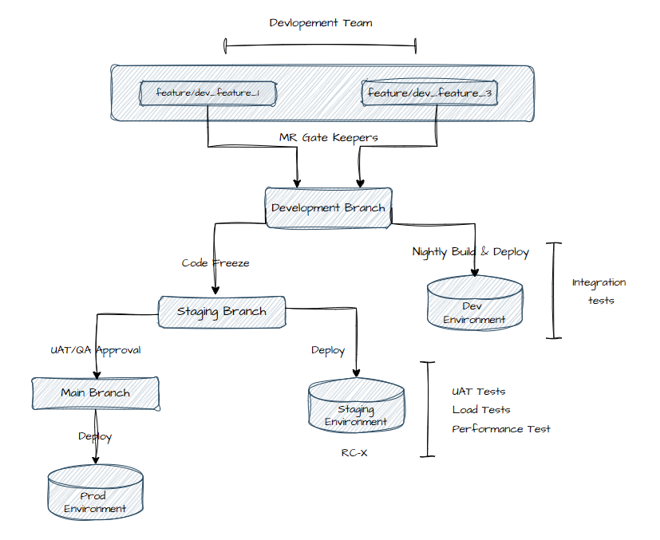
Release Workflow

Slide 4
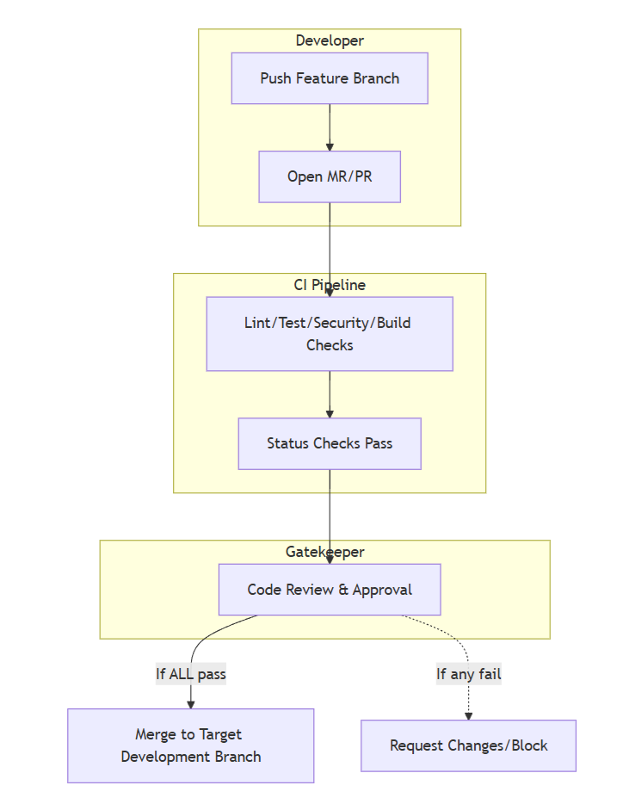
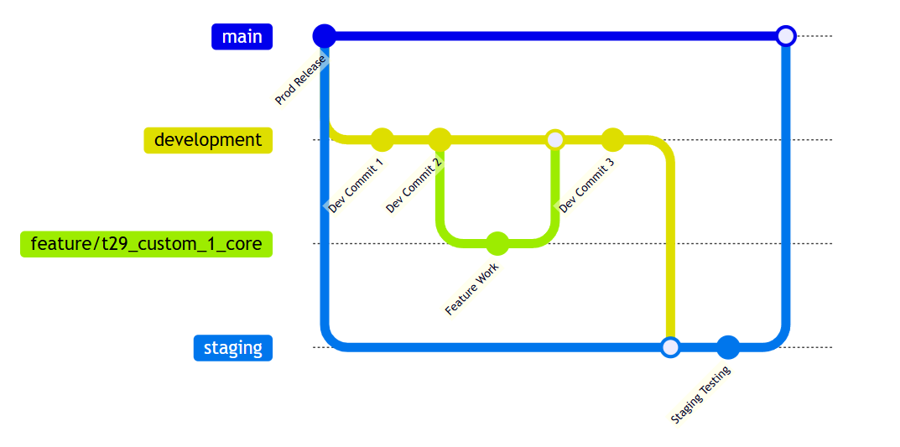
MR-Gatekeepers
Branching Strategy

Slide 5
Jenkins Pipeline Overview
Declarative Multibranch Jenkins Pipeline for Odoo module CI/CD
Docker-based container environment for isolated, reproducible builds
Credentials and tokens securely managed via Jenkins Credentials Store
Various pipeline stages to run linting, formatting to tech stack used.
Security scanning with bandit for static code analysis
Build, test, and deploy Odoo modules to Dev, Staging, and Production environments
Artifacts archived in Jenkins and binaries published to JFrog Artifactory
Notifications sent to stakeholders for build status, test results, and deployments

Slide 6
Jenkins Pipeline Stages
Checkout
Development
Staging
Production
Linitng/
Formating
Deploy Dev
Deploy Staging
Deploy Prod
Security Scanning
Integration Test
UAT, Load, Performance Test
Post Deployment Sanity Checks
Unit Test/ Coverage
Build & Uplaod

Slide 7
Open Points
Limitations
Rollbacks only cover Odoo changes to external systems (like third-party APIs) aren't automatically reverted.
The pipeline depends on early testing, gaps in test coverage could let bugs through.
Deployment assumes staging and production are nearly identical, any differences could lead to unexpected issues.
Production deployments require manual approval for safety, which can slow down release speed.
Switch to container-based deployments (e.g., Kubernetes with GitOps) for easier scaling and consistency?
Is automated testing good enough to catch regressions? How is UAT handled fully automated or partly manual?
Need better observability and Monitoring (logs, traces, KPIs)?
Disaster recovery plan, including regular backup tests?
Any compliance or audit needs around release traceability and change management?

