Slide 1
COMPARABLE INTERFACE

Slide 2
Comparable Interface
Java Comparable interface is used to order the objects of the user-defined class
This interface is found in java.lang package and contains only one method named compareTo(Object)
It provides a single sorting sequence only, i.e., you can sort the elements on the basis of single data member only. For example, it may be rollno, name, age or anything else

Slide 3
compareTo(Object obj) method
public int compareTo(Object obj): It is used to compare the current object with the specified object. It returns
positive integer, if the current object is greater than the specified object (1)
negative integer, if the current object is less than the specified object (-1)
zero, if the current object is equal to the specified object (0)

Slide 4
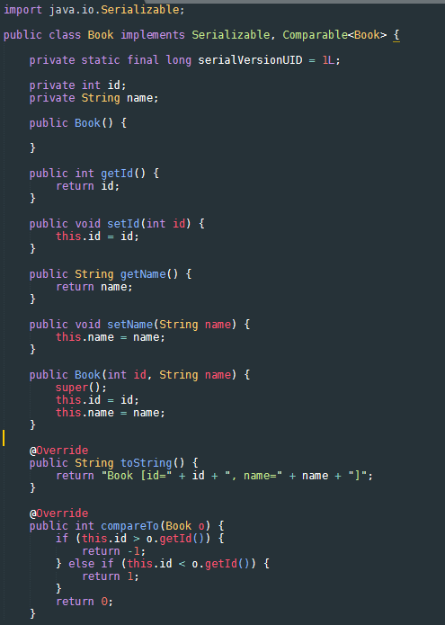
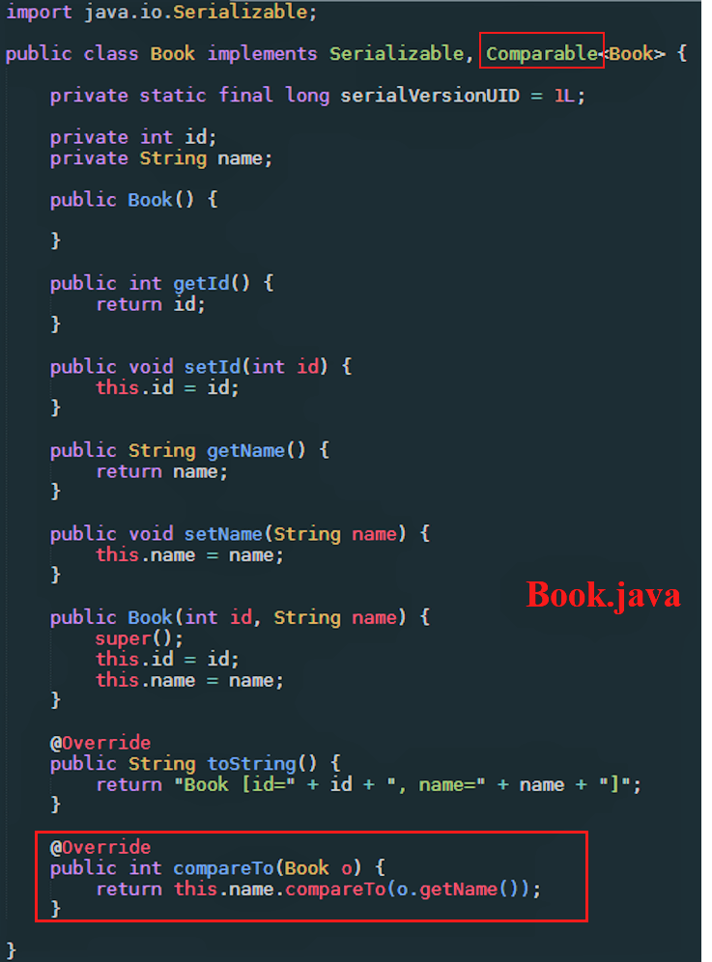
Code
Book.java
Sort by id
Sort by name

Slide 5
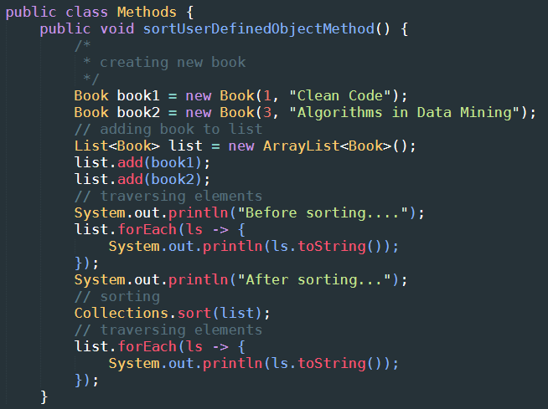
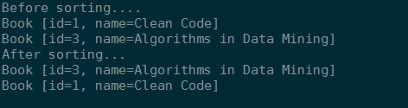
Code
Methods.java
Output by id

