Slide 1
COMPARATOR INTERFACE

Slide 2
Comparator
Java Comparator interface is used to order the objects of a user-defined class
This interface is found in java.util package and contains 2 methods compare(Object obj1,Object obj2) and equals(Object element).

Slide 3
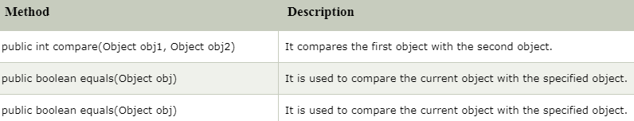
Methods of Java Comparator Interface

Slide 4
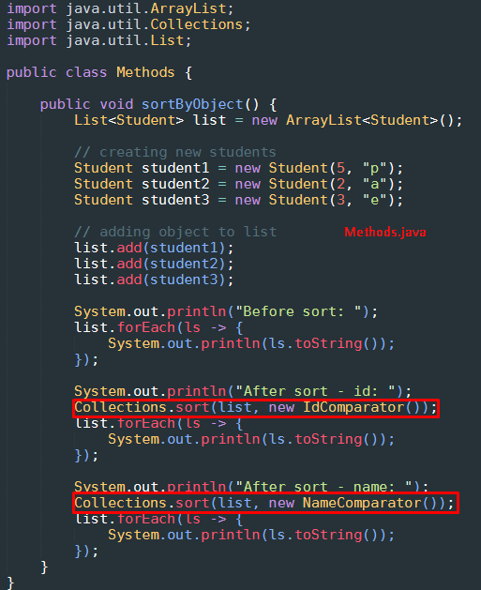
Java Comparator Generic

Slide 5
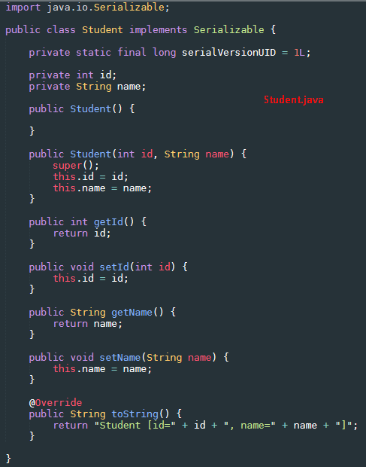
Java Comparator Generic

Slide 6
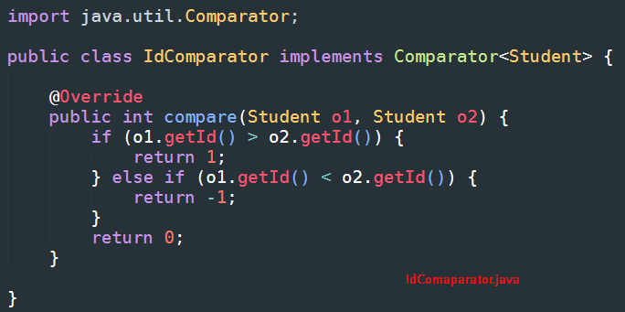
Java Comparator Generic

Slide 7
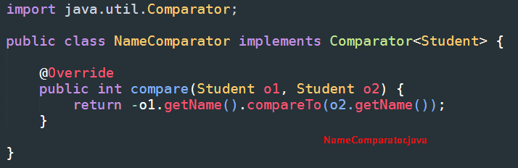
Java Comparator Generic

Slide 8
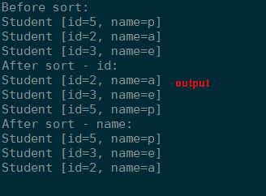
Java Comparator Generic - output

Slide 9
Java 8 Comparator Interface
Java 8 Comparator interface is a functional interface that contains only one abstract method.
We can use the Comparator interface as the assignment target for a lambda expression or method reference.

Slide 10
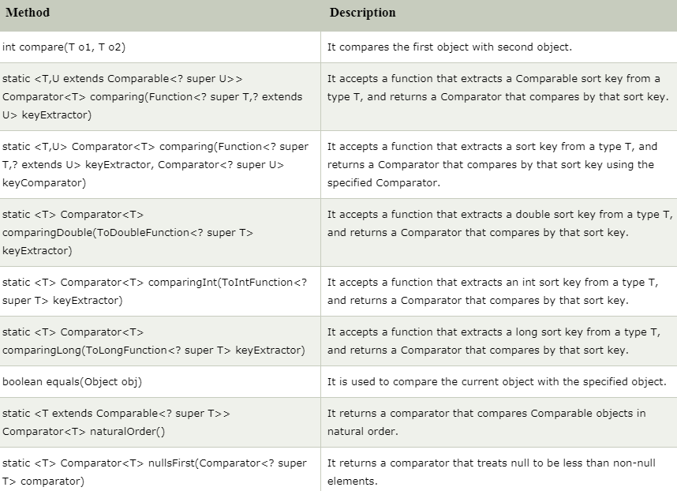
Methods

Slide 11
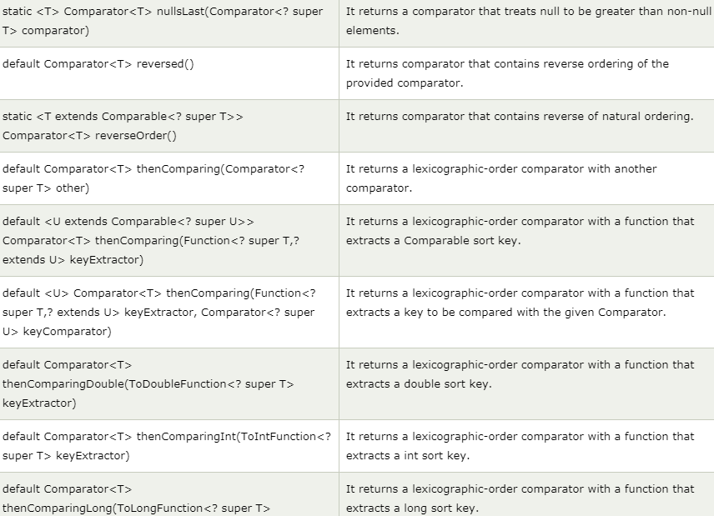
Methods

Slide 12
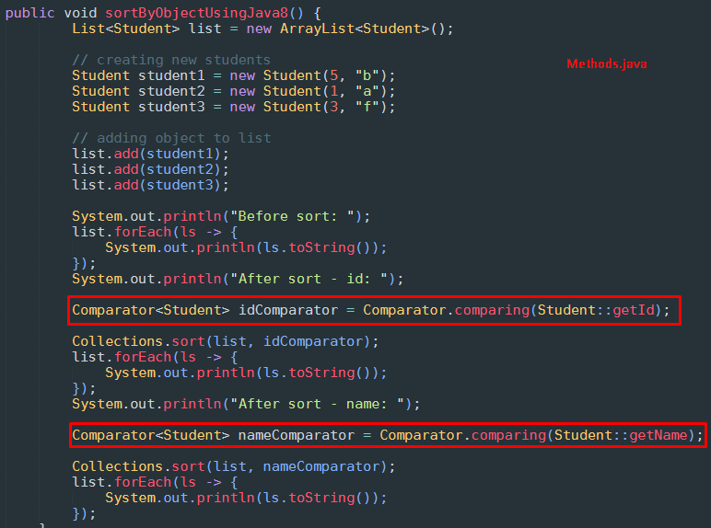
Demo

Slide 13
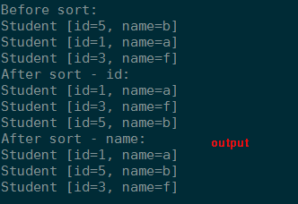
Output

