Slide 1
DIFFERENCE BETWEEN COMPARABLE AND COMPARATOR

Slide 2
Comparable and Comparator both are interfaces and can be used to sort collection elements

Slide 3
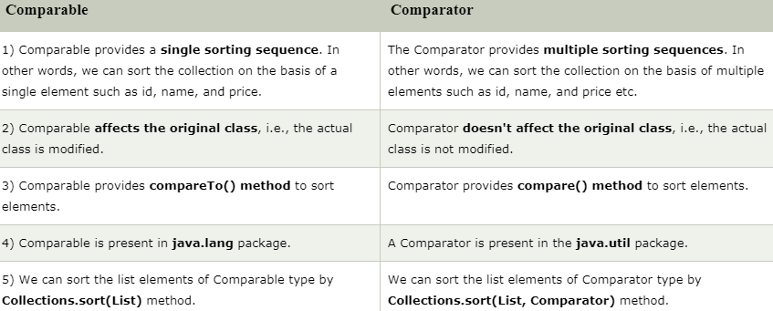
Differences

