Slide 1
JAVA COLLECTIONS

Slide 2
Java Collections
Java Collection framework provides many interfaces (Set, List, Queue, Deque, Map) and classes (ArrayList, Vector, LinkedList, PriorityQueue, HashSet, LinkedHashSet, TreeSet, HashMap, LinkedHashMap, TreeMap, SortedMap)
Java collection class is used exclusively with static methods that operate on or return collections
It inherits Object class.

Slide 3
The important points about Java Collections class
Java Collection class supports the polymorphic algorithms that operate on collections
Java Collection class throws a NullPointerException if the collections or class objects provided to them are null

Slide 4
Collections class declaration
public class Collections extends Object

Slide 5
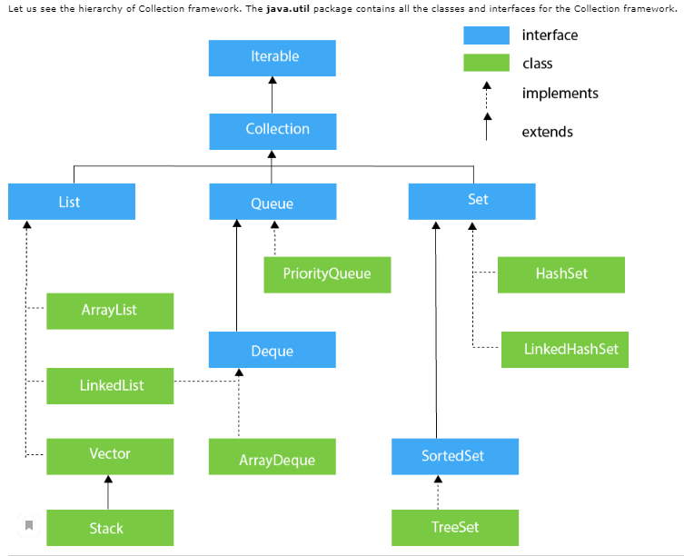
Hierarchy of Collection Framework (watch closely)

Slide 6
Iterator interface
Iterator interface provides the facility of iterating the elements in a forward direction only.

Slide 7
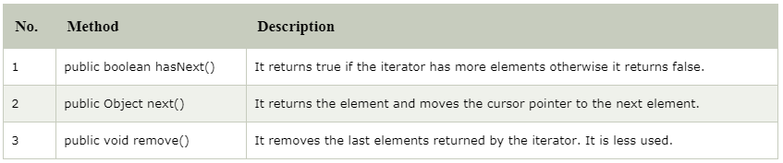
Iterator interface (cont’d)
There are only three methods in the Iterator interface. They are:

Slide 8
Iterator interface (cont’d)
The Iterable interface is the root interface for all the collection classes. The Collection interface extends the Iterable interface and therefore all the subclasses of Collection interface also implement the Iterable interface.

Slide 9
Collection Interface
The Collection interface is the interface which is implemented by all the classes in the collection framework. It declares the methods that every collection will have. In other words, we can say that the Collection interface builds the foundation on which the collection framework depends.
Some of the methods of Collection interface are Boolean add (Object obj), Boolean addAll (Collection collection), void clear(), etc. which are implemented by all the subclasses of Collection interface.

Slide 10
List Interface
List interface is the child interface of Collection interface.
It inhibits a list type data structure in which we can store the ordered collection of objects.
It can have duplicate values.
List interface is implemented by the classes ArrayList, LinkedList, Vector, and Stack.

Slide 11
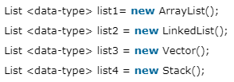
To instantiate the List interface

Slide 12
List - ArrayList
The ArrayList class implements the List interface
It uses a dynamic array to store the duplicate element of different data types
The ArrayList class maintains the insertion order and is non-synchronized
The elements stored in the ArrayList class can be randomly accessed.

Slide 13
List - LinkedList
LinkedList implements the Collection interface
It uses a doubly linked list internally to store the elements
It can store the duplicate elements
It maintains the insertion order and is not synchronized
In LinkedList, the manipulation is fast because no shifting is required.

Slide 14
List - Vector
Vector uses a dynamic array to store the data elements
It is similar to ArrayList
It is synchronized and contains many methods that are not the part of Collection framework.

Slide 15
List - Stack
The stack is the subclass of Vector
It implements the last-in-first-out data structure
The stack contains all of the methods of Vector class and also provides its methods like boolean push(), boolean peek(), boolean push(object o), which defines its properties.

Slide 16
Queue Interface
Queue interface maintains the first-in-first-out order
It can be defined as an ordered list that is used to hold the elements which are about to be processed
There are various classes like PriorityQueue, Deque, and ArrayDeque which implements the Queue interface.

Slide 17
Queue - PriorityQueue
The PriorityQueue class implements the Queue interface
It holds the elements or objects which are to be processed by their priorities
PriorityQueue doesn't allow null values to be stored in the queue.

Slide 18
Deque Interface
Deque interface extends the Queue interface
In Deque, we can remove and add the elements from both the side
Deque stands for a double-ended queue which enables us to perform the operations at both the ends.

Slide 19
Deque - ArrayDeque
ArrayDeque class implements the Deque interface
It facilitates us to use the Deque
Unlike queue, we can add or delete the elements from both the ends
ArrayDeque is faster than ArrayList and Stack and has no capacity restrictions.

Slide 20
Set Interface
Set Interface in Java is present in java.util package
It extends the Collection interface
It represents the unordered set of elements which doesn't allow us to store the duplicate items
We can store at most one null value in Set
Set is implemented by HashSet, LinkedHashSet, and TreeSet.

Slide 21

Set Interface (cont’d)

Slide 22
Set - HashSet
HashSet class implements Set Interface
It represents the collection that uses a hash table for storage
Hashing is used to store the elements in the HashSet
It contains unique items.

Slide 23
Set - LinkedHashSet
LinkedHashSet class represents the LinkedList implementation of Set Interface
It extends the HashSet class and implements Set interface
It also contains unique elements
It maintains the insertion order and permits null elements.

Slide 24
SortedSet Interface
SortedSet is the alternate of Set interface that provides a total ordering on its elements
The elements of the SortedSet are arranged in the increasing (ascending) order
The SortedSet provides the additional methods that inhibit the natural ordering of the elements.

Slide 25
SortedSet - TreeSet
Java TreeSet class implements the Set interface that uses a tree for storage
TreeSet also contains unique elements
The access and retrieval time of TreeSet is quite fast
The elements in TreeSet stored in ascending order (a - z).

