Slide 1
SORTING COLLECTIONS

Slide 2
What is Sort in Collections?
We can sort the elements of
String objects
Wrapper class objects
User-defined class objects
Collections class provides static methods for sorting the elements of a collection. If collection elements are of a Set type, we can use TreeSet. However, we cannot sort the elements of List. Collections class provides methods for sorting the elements of List type elements

Slide 3
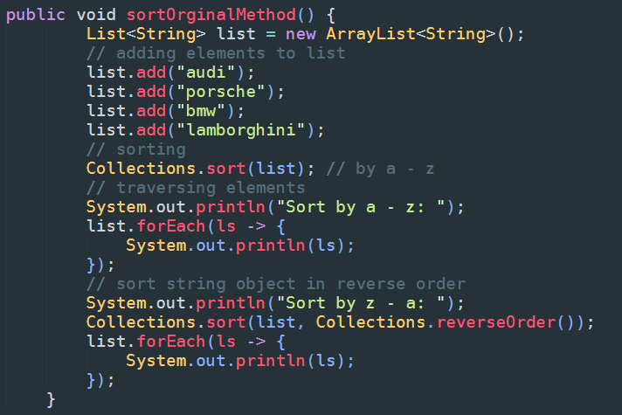
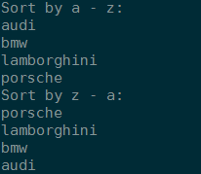
Sort: String Object
output

Slide 4
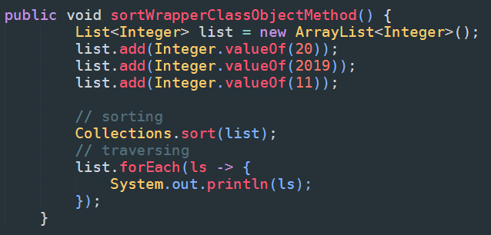

Sort: Wrapper Class Object
output

Slide 5
Sort: User-defined class objects
Include: Book.java, Main.java, Method.java

Slide 6
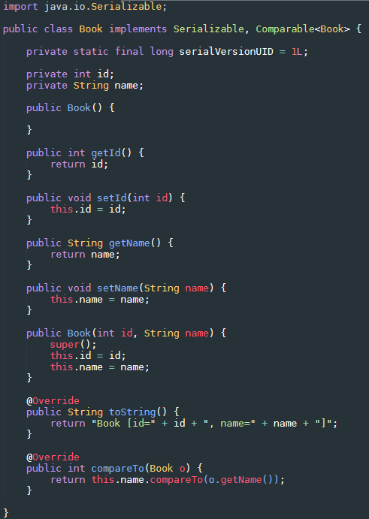
Sort: User-defined class objects
Book.java

Slide 7
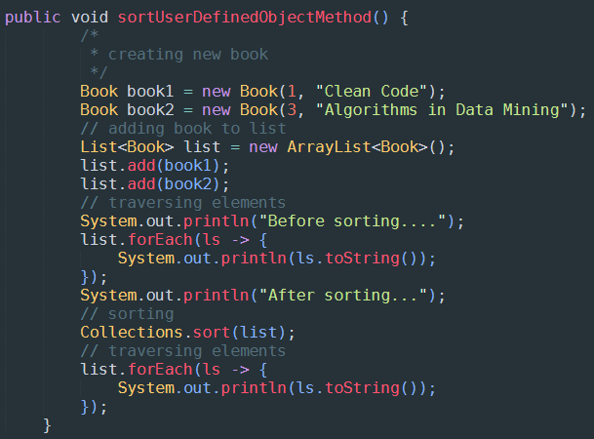

Sort: User-defined class objects
output
Methods.java

