Slide 1
ARRAYLIST AND VECTOR

Slide 2
The Same
ArrayList and Vector both implements List interface and maintains insertion order

Slide 3
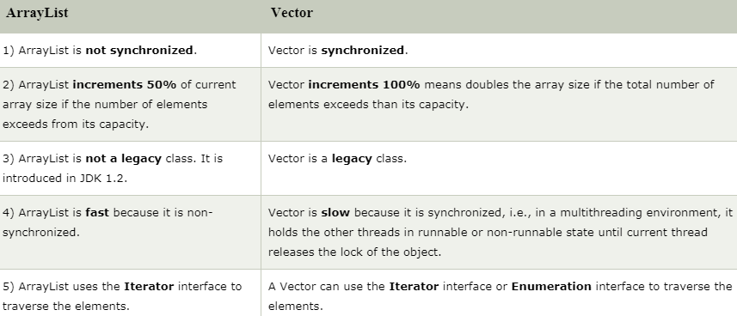
The differences

Slide 4
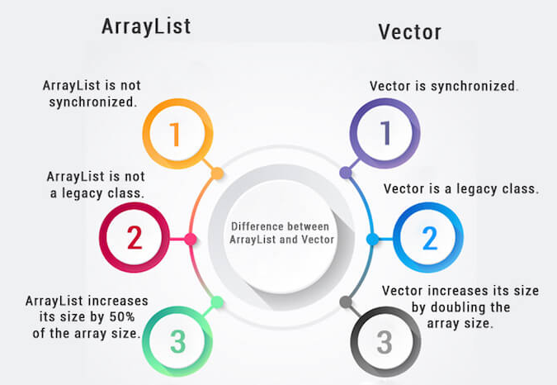
The Flow

