Slide 1
ARRAYLIST CLASS

Slide 2
ArrayList Class
Java ArrayList class uses a dynamic array for storing the elements.
It inherits AbstractList class and implements List interface

Slide 3
The important points about Java ArrayList class
Java ArrayList class can contain duplicate elements
Java ArrayList class maintains insertion order
Java ArrayList class is non synchronized
Java ArrayList allows random access because array works at the index basis
In Java ArrayList class, manipulation is slow because a lot of shifting needs to occur if any element is removed from the array list.

Slide 4
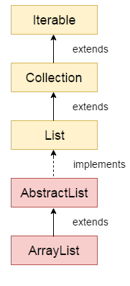
Hierarchy of ArrayList class

Slide 5
ArrayList class declaration
public class ArrayList<E> extends AbstractList<E> implements List<E>, RandomAccess, Cloneable, Serializable

Slide 6
Constructors of Java ArrayList
Constructor | Description
ArrayList() | It is used to build an empty array list.
ArrayList(Collection<? extends E> c) | It is used to build an array list that is initialized with the elements of the collection c.
ArrayList(int capacity) | It is used to build an array list that has the specified initial capacity.

Slide 7
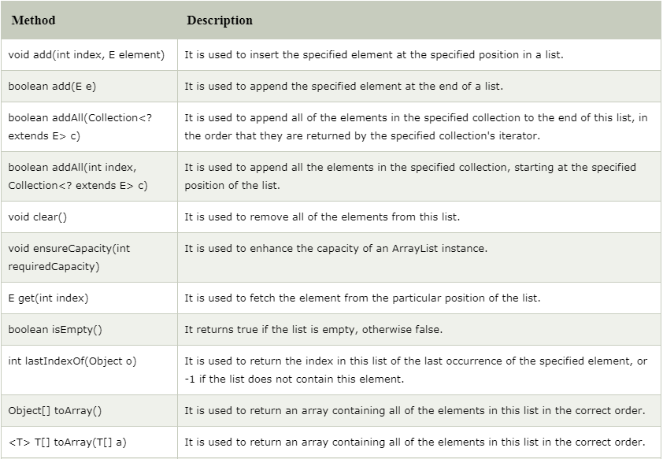
Methods of Java ArrayList

Slide 8
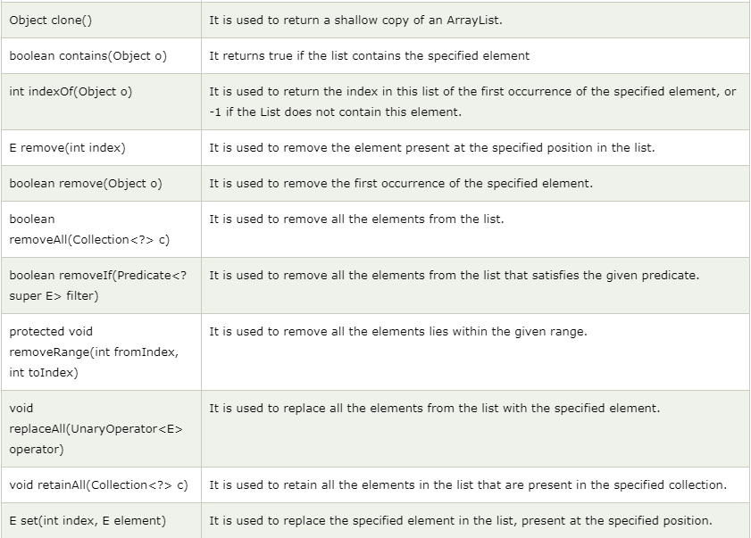
Methods of Java ArrayList (cont’d)

Slide 9
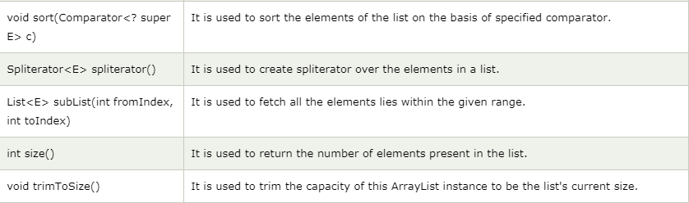
Methods of Java ArrayList (cont’d)

Slide 10
Java Non-generic Vs. Generic Collection
Java collection framework was non-generic before JDK 1.5. Since 1.5, it is generic
Java new generic collection allows you to have only one type of object in a collection. Now it is type safe so typecasting is not required at runtime.
ArrayList al=new ArrayList();//creating old non-generic arraylist
ArrayList<String> al=new ArrayList<String>();//creating new generic arraylist

Slide 11
Ways to iterate the elements of the collection in java
By Iterator interface
By for-each loop
By ListIterator interface
By for loop
By forEach() method
By forEachRemaining() method.

