Slide 1
Deque Interface

Slide 2
Deque
Java Deque Interface is a linear collection that supports element insertion and removal at both ends
Deque is an acronym for "double ended queue".

Slide 3
Deque Interface declaration
public interface Deque<E> extends Queue<E>

Slide 4
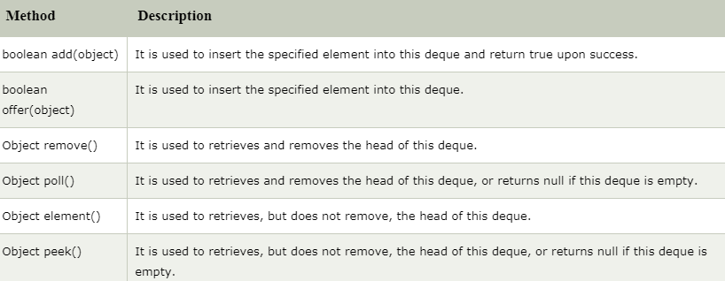
Methods of Java Deque Interface

Slide 5
ArrayDeque class
The ArrayDeque class provides the facility of using deque and resizable-array
It inherits AbstractCollection class and implements the Deque interface.

Slide 6
The important points about ArrayDeque class
Unlike Queue, we can add or remove elements from both sides
Null elements are not allowed in the ArrayDeque
ArrayDeque is not thread safe, in the absence of external synchronization
ArrayDeque has no capacity restrictions
ArrayDeque is faster than LinkedList and Stack

Slide 7
ArrayDeque class declaration
public class ArrayDeque<E> extends AbstractCollection<E> implements Deque<E>, Cloneable, Serializable

