Slide 1
ENUMMAP

Slide 2
EnumMap Class
Java EnumMap class is the specialized Map implementation for enum keys
It inherits Enum and AbstractMap classes.

Slide 3
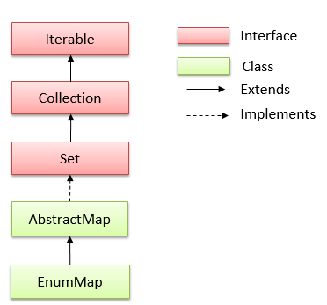
EnumMap class hierarchy

Slide 4
EnumMap class declaration
public class EnumMap<K extends Enum<K>,V> extends AbstractMap<K,V> implements Serializable, Cloneable

Slide 5
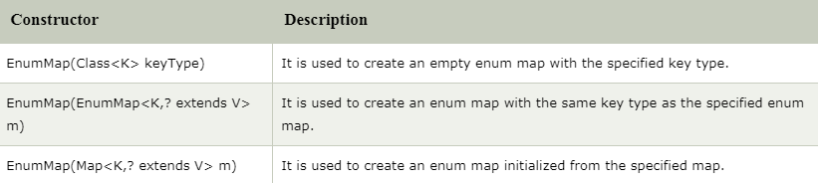
Constructors of Java EnumMap class

Slide 6
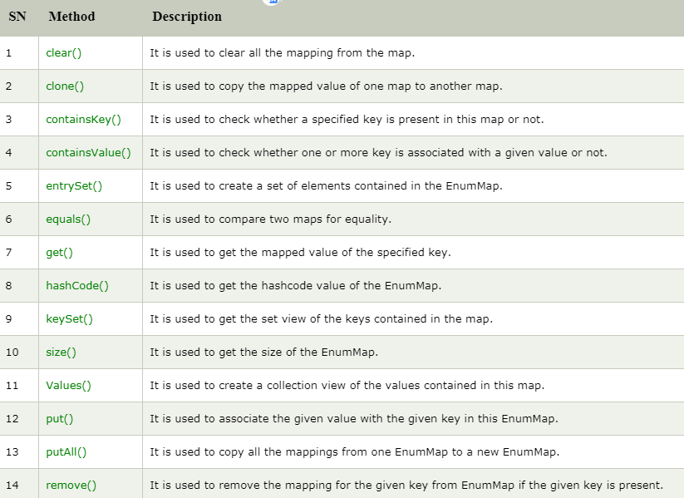
Methods of Java EnumMap class

