Slide 1
EnumSet

Slide 2
EnumSet class
Java EnumSet class is the specialized Set implementation for use with enum types.
It inherits AbstractSet class and implements the Set interface.

Slide 3
EnumSet class declaration
public abstract class EnumSet<E extends Enum<E>> extends AbstractSet<E> implements Cloneable, Serializable

Slide 4
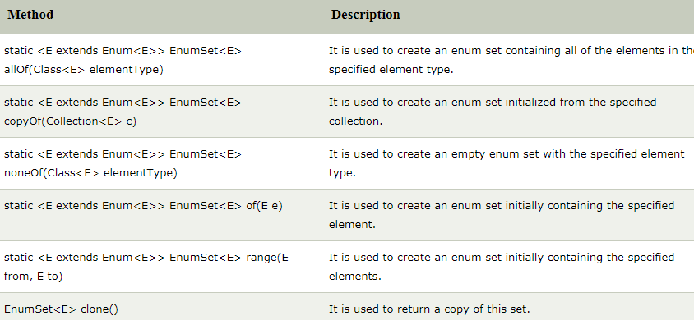
Methods of Java EnumSet class

