Slide 1
HashMap

Slide 2
HashMap
Java HashMap class implements the map interface by using a hash table
It inherits AbstractMap class and implements Map interface.

Slide 3
Points to remember
Java HashMap class contains values based on the key
Java HashMap class contains only unique keys
Java HashMap class may have one null key and multiple null values
Java HashMap class is non synchronized
Java HashMap class maintains no order
The initial default capacity of Java HashMap class is 16 with a load factor of 0.75

Slide 4
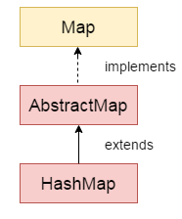
Hierarchy of HashMap class

Slide 5
HashMap class declaration
public class HashMap<K,V> extends AbstractMap<K,V> implements Map<K,V>, Cloneable, Serializable

Slide 6
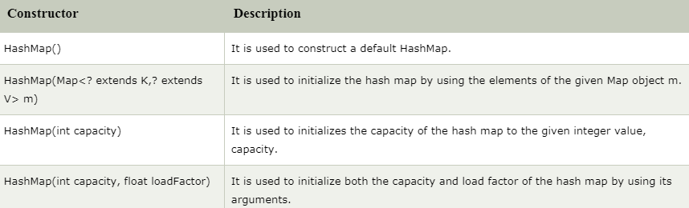
Constructors of Java HashMap class

Slide 7
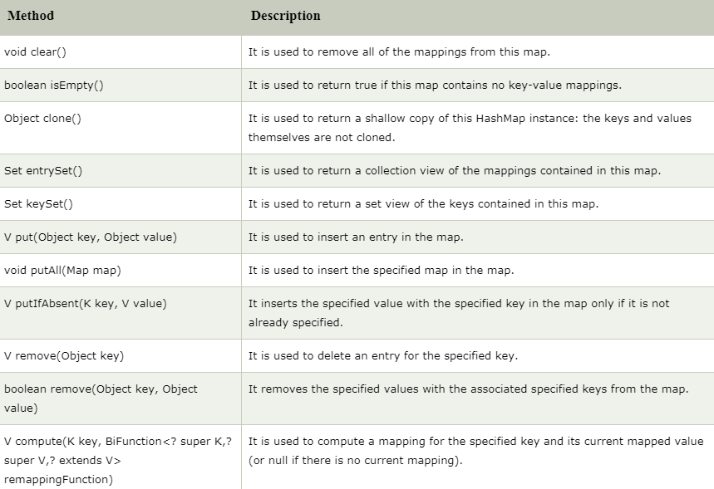
Methods of Java HashMap class

Slide 8
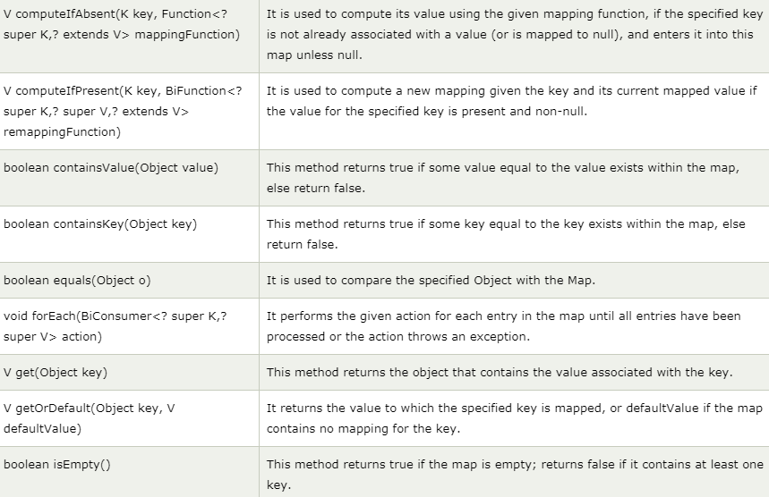
Methods of Java HashMap class (cont’d)

Slide 9
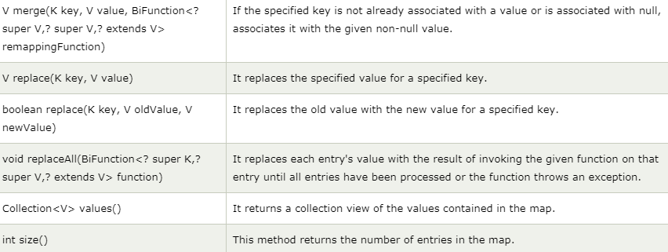
Methods of Java HashMap class (cont’d)

