Slide 1
HashSet

Slide 2
HashSet
Java HashSet class is used to create a collection that uses a hash table for storage
It inherits the AbstractSet class and implements Set interface.

Slide 3
The important points about Java HashSet class
HashSet stores the elements by using a mechanism called hashing
HashSet contains unique elements only
HashSet allows null value
HashSet class is non synchronized
HashSet doesn't maintain the insertion order, elements are inserted on the basis of their hashcode
HashSet is the best approach for search operations
The initial default capacity of HashSet is 16, and the load factor is 0.75

Slide 4
Difference between List and Set
A list can contain duplicate elements whereas Set contains unique elements only

Slide 5
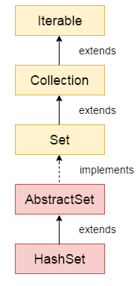
Hierarchy of HashSet class

Slide 6
HashSet class declaration
public class HashSet<E> extends AbstractSet<E> implements Set<E>, Cloneable, Serializable

Slide 7
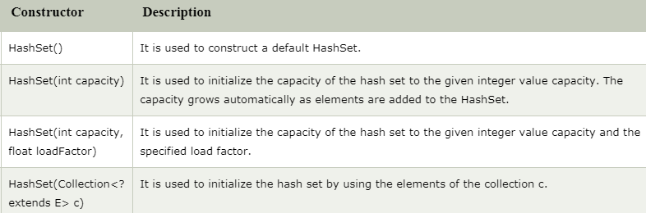
Constructors of Java HashSet class

Slide 8
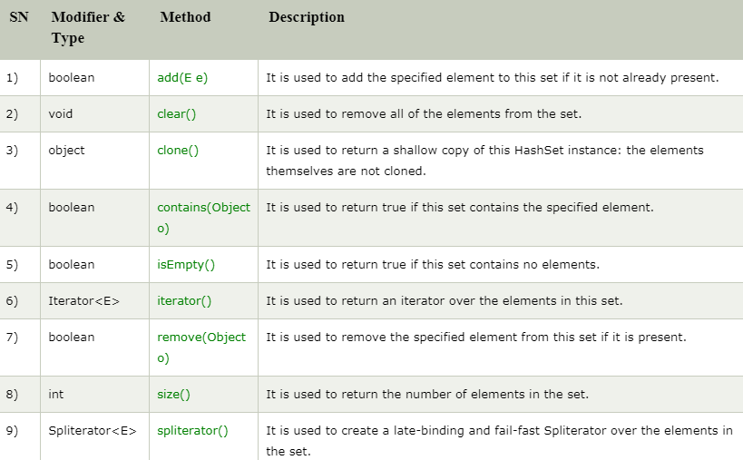
Methods of Java HashSet class

