Slide 1
HASHTABLE

Slide 2
HashTable
Java Hashtable class implements a hashtable, which maps keys to values
It inherits Dictionary class and implements the Map interface.

Slide 3
Points to remember
A Hashtable is an array of a list, each list is known as a bucket
The position of the bucket is identified by calling the hashcode() method
A Hashtable contains values based on the key
Java Hashtable class contains unique elements
Java Hashtable class doesn't allow null key or value
Java Hashtable class is synchronized
The initial default capacity of Hashtable class is 11 whereas loadFactor is 0.75

Slide 4
Hashtable class declaration
public class Hashtable<K,V> extends Dictionary<K,V> implements Map<K,V>, Cloneable, Serializable

Slide 5
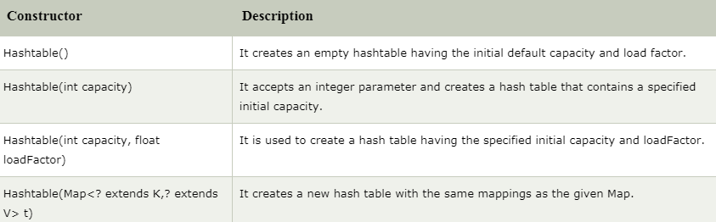
Constructors of Java Hashtable class

Slide 6
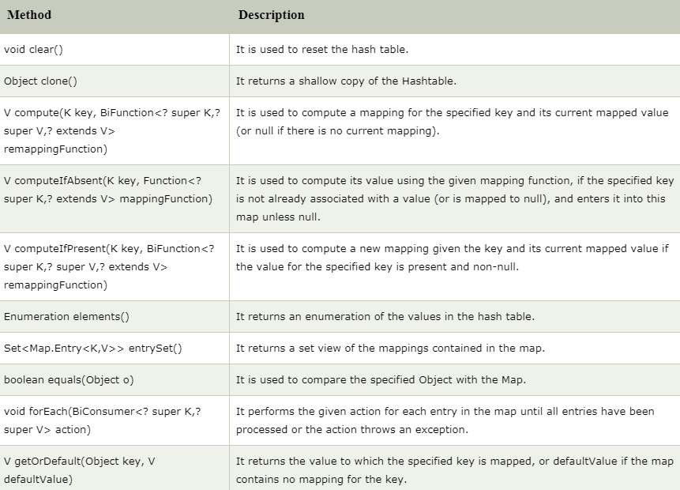
Methods of Java Hashtable class

Slide 7
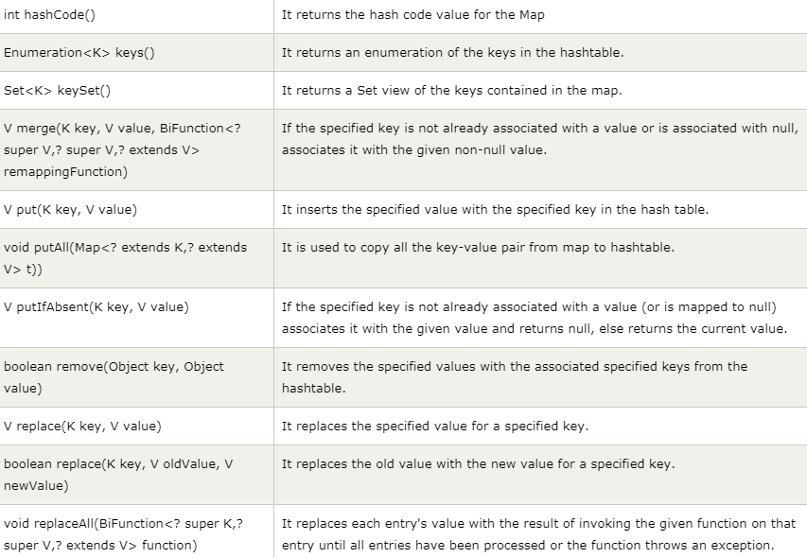
Methods of Java Hashtable class (cont’d)

Slide 8
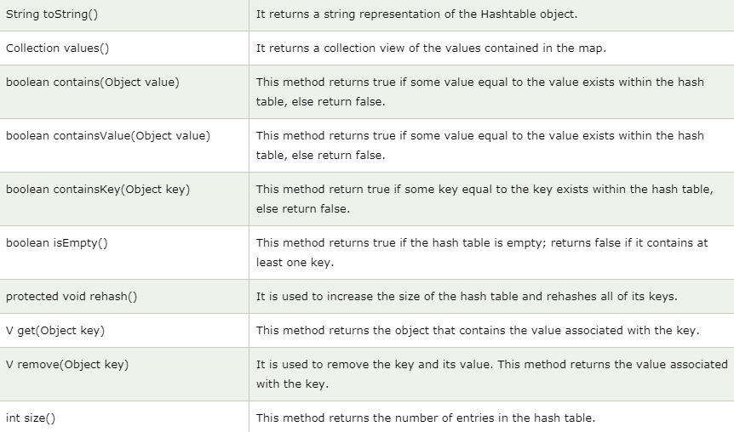
Methods of Java Hashtable class (cont’d)

