Slide 1
LinkedHashMap

Slide 2
LinkedHashMap class
Java LinkedHashMap class is Hashtable and Linked list implementation of the Map interface, with predictable iteration order
It inherits HashMap class and implements the Map interface.

Slide 3
Points to remember
Java LinkedHashMap contains values based on the key
Java LinkedHashMap contains unique elements
Java LinkedHashMap may have one null key and multiple null values.
Java LinkedHashMap is non synchronized
Java LinkedHashMap maintains insertion order.
The initial default capacity of Java HashMap class is 16 with a load factor of 0.75

Slide 4
LinkedHashMap class declaration
public class LinkedHashMap<K,V> extends HashMap<K,V> implements Map<K,V>

Slide 5
LinkedHashMap class Parameters
K: It is the type of keys maintained by this map.
V: It is the type of mapped values

Slide 6
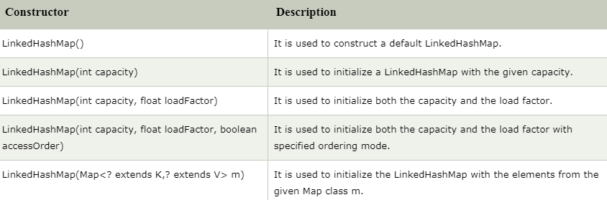
Constructors of Java LinkedHashMap class

Slide 7
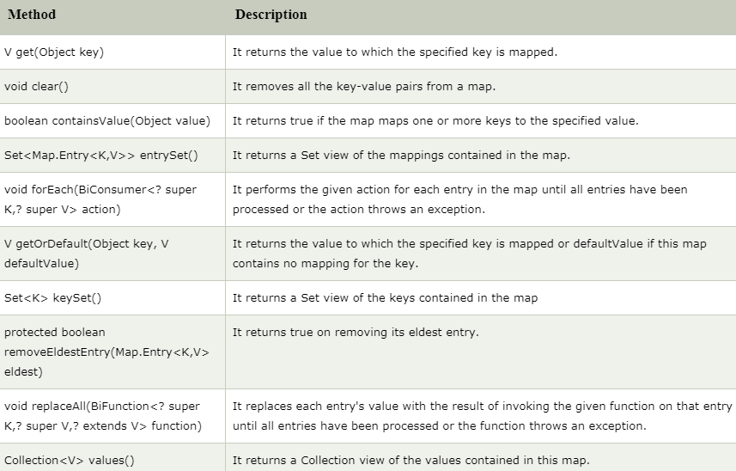
Methods of Java LinkedHashMap class

