Slide 1
LinkedHashSet

Slide 2
LinkedHashSet
Java LinkedHashSet class is a Hashtable and Linked list implementation of the set interface
It inherits HashSet class and implements Set interface.

Slide 3
The important points about Java LinkedHashSet class
Java LinkedHashSet class contains unique elements only like HashSet
Java LinkedHashSet class provides all optional set operation and permits null elements
Java LinkedHashSet class is non synchronized
Java LinkedHashSet class maintains insertion order.

Slide 4
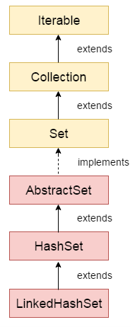
Hierarchy of LinkedHashSet class

Slide 5
LinkedHashSet class declaration
public class LinkedHashSet<E> extends HashSet<E> implements Set<E>, Cloneable, Serializable

Slide 6
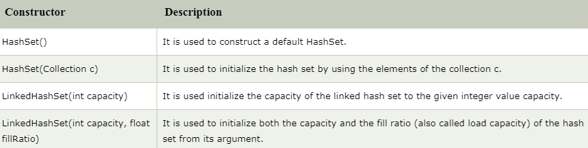
Constructors of Java LinkedHashSet class

