Slide 1
LINKEDLIST CLASS

Slide 2
LinkedList
Java LinkedList class uses a doubly linked list to store the elements
It provides a linked-list data structure
It inherits the AbstractList class and implements List and Deque interfaces

Slide 3
The important points about Java LinkedList
Java LinkedList class can contain duplicate elements
Java LinkedList class maintains insertion order
Java LinkedList class is non synchronized
In Java LinkedList class, manipulation is fast because no shifting needs to occur
Java LinkedList class can be used as a list, stack or queue

Slide 4
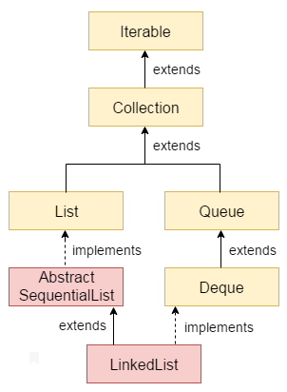
Hierarchy of LinkedList class

Slide 5
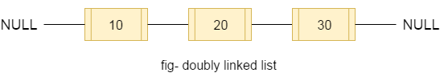
Doubly Linked List
In the case of a doubly linked list, we can add or remove elements from both sides.

Slide 6
LinkedList class declaration
public class LinkedList<E> extends AbstractSequentialList<E> implements List<E>, Deque<E>, Cloneable, …

Slide 7
Constructors of Java LinkedList
Constructor | Description
LinkedList() | It is used to construct an empty list.
LinkedList(Collection<? extends E> c) | It is used to construct a list containing the elements of the specified collection, in the order, they are returned by the collection's iterator.

Slide 8
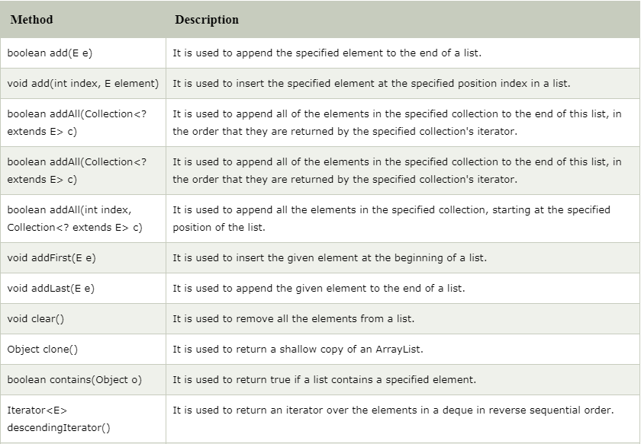
Methods of Java LinkedList

Slide 9
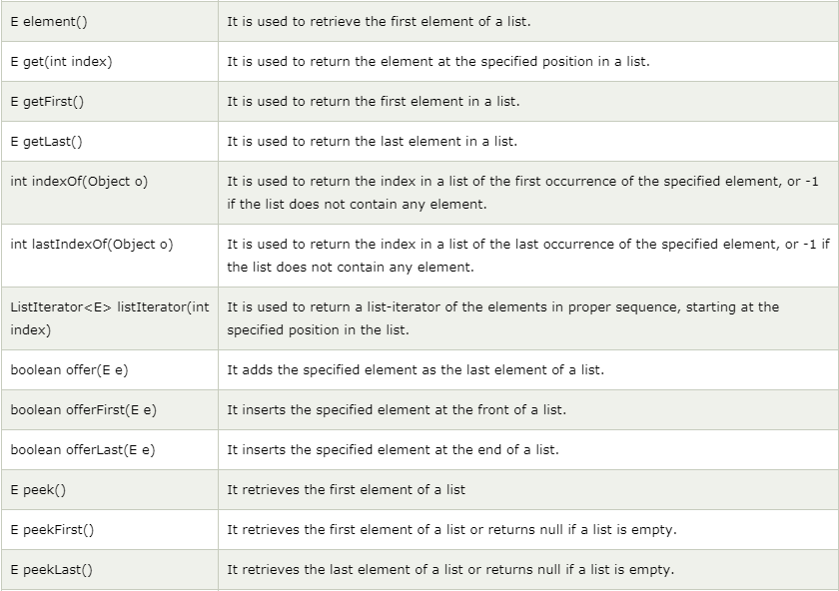
Methods of Java LinkedList (cont’d)

Slide 10
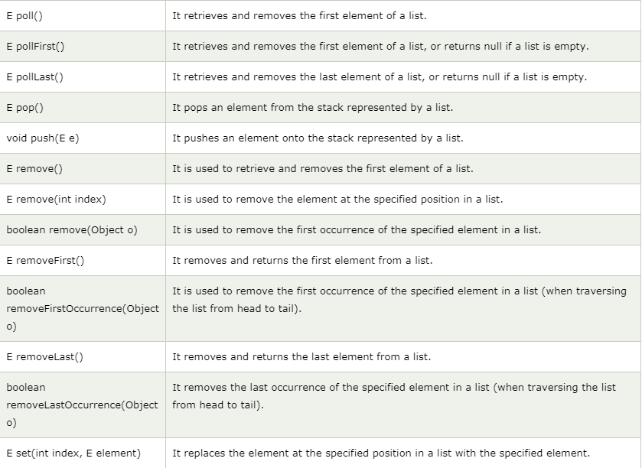
Methods of Java LinkedList (cont’d)

Slide 11
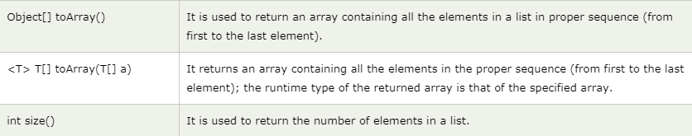
Methods of Java LinkedList (cont’d)

Slide 12
Methods of Java LinkedList (cont’d)

