Slide 1
Java List Interface

Slide 2
List Interface
List Interface is the sub-interface of Collection
It contains index-based methods to insert and delete elements
It is a factory of ListIterator interface.

Slide 3
List Interface declaration
public interface List<E> extends Collection<E>

Slide 4
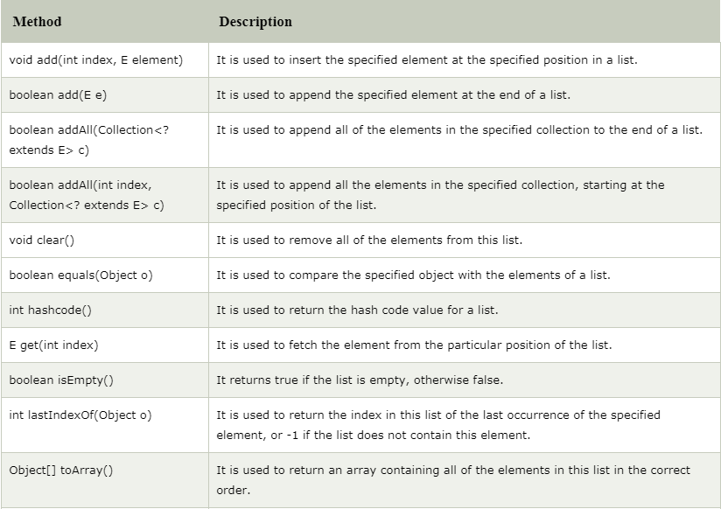
Methods of Java List Interface

Slide 5
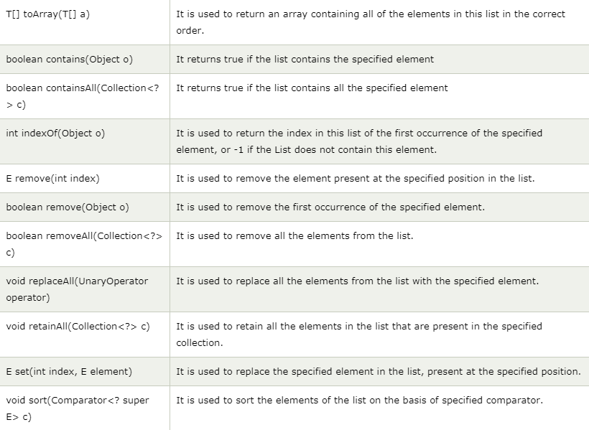
Methods of Java List Interface (cont’d)

Slide 6
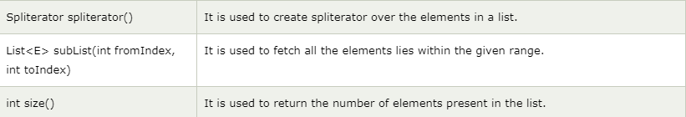
Methods of Java List Interface (cont’d)

