Slide 1
Map Interface

Slide 2
Map
A map contains values on the basis of key
Each key and value pair is known as an entry
A Map contains unique keys
A Map is useful if you have to search, update or delete elements on the basis of a key.

Slide 3
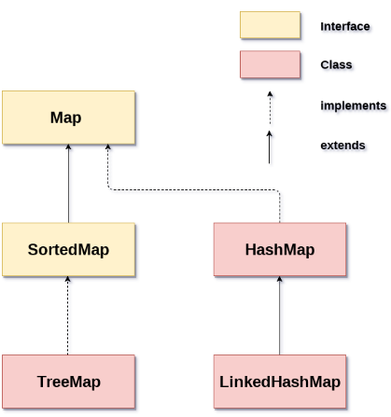
Map Hierarchy
There are two interfaces for implementing Map in java: Map and SortedMap, and three classes: HashMap, LinkedHashMap, and TreeMap

Slide 4
Map Hierarchy (cont’d)
A Map doesn't allow duplicate keys, but you can have duplicate values
HashMap and LinkedHashMap allow null keys and values, but TreeMap doesn't allow any null key or value.
A Map can't be traversed, so you need to convert it into Set using keySet() or entrySet() method

Slide 5
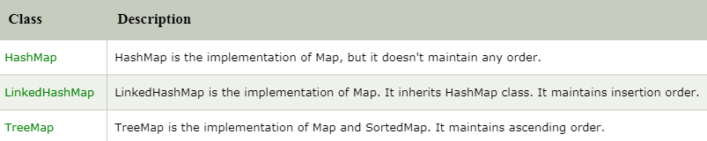
Map Hierarchy (cont’d)

Slide 6
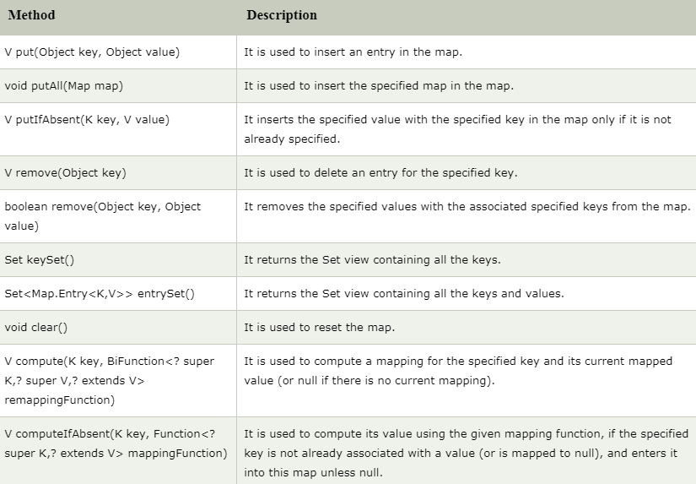
Useful methods of Map interface

Slide 7
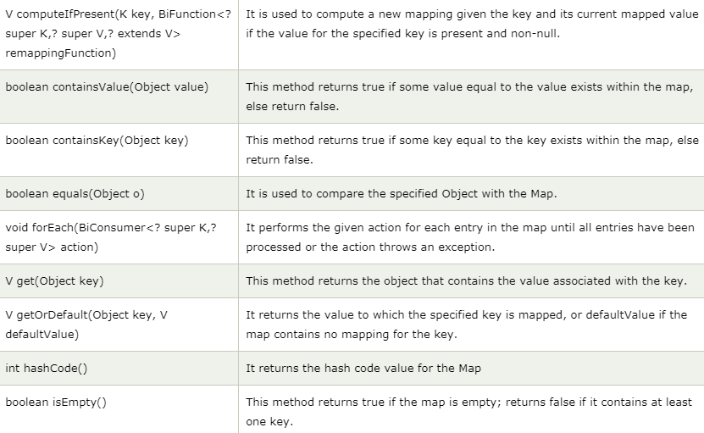
Useful methods of Map interface (cont’d)

Slide 8
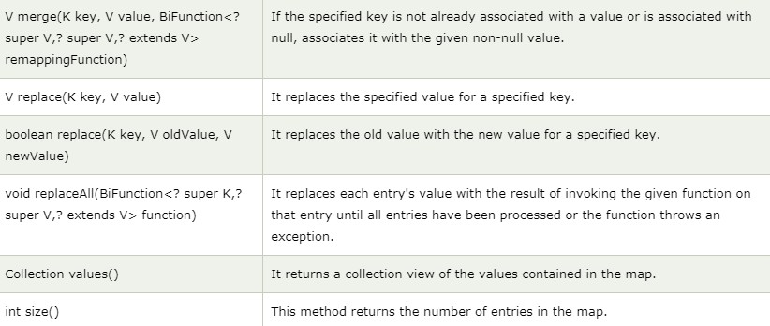
Useful methods of Map interface (cont’d)

Slide 9
Map.Entry Interface
Entry is the sub-interface of Map
We will be accessed it by Map.Entry name
It returns a collection-view of the map, whose elements are of this class
It provides methods to get key and value.

Slide 10
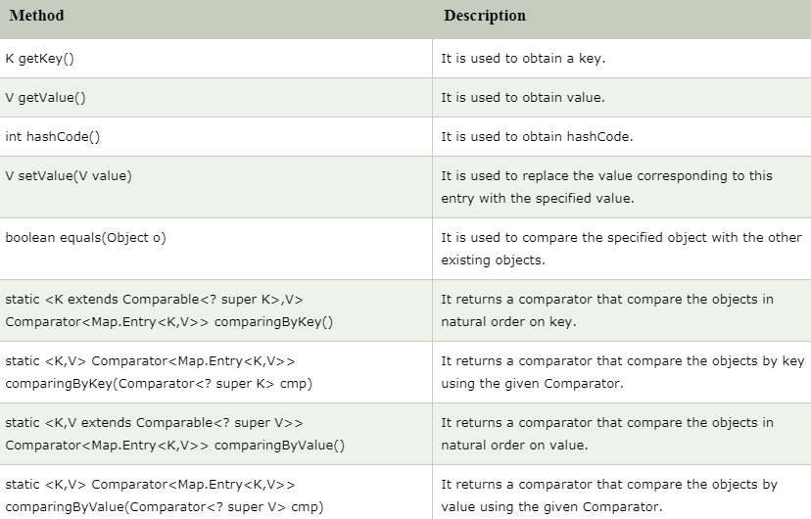
Methods of Map.Entry interface

