Slide 1
METHODS ON COLLECTION CLASS

Slide 2
addAll()
The addAll() is a method of Java Collections class which adds all of the specified elements to the specified collection.
The elements to be added may be specified individually or as an array.
The declaration of addAll() method: public static <T> boolean addAll(Collection<? super T> c, T... elements)

Slide 3
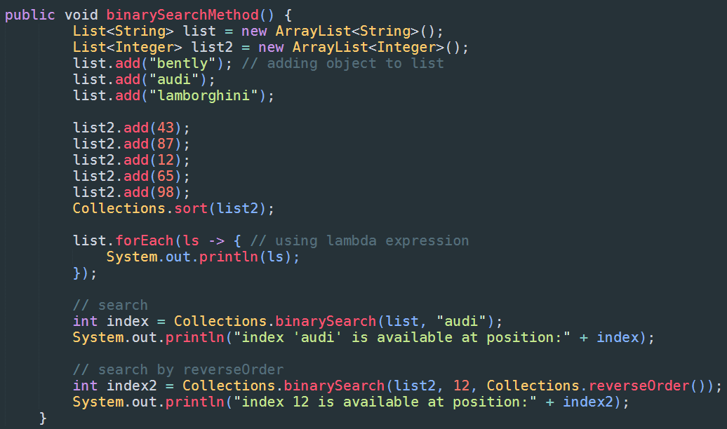
binarySearch() – code 1

Slide 4
addAll() – return
The addAll() method returns true if the collection changed as a result of the method call.

Slide 5
addAll() - exceptions
UnsupportedOperationException- If collection c does not support the add operation
NullPointerException- If elements contain null values and c does not permit null elements, or if c or elements are null
IllegalArgumentException- If some properties of a value in elements prevent it from being added to c

Slide 6
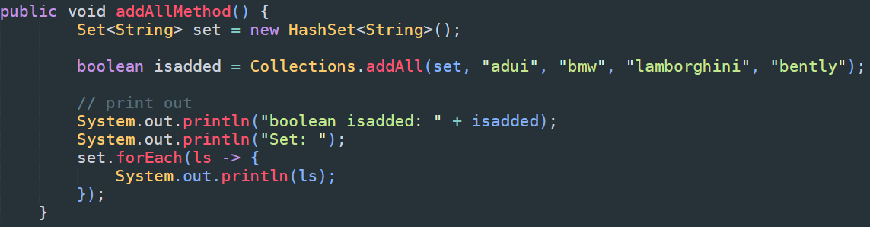
addAll() – code

Slide 7
addAll() – raw
public void addAllMethod() {
Set<String> set = new HashSet<String>();
boolean isadded = Collections.addAll(set, "adui", "bmw", "lamborghini", "bently");
// print out
System.out.println("boolean isadded: " + isadded);
System.out.println("Set: ");
set.forEach(ls -> {
System.out.println(ls);
});
}

Slide 8
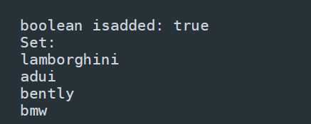
addAll() – output

Slide 9
asLifoQueue()
The asLifoQueue() is an inbuilt method of Java Collections class which returns a view of a Deque as a Last-in-first-out (LIFO) Queue
In this method, the method add and remove is mapped to push and pop operation respectively
It is useful when we want to use a method requiring a Queue but we need LIFO order.

Slide 10
The declaration of aslifoqueue() method
public static <T> Queue<T> asLifoQueue(Deque<T> deque)

Slide 11
asLifoQueue() - return
The asLifoQueue() method returns queue list as a result of the method call

Slide 12
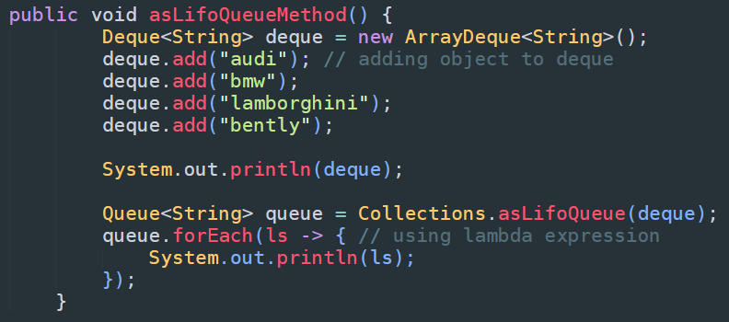
asLifoQueue() - code

Slide 13
asLifoQueue() - raw
public void asLifoQueueMethod() {
Deque<String> deque = new ArrayDeque<String>();
deque.add("audi"); // adding object to deque
deque.add("bmw");
deque.add("lamborghini");
deque.add("bently");
System.out.println(deque);
Queue<String> queue = Collections.asLifoQueue(deque);
queue.forEach(ls -> { // using lambda expression
System.out.println(ls);
});
}

Slide 14
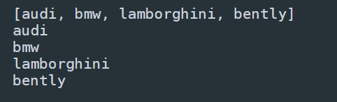
asLifoQueue() - output

Slide 15
binarySearch()
The binarySearch() is an inbuilt method of Java Collections class which returns the position of the object in a sorted list
There are two different types of Java collections binarySearch() method which can be differentiated depending on its parameter.

Slide 16
There are two different types of Java collections binarySearch()
Java Collections binarySearch(List<? extends Comparable<? super T>> list, T key)
Java Collections binarySearch(List<? extends T> list, T key, Comparator<? super T> c)

Slide 17
Java Collections binarySearch(List<? extends Comparable<? super T>> list, T key)
This method is used to search the provided list for the specified object using the binary search algorithm.
The list must be sorted into ascending order according to the specified natural number, prior to making the method call.
If the list is not sorted, the results are undefined.

Slide 18
Java Collections binarySearch(List<? extends T> list, T key, Comparator<? super T> c)
This method is used to search the provided list for the specified object using the binary search algorithm.
The list must be sorted into ascending order according to the specified comparator prior to making the method call.

Slide 19
The declaration of binarysearch() method
public static <T> int binarySearch(List<? extends Comparable<? super T>> list, T key)
public static <T> int binarySearch(List<? extends T> list, T key, Comparator<? super T> c)

Slide 20
binarySearch() – return
binarySearch(List<? extends Comparable<? super T>> list, T key) - It returns the index of the key in a sorted list of an ascending order
binarySearch(List<? extends T> list, T key, Comparator<? super T> c) - It returns the index of the key in a sorted list of an order defined by comparator c.

Slide 21
binarySearch() – exceptions
ClassCastException- It throws exception if the elements of the list are not mutually comparable or the search key is not mutually comparable with the elements of the list.

Slide 22
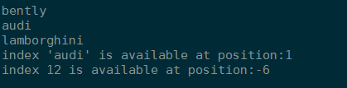
binarySearch() – output 1

Slide 23
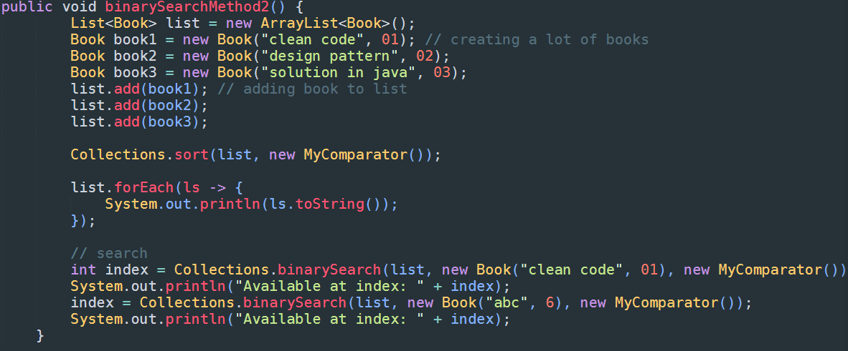
binarySearch() – code 2

Slide 24
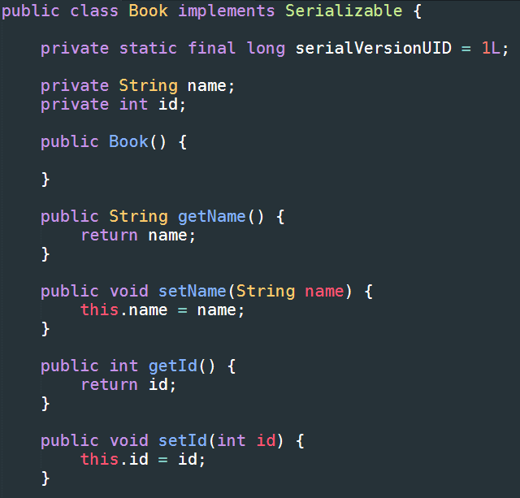
binarySearch() – code 2

Slide 25
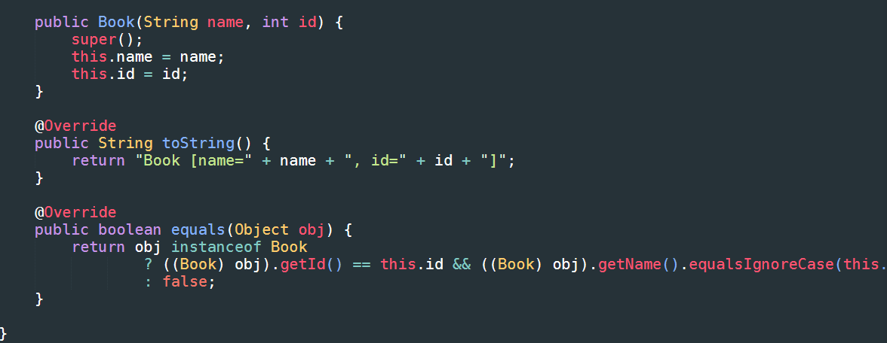
binarySearch() – code 2

Slide 26
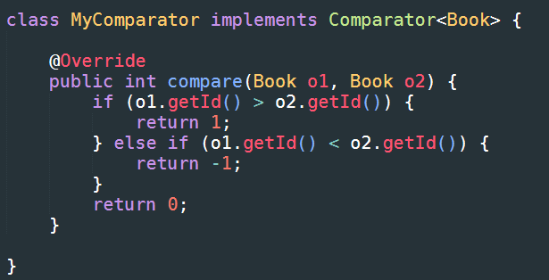
binarySearch() – code 2

Slide 27
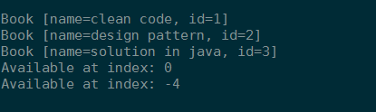
binarySearch() – output 2

Slide 28
binarySearch() – code 2 - raw
public void binarySearchMethod2() {
List<Book> list = new ArrayList<Book>();
Book book1 = new Book("clean code", 01); // creating a lot of books
Book book2 = new Book("design pattern", 02);
Book book3 = new Book("solution in java", 03);
list.add(book1); // adding book to list
list.add(book2);
list.add(book3);
Collections.sort(list, new MyComparator());
list.forEach(ls -> {
System.out.println(ls.toString());
});
// search
int index = Collections.binarySearch(list, new Book("clean code", 01), new MyComparator());
System.out.println("Available at index: " + index);
index = Collections.binarySearch(list, new Book("abc", 6), new MyComparator());
System.out.println("Available at index: " + index);
}

Slide 29
binarySearch() – code 2 - raw
public class Book implements Serializable {
private static final long serialVersionUID = 1L;
private String name;
private int id;
public Book() {
}
public String getName() {
return name;
}
public void setName(String name) {
this.name = name;
}
public int getId() {
return id;
}
public void setId(int id) {
this.id = id;
}
public Book(String name, int id) {
super();
this.name = name;
this.id = id;
}

Slide 30
binarySearch() – code 2 - raw
@Override
public String toString() {
return "Book [name=" + name + ", id=" + id + "]";
}
@Override
public boolean equals(Object obj) {
return obj instanceof Book
? ((Book) obj).getId() == this.id && ((Book) obj).getName().equalsIgnoreCase(this.name)
: false;
}
}

Slide 31
binarySearch() – code 2 - raw
class MyComparator implements Comparator<Book> {
@Override
public int compare(Book o1, Book o2) {
if (o1.getId() > o2.getId()) {
return 1;
} else if (o1.getId() < o2.getId()) {
return -1;
}
return 0;
}
}

Slide 32
checkedCollection()
The checkedCollection() is a method of Java Collections class which returns a dynamically type safe view of the specified collection.
If an element inserted of the wrong type, it will result in an immediate ClassCastException.

Slide 33
checkedCollection() - syntax
public static <E> Collection<E> checkedCollection(Collection<E> c, Class<E> type)

Slide 34
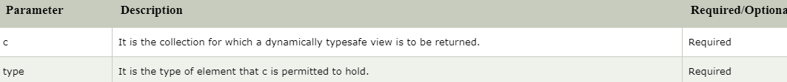
checkedCollection() – parameter

Slide 35
checkedCollection() - return
The checkedCollection() method returns a dynamically typesafe view of the specified collection

Slide 36
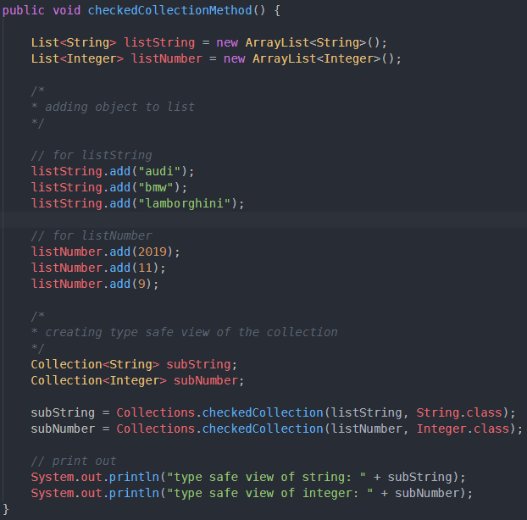
checkedCollection() - code

Slide 37

checkedCollection() - output

Slide 38
checkedList()
The checkedList() is a method of Java Collections class which returns a dynamically type safe view of the specified list.
If an element inserted of the wrong type, it will result in an immediate ClassCastException.

Slide 39
checkedList() - syntax
public static <E> List<E> checkedList(List<E> list, Class<E> type)

Slide 40

checkedList() - parameter

Slide 41
checkedList() - return
The checkedList() method returns a dynamically typesafe view of the specified List.

Slide 42
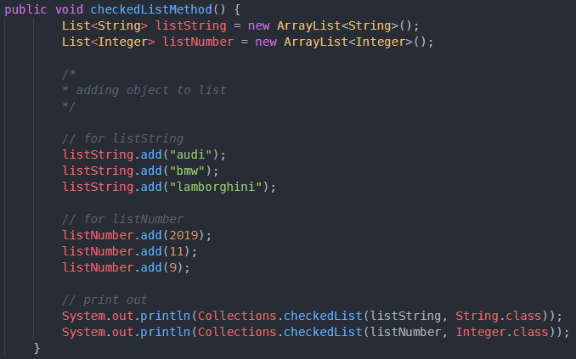
checkedList() - code

Slide 43

checkedList() - output

Slide 44
checkedMap()
The checkedMap() is an inbuilt method of Java Collections class.
This method is used to get a dynamically type safe view of the specified Map. If any attempt of insert mapping whose key or value has the wrong type, it will result in an immediate ClassCastException.

Slide 45
checkedMap() - syntax
public static <K,V> Map<K,V> checkedMap(Map<K,V> m, Class<K> keyType, Class<V> valueType)

Slide 46
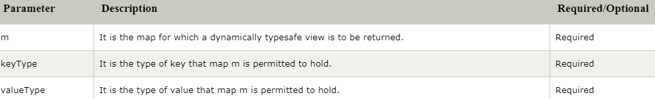
checkedMap() - parameter

Slide 47
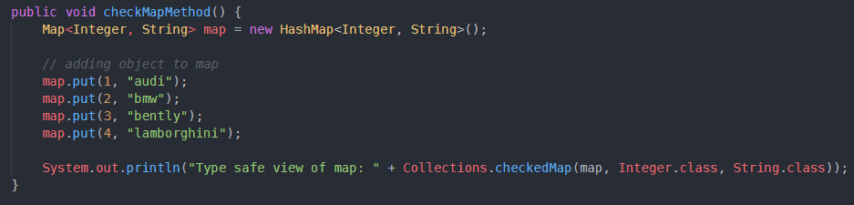
checkedMap() - code

Slide 48
checkedNavigableMap()
The checkedNavigableMap() is an inbuilt method of Java Collections class.
This method is used to get a dynamically type safe view of the specified Navigable Map. If there is any attempt of insert mapping whose key or value has the wrong type, it will result in an immediate ClassCastException.

Slide 49
checkedNavigableMap() - syntax
public static <K,V> NavigableMap<K,V> checkedNavigableMap(NavigableMap<K,V> m, Class<K> keyType, Class<V> valueType)

Slide 50
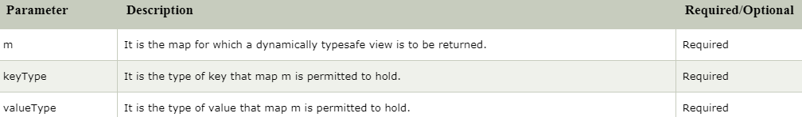
checkedNavigableMap() - parameter

Slide 51
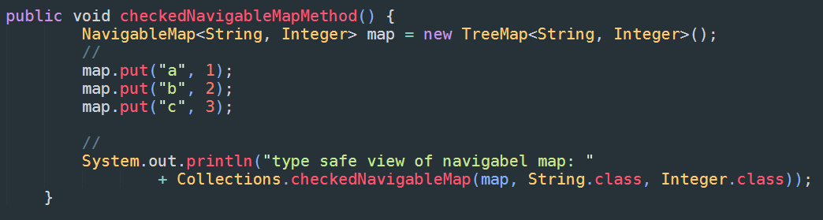
checkedNavigableMap() – code

Slide 52

checkedNavigableMap() - output

Slide 53
checkedNavigableSet()
The checkedNavigableSet() is an inbuilt method of Java Collections class.
This method is used to get a dynamically type safe view of the specified Navigable Set.
If any attempt of inserting an element whose value has the wrong type, it will through an immediate ClassCastException

Slide 54
checkedNavigableSet() -syntax
public static <E> NavigableSet<E> checkedNavigableSet(NavigableSet<E> s, Class<E> type)

Slide 55

checkedNavigableSet() - parameter

Slide 56
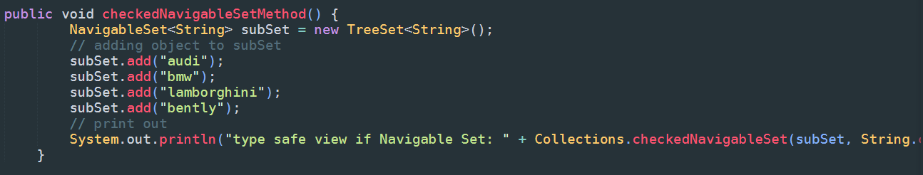
checkedNavigableSet() – code

Slide 57
checkedNavigableSet() – output

