Slide 1
PROPERTIES

Slide 2
Introduction
The properties object contains key and value pair both as a string
The java.util.Properties class is the subclass of Hashtable
It can be used to get property value based on the property key.
The Properties class provides methods to get data from the properties file and store data into the properties file.
Moreover, it can be used to get the properties of a system.

Slide 3
An Advantage Of The Properties File
Recompilation is not required if the information is changed from a properties file: If any information is changed from the properties file, you don't need to recompile the java class. It is used to store information which is to be changed frequently

Slide 4
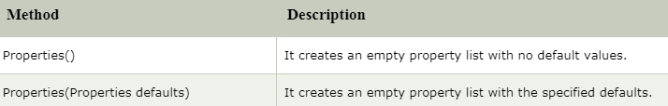
Constructors of Properties class

Slide 5
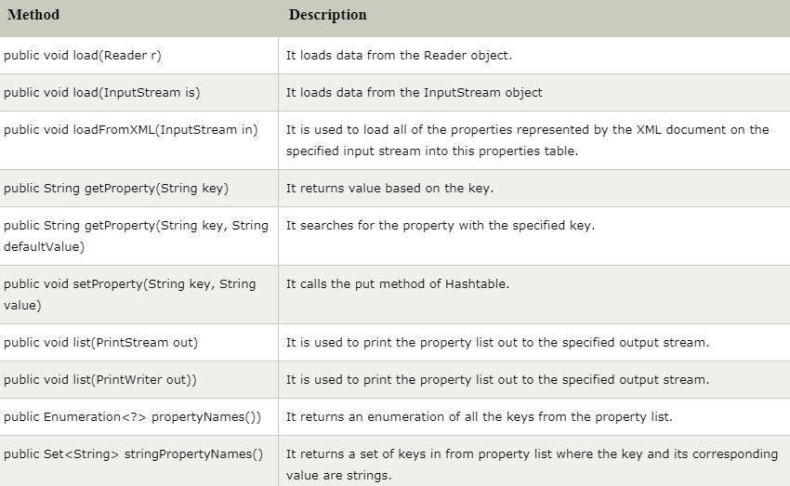
Methods of Properties class

Slide 6
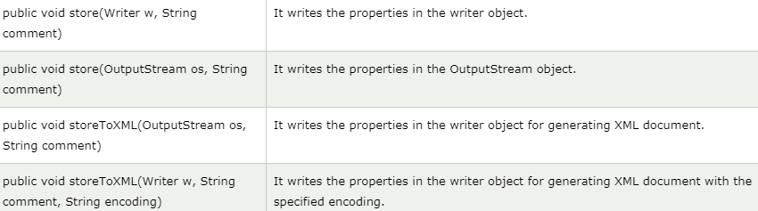
Methods of Properties class (cont’d)

Slide 7
Demo
Properties class to get information from the properties file
Properties class to get all the system properties
Properties class to create the properties file

Slide 8
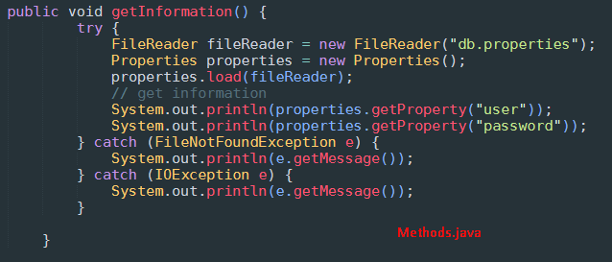


Properties class to get information from the properties file

Slide 9
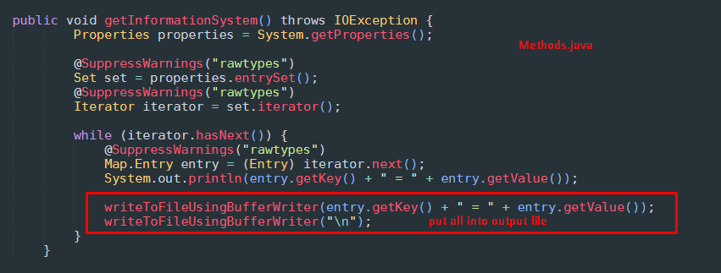
Properties class to get all the system properties

Slide 10
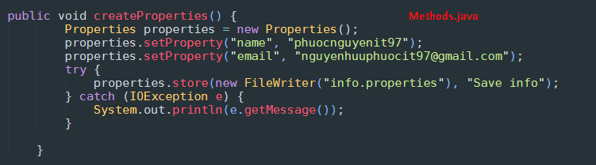

Properties class to create the properties file

