Slide 1
Queue Interface

Slide 2
Queue
Java Queue interface orders the element in FIFO(First In First Out) manner
In FIFO, first element is removed first and last element is removed at last.

Slide 3
Queue Interface declaration
public interface Queue<E> extends Collection<E>

Slide 4
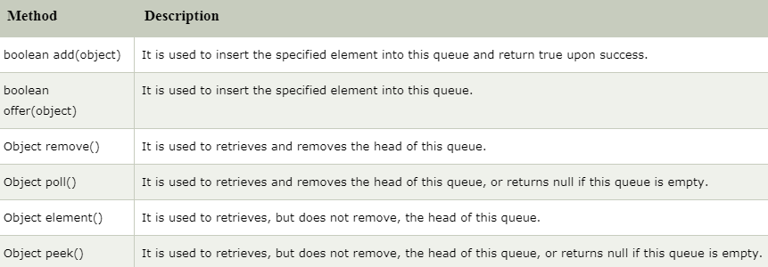
Methods of Java Queue Interface

Slide 5
PriorityQueue class
The PriorityQueue class provides the facility of using queue
But it does not orders the elements in FIFO manner
It inherits AbstractQueue class.

Slide 6
PriorityQueue class declaration
public class PriorityQueue<E> extends AbstractQueue<E> implements Serializable

