Slide 1
TreeMap

Slide 2
TreeMap
Java TreeMap class is a red-black tree based implementation
It provides an efficient means of storing key-value pairs in sorted order.

Slide 3
The important points about Java TreeMap class
Java TreeMap contains values based on the key.
It implements the NavigableMap interface and extends AbstractMap class
Java TreeMap contains only unique elements
Java TreeMap cannot have a null key but can have multiple null values
Java TreeMap is non synchronized
Java TreeMap maintains ascending order

Slide 4
TreeMap class declaration
public class TreeMap<K,V> extends AbstractMap<K,V> implements NavigableMap<K,V>, Cloneable, Serializable

Slide 5
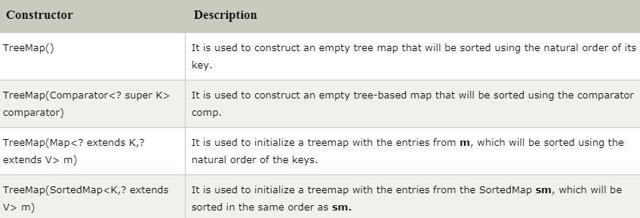
Constructors of Java TreeMap class

Slide 6
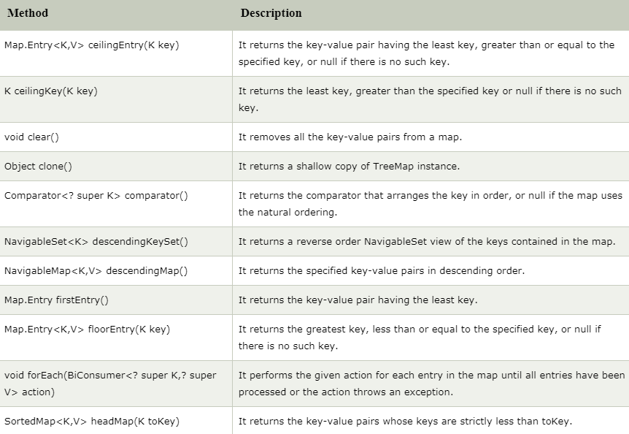
Methods of Java TreeMap class

Slide 7
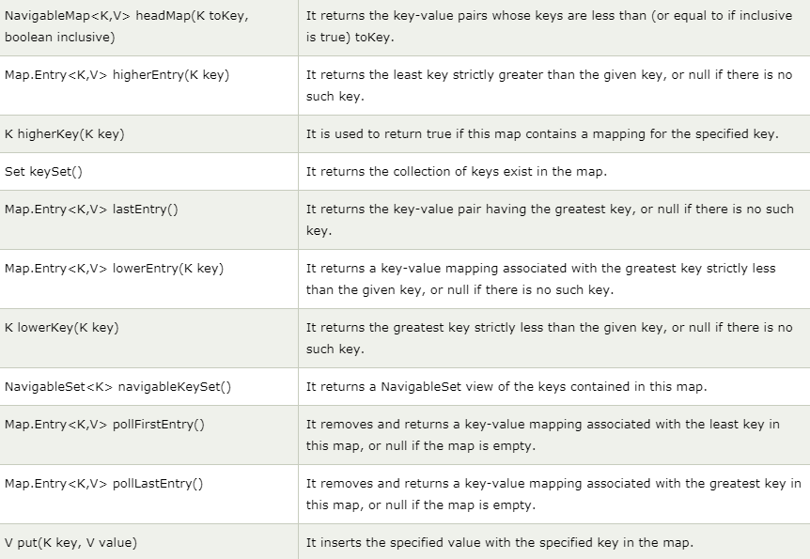
Methods of Java TreeMap class (cont’d)

Slide 8
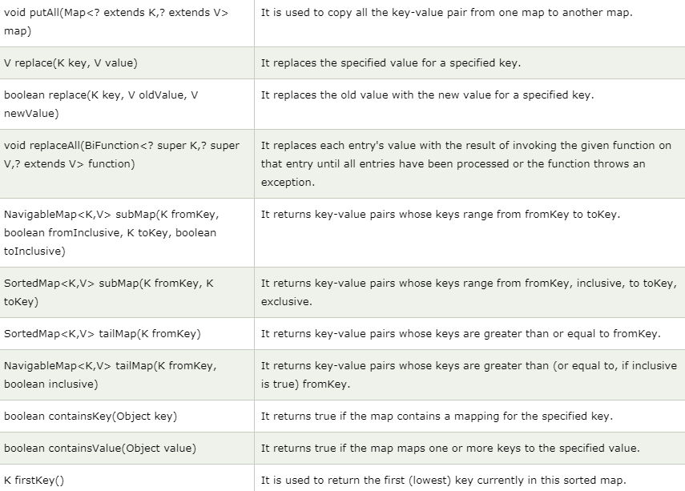
Methods of Java TreeMap class (cont’d)

Slide 9
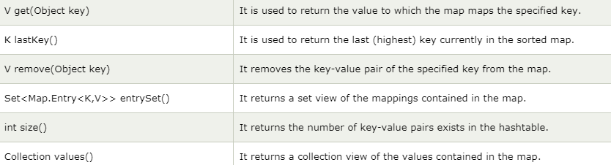
Methods of Java TreeMap class (cont’d)

Slide 10
What is difference between HashMap and TreeMap?
HashMap | TreeMap
HashMap can contain one null key. | TreeMap cannot contain any null key.
HashMap maintains no order. | TreeMap maintains ascending order.

