Slide 1
TREESET

Slide 2
TreeSet
Java TreeSet class implements the Set interface that uses a tree for storage
It inherits AbstractSet class and implements the NavigableSet interface
The objects of the TreeSet class are stored in ascending order.

Slide 3
The important points about Java TreeSet class
Java TreeSet class contains unique elements only like HashSet
Java TreeSet class access and retrieval times are quiet fast
Java TreeSet class doesn't allow null element
Java TreeSet class is non synchronized
Java TreeSet class maintains ascending order.

Slide 4
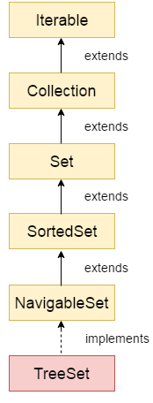
Hierarchy of TreeSet class

Slide 5
TreeSet class declaration
public class TreeSet<E> extends AbstractSet<E> implements NavigableSet<E>, Cloneable, Serializable

Slide 6
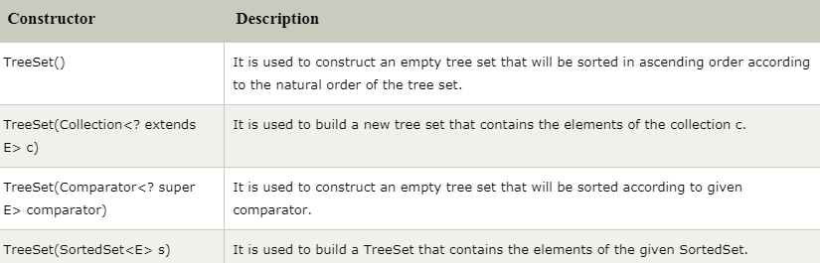
Constructors of Java TreeSet class

Slide 7
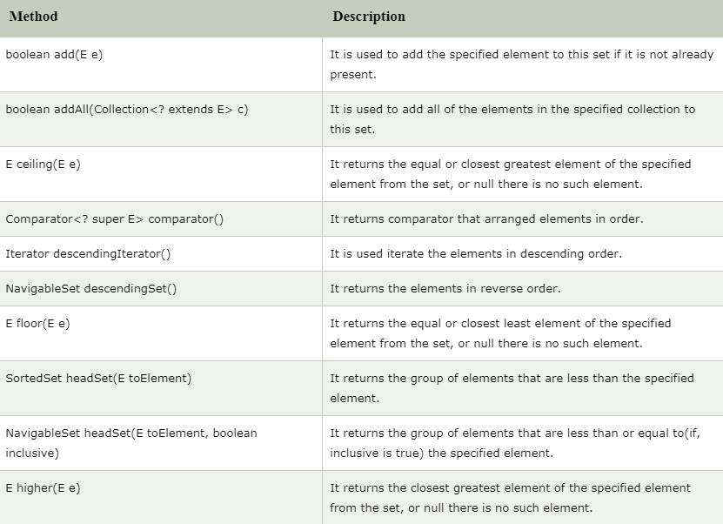
Methods of Java TreeSet class

Slide 8
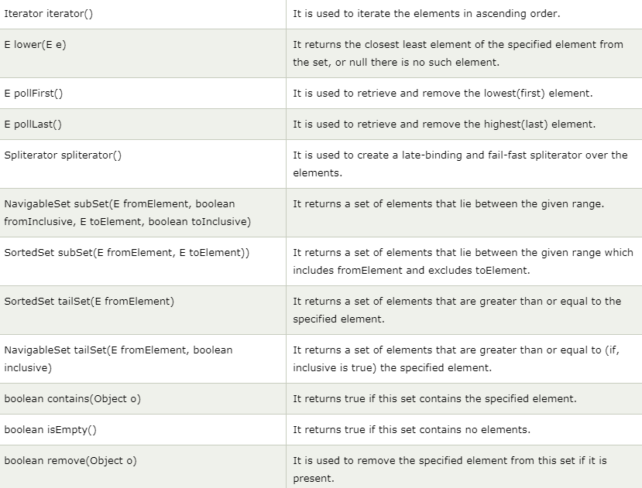
Methods of Java TreeSet class (cont’d)

Slide 9
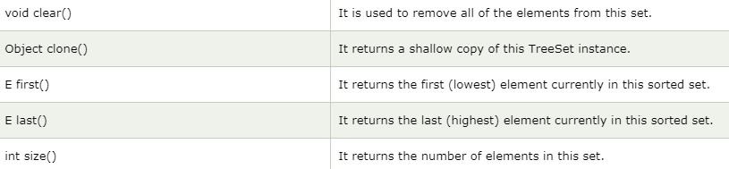
Methods of Java TreeSet class (cont’d)

