Slide 1
WAYS TO ITERATE THE ELEMENTS OF THE COLLECTION IN JAVA

Slide 2
Ways to iterate the elements of the collection in java
By Iterator interface
By for-each loop
By ListIterator interface
By for loop
By forEach() method
By forEachRemaining() method.

Slide 3
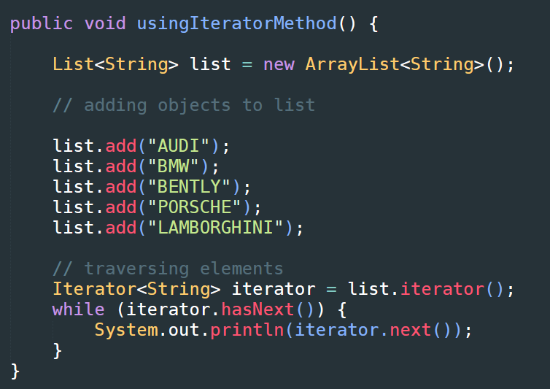
By Iterator interface

Slide 4
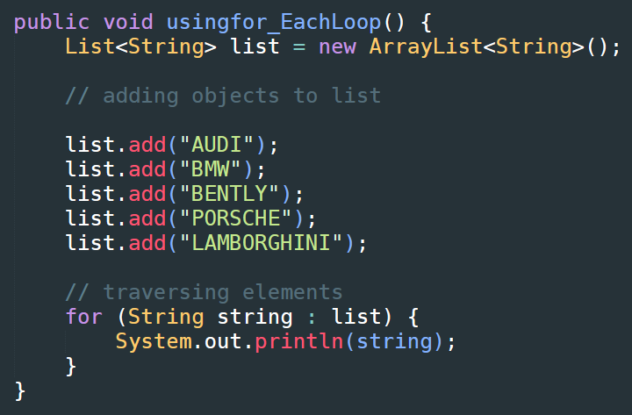
By for-each loop

Slide 5
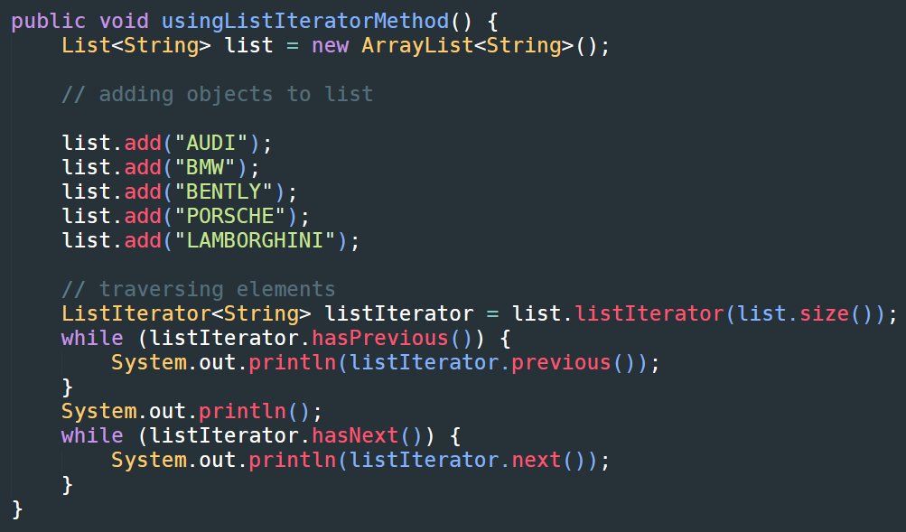
By ListIterator interface

Slide 6
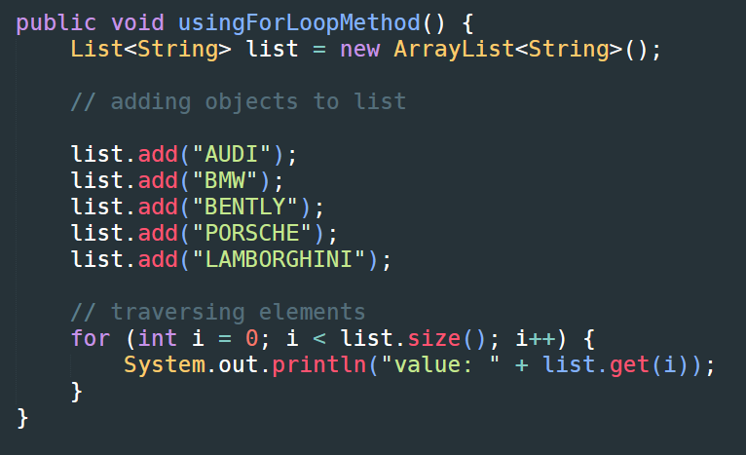
By for loop

Slide 7
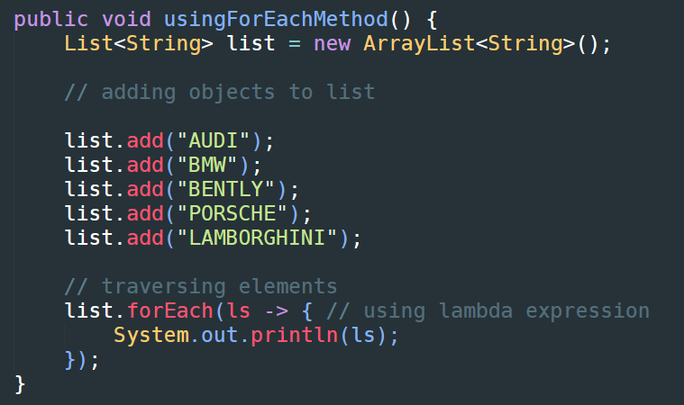
By forEach() method

Slide 8
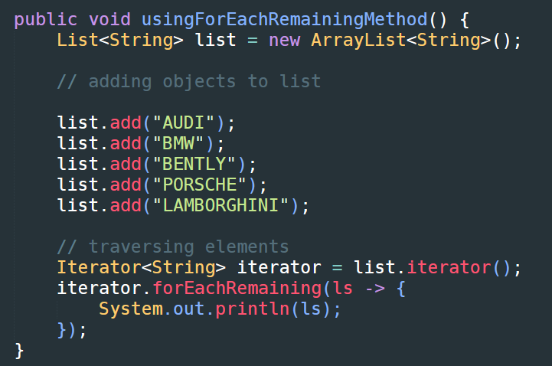
By forEachRemaining() method

