Slide 1
WORKING OF HASHMAP

Slide 2
What is Hashing
It is the process of converting an object into an integer value. The integer value helps in indexing and faster searches.

Slide 3
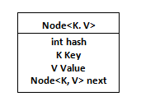
What is HashMap
HashMap is a part of the Java collection framework
It uses a technique called Hashing
It implements the map interface
It stores the data in the pair of Key and Value
HashMap contains an array of the nodes, and the node is represented as a class
It uses an array and LinkedList data structure internally for storing Key and Value
There are four fields in HashMap

Slide 4
What is HashMap (cont’d)
equals(): It checks the equality of two objects. It compares the Key, whether they are equal or not. It is a method of the Object class. It can be overridden. If you override the equals() method, then it is mandatory to override the hashCode() method.
hashCode(): This is the method of the object class. It returns the memory reference of the object in integer form. The value received from the method is used as the bucket number. The bucket number is the address of the element inside the map. Hash code of null Key is 0.
Buckets: Array of the node is called buckets. Each node has a data structure like a LinkedList. More than one node can share the same bucket. It may be different in capacity.

Slide 5
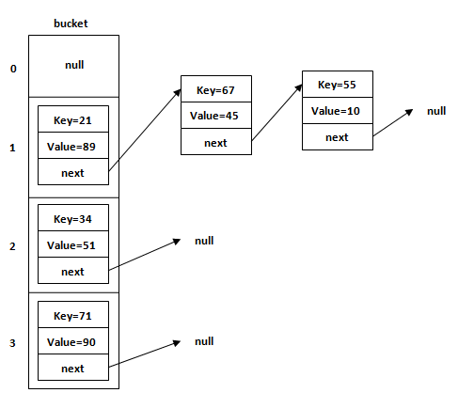
What is HashMap (cont’d)

Slide 6
Insert Key, Value pair in HashMap
We use put() method to insert the Key and Value pair in the HashMap
The default size of HashMap is 16 (0 to 15)

Slide 7
Hash Collision
This is the case when the calculated index value is the same for two or more Keys.

Slide 8
get() method in HashMap
get() method is used to get the value by its Key. It will not fetch the value if you don't know the Key. When get(K Key) method is called, it calculates the hash code of the Key.

