Slide 1
Meta Learning Approach For Adversarial Attacks

Slide 2
Team Members
Shaik Mohammed Sayeed - CS19BTECH11004
Gantasala Naga Aneesh Ajaroy - CS19BTECH11010
Peddi Naga Hari Teja - CS19BTECH11021
Vemulapalli Aditya - CS19BTECH11025
Appanagari Sathwik Chakravarthi - ES19BTECH11008

Slide 3
Adversarial Attacks Introduction
It includes adversarial examples, input images formed by applying small perturbations to examples from the dataset, such that the perturbed input results in the model outputting an incorrect answer with high probability.
The perturbed image is the same as input image to the naked eye but the model mis classifies it as another.

Slide 4
FGSM Attack
It is a white box attack.
It is done based on knowledge of the architecture of the given network.
It attacks the neural network based on the idea that gradient descent is used to find the lowest point of loss, hence going in the opposite direction of it, the loss can be maximized by adding a small amount of perturbation
The gradient of loss is calculated w.r.t to the input data and the input data is adjusted to maximize the loss.

Slide 5
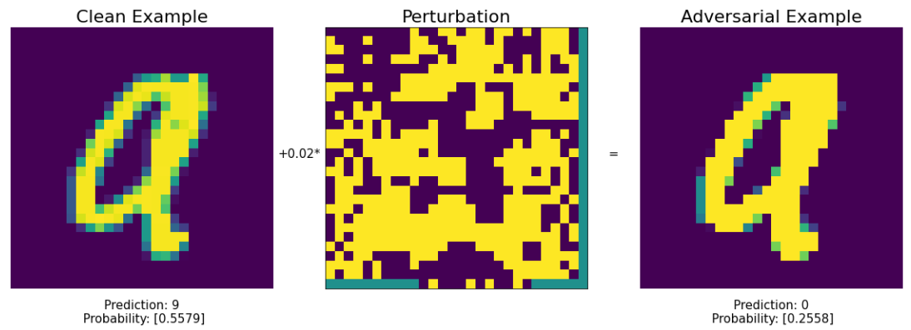
Adversarial Example Generated using FGSM Attack on an image from MNIST Dataset

Slide 6
META LEARNING

Slide 7
Model Agnostic Meta Learning (MAML)
The goal of this approach is that we want to perform better on a new task with only using a few data samples for training without overfitting, given the model is trained on a variety of learning tasks.
The model is easily suitable to different architectures and problem settings and a variety of loss functions.
It learns an internal representation so that it can be suitable for many tasks so that slight changes of the parameters can produce good results.
Unlike traditional approaches, which solve tasks from the ground up using a fixed learning algorithm, meta-learning aims to enhance the learning algorithm by incorporating numerous learning experiences

Slide 8
Adversarial Meta Learning
It is a variant of MAML. The meta learning model is trained with both clean and adversarial samples to find robust and better model parameters.
Both clean and adversarial samples are used in inner and outer loops in the MAML algorithm and they contribute equally in updating the model parameters. The correlation between the clean and adversarial samples is used by ADML, to make the model parameters robust to adversarial samples and generalize well to new samples.

Slide 9
Why we choose to use Meta Learning for Adversarial Attacks
For Adversarial Attacks it usually takes a huge amount of time to train the model
It requires a huge amount of data points to gain the accuracy over the different models/attacks
In adversarial training it consumes a huge amount of time ,so we come up with a solution to integrate meta learning with adversarial attacks.
In meta learning we can train the same model over and over with different model , so that it get better with all the combination of attacks /models
It can able to learn with lesser number of data points

Slide 10

Brief Procedure
Suppose we have a task distribution , we then sample a batch of tasks , from the task distribution. Then for each task we sample a batch of k data points in train and test sets.
Suppose for each task we sample clean and adversarial samples for both train and test sets
We then find the optimal parameter . We minimize the loss by gradient descent on both clean and adversarial training sets and find optimal parameters

Slide 11
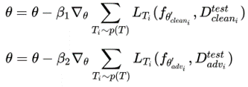
After this we enter into the meta training phase where the optimal parameter is calculated. We update it by minimizing the loss w.r.t to optimal parameters

Slide 12
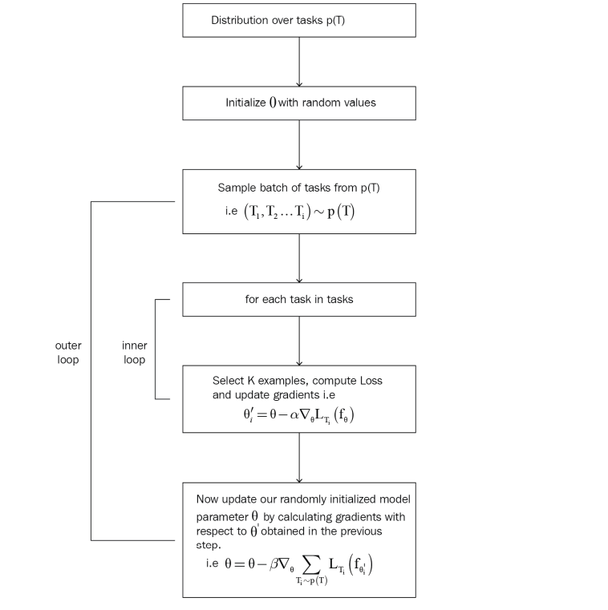

Slide 13
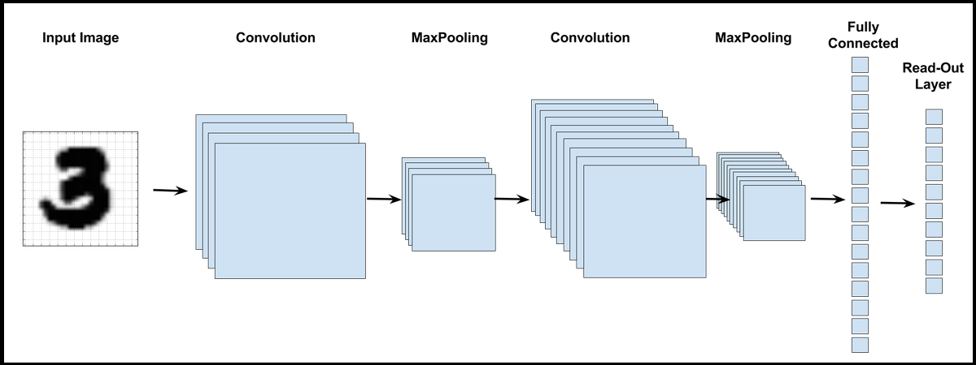
CNN Architecture
5x5
2x2
5x5
2x2

Slide 14
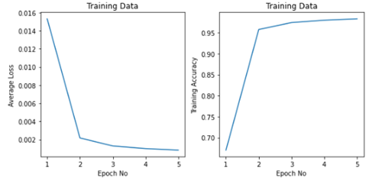
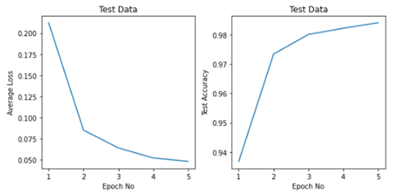
Results obtained for general CNN Classifier trained with clean samples

Slide 15
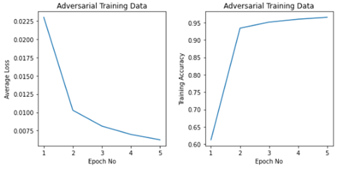
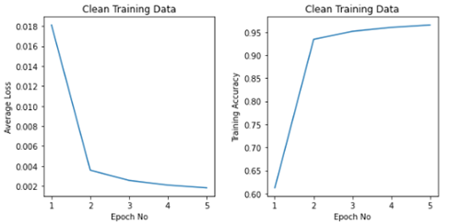
Results obtained for CNN Classifier trained with both clean samples and adversarial samples

Slide 16
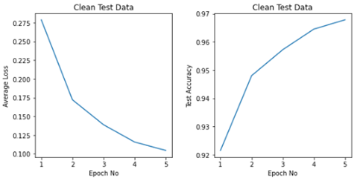
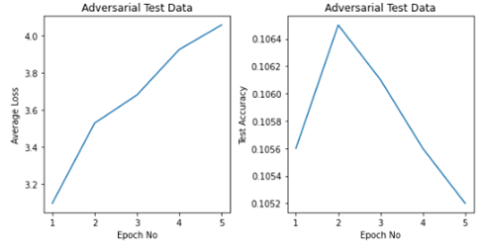
Results obtained for CNN Classifier trained with both clean samples and adversarial samples

Slide 17
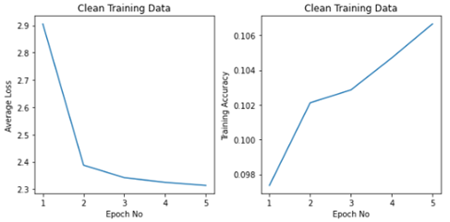
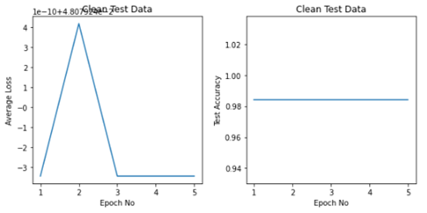
Results obtained for CNN Classifier trained with MAML algorithm

Slide 18


Contributions
Code Peddi Naga Hari Teja Shaik Mohammed Sayeed
Adversarial Gantasala Naga Aneesh Ajaroy Vemulapalli Aditya Appanagari Sathwik Chakravarthi
MAML Vemulapalli Aditya Appanagari Sathwik Chakravarthi Gantasala Naga Aneesh Ajaroy

Slide 19
THANK YOU

