Slide 1

Carbon Emissions
Tracking Application (CETA)

Slide 2
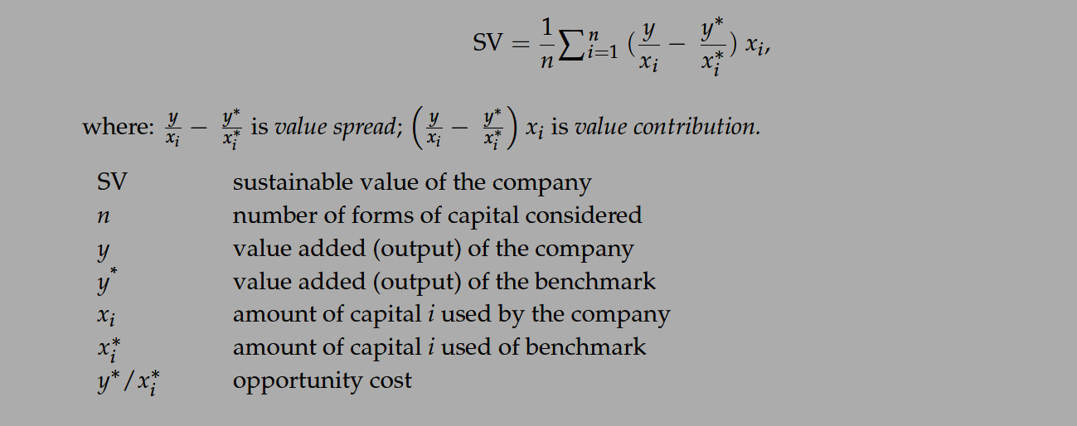

Quantifying the relationship between Sustainability & Profitability

Slide 3
Why is this important?
1
Make Emissions Data Readily Available to the Public
2
Promote Brand Growth for Sustainable Companies
3
Hold deficient, polluting Companies Accountable

Slide 4

Demo ☺

