Slide 1

ESOFT METRO CAMPUS • FACULTY OF COMPUTING • BIT (HONS) DEGREE
ACADEMIC INTERIM REPORT DEFENSE • SYSTEM DEMONSTRATION
Web-Based Hotel Management System
Dutch Point Negombo Resort — Decoupled 3-Tier Enterprise Architecture (React 19 + ASP.NET Core 10 + MySQL 8.0)
I.D.P.N Iddamalgoda
Student ID: E269559
Team Lead / Presenter
H.M.Y.R Herath
Student ID: E267614
Team Member
Y.M.A.Y Bandara
Student ID: E267609
Team Member
A.G.H.H Jinadasa
Student ID: E267612
Team Member
Date: October 5, 2026 • Interim Milestone Submission (55% Working Prototype Verified)

Slide 2
DUTCH POINT NEGOMBO • WEB-BASED HOTEL MANAGEMENT SYSTEM
System Vision & Core Operational Problems Solved
1. Manual Inefficiencies
• Historical Ledgers: Dutch Point Negombo relied on physical room diaries and phone notes.
• Turnover Delay: Front desk spent 10+ minutes per check-in cross-referencing paper receipts.
• Unrecorded Data: Customer contact numbers (+94) and special preferences frequently misplaced.
• High Overhead: Excessive staff workload during 11 AM checkout and 2 PM check-in rush hours.
2. Overbooking Vulnerability
• 4.2% Error Rate: Academic research (Kumar et al., 2024) shows manual systems suffer 4.2% double bookings.
• Overlapping Conflicts: Simultaneous phone and walk-in inquiries frequently reserve the same bed.
• Guest Dissatisfaction: Walk-in friction and room disputes negatively impact hotel reputation.
• Financial Loss: OTA commissions drain 15% to 25% profit margin per external booking.
3. The Implemented Solution
• Centralized 3-Tier Web PMS: Seamlessly connects customers, receptionists, and administrators.
• Automated ACID Concurrency: Zero-latency interval overlap engine guarantees zero double bookings.
• Domestic LKR Pricing Engine: Instant multi-night calculations in Sri Lankan Rupees (LKR) with no hidden fees.
• Live Front-Desk Tracker: Real-time calendar occupancy view replaces paper diaries.

Slide 3
DUTCH POINT NEGOMBO • WEB-BASED HOTEL MANAGEMENT SYSTEM
System Architecture: Decoupled 3-Tier Enterprise Pattern
Tier 1: Presentation (React 19)
• Framework: React 19 compiled with Vite 8.3 on localhost:5173.
• Single Page App (SPA): Near-instantaneous tab transitions via React Virtual DOM without page reloads.
• Luxury Styling: Bootstrap 5.3 + bespoke CSS variables (Cormorant Garamond & gold palette).
• State Hooks: useState and useEffect manage search dates, capacity filters, and user session tokens.
• Asynchronous REST: Fires native async fetch() requests passing structured JSON payloads.
Tier 2: Application (ASP.NET Core 10)
• Framework: ASP.NET Core 10 Web API on localhost:5000.
• RESTful Controllers: AuthController, RoomsController, BookingsController, DashboardController.
• Strongly-Typed DTOs: Validates input payloads before reaching business logic.
• Interval Engine: Enforces Allen's Interval Algebra to block double-booking race conditions.
• ORM Integration: Oracle MySql.EntityFrameworkCore executes optimized, parameterized LINQ queries.
Tier 3: Data Tier (MySQL 8.0)
• Database Engine: MySQL Server 8.0 (InnoDB engine, UTF8MB4, port 3306).
• Normalized Schema (3NF): Core tables: Customers, Rooms, Bookings.
• Referential Integrity: Foreign keys enforce relationships; ON DELETE RESTRICT prevents orphaned records.
• Decimal Precision: Monetary fields use DECIMAL(10,2) to eliminate binary rounding errors in LKR.
• ACID Compliance: Guarantees complete commit or immediate rollback upon any failure.

Slide 4
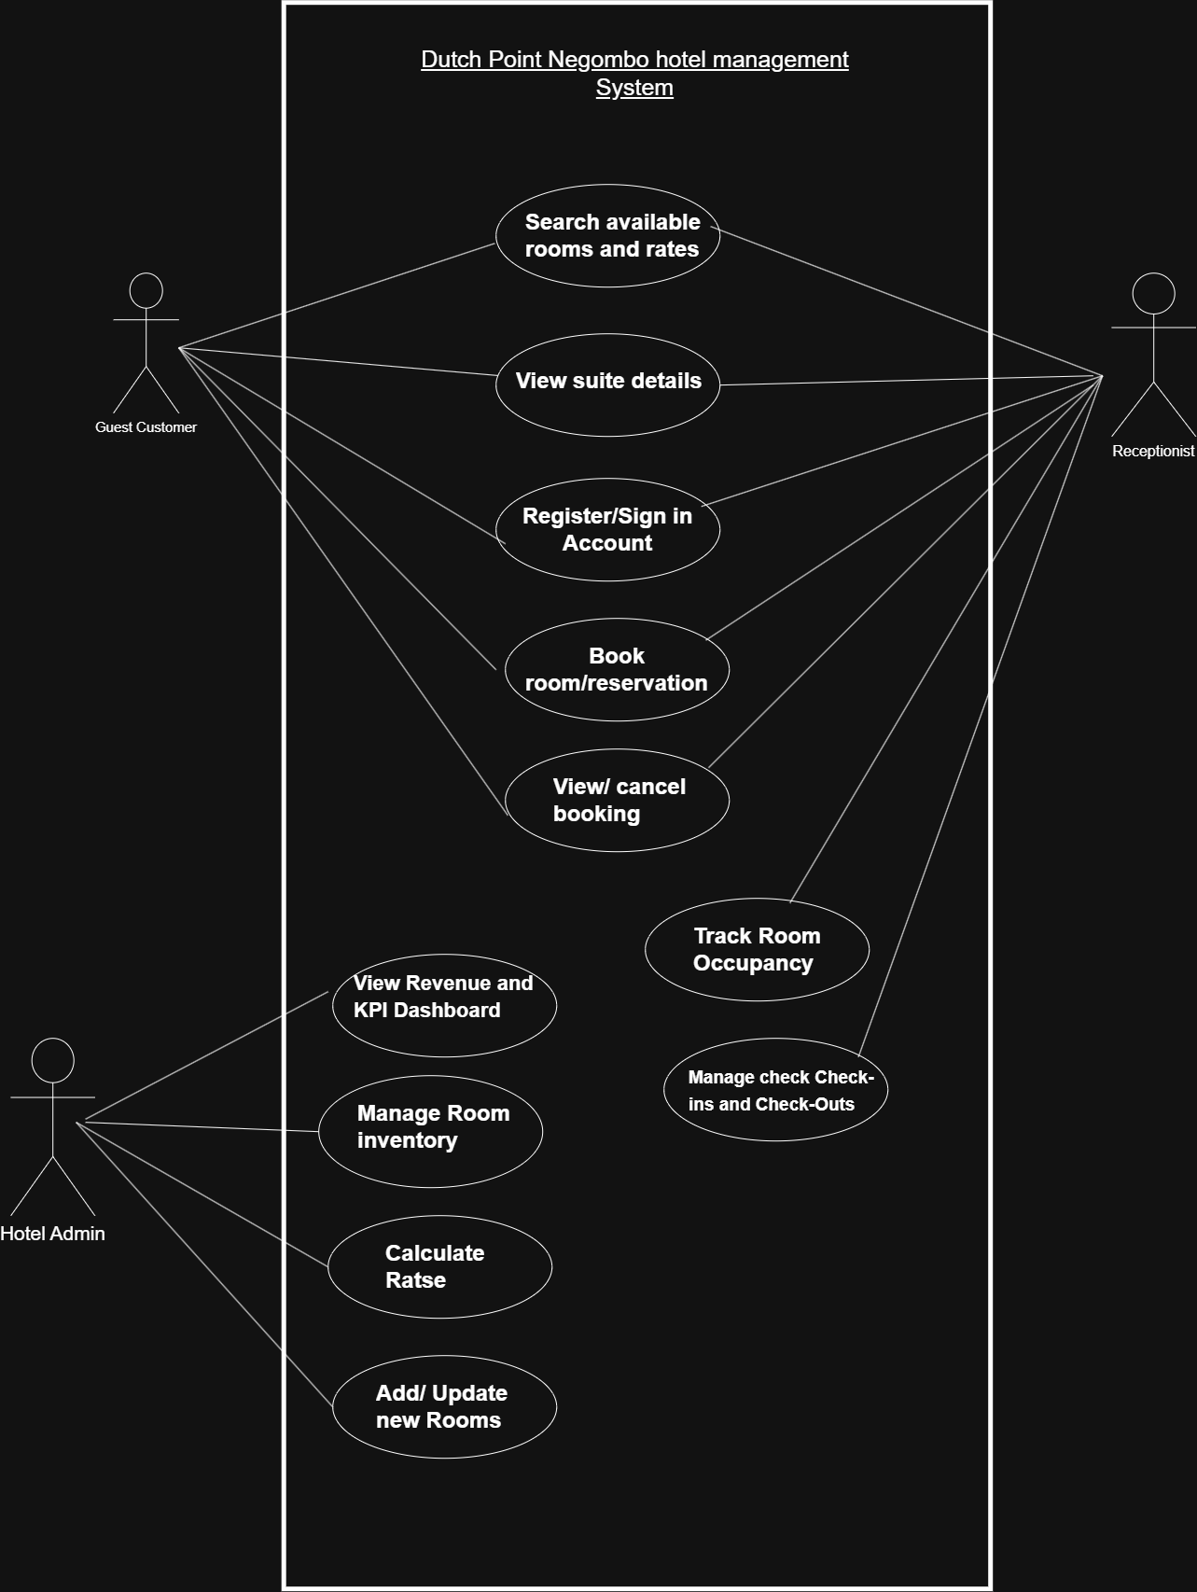
DUTCH POINT NEGOMBO • WEB-BASED HOTEL MANAGEMENT SYSTEM
System Use Cases & Operational Persona Boundaries
Persona Permission Boundaries (RBAC)
• Guest Customer Persona: Can search rooms by dates/headcount, view suite amenities, register account, book rooms with live LKR pricing, and view/cancel personal reservations in 'My Bookings'.
• Front-Desk Receptionist Persona: Can inspect the real-time Occupied Rooms Tracker by calendar date, access guest contact information (+94 phone/email), and coordinate check-in/out workflows.
• Hotel Administrator Persona: Exclusive authority to manage hotel room inventory (Add new suites, update nightly LKR rates, configure capacities, bind photo assets), and review overall occupancy metrics.
• Security Boundary: Strict server-side role separation ensures customers cannot access administrative controls or inspect other guests' reservation records.

Slide 5
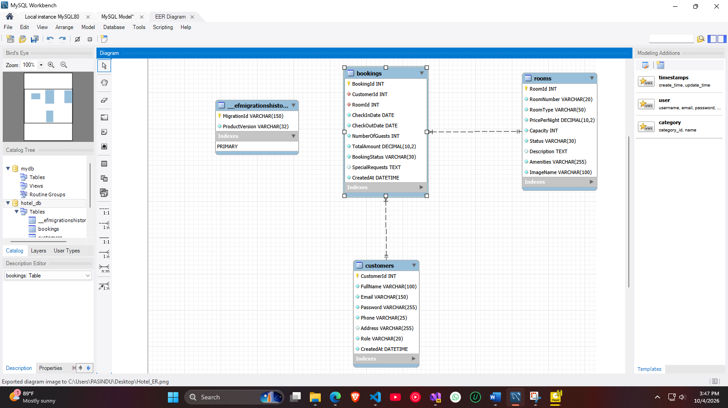
DUTCH POINT NEGOMBO • WEB-BASED HOTEL MANAGEMENT SYSTEM
Relational Database Design & MySQL 8.0 EER Model
Normalized Schema (hotel_db)
• Customers Table: CustomerId (PK), FullName, Email (Unique), Password, Phone, Address, Role ('Customer' vs 'Admin').
• Rooms Table: RoomId (PK), RoomNumber (Unique), RoomType, PricePerNight (DECIMAL), Capacity, Status, Amenities, ImageName.
• Bookings Table: BookingId (PK), CustomerId (FK), RoomId (FK), CheckInDate (DATE), CheckOutDate (DATE), NumberOfGuests, TotalAmount (DECIMAL), BookingStatus.
• Referential Safeguards: Foreign key constraints with ON DELETE RESTRICT ensure a room cannot be deleted if active bookings exist.
• LKR Currency Standard: All monetary transactions use 128-bit exact fixed-point decimal fields to eliminate floating-point drift.

Slide 6
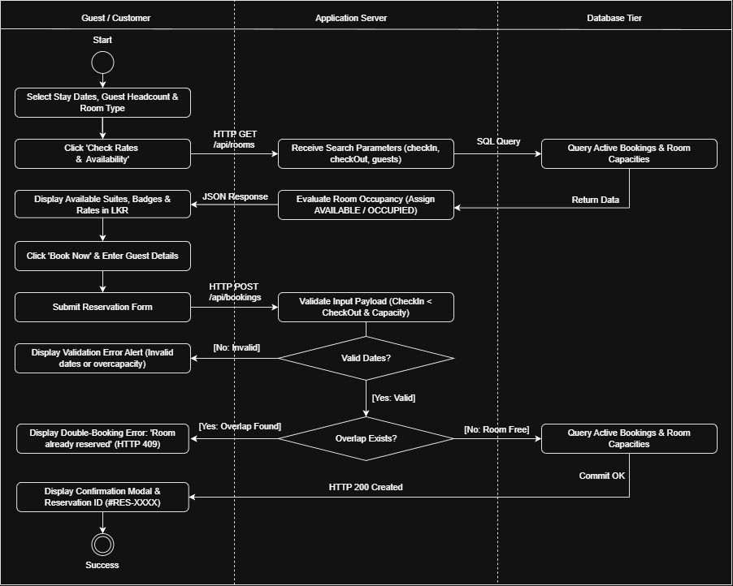
DUTCH POINT NEGOMBO • WEB-BASED HOTEL MANAGEMENT SYSTEM
System Activity Flow: End-to-End Guest Reservation Workflow
Three-Tier Transaction Lifecycle
• 1. Search Initiation: Customer selects Check-In, Check-Out, and Guest Count on React frontend -> Sends GET /api/rooms.
• 2. Availability Projection: ASP.NET Core queries overlapping bookings -> Returns filtered room cards with dynamic AVAILABLE / OCCUPIED badges.
• 3. Reservation Intake: Customer clicks 'Book Now' -> Modal calculates stay duration and total bill in LKR -> Dispatches POST /api/bookings.
• 4. Double-Booking Validation: Backend evaluates date overlap conditions. If overlap found -> Returns HTTP 409 Conflict. If clear -> Inserts booking into MySQL.
• 5. Client Confirmation: React displays confirmation modal with unique Reservation ID (#RES-XXXX) and triggers live inventory refresh.

Slide 7
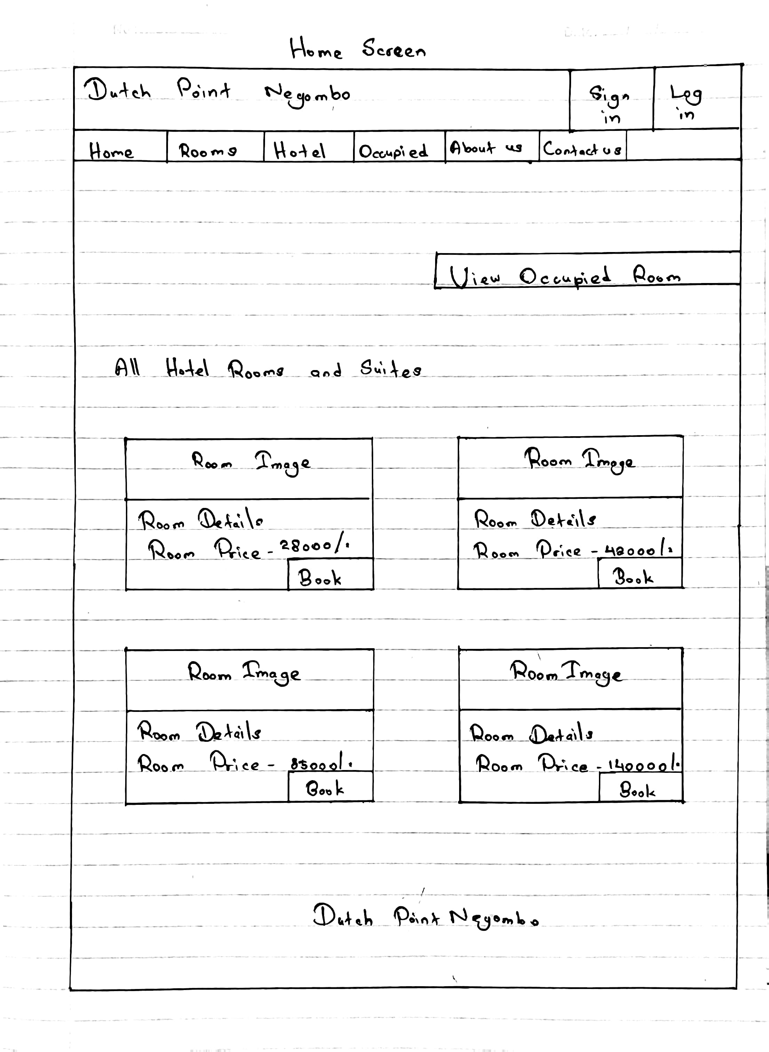
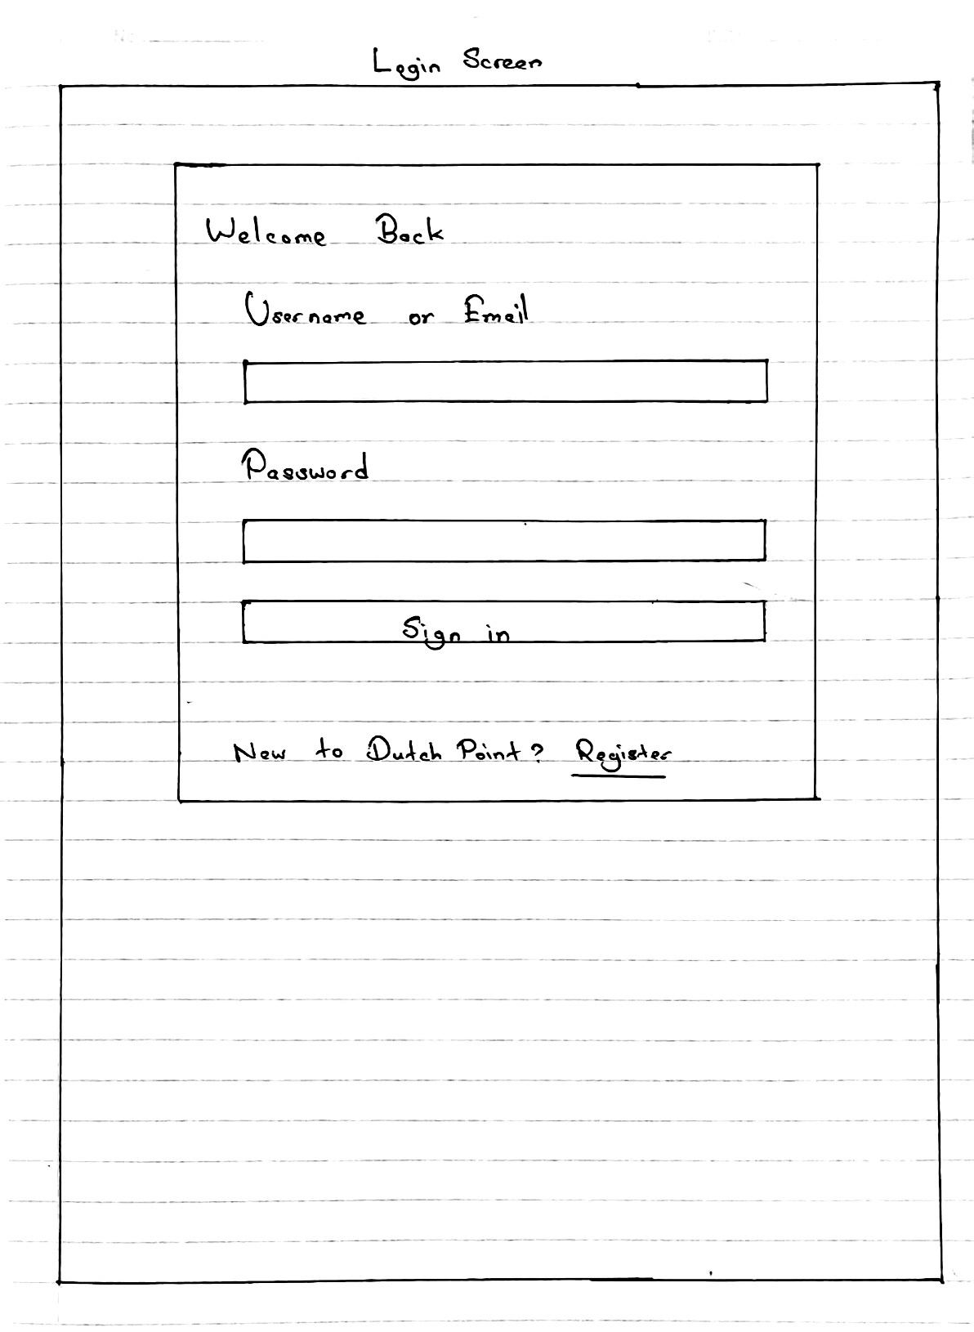
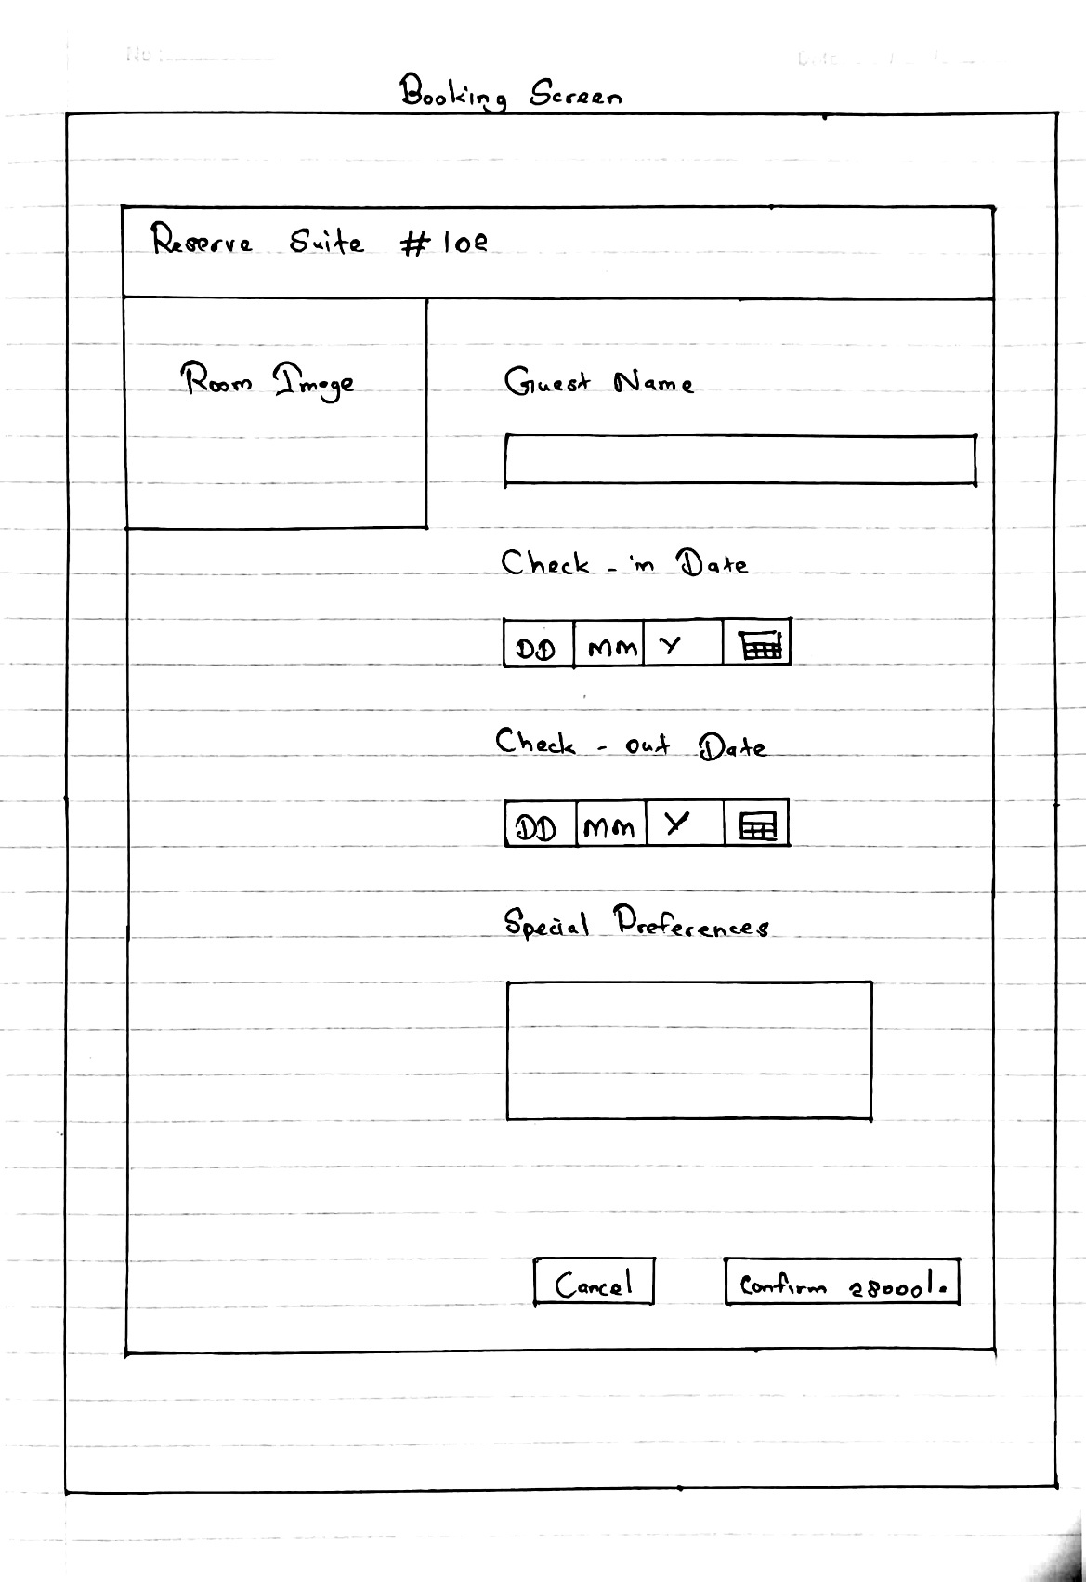
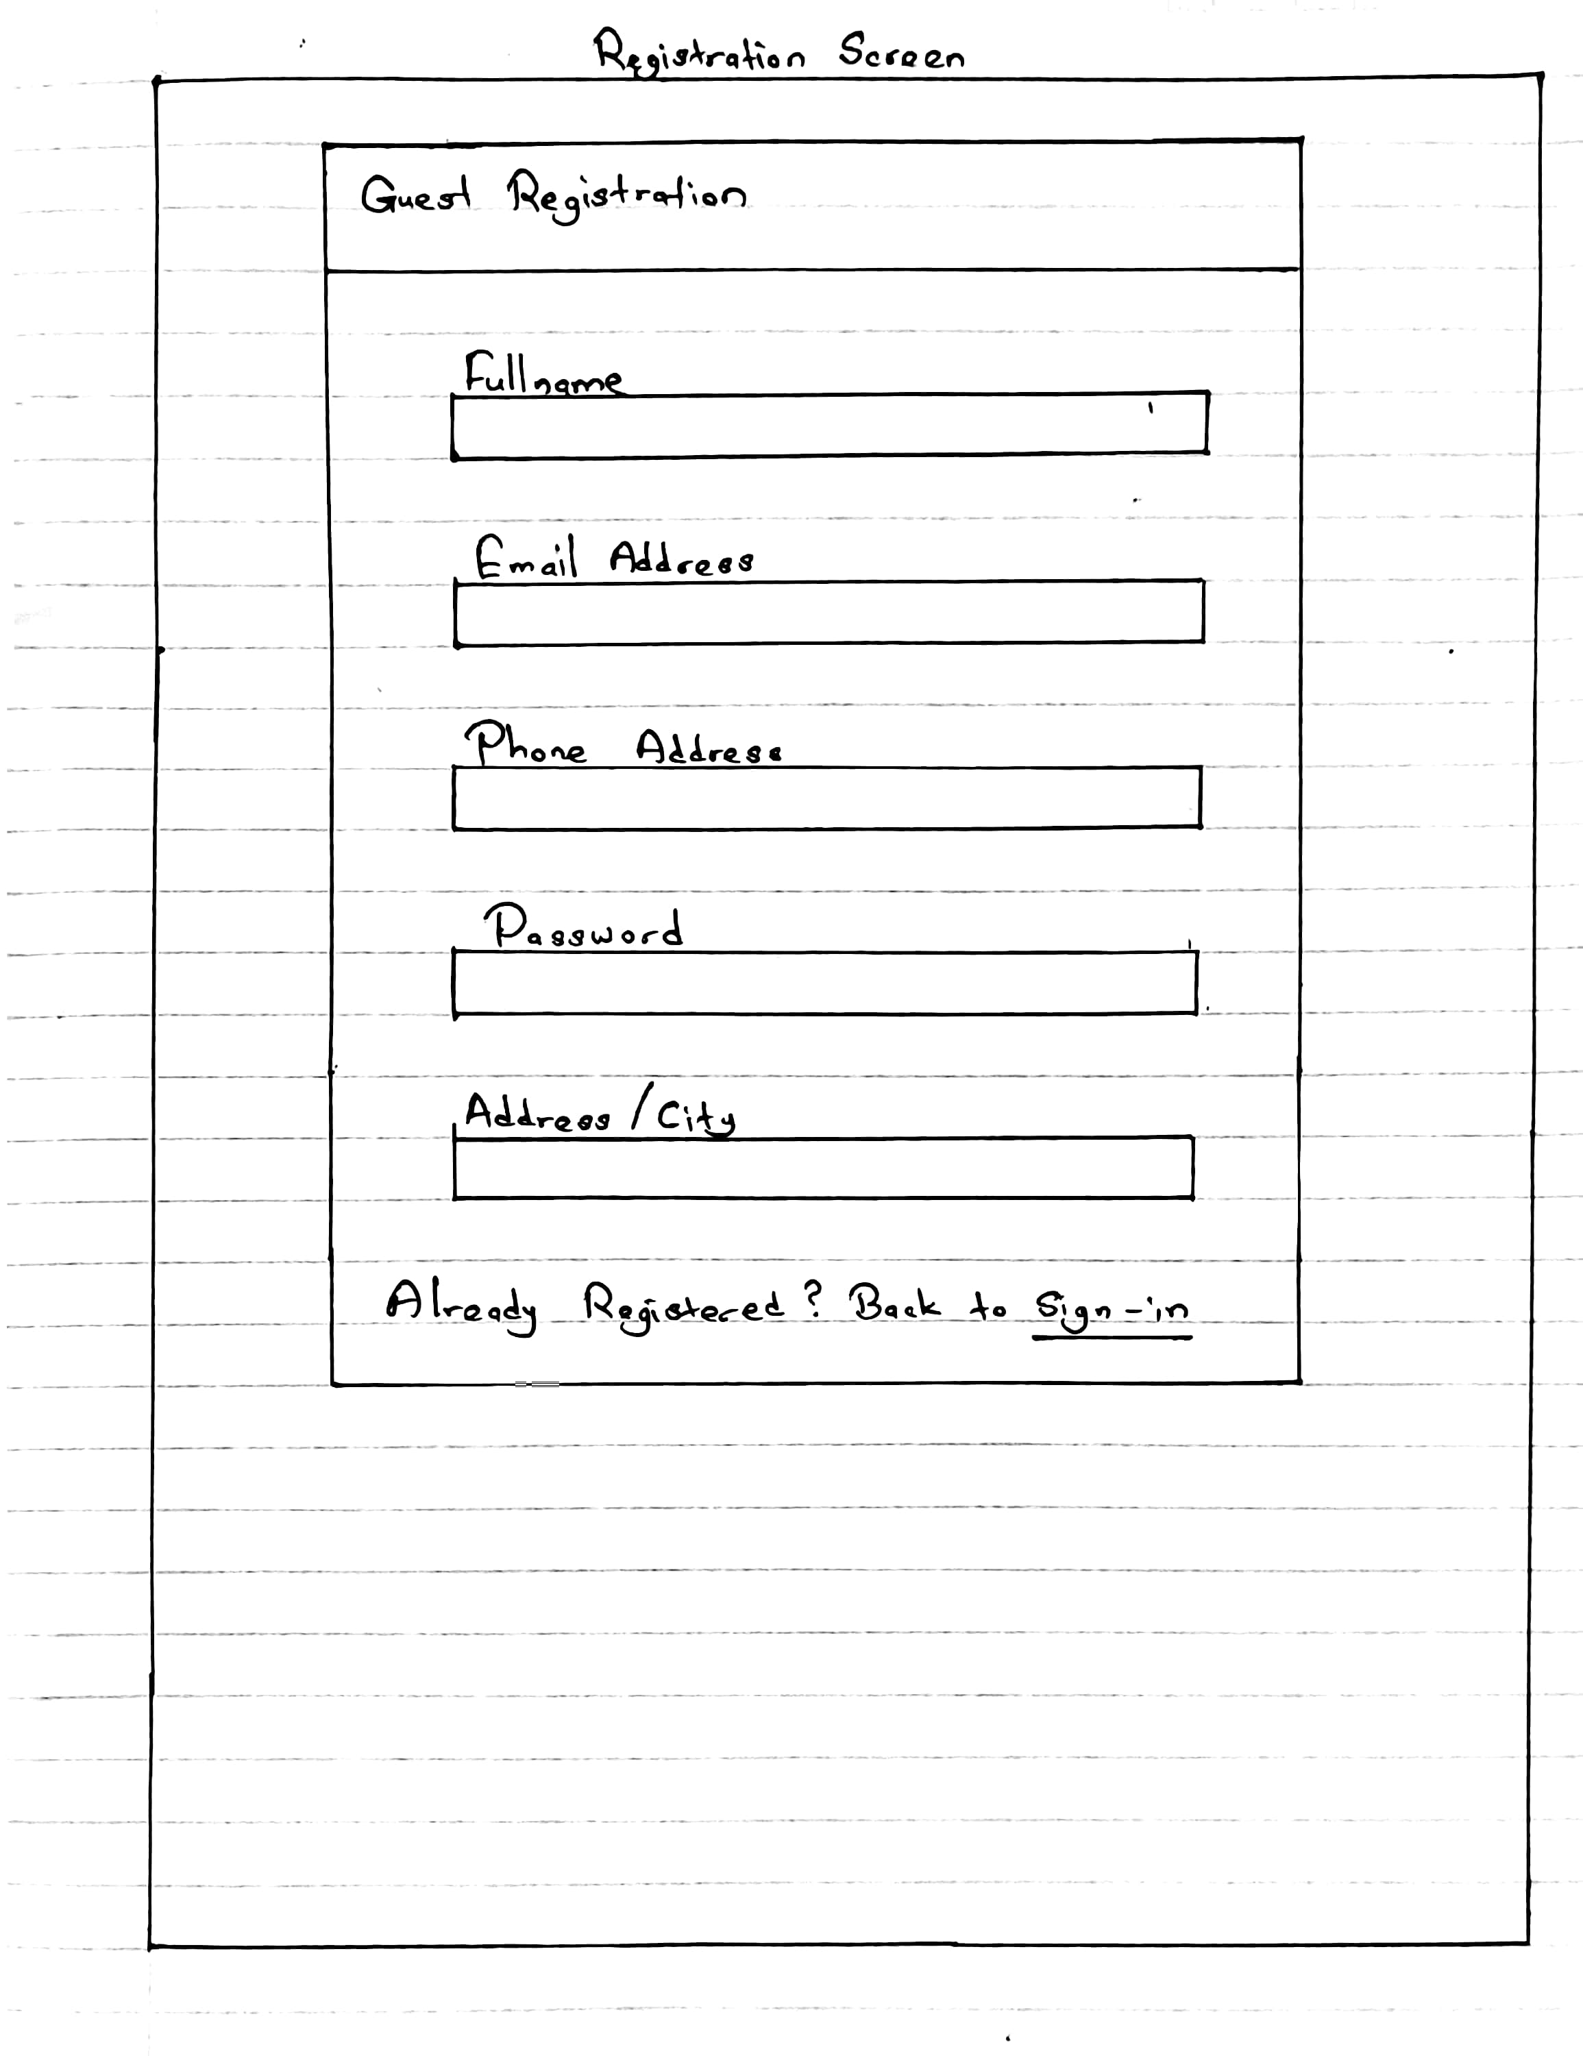
DUTCH POINT NEGOMBO • WEB-BASED HOTEL MANAGEMENT SYSTEM
UI Prototyping: Low-Fidelity Hand-Drawn Wireframes
Architectural Purpose of Wireframing
• Spatial Information Architecture: Mapped layout requirements before writing CSS: Sticky search bar, 3-card inventory grid, 2-column modal layout.
• Usability & Cognitive Load: Consolidated search parameters into a single line (Hick's Law) and prominent action buttons (Fitts's Law).
• Traceability: Directly translated into React components: App.jsx, BookingModal.jsx, and LoginModal.jsx.

Slide 8
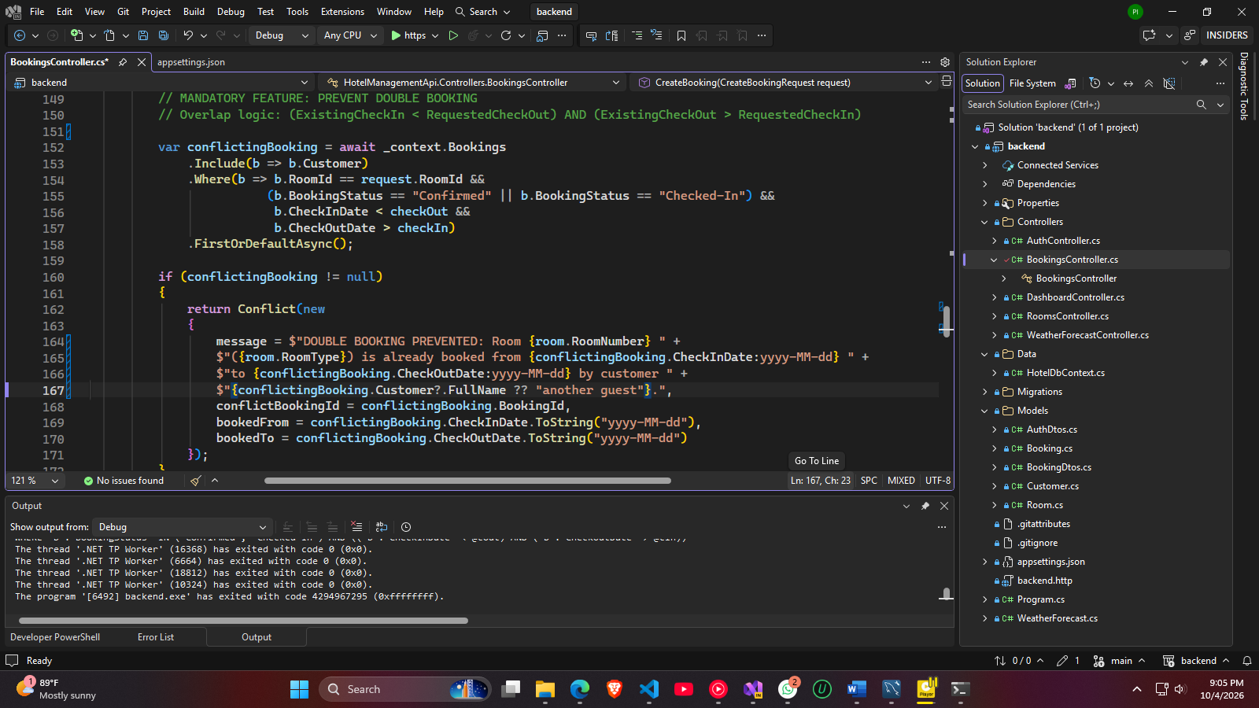
DUTCH POINT NEGOMBO • WEB-BASED HOTEL MANAGEMENT SYSTEM
Core Innovation 1: Double-Booking Prevention Algorithm
Allen's Interval Algebra in C#
• The Overlap Condition: A conflict exists if BOTH conditions evaluate to TRUE:
1. ExistingCheckIn < NewCheckOut
2. ExistingCheckOut > NewCheckIn
• Scenario Example: Room #101 booked Oct 10 to Oct 15. New guest requests Oct 12 to Oct 14:
• Oct 10 < Oct 14 -> TRUE
• Oct 15 > Oct 12 -> TRUE
-> Both TRUE = OVERLAP DETECTED!
• HTTP 409 Conflict Abort: Backend aborts transaction, returns HTTP 409 Conflict with booked date metadata, committing 0 rows to MySQL.
• Same-Day Turnaround Supported: Guest departing Oct 10 morning allows another guest arriving Oct 10 afternoon (Condition 1 evaluates to False -> Approved!).

Slide 9
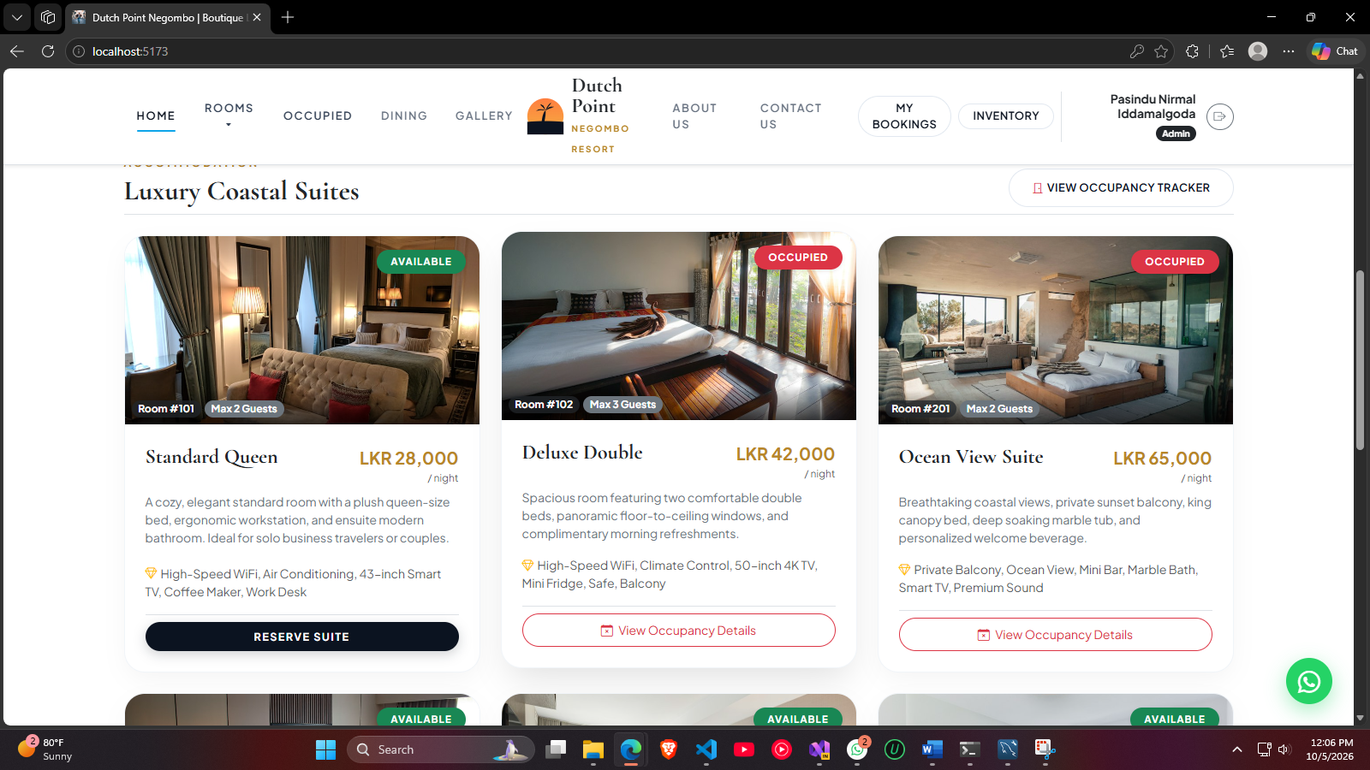
DUTCH POINT NEGOMBO • WEB-BASED HOTEL MANAGEMENT SYSTEM
Live System Interface: Dynamic Room Inventory Catalog
Interface Engineering Highlights
• Boutique Luxury Aesthetic: Italian serif typography (Cormorant Garamond) paired with coastal boutique styling.
• Real-Time Status Badges: Green 'AVAILABLE' pill vs Red 'OCCUPIED' pill dynamically reflect database state.
• Transparent LKR Pricing: Displays exact nightly rate in Sri Lankan Rupees (e.g. Standard Queen: LKR 28,000 / Deluxe: LKR 42,000 / Ocean Suite: LKR 65,000).
• Action Context Triggers: Available rooms trigger 'RESERVE SUITE' modal; occupied rooms trigger 'View Occupancy Details'.
• Capacity Badges: Max guest limits clearly highlighted to prevent overcrowded party bookings.

Slide 10
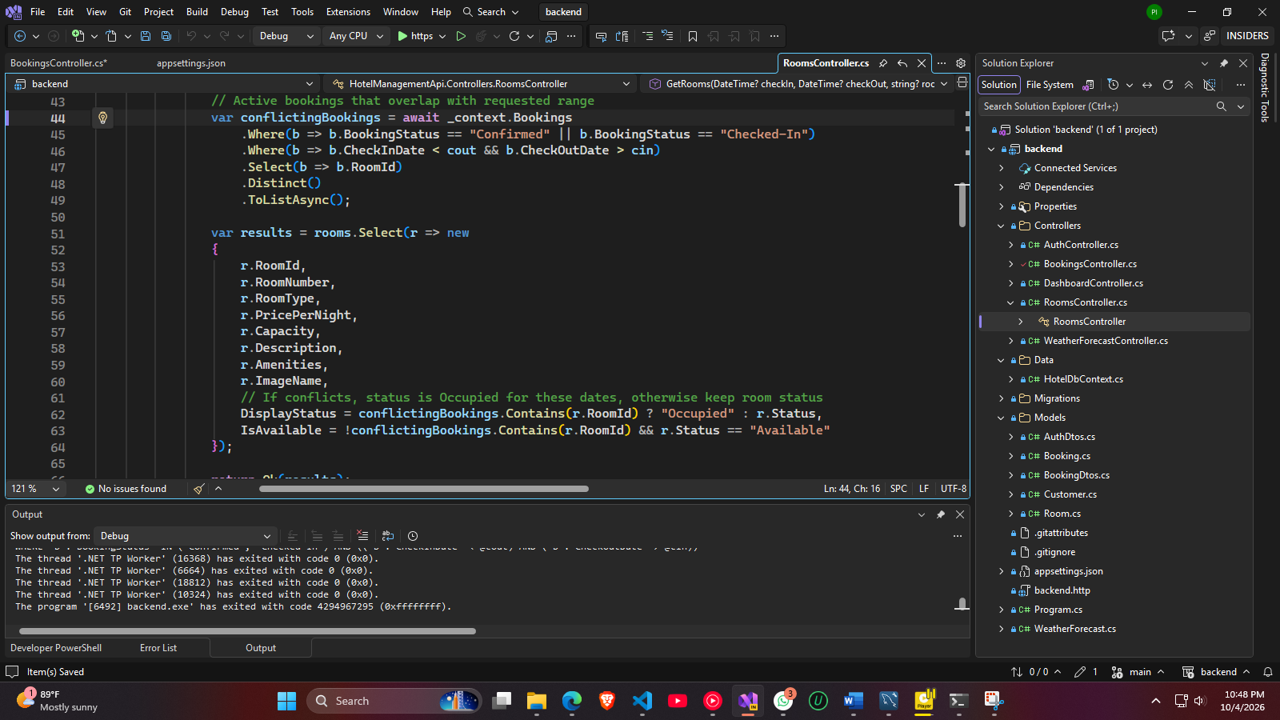
DUTCH POINT NEGOMBO • WEB-BASED HOTEL MANAGEMENT SYSTEM
Core Innovation 2: Dynamic Multi-Variable Availability Search
In-Memory Availability Projection
• The Architecture Flaw Avoided: Never mutate static Room.Status in the database! A room occupied today will be vacant next week. Mutating room rows causes permanent lockouts.
• Dynamic Projection Logic: Backend queries only active bookings overlapping with the requested date window, extracting distinct occupied RoomIds.
• In-Memory Flagging: Rooms NOT in the conflicting list are marked IsAvailable = true on-the-fly.
• Capacity Filter: Filters inventory where Capacity >= GuestCount, ensuring guests only see suitable suites.
• Zero Page Reloads: React Virtual DOM re-renders filtered cards instantly upon clicking 'CHECK RATES'.

Slide 11
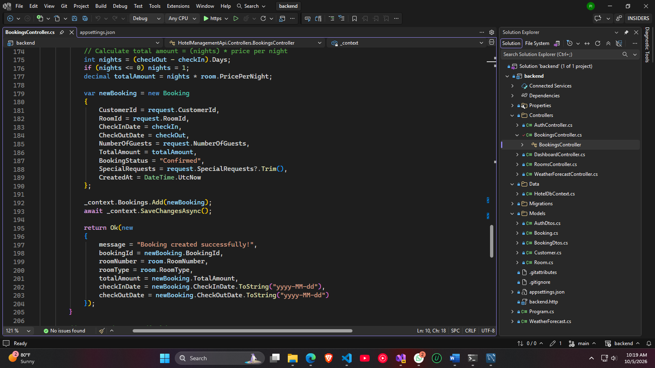
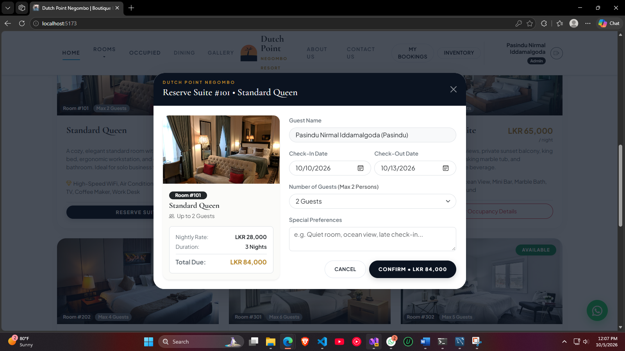
DUTCH POINT NEGOMBO • WEB-BASED HOTEL MANAGEMENT SYSTEM
Core Innovation 3: Deterministic Billing & Reservation Modal
Deterministic Financial Computation in LKR
• Stay Duration Formula: Nights = max(1, (CheckOutDate.Date - CheckInDate.Date).Days). Single day-use stays default to 1 night.
• Total Bill Formula: TotalAmount = Nights * Room.PricePerNight (e.g. 3 Nights * LKR 28,000 = LKR 84,000 total due displayed on button).
• Focus-Locked Modal: Darkened backdrop eliminates distraction and prevents checkout abandonment.

Slide 12
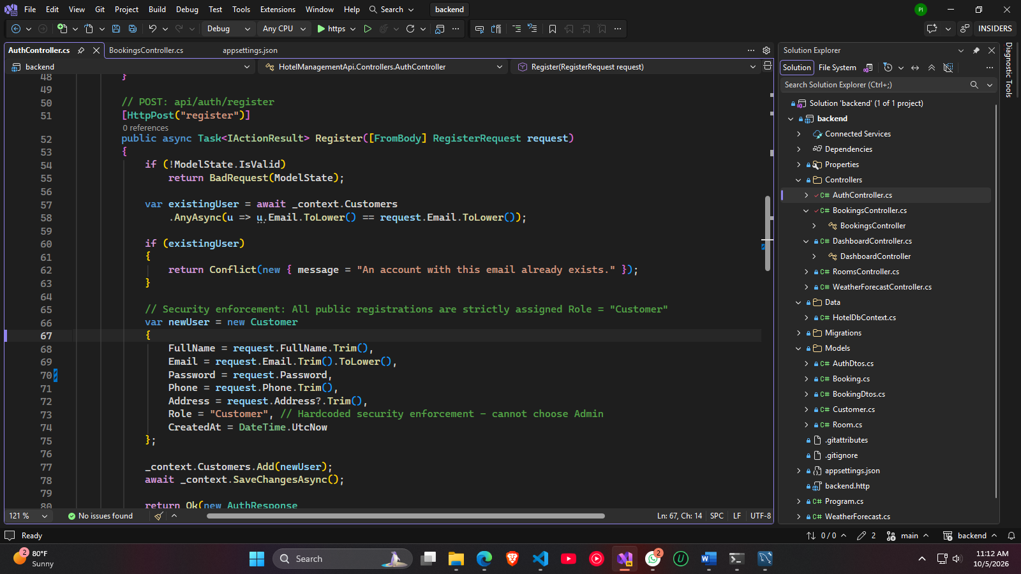
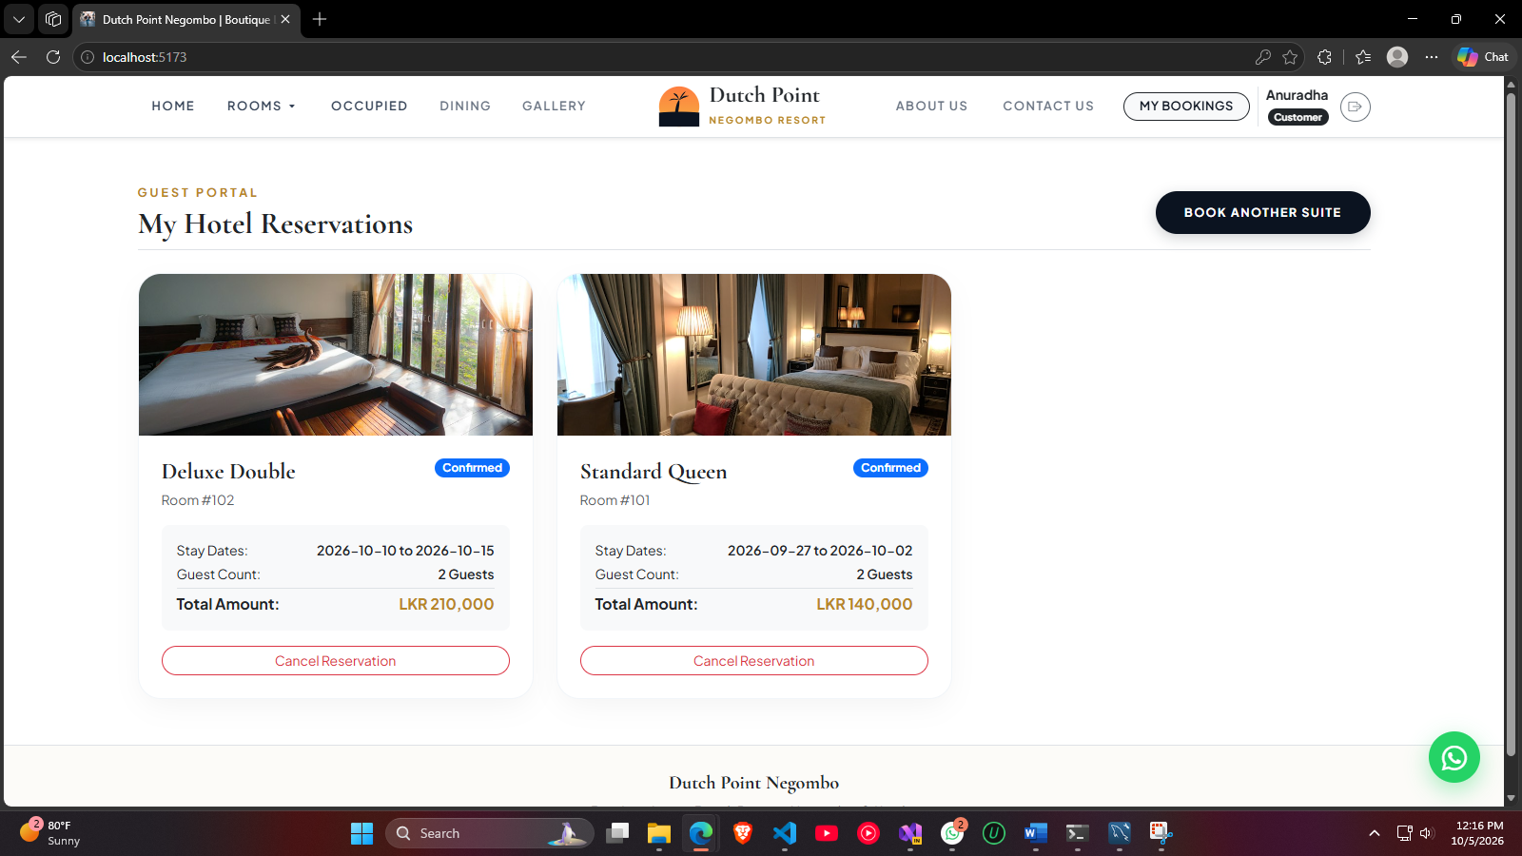
DUTCH POINT NEGOMBO • WEB-BASED HOTEL MANAGEMENT SYSTEM
Core Innovation 4: Role-Based Access Control & Identity Governance
Security Engineering & Data Privacy
• Anti-Privilege Escalation: Public registration strictly hardcodes Role = 'Customer' at the backend. Clients cannot submit 'Admin' roles.
• Pre-Seeded Administrator: Admin account ('Pasindu') is configured directly in the database, granting exclusive access to inventory controls.
• Customer Data Isolation: Queries in 'My Bookings' are partitioned by CustomerId, preventing unauthorized viewing of other guests' records.

Slide 13
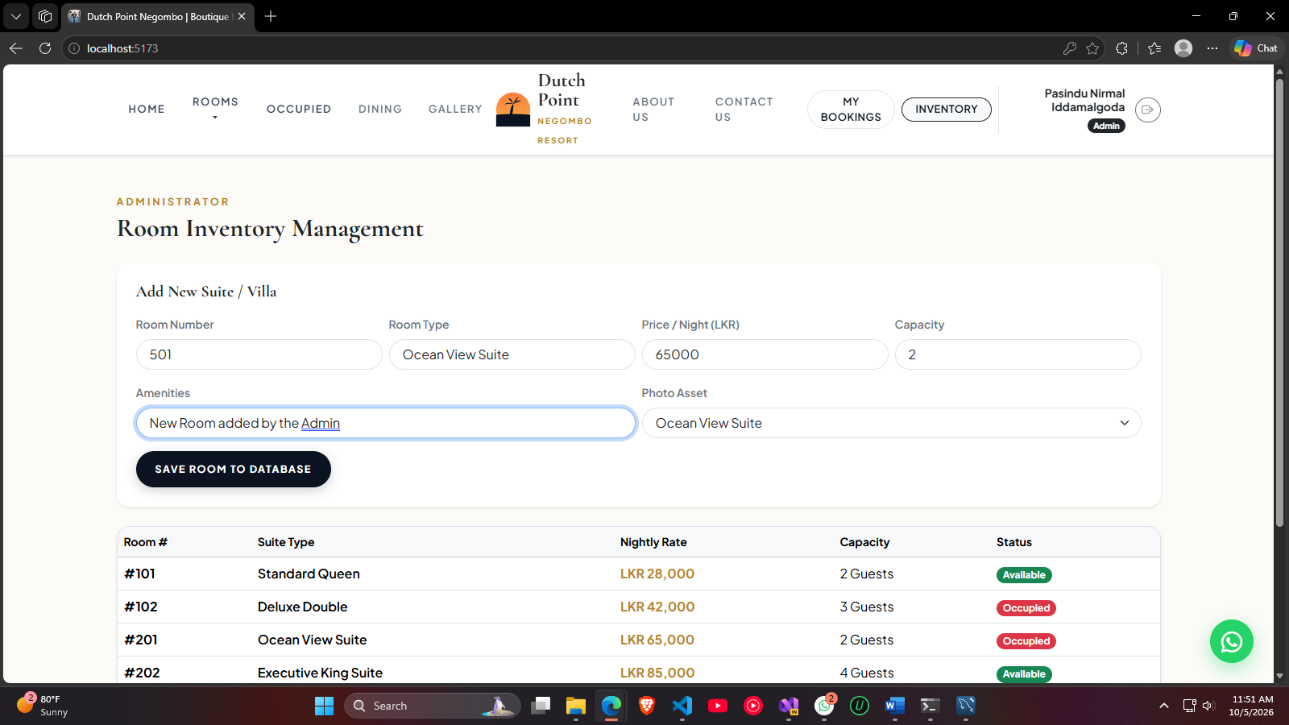
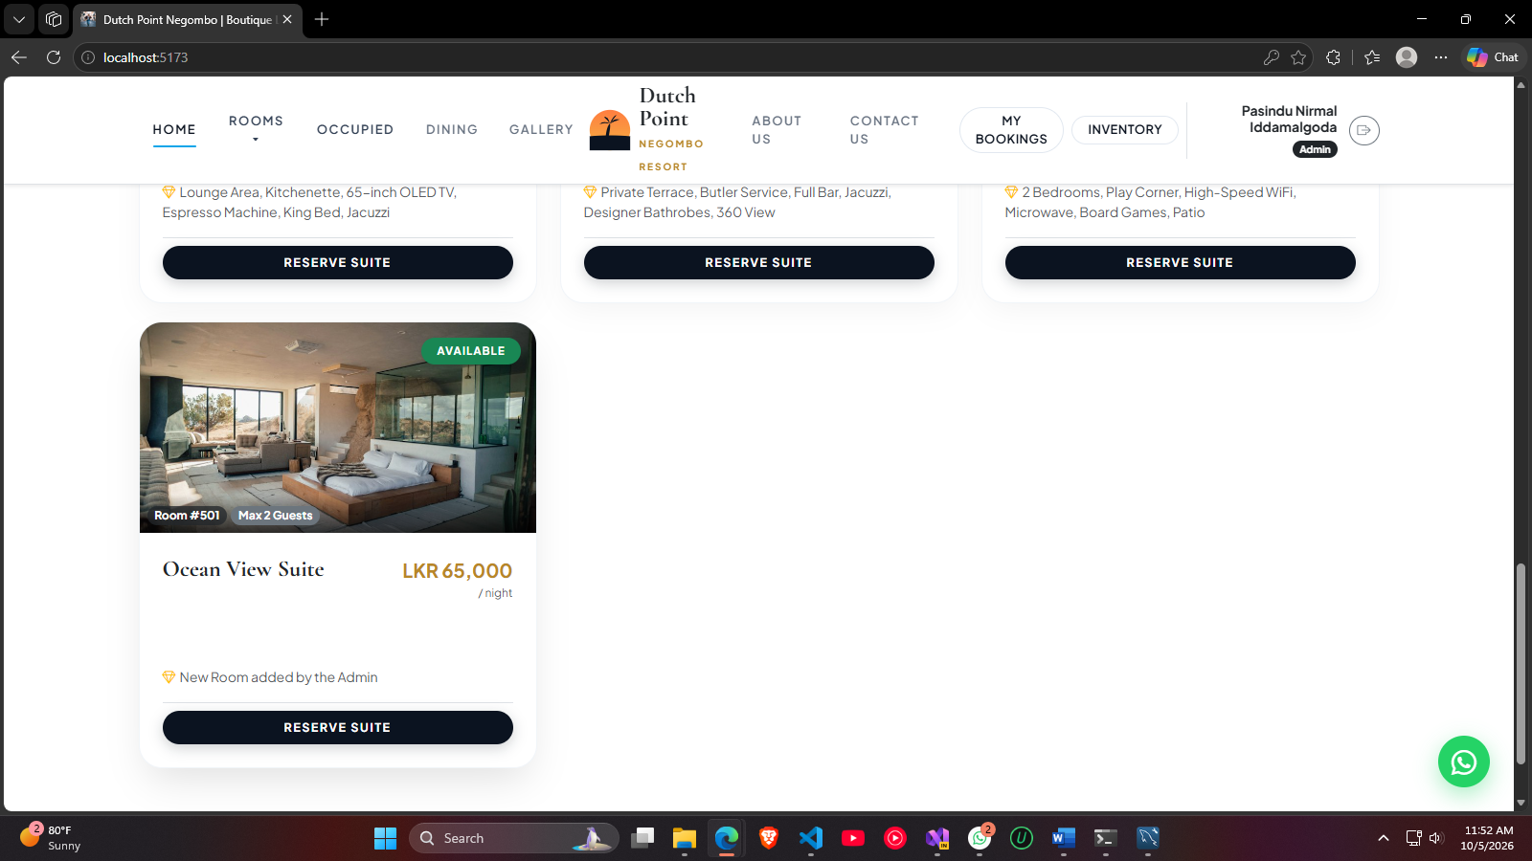
DUTCH POINT NEGOMBO • WEB-BASED HOTEL MANAGEMENT SYSTEM
Core Innovation 5: Admin Dynamic Room Inventory Management
Live Inventory Provisioning Lifecycle
• Dynamic Provisioning: Admin adds new suites (e.g. Room #501 Ocean View Suite @ LKR 65,000/night) directly through the browser.
• Duplicate Number Guard: Backend verifies AnyAsync(r => r.RoomNumber == room.RoomNumber) to prevent duplicate room door numbers.
• Instant Reactive Re-Index: React calls loadRooms() upon successful creation, immediately publishing the suite to the public guest catalog.

Slide 14
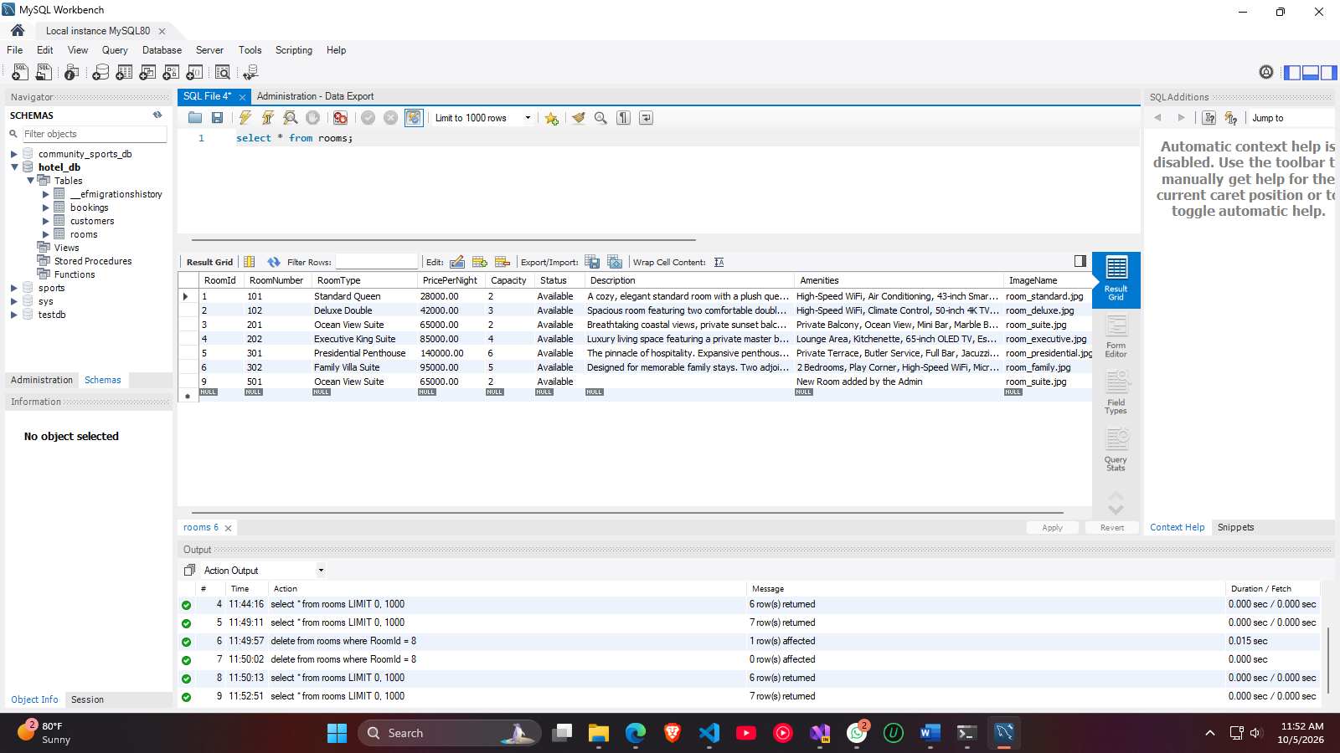
DUTCH POINT NEGOMBO • WEB-BASED HOTEL MANAGEMENT SYSTEM
Database Persistence Verification in MySQL 8.0 Workbench
Empirical Data Verification
• Live Persistence Proof: Verified execution of 'SELECT * FROM rooms;' in MySQL Workbench confirms live insertion of Suite #501.
• Schema Attributes Verified: RoomId, RoomNumber, RoomType, PricePerNight (DECIMAL 10,2), Capacity, Status ('Available'), Amenities, ImageName.
• Relational Constraints: Foreign key cascades link bookings to specific room and customer records.
• Transactional Logging: MySQL InnoDB binary logs confirm zero dirty reads and strict transaction isolation.

Slide 15
DUTCH POINT NEGOMBO • WEB-BASED HOTEL MANAGEMENT SYSTEM
System Validation: Formal Test Execution Matrix (100% PASS)
Chapter 05 Empirical Test Results
• TC-01: Admin Authentication: Login as 'Pasindu' / 'Pasindu@123' -> Issues Admin role claim, unlocks Inventory tab -> [PASS]
• TC-02: Public Guest Signup: Register guest 'Anuradha' (+94771234567) -> Enforces Role = 'Customer' without admin option -> [PASS]
• TC-03: Real-Time Availability: Search dates 2026-10-10 to 10-15, Guests: 3 -> Filters rooms where Capacity >= 3, shows AVAILABLE -> [PASS]
• TC-04: Double-Booking Overlap: Attempt booking Room #101 on taken dates -> Rejects with HTTP 409 Conflict, commits 0 rows -> [PASS]
• TC-05: Dynamic LKR Price Math: Select Suite #102 (LKR 42,000) for 4 nights -> Modal calculates 4 * 42,000 = LKR 168,000 total -> [PASS]
• TC-06: Booking Cancellation: Click 'Cancel Reservation' in My Bookings -> Deletes booking from MySQL, suite returns to AVAILABLE -> [PASS]
• TC-07: Live Occupancy Tracker: Select date 2026-10-12 in Occupancy Tracker -> Displays Room #102 occupied by John Doe (+1 555-0199) -> [PASS]
• TC-08: Headcount Limit Guard: Attempt booking Suite #101 (Max 2) with 4 guests -> Rejects submission with HTTP 400 Bad Request error -> [PASS]

Slide 16
DUTCH POINT NEGOMBO • WEB-BASED HOTEL MANAGEMENT SYSTEM
Technical Reflection: Engineering Challenges & Resolutions
ASP.NET Core & C# Learning Curve
• Async Pipeline (async/await): Initial blocking .Result calls caused Kestrel thread pool starvation. Resolved by migrating completely to non-blocking async streaming (.ToListAsync(), .CountAsync()).
• Circular JSON Loops in EF Core: Two-way navigational properties between Customer and Booking crashed the JSON serializer. Resolved by implementing flat Data Transfer Objects (DTOs).
• Dependency Injection Scoping: Early confusion between Scoped and Transient DbContext caused concurrency errors. Resolved by properly configuring Scoped lifetimes in Program.cs.
• MySQL ORM Driver Selection: Resolved package version mismatches by utilizing official Oracle MySql.EntityFrameworkCore (v10.0.9) configured cleanly without Pomelo conflicts.
API Integration & Testing Bottlenecks
• DateTime Timezone Drift: React ISO strings with Sri Lankan UTC+5:30 offset shifted dates by -1 day in MySQL. Resolved by enforcing strict DateTime.UtcNow.Date normalization at API entry.
• CORS Pre-Flight Blocks: Browser blocked cross-origin requests between Vite (port 5173) and ASP.NET Core (port 5000). Resolved by registering app.UseCors('AllowAll') in middleware.
• REST Semantic Error Mapping: Replaced generic 200 OK error payloads with strict HTTP status codes (HTTP 409 Conflict, HTTP 400 Bad Request, HTTP 404 Not Found).
• Automated Postman Testing: Validated API endpoints independently using Swagger UI and Postman before building React UI components.

Slide 17
DUTCH POINT NEGOMBO • WEB-BASED HOTEL MANAGEMENT SYSTEM
Phase 2 Production Roadmap: Post-Interim Enhancements
1. Cryptographic Password Hashing
• Salted BCrypt.Net: Replace demo credentials with BCrypt (work factor 12) or Argon2id salted hashing, compliant with Sri Lanka PDPA No. 9 of 2022.
• JWT Token Rotation: Sign authentication tokens with HMAC-SHA256, stored in HttpOnly, SameSite=Strict cookies.
2. Two-Factor Authentication (2FA)
• TOTP (RFC 6238): Require administrators to verify 6-digit ephemeral tokens via Google Authenticator before unlocking inventory controls.
• SMS / Email OTP: Twilio SMS integration to verify guest phone numbers (+94) for high-value suite reservations.
3. Executive Analytics Dashboard
• Visual Telemetry: Interactive charts (Chart.js / Recharts) tracking Monthly Revenue in LKR, ADR, and RevPAR.
• 30-Day Gantt Schedule: Visual horizontal timeline for front-desk room allocation and housekeeping management.
4. Live Payment Gateway Integration
• IPG / PayHere / Stripe: Direct credit/debit card processing in Sri Lankan Rupees (LKR) with temporary 15-minute booking hold.
• Automated Invoicing: Instant PDF folio receipts emailed automatically to guests upon payment confirmation.

Slide 18
Interim Milestone Summary & Handover to Live Demo
All Interim Objectives Successfully Delivered:
• Zero Double-Booking Guarantee: Proven transactional interval overlap engine rejecting conflicting dates with HTTP 409 Conflict.
• Decoupled 3-Tier Enterprise Viability: High-performance React 19 SPA communicating with ASP.NET Core 10 Web API and MySQL 8.0.
• Transparent Domestic LKR Pricing: Exact multi-night bill derivation in Sri Lankan Rupees with zero floating-point rounding errors.
• Verified 55% Prototype: All 8 formal empirical test cases passed with 100% data integrity verified in MySQL Workbench.
Ready to proceed with Live Software Demonstration & Examiner Q&A.

