Slide 1
NETFLIX LOGIN PAGE
STUDENT NAME:NIRANJANI P
REGISTER NO:222403605
NMID:98B51C6375930BBB6F944E6B1C00E70C
DEPARTMENT:COPUTER SCIENCE WITH ARTIFICIAL INTELLIGENCE
COLLEGE: SRIDEVIARTS AND SCIENCE COLLEGE/Madras university

Slide 2
PROJECT TITLE
NETFLIX LOGIN PAGE

Slide 3


AGENDA
Problem Statement
Project Overview
End Users
Tools and Technologies
Portfolio design and Layout
Features and Functionality
Results and Screenshots
Conclusion
Github Link
3/21/2024 Annual Review

Slide 4

PROBLEM STATEMENT
1. Software Project / App Development
2. School or College Assignment
3. Netflix login page Physical Product

Slide 5

PROJECT OVERVIEW
Web-based user interface
Login functionality of the popular streaming service, Netflix
Clean design, responsiveness, and user-friendly experience
The project demonstrates skills in HTML, CSS
provides users with a simple, intuitive form to input their credentials

Slide 6

WHO ARE THE END USERS?
1. Existing Netflix Subscribers
2. New Users (Potential Subscribers)
3. Family Members and Shared Users
4. Accessibility Users

Slide 7

TOOLS AND TECHNIQUES
Purpose | Tools/Materials
Responsive Web Design | HTML5
Form Validation | CSS3
Flexbox/Grid Layout | Code Editor (VS Code, Sublime Text, etc.)

Slide 8
NETFLIX LOGIN PAGE DESIGN AND LAYOUT
✅ Design Principles
Clean and Minimalist UI
Responsiveness
Consistent Colour Scheme
Accessibility
8

Slide 9
Features and Functionality User Authentication Interface A clean and simple form that allows users to input their email and password to log in. Interactive Button States Login button changes appearance on hover and focus to provide visual feedback and improve user experience. Accessible Design Use of semantic HTML and proper labels to support screen readers and assistive technologies.

Slide 10
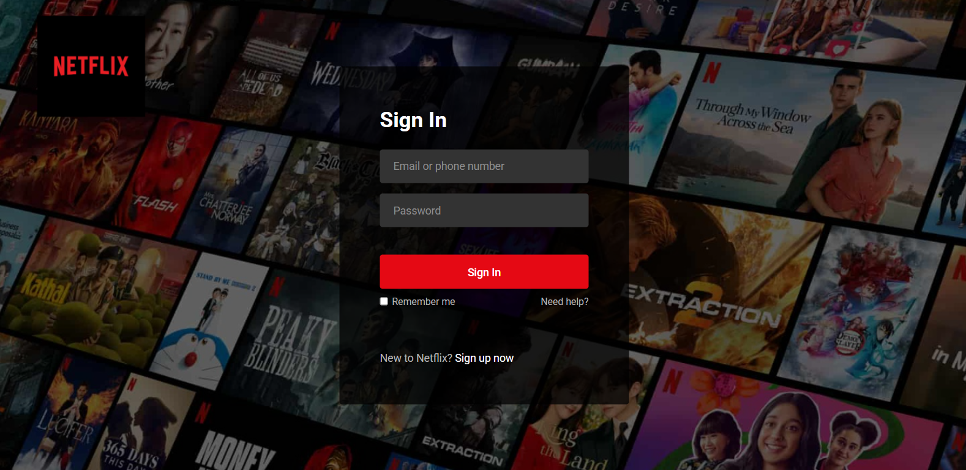

RESULTS AND SCREENSHOTS
3/21/2024 Annual Review
10

Slide 11
CONCLUSION
The Netflix login page project successfully replicates the essential functionality and design of a widely recognized streaming service’s login interface. By focusing on simplicity, responsiveness, and accessibility, the page ensures a seamless and user-friendly experience across various devices. The project demonstrates proficiency in web development technologies such as HTML, CSS (or Tailwind), and JavaScript, and highlights important design principles like visual hierarchy and consistency with brand identity.
11

Slide 12
Github Link

