Slide 1

HU-22.8.1 DevOps Batch Product Expo
AWS Lambda, Serverless and Terraform

Slide 2

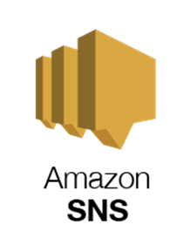
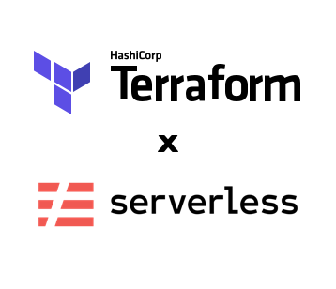
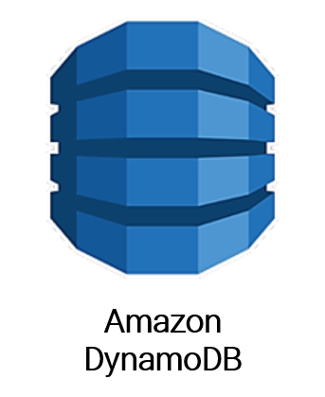
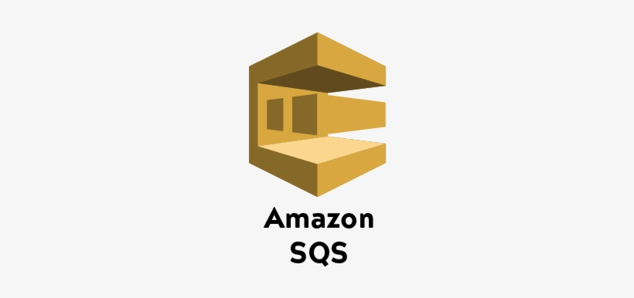

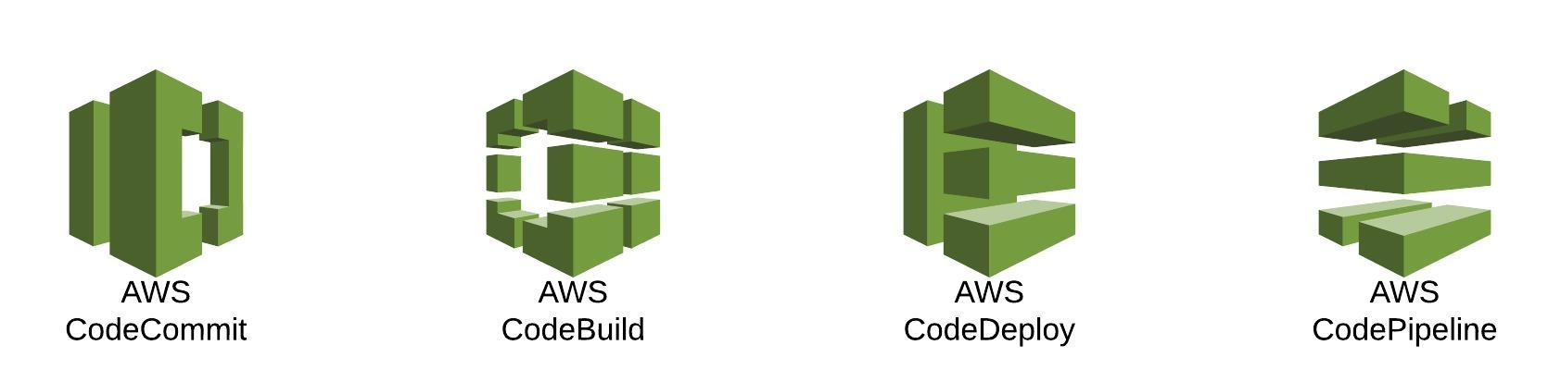
Member
Mentors:
Nirosha Pothagani
Manjunath P R
Shrey Dheshpandey

Slide 3
Agenda
Objectives
Understanding Serverless&Automation
General Problem Statement
Our Solution
Tools Used
Solution Architecture
Live demo
Final OutComes
References
Q&A

Slide 4
Objectives
Remove Manual Build and Deploy Process
Integrate security(IAM) into our AWS Code pipeline
Implement efficient, continuous, automated and secure development and deployment process
Serverless Deployment
Automating Decouple serverless architecture for asynchronous workloads using Terraform.

Slide 5
What is Serverless ?
A serverless architecture is a way to build and run applications and services without having to manage infrastructure. Our application still runs on servers, but all the server management is done by AWS.
A serverless application is a combination of Lambda functions, event sources, and other resources that work together to perform tasks.
For a server to be serverless it needs to be have 4 properties:
1. No Servers to manage either physical or virtual
2. Scale automatically, no need to configure any auto scaling groups
3. Only pay what we use
4. Highly available & High tolerance
There are many serverless services in aws
Eg: DynamoDB, API Gateway, SNS, SQS, Eventbridge, and the most popular one is AWS Lambda
AWS Lambda is a serverless compute service for running code without having to provision or manage servers

Slide 6
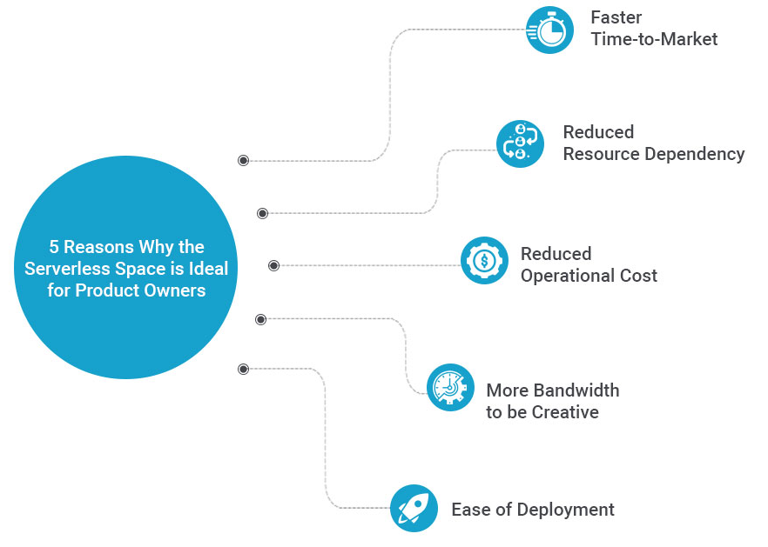
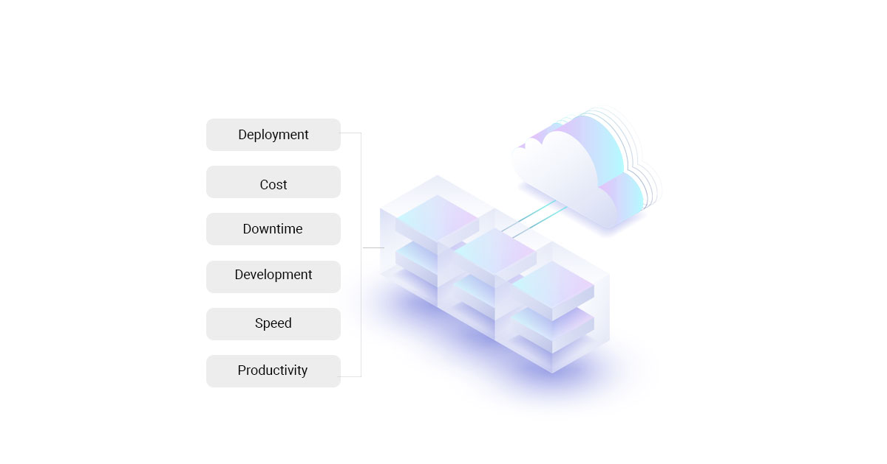
Why Serverless architecture?

Slide 7
Problem Statement
When Teams upgrade the backend architecture, there is cases where the system went down and customer orders were lost and leading to significant revenue loss for the company.
Everytime a developer commits their code to the repository, they have to manually trigger a single EC2 instance-based Jenkins pipeline to build and test the code.
Often, the Jenkins server slows down and stops responding, resulting in a lot of time wastage. This approach is a time-consuming task for the developers.
They would just like to focus on pushing their application code to the Git repository, and the rest should be taken care of automatically by a more stable pipeline.
Building an architecture by provisiong and managing the servers with high-availablity, scalability is time consuming and cost-effective.

Slide 8
Solutions
Create an automated pipeline using AWS services which will allow automating the entire process.
Developing a decoupled serverless architecture framework for complex work that allows components to remain completely autonomous and unaware of each other
To decouple serverless microservices using high available and fully managed services on AWS.
Making the architecture, that it is really cost-effective, at the same time it’s resilient and allows us to make solid decoupled services.
Using cloud services like AWS Lambda, Amazon SQS, and Amazon DynamoDB to implement serverless architectural patterns that reduce the operational complexity of running and managing applications.

Slide 9
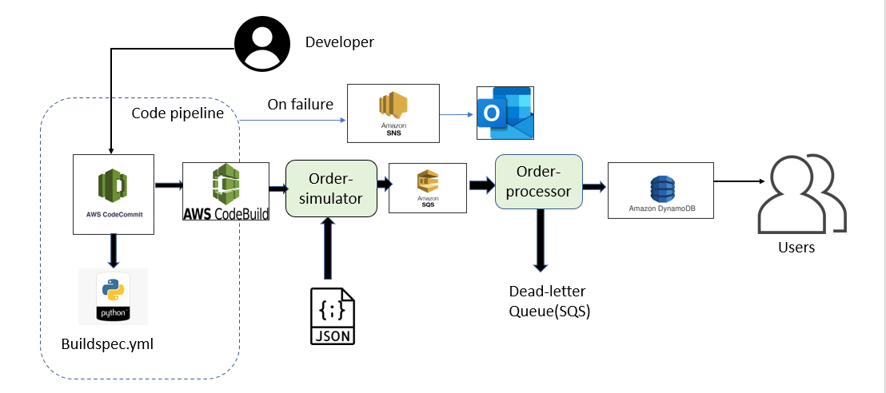
Architecture Diagram

Slide 10
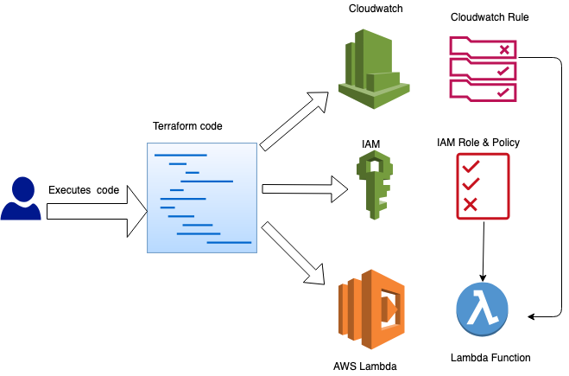
Automating Serverless architecture

Slide 11
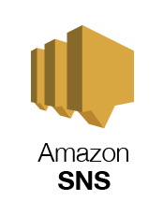

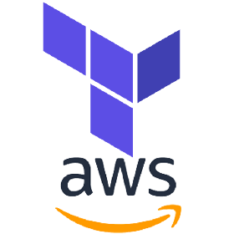
Tech stack
AWS codecommit : Store the code in the code commit repository
AWS code build: Build logic to put the code to the 2 lambda functions.
Lambda functions: To have the code provided by us through code pipeline
Lambda functions : To connect to other AWS services(SQS, DynamoDB) to serve the requests with data and other information.
DynamoDb Create the DB with Table information - Table name order, Primary key id(number).
SQS To create an SQS standard queue to store and process the customer orders.
SNS: Simple Notification Service
Terraform
Terraform AWS modules can help automate and provision
Serverless application resources much more efficiently.

Slide 12
Walkthrough Of Product
The SQS queue receives messages from Lambda and store to the DynamoDB database through lambda function.
The Lambda Consumer which is DynamoDB reads as many messages as possible from the SQS
The CloudWatch Event Rule triggers the Lambda Consumer based on a schedule (e.g. every minute).
The Lambda Consumer reads as many messages as possible from the SQS and executes a Lambda Worker for each message.
Doing so allows you to build a serverless microservice consuming tasks from a queue, e.g.: sending out massive amounts of emails, transcoding video files after upload, or analyzing user behavior.
Deploying AWS Lambda with Terraform

Slide 13
LIVE DEMO

Slide 14
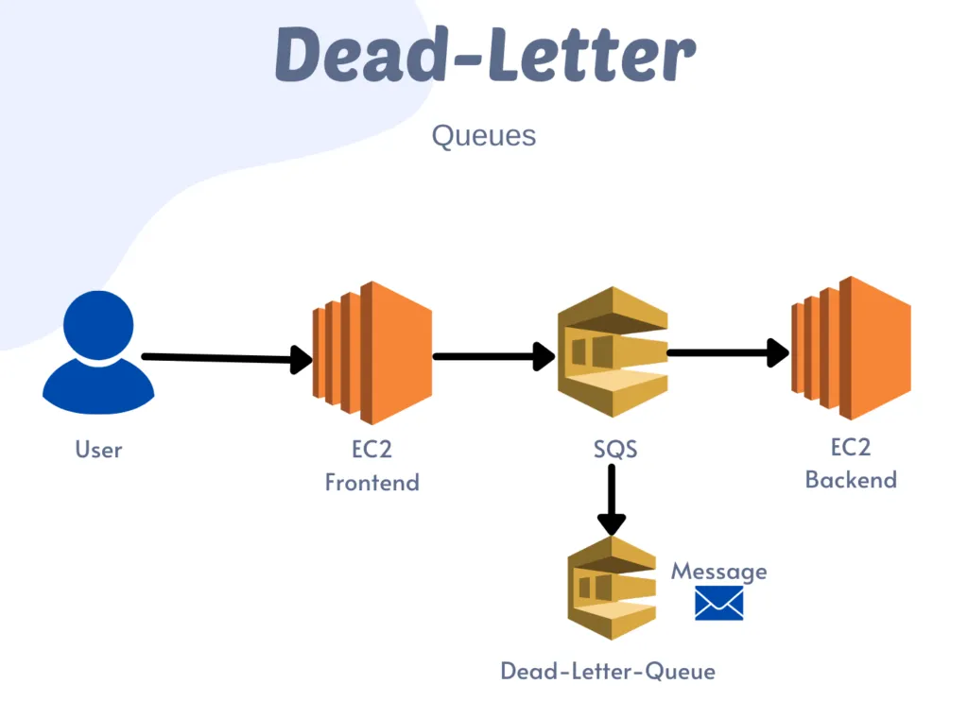
Usecases
Use case 1:
Leverage an SQS standard queue to send, store, and receive order messages and then configure the SQS Event Source to trigger the Lambda function which in turn processes the orders into a DynamoDB table.

Slide 15
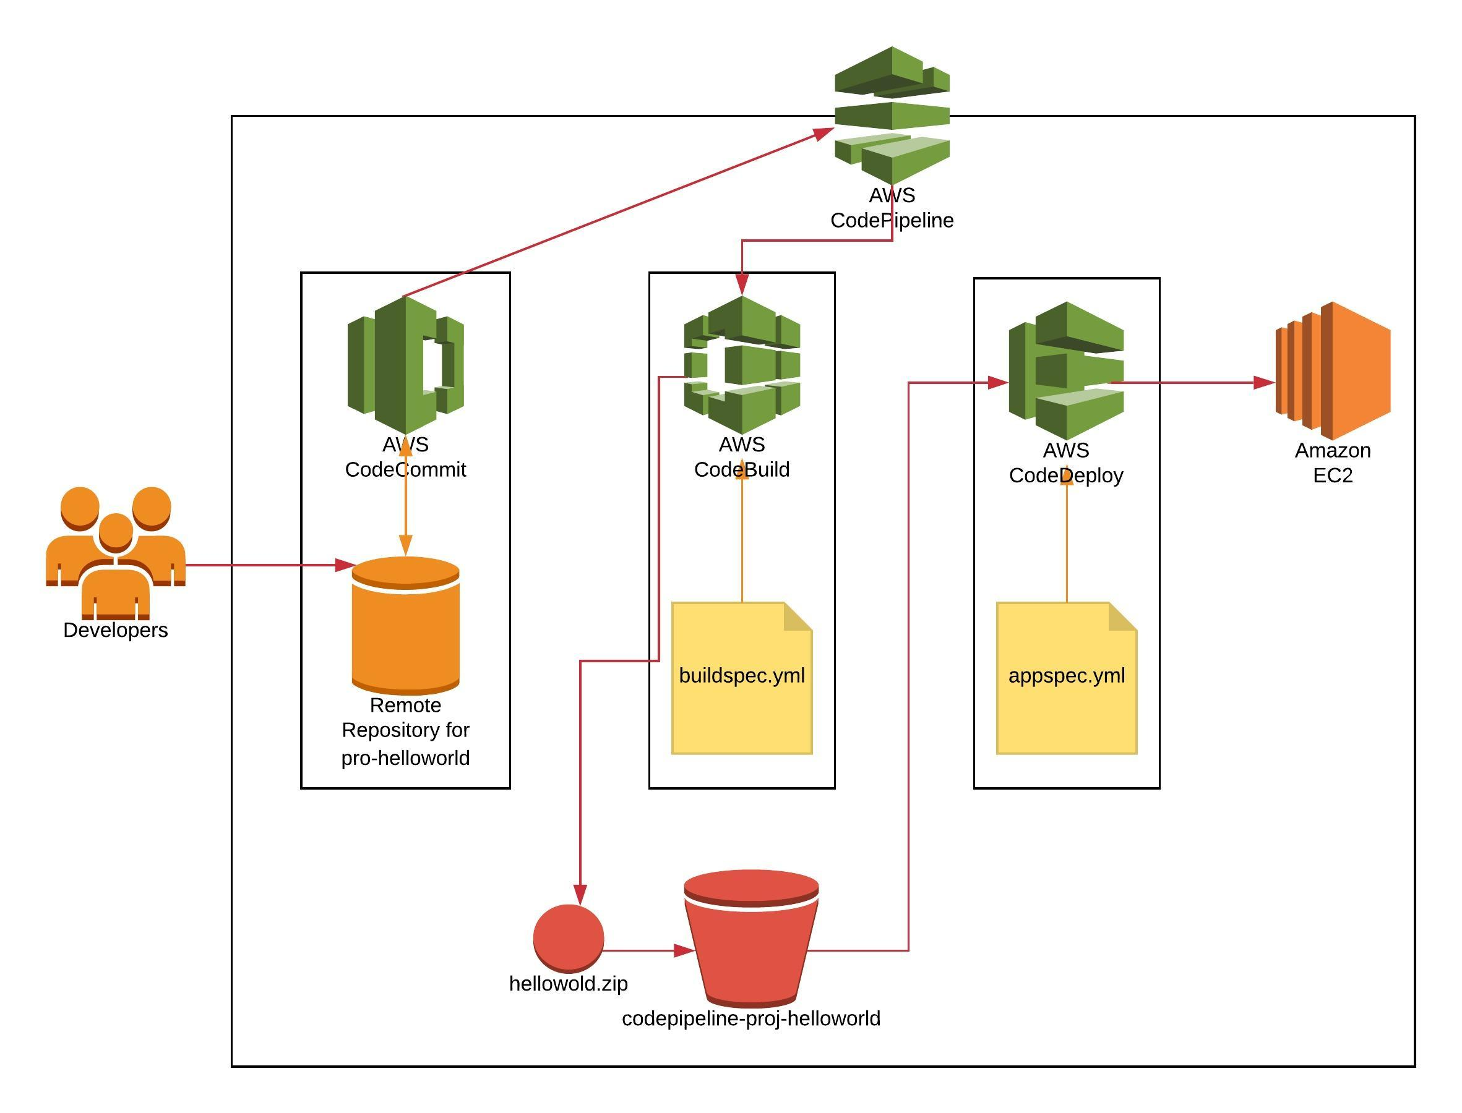
Usecases
Use case 2:
They would just like to focus on pushing their application code to the Git repository, and the rest should be taken care of automatically by a more stable pipeline.
Creating an automated pipeline using AWS services that can achieve this. In addition, developers should be notified via email if their build fails.

Slide 16
Final outcomes
Efficient, continuous, automated and secure development and deployment process
Scalable and highly available computing capacity of an application.
Automated deployments allowing to create a continuous delivery pipeline.
A fully managed and maintenance-free service

Slide 17
References
https://www.proud2becloud.com/decoupling-services-using-sqs-as-lambda-trigger/
https://www.linkedin.com/pulse/aws-lambda-sqs-building-blocks-decoupled-modern-susanta-praharaj/
https://cloudonaut.io/integrate-sqs-and-lambda-serverless-architecture-for-asynchronous-workloads/
https://www.serverlessguru.com/blog/terraform-create-and-deploy-aws-lambda
https://blog.devgenius.io/pushing-messages-from-amazon-sqs-to-dynamodb-bf1c1fa5c2c3

Slide 18
Q&A

Slide 19
For more Info:
https://hashedin.com/hashedin-university/
THANK YOU
INDIA
#459, 17th Cross, HSR Layout, Bangalore, KA, 560102

