Slide 1
KALASALINGAM ACADEMY OF RESEARCH AND EDUCATION
Department of Computer Science & Engineering • Artificial Intelligence & Machine Learning
FinFlow
Personal Finance & Wealth Architecture Platform
A full-stack, enterprise-grade personal financial management system delivering real-time net worth tracking, envelope budgeting, and algorithmic cash velocity analytics.
🌐 Live Production Platform: https://fineflow-finance.onrender.com/

Slide 2
02/11 • PROJECT MOTIVATION
02 / 11
Problem Statement & Project Objectives
THE CHALLENGES (CURRENT REALITY)
PROJECT OBJECTIVES & SOLUTION
• Fragmented Accounts: Checking, savings, credit cards, and cash pools are spread across different portals with no single unified view.
• Manual Ledger Overhead: Manual spreadsheet tracking leads to calculation errors, missing entries, and lack of historical consistency.
• Surprise Budget Overruns: Traditional budgeting alerts users only AFTER overspending occurs rather than providing real-time proactive threshold warnings.
• Lack of Cash Velocity Insights: Standard banking apps show static account balances without revealing burn rates, net cash flow velocity, or savings rate percentages.
✔ Unified Asset & Liability Ledger: Aggregate liquid checking accounts, high-yield vaults, and credit card liabilities to compute live net worth instantaneously.
✔ Proactive Envelope Budgeting: Establish category-specific spending caps with automated color-coded alerts at 80% and 100% threshold proximity.
✔ Algorithmic Financial Mathematics: Automate mathematical computations for savings rate (%), net cash velocity, and expense category distributions without manual formulas.
✔ Zero-Trust Multi-Tenant Isolation: Enforce strict tenant data boundaries where every single database query is cryptographically scoped to the authenticated user ID.

Slide 3
03/11 • IMPLEMENTATION
03 / 11
Technology Stack & Architecture Tools
FRONTEND CLIENT
BACKEND SERVER
DATABASE & DEVOPS
• React 18
Declarative component-driven UI architecture
• Vite Bundler
Lightning-fast HMR and optimized asset compilation
• Tailwind CSS v3
Utility-first luxury theme token system
• Recharts
Interactive SVG cash velocity & donut charts
• React Router v7
Client-side SPA navigation & ProtectedRoute guards
• Axios Client
Custom HTTP client with 60s timeout & JWT interceptor
• Node.js Runtime
Non-blocking event-driven asynchronous backend
• Express.js
RESTful routing pipeline & security middleware
• JWT Auth
Stateless cryptographically signed tokens (7d expire)
• Bcrypt.js
Salted cryptographic password hashing (10 rounds)
• Helmet Security
Defense-in-depth HTTP security header protection
• Express Rate Limit
Brute-force protection on authentication endpoints
• MongoDB Atlas
Scalable cloud NoSQL replica-set cluster
• Mongoose ODM
Strict schema definition, virtuals & validation
• Render Cloud
Automated continuous delivery cloud hosting
• Git & GitHub
Distributed version control with automated CI/CD
• Node Test Runner
Native unit testing suite without external mocks
• Vercel Multi-Service
Zero-CORS unified domain routing architecture

Slide 4
04/11 • SYSTEM DESIGN
04 / 11
End-to-End System Architecture & Data Flow
1. User Action
2. API Request
3. Security Guard
4. Business Engine
5. Persistent Storage
Browser / React 18 UI
User submits transaction or opens financial portfolio in responsive client.
Axios Interceptor
Attaches Bearer JWT token from localStorage; dispatches request to /api.
Express Middleware
Helmet, CORS, Rate Limiter & JWT verification authenticate identity.
Controllers & Services
Validates payload, executes financial math, and scopes query to userId.
MongoDB Atlas Cloud
Mongoose updates user documents & reconciles live account balances.
ARCHITECTURAL HIGHLIGHTS & DESIGN PRINCIPLES
✔ Decoupled Tier Architecture: Frontend SPA and backend REST API communicate strictly over standard JSON protocols.
✔ Stateless Scalability: JWT authentication allows horizontal server scaling without session memory bottleneck.
✔ Pure Function Service Isolation: Financial calculations (savings rate, net worth, outflow breakdown) are isolated in pure functions for zero-side-effect automated testing.
✔ Serverless & Container Dual Compatibility: Database connection caching handles warm serverless invocations as well as long-running Docker/Render containers.

Slide 5
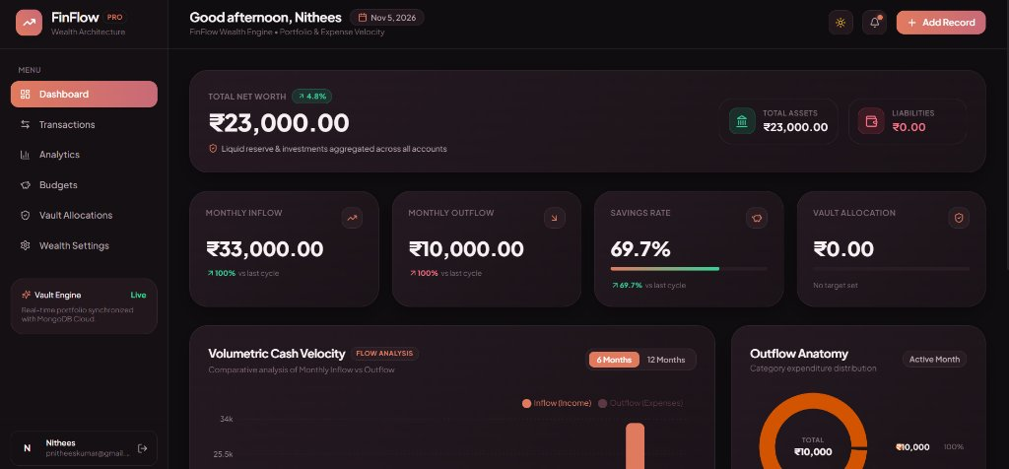
05/11 • LIVE DEMO PREVIEW
05 / 11
Visual Showcase: Executive Wealth Dashboard
DASHBOARD CAPABILITIES
• Real-Time Net Worth Card
Instant dynamic aggregation: Total Assets (₹23,000) minus Liabilities (₹0.00).
• Monthly Cash Velocity
Side-by-side comparison of Inflow (₹33,000) vs. Outflow (₹10,000).
• Automated Savings Rate
Live algorithmic savings metric calculated as (Income - Outflow) ÷ Income = 69.7%.
• Volumetric Inflow/Outflow Bars
Recharts visual bar diagram tracking monthly financial pace.
• Outflow Anatomy Donut
Instant category expenditure breakdown with dynamic percentage distribution.

Slide 6
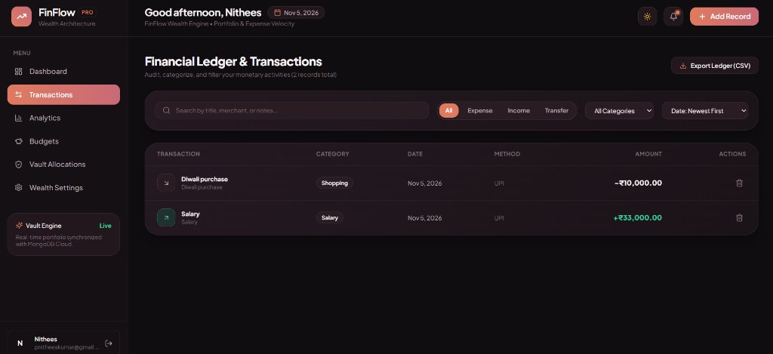
06/11 • LIVE DEMO PREVIEW
06 / 11
Visual Showcase: Financial Ledger & Operations
TRANSACTION ENGINE
• Multi-Field Instant Search
Debounced client search queries descriptions, merchants, and tags simultaneously.
• Multi-Dimensional Filtering
Filter by type (Income / Expense / Transfer), category, and sort by date/amount.
• Atomic Balance Updates
Recording a new transaction automatically updates the linked account balance inside MongoDB.
• Complete Audit Trail
Records exact timestamps, payment methods (UPI, Card, Bank), and audit logs.
• Safe Record Deletion
Removing a transaction automatically rolls back account balance changes seamlessly.

Slide 7
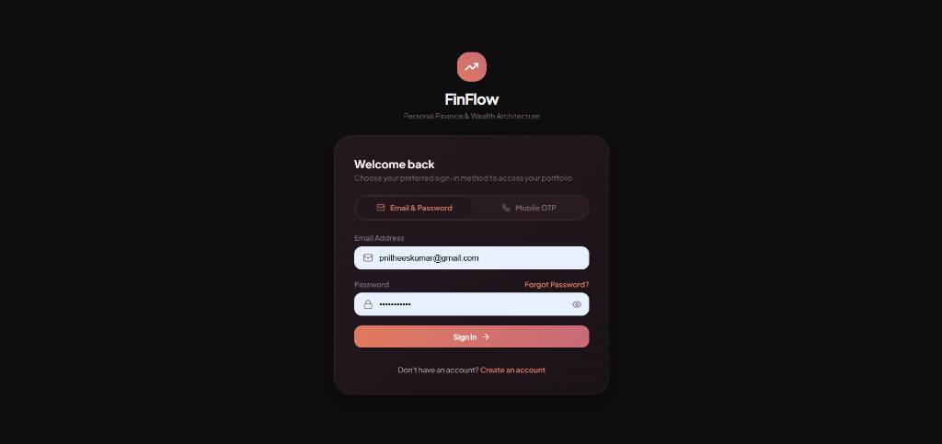
07/11 • SECURITY DESIGN
07 / 11
Visual Showcase: Authentication & Security Architecture
DEFENSE-IN-DEPTH SECURITY PRACTICES
✔ Salted Password Hashing: Passwords encrypted using bcryptjs with 10 salt rounds before database persistence. Plaintext passwords never stored.
✔ Hidden Password Hashes: Mongoose User schema enforces 'select: false' on passwordHash so hashes are never returned in queries or API responses.
✔ Stateless JWT Authentication: Signed with a 256-bit secret and validated via Bearer header or signed httpOnly cookies.
✔ Strict Multi-Tenant Isolation: Every database read, write, and update strictly requires { userId: req.user._id }. Users cannot see each other's data.
✔ Brute-Force & Denial-of-Service Defense: Express rate limiting restricts authentication endpoints to 100 requests per 15-minute window.
✔ Cold-Start Resilience: Client Axios configured with 60s timeout to prevent premature aborts during cloud spin-ups.

Slide 8
08/11 • PLANNING MODULES
08 / 11
Budget Envelopes & Savings Vaults Management
ENVELOPE BUDGETING SYSTEM
SAVINGS GOALS & MILESTONES
• Category Spending Limits: Define monthly expenditure caps per category (e.g., Food & Dining, Shopping, Utilities).
• Real-Time Threshold Calculations: Dynamically sums current month's expenses against envelope limits.
• Color-Coded Visual Indicators: Normal progress (Green <80%), Warning threshold (Amber 80-99%), and Budget Exceeded (Red >=100%).
• Remaining Balance Velocity: Displays exact unspent envelope surplus to pace discretionary spending throughout the month.
• Target Milestone Planning: Set specific monetary targets (Emergency Reserve, Vehicle, Vacation) with target completion dates.
• Incremental Contributions: Record deposits directly into targeted savings vaults with immediate progress recalculation.
• Completion Percentage Tracking: Animated visual progress bars displaying percentage towards full milestone funding.
• Priority Hierarchy: Categorize goals into High, Medium, and Low priorities to systematically allocate surplus cash flow.

Slide 9
09/11 • QUALITY ASSURANCE
09 / 11
Automated Testing & Calculation Verification
NATIVE TEST SUITE (node --test)
TESTING METRICS & VERIFICATION
✔ Savings Rate Exact Calculation
Validates (Income - Expense) ÷ Income × 100 with standard numbers (e.g. ₹48.5k income vs. ₹18.2k expenses).
✔ Zero & Negative Income Edge Cases
Guarantees calculation engine returns 0% when income is <= 0 without throwing divide-by-zero exceptions.
✔ Expense Deficit Scenarios
Confirms savings rate caps at 0% when monthly expenses exceed total inflow.
✔ Net Worth Deductions
Tests asset aggregation minus liabilities balance calculations accurately.
✔ Expense Category Distribution
Confirms category percentages sum precisely to 100% across all transactions.
• Total Test Cases: 6 Automated Unit Tests
• Test Execution Time: 175 ms (High-velocity native runner)
• Pass Rate: 100% Passing (0 failures, 0 skipped)
• Coverage Areas: Financial Math, Net Worth, Boundary Conditions
• Database Isolation: Pure function testing with zero external DB dependencies
• Regression Safety: Enforced prior to deployment on continuous integration

Slide 10
10/11 • DEVOPS ARCHITECTURE
10 / 11
Cloud Deployment & Production Infrastructure
WEB APPLICATION TIER
DATABASE CLUSTER
API HEALTH STATUS
Platform:
Render Cloud Hosting
Production URL:
fineflow-finance.onrender.com
Health Status:
HTTP 200 OK • Healthy
Routing Architecture:
Unified Single-Domain Routing
SSL Certificate:
Automatic HTTPS / TLS 1.3 Encryption
Platform:
MongoDB Atlas Global Cloud
Topology:
3-Node Multi-Zone Replica Set
Authentication:
SCRAM-SHA-256 Credentials
Connection Caching:
Serverless-ready Mongoose Cache
Persistence:
100% Live Cloud Storage
Health Endpoint:
/api/health
Database State:
Connected (readyState: 1)
API App Name:
FinFlow REST API v1.0.0
CORS Whitelist:
Configured for Production Domain
Uptime Monitoring:
Automated Process Supervisor

Slide 11
11/11 • CONCLUSION
11 / 11
Summary, Impact & Future Roadmap
PROJECT ACHIEVEMENTS
FUTURE ROADMAP & Q&A
✔ Full-Stack MERN Architecture: Delivered complete end-to-end integration across React, Express, Node.js, and MongoDB Atlas.
✔ Executive Aesthetic & UX: Custom luxury design system with dark/light themes, fluid micro-interactions, and Recharts SVG graphics.
✔ Real-World Production Deployment: Live publicly accessible web service on Render with 100% cloud database synchronization.
✔ Defensive Security Engineering: Strict multi-tenant authorization, salted bcrypt password hashes, and rate limiting.
🚀 AI Predictive Insights: Machine learning anomaly detection to forecast upcoming expense spikes and recommend savings allocations.
🚀 Automated Open Banking Sync: Direct bank feed integration (Account Aggregator / Plaid) for automatic transaction imports.
🚀 Report Export Engine: Export comprehensive financial audits and monthly tax reports in PDF & CSV formats.
Thank you! Any Questions?

