Slide 1
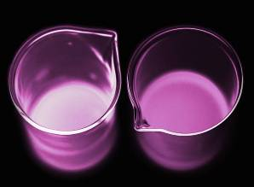


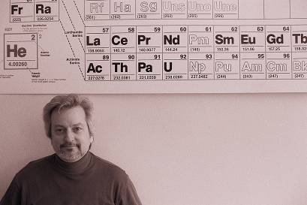
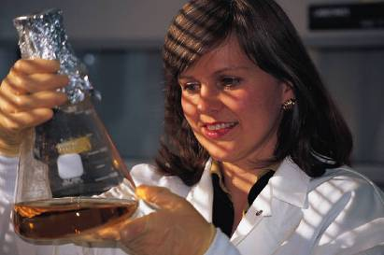
AP Chemistry
Chemical Particles

Slide 2
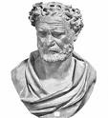

Historical Development of the Atomic Model
Greeks (~400 B.C.E.)
-- Democritus Leucippus (and others)
Matter is discontinuous (i.e., “grainy”).
Greek model
of atom
-- Plato and Aristotle disagreed,
saying that matter was continuous.

Slide 3
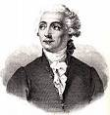

Hints at the Scientific Atom
-- Antoine Lavoisier:
law of conservation of mass
-- Joseph Proust (1799):
law of definite proportions: every compound has a fixed proportion
by mass
e.g., water………………….
8 g O : 1 g H
chromium(II) oxide…..
13 g Cr : 4 g O

Slide 4
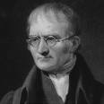
Hints at the Scientific Atom (cont.)
-- John Dalton (1803):
law of multiple proportions: When two different compounds have same two elements, equal mass of one element results in integer multiple of mass of other.
e.g., water……………………..
8 g O
:
1 g H
hydrogen peroxide..…….
16 g O
:
1 g H
chromium(II) oxide……..
13 g Cr
:
4 g O
chromium(VI) oxide…….
13 g Cr
:
12 g O

Slide 5

John Dalton’s Atomic Theory (1808)
1. Elements are made of
indivisible particles called atoms.
Atoms are not indivisible.
2. Atoms of the same element are exactly
alike; in particular, they have the same mass.
Isotopes!
3. Compounds are formed by
the joining of atoms of two
or more elements in fixed,
whole number ratios.
Dalton’s model
of atom
e.g.,
1:1, 2:1, 1:3, 2:3, 1:2:1
Dalton’s was the first atomic theory that had… evidence to support it.
NaCl, H₂O, NH₃, Fe₂O₃, C₆H₁₂O₆

Slide 6
Law of Electrostatic Attraction
opposite charges attract; like charge repel
ATTRACTIVE REPULSIVE
+
–
+
+
–
–
(also called coulombic attraction)

Slide 7
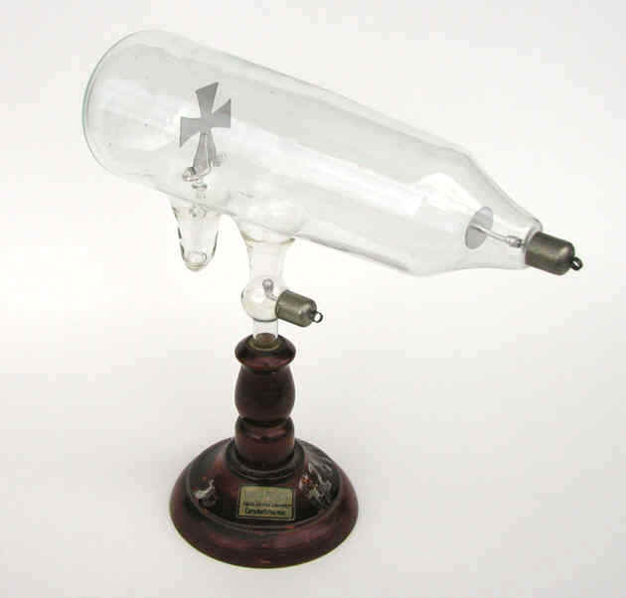
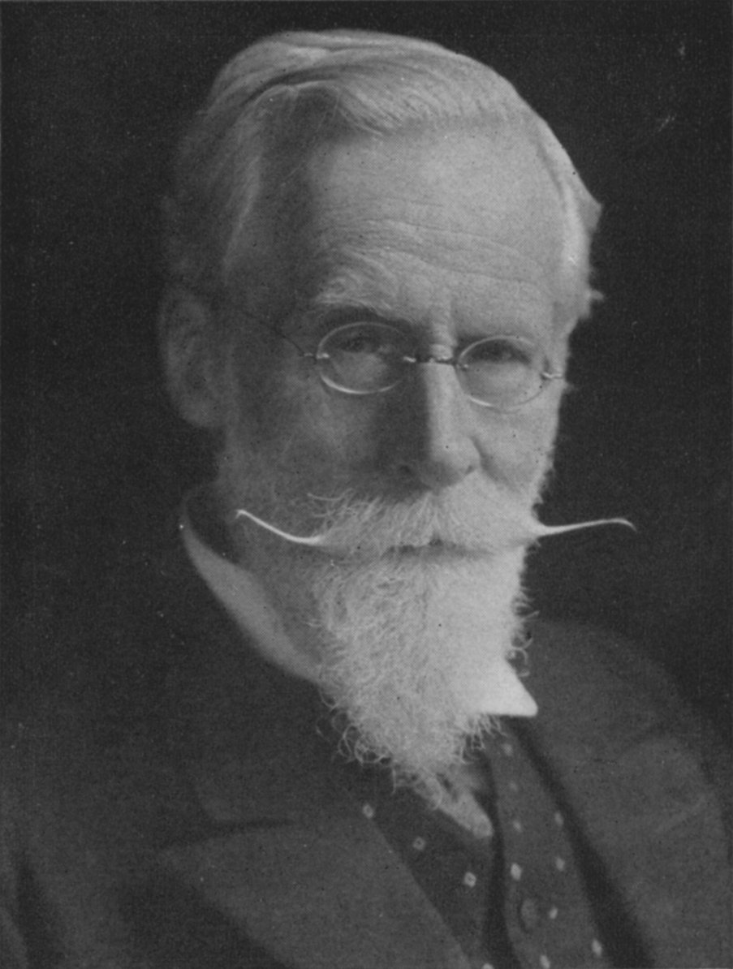



-- William Crookes
(1870s):
“Rays” causing
shadow were
emitted from
the cathode.
Maltese cross CRT
computer monitor
radar screen
television

Slide 8
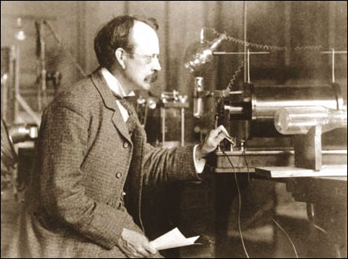
-- J.J. Thomson (1897) discovered
that “cathode rays” are deflected
by electric and magnetic fields.
He found that “cathode rays” were particles (today, we call them electrons) having a charge-to-mass ratio of 1.76 x 10⁸ C/g.
electric field lines
“cathode rays”
+ + + + + +
Crooke’s tube
– – – – – –
(–) particles
electrons
phosphorescent
screen

Slide 9
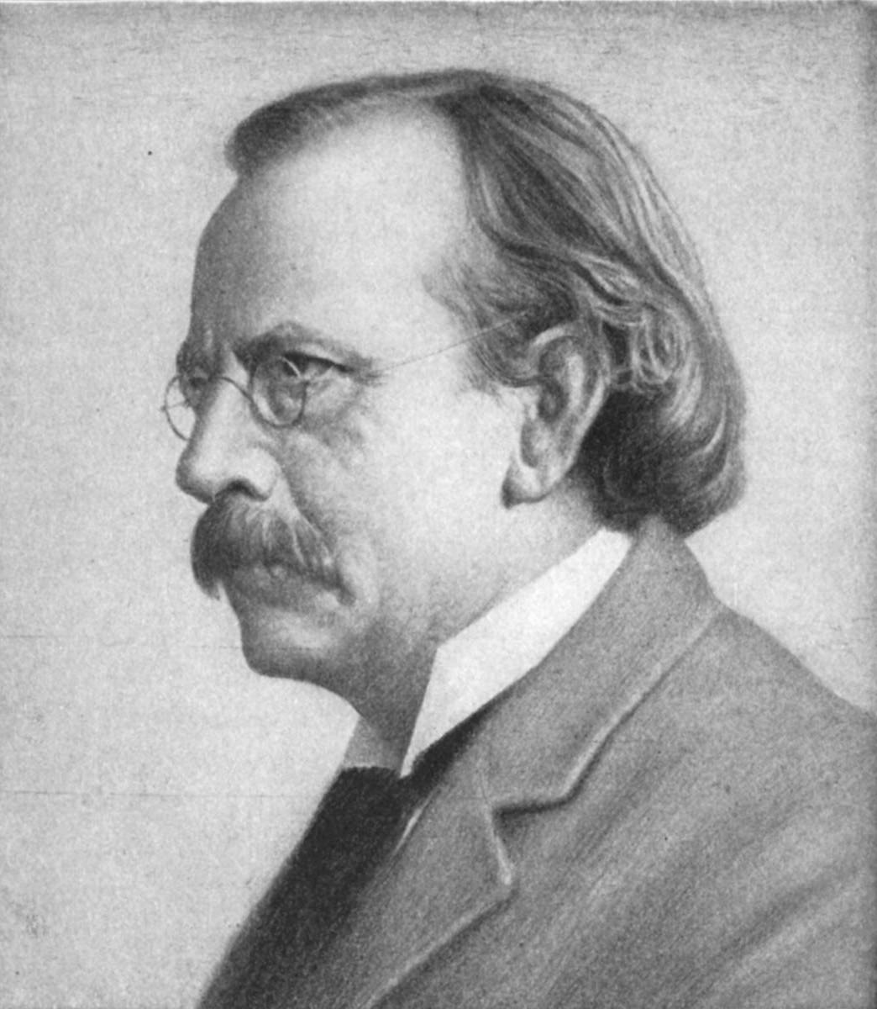
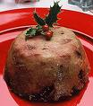
Since atom was known to be
electrically neutral, he proposed the plum pudding model.
-- Equal quantities of (+) and (–)
charge distributed uniformly
in atom.
+
+
–
+
–
+
-- (+) is ~2000X more massive
than (–).
–
+
+
–
+
–
+
–
–
–
+
–
+
+
–
–
(plum
pudding)
Thomson’s plum pudding model

Slide 10
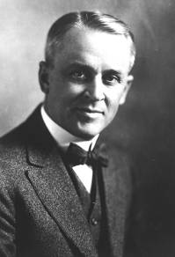
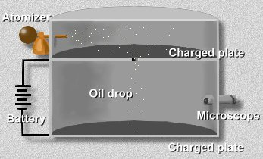
-- Robert Millikan (1909) performed
the “oil drop” experiment. Oil
drops were given negative
charges of varying magnitude.
(using x-rays)
x-rays

Slide 11
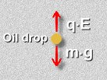

Charges on oil drops were found to be integer
multiples of 1.60 x 10^{–19} C.
6.40 x 10^{–19} C
4.80 x 10^{–19} C
1.60 x 10^{–19} C
3.20 x 10^{–19} C
6.40 x 10^{–19} C
1.60 x 10^{–19} C
m g = q E
8.00 x 10^{–19} C
9.60 x 10^{–19} C
4.80 x 10^{–19} C
1.60 x 10^{–19} C
8.00 x 10^{–19} C
9.60 x 10^{–19} C
3.20 x 10^{–19} C
6.40 x 10^{–19} C
He reasoned that this must be the charge on a
single electron. He then found the electron’s mass:
charge
1.60 x 10^{–19} C
=
charge per mass
1.76 x 10⁸ C/g
= 9.09 x 10^{–28} g

Slide 12
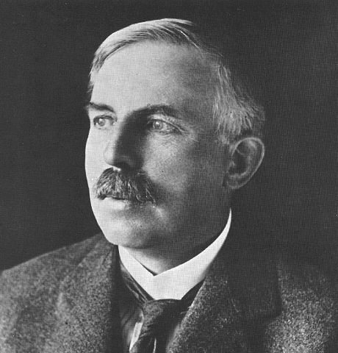
Ernest Rutherford (1910):
Gold Leaf Experiment
A beam of α-particles (+) was directed at a gold leaf surrounded by a phosphorescent (ZnS) screen.
gold
leaf
particle beam
α-source
lead block
ZnS screen

Slide 13
Most α-particles passed through, some angled slightly, and a tiny fraction bounced back.
Conclusions:
1.
Atom is mostly empty space.
2.
(+) particles are concentrated at center.
nucleus = “little nut”
3.
(–) particles orbit nucleus.

Slide 14
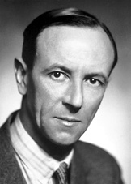
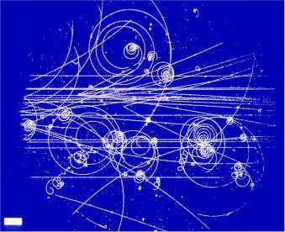
-- James Chadwick
discovered neutrons in 1932.
Purpose of n⁰ =
help to bind p⁺
together in nucleus
And now we believe in many other subatomic particles:
quarks,
muons,
positrons,
neutrinos,
pions, etc.
photo from liquid H₂ bubble chamber

Slide 15
Thomson’s Plum Pudding Model
Dalton’s (also the Greek) Model
Rutherford’s Model
–
+
–
+
–
+
+
–
–
–
+
+
–
–
+
N
+
–
–
–
–
–
+
+
–
–
–
+
–

