Slide 1
electronic charge =
1.602 x 10^{–19} C
-- In chemistry, charges are expressed as unitless
multiples of this value, not in C.
e.g.,
2+ (as in Ca²⁺), not 2 (1.602 x 10^{–19} C)
= 3.204 x 10^{–19} C
-- atomic mass unit (amu): used to measure masses
of atoms and subatomic particles
1 p⁺ = 1.0073 amu
1 n⁰ = 1.0087 amu
1 e– = 0.0005486 amu
~
~
i.e., m_{p+} = m_{n0} = 1 amu
Conversion:
1 g = 6.02 x 10²³ amu

Slide 2
Angstroms (A) are often used to measure
atomic dimensions.
Conversion:
1 A = 1 x 10^{–10} m = 1 x 10^{–8} cm
atomic number:
# of p⁺
-- the whole number on Periodic Table;
determines the identity of an atom
mass number:
(# of p⁺) + (# of n⁰)
isotopes: different varieties of an element’s atoms
--
same # of p⁺, diff. #’s of n⁰ (thus, diff. masses)
-- some are radioactive; others aren’t
-- A nucleus of a specific isotope is sometimes
called a… nuclide.
All atoms of an element react the same, chemically.

Slide 3
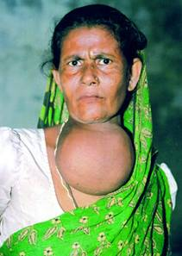
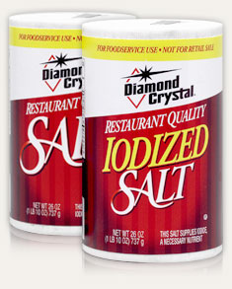
Complete Atomic Designation
…gives precise info about an atomic particle
mass #
charge (if any)
element
symbol
atomic #
125
–
I
53
Goiter due to lack of iodine
iodine is now added to salt

Slide 4
Complete
Atomic Designation
Protons
Neutrons
Electrons
238
92
146
92
U
92
23
+
11
12
10
Na
11
79
2–
34
45
36
Se
34
59
3+
27
32
24
Co
27
37
–
17
20
18
Cl
17
55
7+
25
30
18
Mn
25

Slide 5
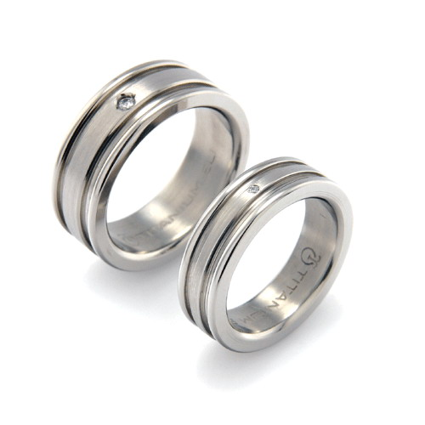
Average Atomic Mass
(a.k.a., Atomic Mass or Atomic Weight)
This is the weighted average mass of all atoms of an element, measured in a.m.u.
For an element with
isotopes A, B, etc.:
Ti has five naturally-occurring isotopes
AAM = Mass A (% A) + Mass B (% B) + …
% abundance
(use the decimal form of the %;
e.g., use 0.253 for 25.3%)

Slide 6
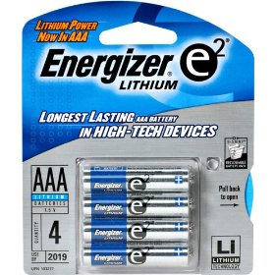
Lithium has two isotopes.
Li-6 atoms have mass 6.015 amu;
Li-7 atoms have mass 7.016 amu.
Li-6 makes up 7.5% of all Li atoms.
Find AAM of Li.
Li batteries
AAM = Mass A (% A) + Mass B (% B)
AAM = 6.015 amu (0.075) + 7.016 amu
(0.925)
AAM = 0.451 amu
+ 6.490 amu
AAM = 6.94 amu
** Decimal number on Table refers to…
molar mass (in g) OR AAM (in amu).
6.02 x 10²³ atoms
1 “average” atom

Slide 7
% abundance
Isotope
Mass
Si-28
27.98 amu
92.23%
Si-29
28.98 amu
4.67%
Si-30
?
3.10%
AAM = M_{A} (% A) + M_{B} (% B) + M_{C} (% C)
28.086
= 27.98 (0.9223) + 28.98 (0.0467) + X (0.031)
28.086 = 25.806 + 1.353 + 0.031X
28.086 = 27.159 + 0.031X
0.927 = 0.031X
0.031
0.031
X = M_{Si-30} = 29.90 amu

Slide 8
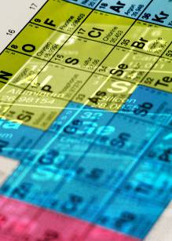
The
Periodic
Table
group: a vertical column; elements in a
group share certain phys. and
chem. properties
metals
nonmetals
metalloids
-- group 1 = alkali metals
-- group 2 = alkaline earth metals
-- group 16 = chalcogens
-- group 17 = halogens
-- group 18 = noble gases

Slide 9
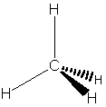
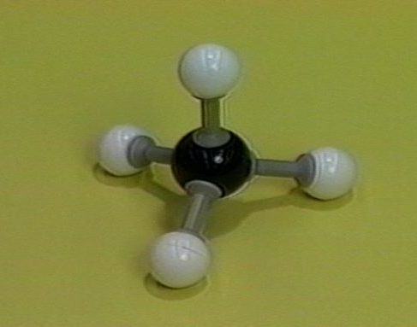
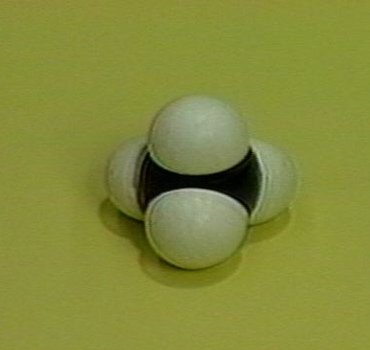
Molecular compounds contain only… nonmetals.
empirical formula:
shows relative #s of each type
of atom in m’cule (CH₂)
molecular formula:
shows actual #s & types of
atoms in m’cule (C₃H₆)
F
structural formula:
shows which atoms
are bonded
to which
F–C–F
Just like a Lewis structure,
but w/o unshared pairs.
F
Also… perspective ball-and- space-filling
drawing stick model model

Slide 10
Nomenclature of Binary Molecular Compounds
(two types of nonmetals)
FORGET CHARGES!
Use Greek prefixes to indicate how
many atoms of each element, but
don’t use “mono” on first element.
1 –
mono
6 –
hexa
Also, don’t use any prefixes
if H is the first element
2 –
di
7 –
hepta
e.g., H₂S
HF
HCl
3 –
tri
8 –
octa
4 –
tetra
9 –
nona
5 –
penta
10 –
dec

Slide 11
carbon dioxide
CO₂
CO
carbon monoxide
dinitrogen trioxide
N₂O₃
N₂O₅
dinitrogen pentoxide
carbon tetrachloride
CCl₄
NI₃
nitrogen triiodide

