Slide 1
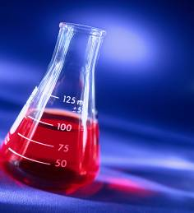
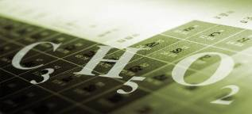
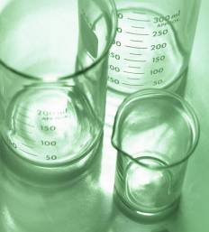
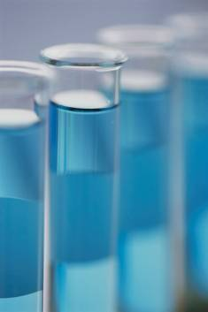
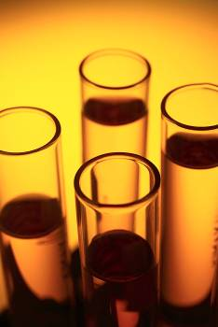
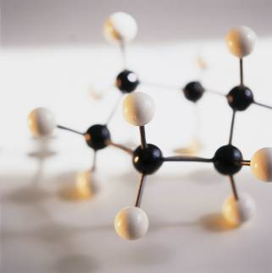
AP Chemistry
Introduction

Slide 2
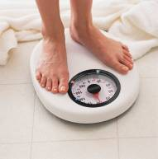
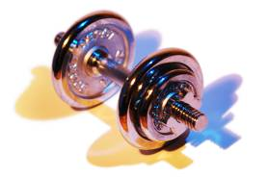
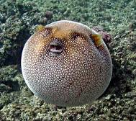
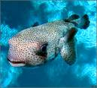
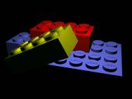
matter: anything having mass and volume
mass:
the amount of matter in an object
weight:
the pull of gravity on an object
volume:
the space an object occupies
units: L, dm³, mL, cm³
conversions: 1 L = 1 dm³; 1 mL = 1 cm³
state of matter:
solid, liquid, or gas
atom: a basic building block of matter
-- ~100 diff. kinds

Slide 3

Elements
contain only one type of atom.
Broken Dreams Blvd.
(a) monatomic elements consist of “unbonded,”
identical atoms
e.g.,
Fe, Al, Cu, He
(b) polyatomic elements consist
of several identical atoms bonded
together
-- diatomic elements:
H₂ O₂ Br₂ F₂ I₂ N₂ Cl₂
“7 7 7”
-- others:
P₄ S₈

Slide 4
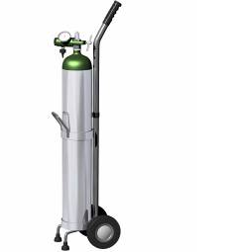
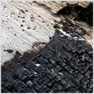

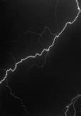
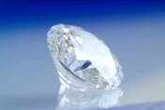

(c) allotropes: different forms of the same element in
the same state of matter
OXYGEN CARBON
oxygen gas
(O₂)
elemental
carbon
graphite
ozone
(O₃)
diamond
buckyball

Slide 5
molecule: a neutral group of bonded atoms
Description | Chemical Symbol | Model
1 oxygen atom
1 oxygen molecule
2 unbonded oxygen atoms
1 phosphorus atom
1 phosphorus molecule
4 unbonded phosphorus atoms
O
O₂
2 O
P
P₄
4 P
Elements may consist of… either molecules or unbonded atoms.

Slide 6
2
Chemical symbols for elements
appear on the periodic table;
only the first letter
is capitalized.
He
4.003
10
Ne
20.180
18
Ar
39.948
36
Kr
83.80
54
Xe
131.29
86
Rn
(222)

Slide 7
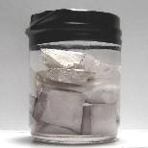
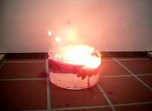
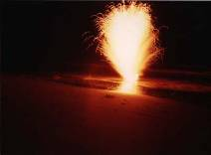
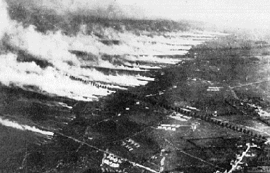
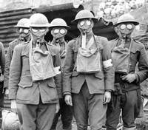
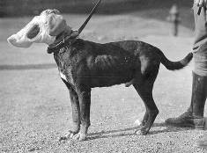
Compounds
contain two or more different types of atoms.
-- have properties that differ from
those of their constituent elements
table salt
e.g., Na (sodium):
explodes in water
(NaCl)
Cl₂ (chlorine):
poisonous gas

Slide 8
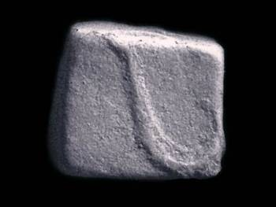
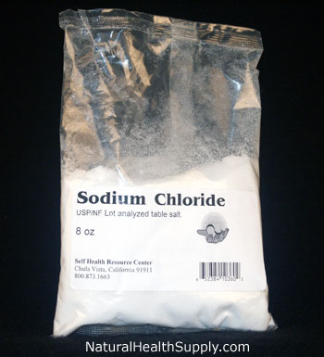
Compound Composition
All samples of a given compound
have the same composition by mass.
Every sample of NaCl tastes the same,
melts at the same temp., and is
39.3% Na and 60.7% Cl by mass.

Slide 9
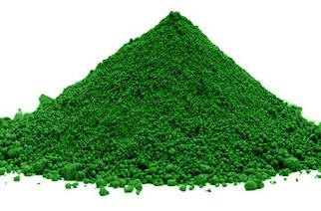
A 550. g sample of chromium(III) oxide (Cr₂O₃)
has 376 g Cr. How many grams of Cr and O
are in a 212 g sample of Cr₂O₃?
% Cr =
68.4% Cr
and
31.6% O
(New sample has same composition.)
Cr:
212 g (0.684)
= 145 g Cr
chromium(III) oxide
O:
212 g (0.316)
= 67 g O

Slide 10
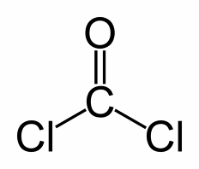
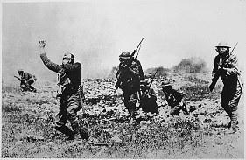
composition:
what the matter is made of
copper:
water:
many Cu atoms
many “threesomes” of
2 H’s and 1 O
Properties
describe the matter.
e.g., what it looks like, smells like, how it behaves
Chemistry tries to relate
the microscopic and
macroscopic worlds.

Slide 11
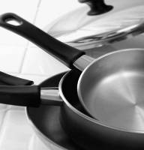


States of Matter
SOLID
LIQUID
GAS
( ( ) )
( ( ) )
( ( ) )
( ( ) )
( ( ) )
( ( ) )
( ( ) )
( ( ) )
( ( ) )
( ( ) )
( ( ) )
( ( ) )
( ( ) )
( ( ) )
( ( ) )
vibrating
translating;
close together
translating quickly;
far apart
vapor:
the gaseous state of a substance that
generally is found as a solid or liquid

Slide 12
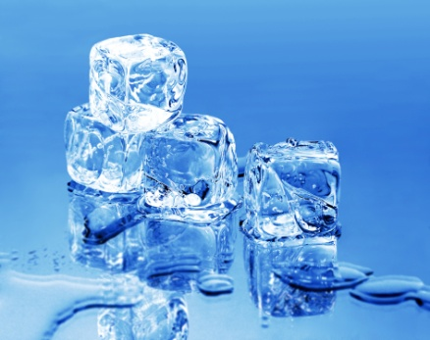
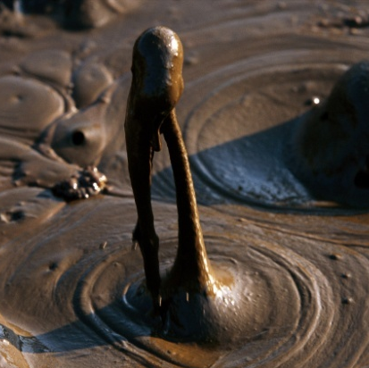
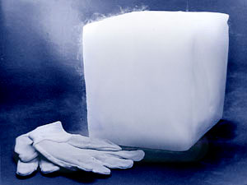
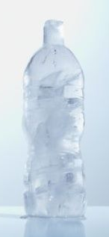
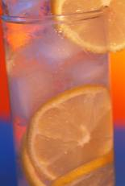

Changes in State
Energy put into system:
sublimation
melting
boiling
SOLID
LIQUID
GAS
freezing
condensation
deposition
Energy removed from system:

Slide 13
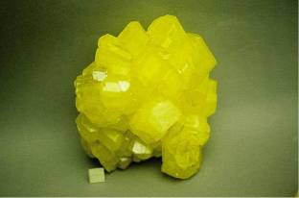
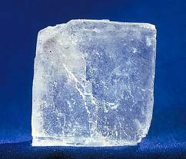
Classifying Matter
(Pure) Substances
have a fixed composition
and fixed properties.
-- they have a single chemical formula
ELEMENTS
COMPOUNDS
e.g.,
Fe, N₂, S₈, U
e.g.,
H₂O, NaCl, HNO₃
sulfur (S₈)
sodium chloride (NaCl)

Slide 14
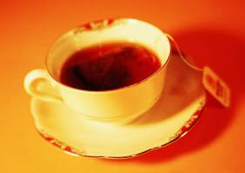
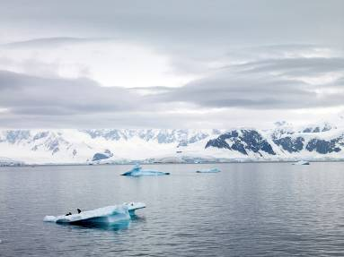
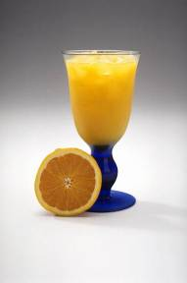
Mixtures
contain two or more substances
mixed together.
-- have varying composition
and varying properties
-- The substances are NOT chemically bonded;
they retain their individual properties.
Tea, orange
juice, oceans,
and air are
mixtures.

Slide 15
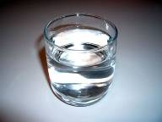
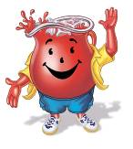
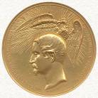
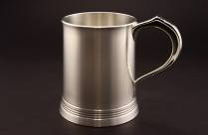
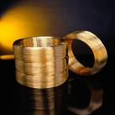
Two Types of Mixtures
homogeneous: (or solution)
sample has same composition and properties
throughout; evenly mixed at the
particle level
e.g.,
salt water
Kool Aid
alloy: a homogeneous mixture of metals
e.g.,
bronze (Cu + Sn)
pewter (Pb + Sn)
brass (Cu + Zn)

Slide 16
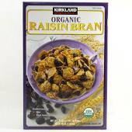
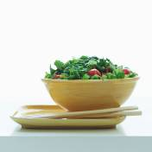
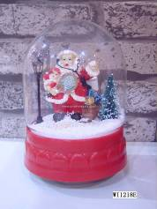

Two Types of Mixtures (cont.)
heterogeneous:
different composition and properties in the
same sample; unevenly mixed
tossed salad
e.g.,
raisin bran
suspension: settles over time
e.g.,
paint
snow globes

Slide 17
Chart for Classifying Matter
MATTER
PURE SUBSTANCE
MIXTURE
ELEMENT
COMPOUND
HETEROGENEOUS
HOMOGENEOUS

Slide 18
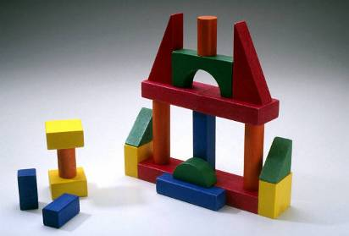
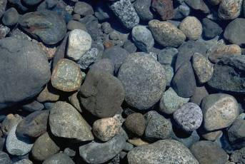

Separating Mixtures
-- No chemical reactions
are needed because…
involves
physical means, or
physical changes.
substances are NOT bonded.
1. sorting:
by color,
shape,
texture,
etc.
2. filtration:
by particle
size

Slide 19
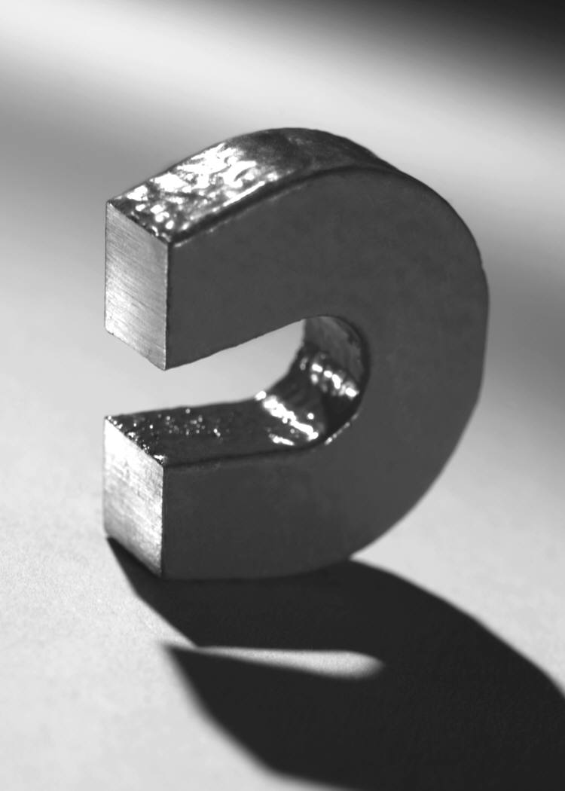
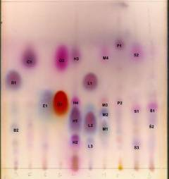
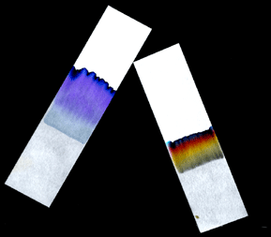

Separating Mixtures (cont.)
3. magnetism:
one substance
must contain iron
4. chromatography:
some substances dissolve
more easily than others

Slide 20



Separating Mixtures (cont.)
5. density:
“sink vs. float”;
perhaps use a centrifuge
blood after high-
speed centrifuging
decant: to pour
off the liquid

Slide 21

Separating Mixtures (cont.)
6. distillation:
different boiling points
thermometer
water out
(warmer)
water in
(cooler)
more-volatile
substance
condenser
(i.e., the one
with the lower
boiling point)
mixture
more-volatile
substance, now
condensed
heat source
Volatile substances evaporate easily.

