Slide 1
Properties of Matter
CHEMICAL properties tell how a substance
reacts with other substances.
ONE OF THESE
PHYSICAL properties can be observed without
chemically changing the substance.
AND
EXTENSIVE properties depend on the amount
of substance present.
ONE OF THESE
INTENSIVE properties do NOT depend on the
amount of substance.

Slide 2

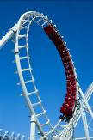

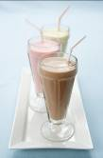
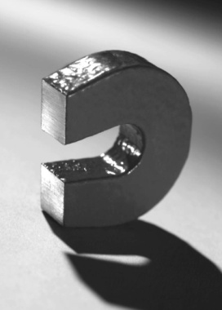
Examples:
electrical conductivity………………………
P,
I
P,
I
ductile: can be drawn (pulled) into wire…..
malleable: can be hammered into shape…
P,
I
reactivity with water………………………...
C,
I
P,
I
brittleness…………………………………….
P,
I
magnetism……………………………………

Slide 3
Density
→ how tightly packed the particles are
Density =
** Density of water =
1.0 g/mL = 1.0 g/cm³
The density of a liquid or solid is nearly constant,
no matter the sample’s temperature.
Density of gases is highly dependent on temperature.
A student needs 15.0 g of ethanol, which has a density
of 0.789 g/mL. What volume of ethanol is needed?
= 19.0 mL

Slide 4
Prefix | Symbol | Meaning
giga- | G | 10⁹
mega- | M | 10⁶
kilo- | k | 10³
deci- | d | 10^{–1}
centi- | c | 10^{–2}
milli- | m | 10^{–3}
micro- | m | 10^{–6}
nano- | n | 10^{–9}
pico- | p | 10^{–12}
femto- | f | 10^{–15}
SI Prefixes to Memorize

Slide 5

10⁹
10⁶
10³
10^{–1}
10^{–2}
10^{–3}
10^{–6}
10^{–9}
10^{–12}
10^{–15}
G
M
k
d
c
m
μ
n
p
f
iga
ega
ilo
eci
enti
illi
icro
ano
ico
emto
“Got
my
kilt,
Dad!
Can’t
miss
μidsummer’s
no-
pants
Friday!”

Slide 6
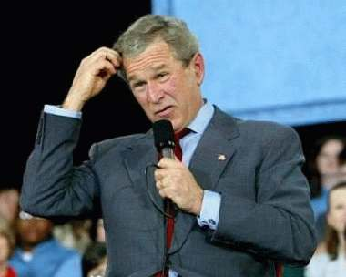
Significant Figures:
Is a digit significant?
All non-zeroes are significant.
Zeroes might or might not be.
Use the box-and-dot method to determine the sig figs
in a given quantity.
?
1. Identify the leftmost AND rightmost non-zeroes.
2. Draw a box around these AND everything in-between.
3. Everything in the box is significant.
4. NOTHING on the box’s LEFT is significant.
5. If there is a decimal point ANYWHERE, the digits on the box’s RIGHT ARE significant. Otherwise, no.

Slide 7
3
8 0 . 0
3
0 . 0 9 4 4
2
0 . 0 0 3 2
1
2 0 0 0
6
1 3 0 0 . 4 0
5
1 2 4 . 0 0
3
0 . 0 0 3 0 4
3
0 . 0 2 5 0
In scientific notation, the
exponent has no effect on
the number of sig. figs.
3
1 . 4 0 x 10⁹
3
5 . 0 6 x 10^{–3}
4
7 . 1 2 0 x 10⁵
7.2 x 10⁵
2
7 2 0 x 10³

Slide 8






Rules:
Significant Figures and Mathematical Operations
1. When multiplying or dividing, the answer must have the same number of sig. figs. as does the quantity with the fewest sig. figs.
.
.
1.52 C 3.431 s =
0.443 C/s
.
.
0.0251 N x 4.62 m 3.7 s =
0.031 N.m/s

Slide 9
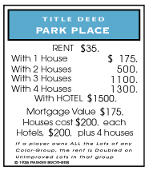
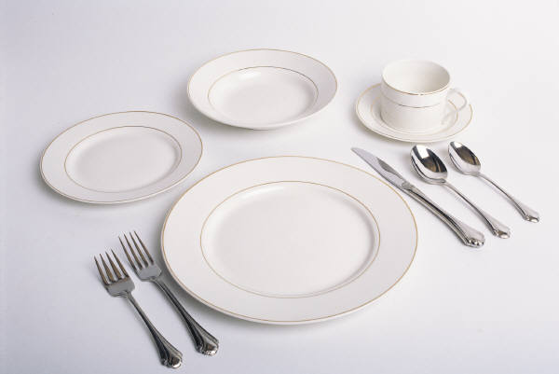
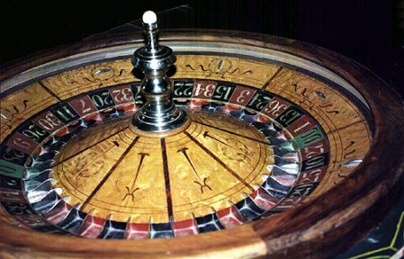
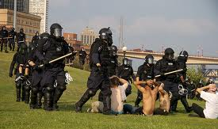

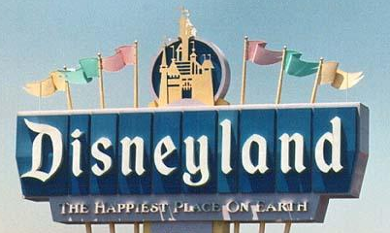
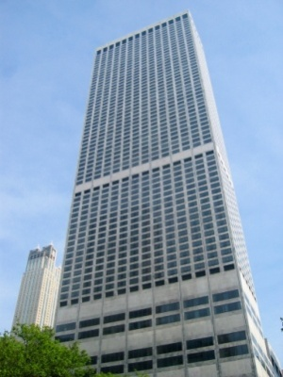
2. When adding or subtracting, the answer must be
rounded to the place value of the least precise
quantity.
2.53 s + 117.4 s =
119.9 s
2.11 m + 104.056 m + 0.1205 m =
106.29 m

Slide 10
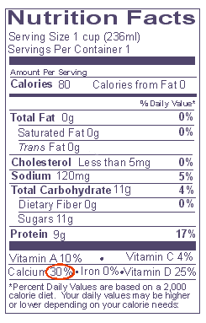
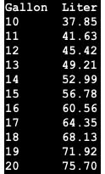
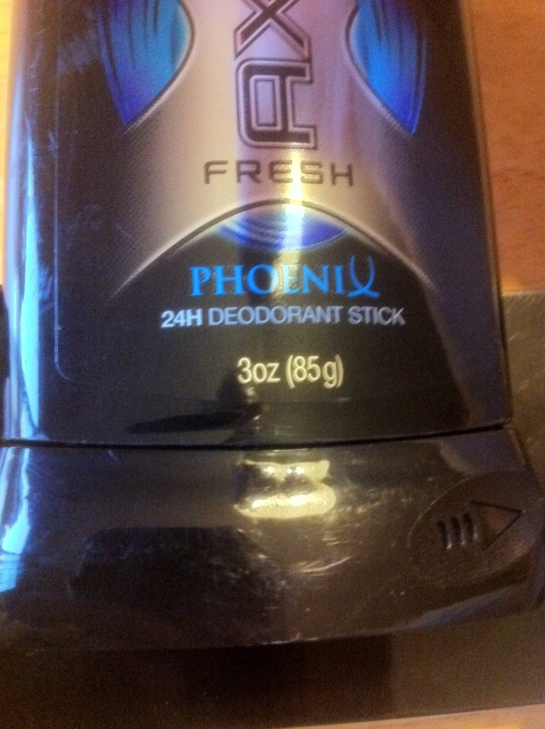
3. Because conversion factors are exact numbers, they do NOT affect the # of sig. figs. Your answer should have the same # of sig. figs. as does the quantity you start with.
(Arrggh! Rookies!)

Slide 11
Conversion Factors and
Unit Cancellation
For the rectangular solid:
L = 14.2 cm
W = 8.6 cm
H = 21.5 cm
Find volume.
V = L . W . H
= (14.2 cm)(8.6 cm)(21.5 cm)
=
2600
cm³

Slide 12
Convert to mm³.
(
)
______
2600 cm³
10 mm
³
= 2,600,000 mm³
1 cm
= 2.6 x 10⁶ mm³
mm and cm differ by a factor of……….
mm² “ cm² “ “ “ “ “ ……….
mm³ “ cm³ “ “ “ “ “ ……….
10
100
1000

Slide 13
Saul ‘Chuck’ Cooawlkay knows exceptions? Naaaah.
Saul Brickell double-hugged Agatha… and Paul Bunyan, too.
Saul Sulf ate two huge bars… and peanut butter, too.
The poor crow was cold; he huddled with everyone, but Al K. said, “Naaaah.”
‘Soooooo… You two are always combined.’ “Naaaht when we’re strongly basic.”

