Slide 1

FlexiNNSim Getting Started
Pedro Nuno de Jesus Francisco Freitas
P.N.Freitas@2017.ljmu.ac.uk

Slide 2
Outline
Required Matlab software
Creating MNIST datastore object for first use
Considerations on datastore objects
Data format of RRAM Data file

Slide 3
Required Matlab software
FlexiNNSim was developed on Matlab R2021a and it is recommended to use this same version (certain implemented functions may be incompatible with different Matlab versions)
FlexiNNSim current version (v0.9) requires the following toolboxes:
Deep Learning Toolbox
Curve Fitting Toolbox
Image Processing Toolbox
Parallel Computing Toolbox
Statistics and Machine Learning Toolbox

Slide 4
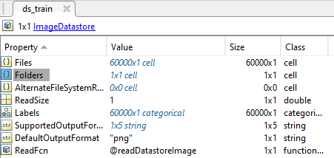

Creating MNIST datastore object
Before starting the first NN simulation, the datastore object that will be used, must be created locally so that the correct path is indicated in the datastore object.
MNIST images are already located in the subfolders present in: /Datasets/MNIST
To create the MNIST datastore objects to be used in FlexiNNSim based on these images, run: /Datasets/MNIST/Generate_MNISTDSObject.m
This script will create two datastore objects: MNIST_trainDS.mat and MNIST_testDS.mat corresponding to the trainDataset and testDataset respectively.
The “Folders” property of these datastore objects should be checked so that the path is correct (this path should be the absolute path to the folder containing the images).
Load
Open
Check

Slide 5
Considerations on datastore objects
Datastore objects are used in FlexiNNSim with the objective of allowing the framework to handle all types of datasets.
However, due to the lack of testing it is possible that some bugs may occur with other datasets other than MNIST.
In principle, using similar methods described in the previous slides, it should be possible to train in any other types of image datastores.
To work with different types of datasets (text, audio, etc.) further code revisions may be necessary.

Slide 6
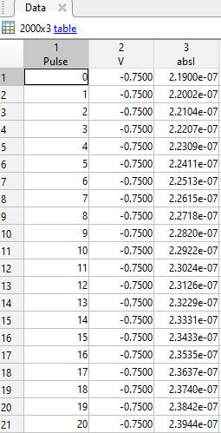
Data format of RRAM data file
RRAM data files that are open in the Variability analysis tab must obey the structure displayed in the image:
1st column: Pulse
2nd column: V (Voltage)
3rd column: absI (|Current|)
Can have any number of rows
V values are irrelevent for the calculations. These values are only used to determine if the programming polarity is SET or RESET, so only the sign of V is relevant.
By default the first polarity is always SET and when the sign changes, the program considers it to be RESET. (In practice all V values can be changed to -1 or 1).

