Slide 1
Google Analytics Capstone Project: How Does a Bike-Share Navigate Speedy Success?
Created By Pankaj Kumawat
date: 27/07/2022

Slide 2
About the company
In 2016, Cyclistic launched a successful bike-share offering. Since then, the program has grown to a fleet of 5,824 bicycles that are geotracked and locked into a network of 692 stations across Chicago. The bikes can be unlocked from one station and returned to any other station in the system anytime.
Cyclistic’s finance analysts have concluded that annual members are much more profitable than casual riders. Although the pricing flexibility helps Cyclistic attract more customers, Moreno believes that maximizing the number of annual members will be key to future growth. Rather than creating a marketing campaign that targets all-new customers, Moreno believes there is a very good chance to convert casual riders into members. She notes that casual riders are already aware of the Cyclistic program and have chosen Cyclistic for their mobility needs.

Slide 3
Business Task
Analyze rider’s usage patterns for marketing membership conversion programs.
Tools: R studio

Slide 4
Six Phases of My Analysis
Ask
Prepare
Process
Analyze
Share
Act

Slide 5
Stake Holders
Director of marketing at Cyclistic
The Cyclistic marketing team
The Cyclistic management team

Slide 6
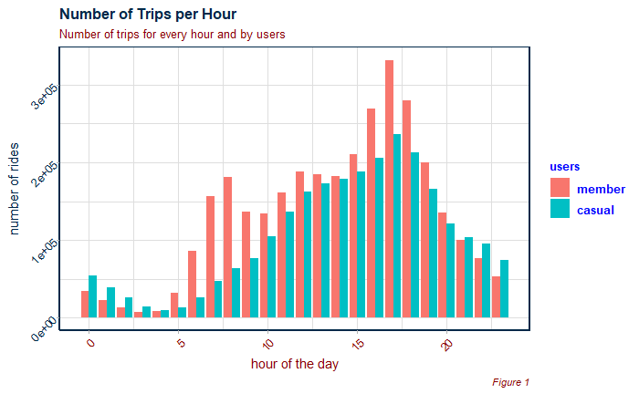
Count of Trips per hour
12 Pm to 8 Pm is the most busy time period.
Members are making more number of rides in these busy hours of the day.

Slide 7
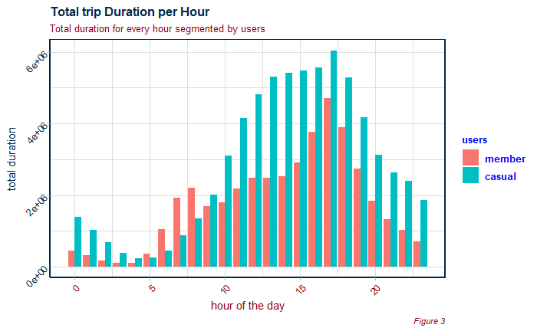
Total Trip Duration Per Hour
Though number of rides by members are more than that of casuals, but trip duration is more by casual users during busy hours. (trip duration is in minutes)

Slide 8
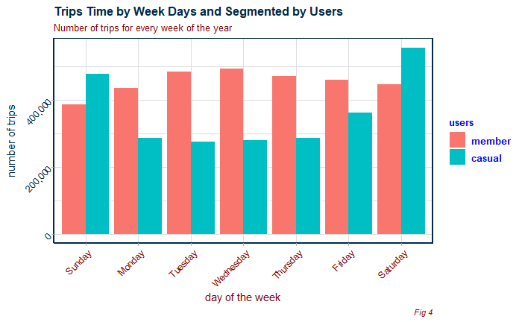
Trips count by days
Casual users take more number of rides on Friday, Saturday and Sunday.

Slide 9
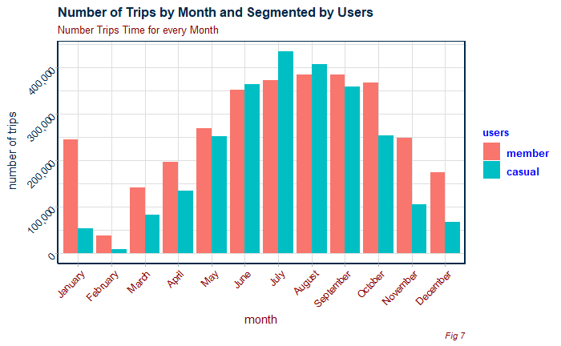
Trips count by months
May to October of every year
are the months where casual users have more number of rides.

Slide 10
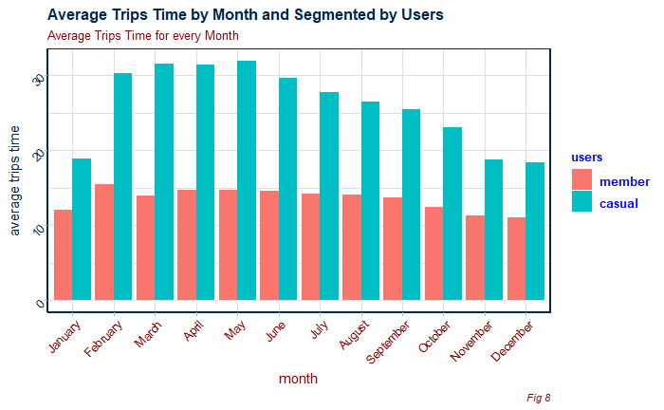
Average trip duration by month
Average trip duration is almost consistent through out the year.

Slide 11
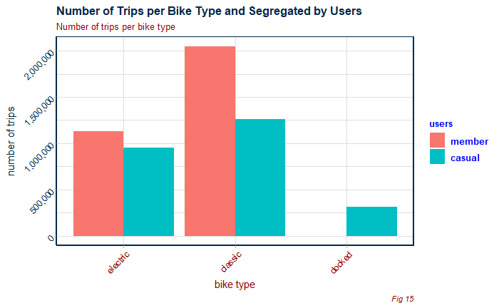
Number of trips per bike
Electric and classic bikes are quite popular among users
But docked bike are not that famous.

Slide 12
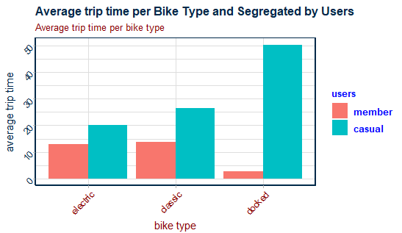
Average trip time per bike type
It seems like docked bike is used by casual users for long rides.

Slide 13
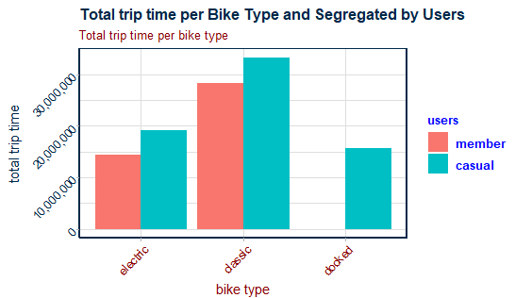
Total trip time per bike type
Docked bikes are not that famous among member users.
And electric and classic are more famous among both users.

Slide 14
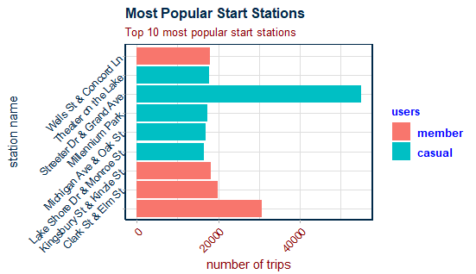
Most Popular Start Stations

Slide 15
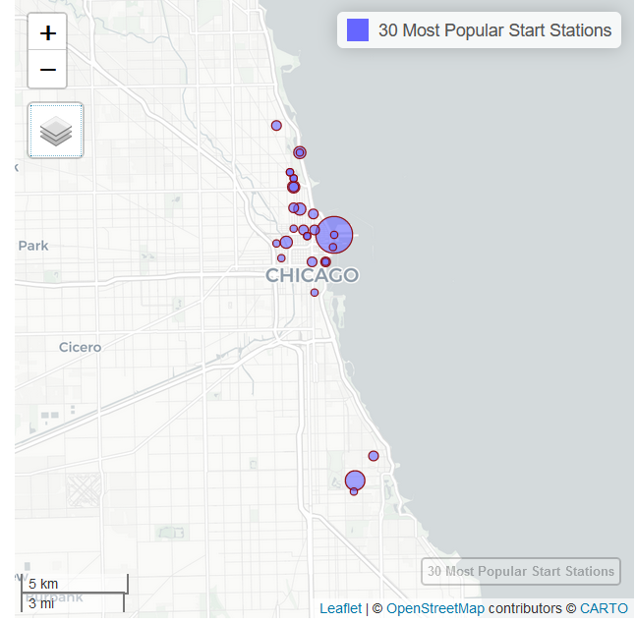
Map of Most Popular Start Stations

Slide 16
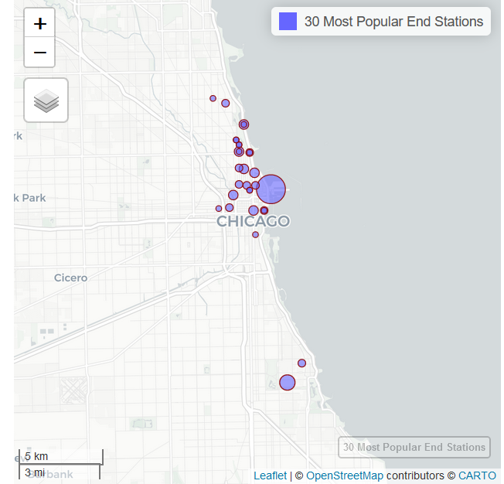
Most Popular End Stations

Slide 17
Conclusions:
The stations that are popular for starting and ending rides differ between members and casual cyclists.
Top starting and destination stations for casual users cluster around tourist locations within about 1km of the lakefront.
Top stations for members riders are more dispersed and reflect office locations.

Slide 18
Recommendations
The casual riders’ favorite start and end stations should be the focus of the marketing campaign.
Marketing campaign should be focused for the busiest casual rider days (Friday, Saturday and Sunday), busiest hours (afternoon) and most popular months to reach the most riders (June, July and August).

