Slide 1

Problem Statement
Ministry/Organization Name : AICTE , MIC- Student Innovation
PS Code : 1487
Problem Statement Title : “Student Innovation – Solution could be in
the form of waste Segregation, Disposal
and Improve Sanitization System”.
Team Name : Eco-Warrior’s
Team Leader : Sneha D Nile
Institute Code (AISHE) : 2020
Institute Name : Shri Guru Gobind Singhji Institute of Engineering
and Technology (SGGSIET), Nanded
Theme Name : Clean And Green Technology

Slide 2


Idea/Approach Details
Technology stack :
Figma
Flutter
Python
Cloud services
Database language’s like MySql and MongoDB
idea/Solution/Prototype :
The "Smart Recycling and Waste Management System with User Incentives" integrates technology and user engagement to encourage responsible waste disposal and recycling.
In this system, drivers operating collection vehicles scan QR codes and input the weight of users' garbage into the app.
The collected waste is then transported to a central facility, and users receive notifications confirming their waste's arrival, accompanied by reward points.
At the facility, the garbage is categorized and sent for recycling, with additional rewards for users contributing to recycling efforts.
This system promotes environmental awareness, transparency, and community involvement, reducing landfill waste and the carbon footprint. Collected data guides sustainable waste management strategies for a greener future.

Slide 3
Idea/Approach Details
"
Use Cases
Dependencies
Efficient Waste Recording:
Users, in an effort to responsibly manage waste, use the app to record their garbage's weight by scanning QR codes on waste collection vehicles.
Transparent Waste Journey:
After disposal, users receive notifications confirming their waste's arrival at the central facility and later at recycling factories.
Incentivized Recycling Participation:
Users receive bonus points upon their waste being successfully recycled, encouraging consistent recycling efforts.
User-Friendly Waste Categorization:
Users receive notifications indicating the successful sorting of their waste into specific categories at the central facility.
Mobile Application:
Dependencies: Smartphone or tablet, compatible operating system (iOS, Android), app stores (Google Play, Apple App Store).
QR Code Infrastructure:
Dependencies: QR code generator, waste collection vehicles equipped with QR scanners.
3. Notification System:
Dependencies: Internet connectivity, push
notification services.

Slide 4
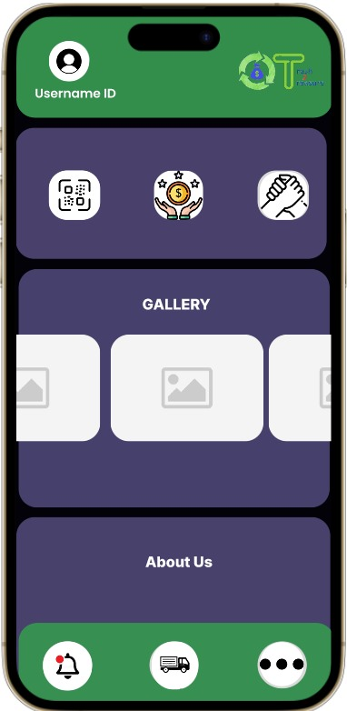
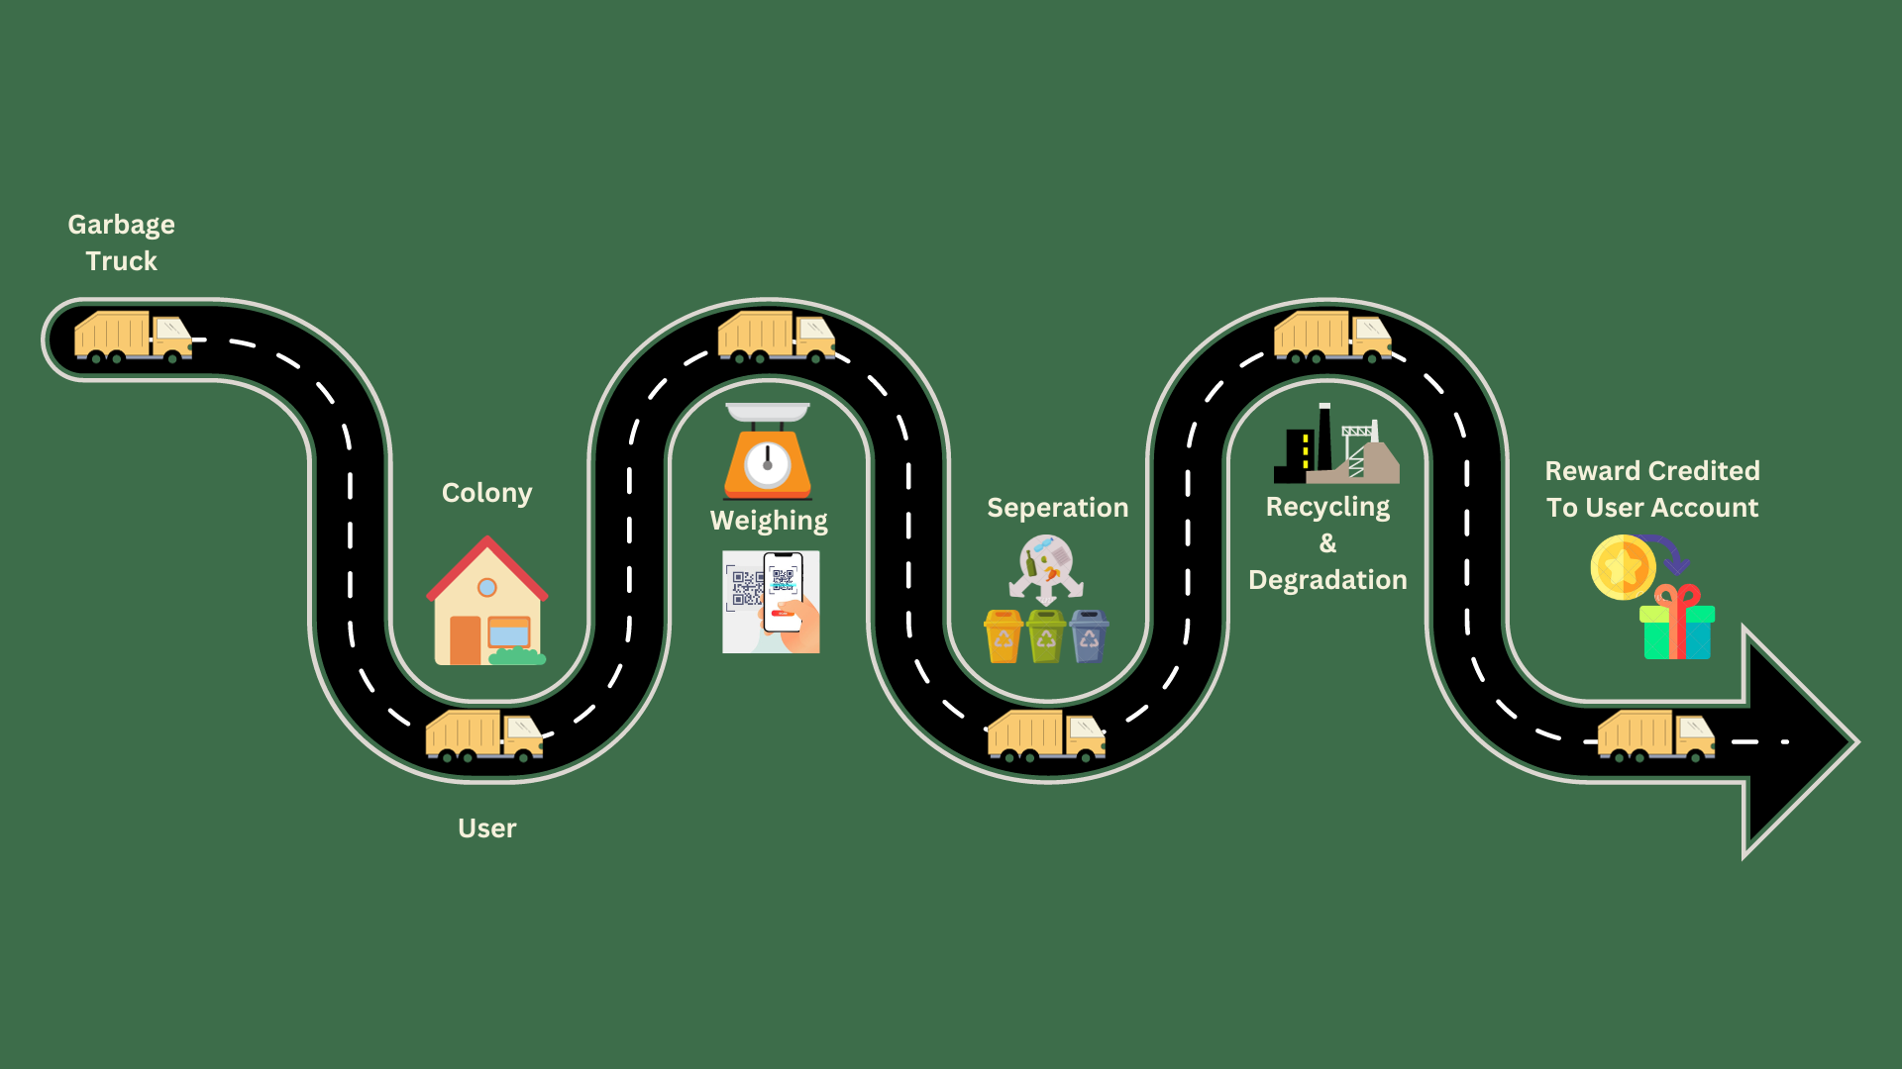
Working Model
App Prototype
Flowchart

Slide 5
Team Member Details
Leader : Sneha D Nile IT(3rd year) (2021bit051@sggs.ac.in)
Member 1 : Ujjwal S Patil IT(3rd year) (2021bit019@sggs.ac.in)
Member 2 : Pankaj G Shahare IT(3rd year) (2021bit058@sggs.ac.in)
Member 3 : Mahesh D Sawant IT(3rd year) (2021bit043@sggs.ac.in)
Member 4 : Vaibhav N Lanjewar IT(3rd year) (2021bit023@sggs.ac.in)
Member 5 : Rajesh Z Jadhav IT(3rd year) (2021bit057@sggs.ac.in)
Team Mentor : Dr. Megha V. Jonnalagedda

