Slide 1
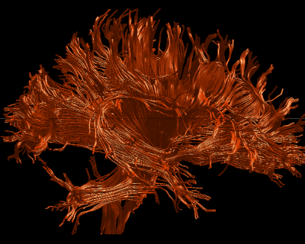
Using Software for
Computing DTI Measurements

Slide 2
Command Line Scripting
-Runs from the terminal
-Takes an input of any number of .vtk file names
-Prints results to the terminal
-Saves to a .csv file you specify

Slide 3
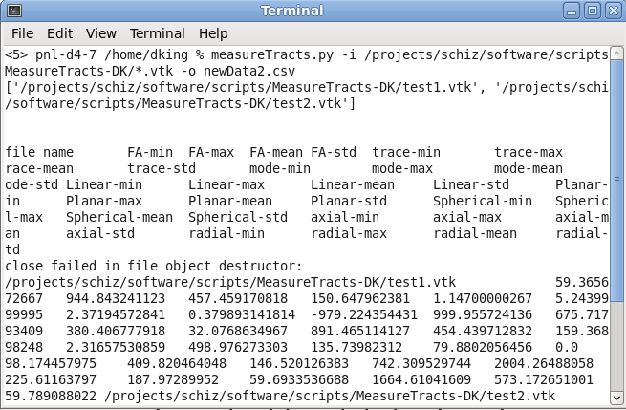
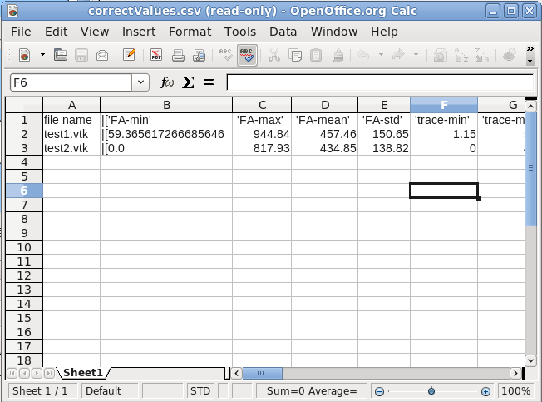
How To Use The Command Line Tool
-Type “measureTracts.py”
-Type “-i” followed by the name of
Each .vtk separated by spaces
-Type “-o” followed by the name of
The .csv you want to save to
-If you enter the name of a .csv which
Already exists, the terminal will ask if
You wish to append the file.
-Enter the tag “-f” or “--force” to overwrite
Any file which may share that name
-Open your .csv as a spreadsheet for
further analysis

Slide 4
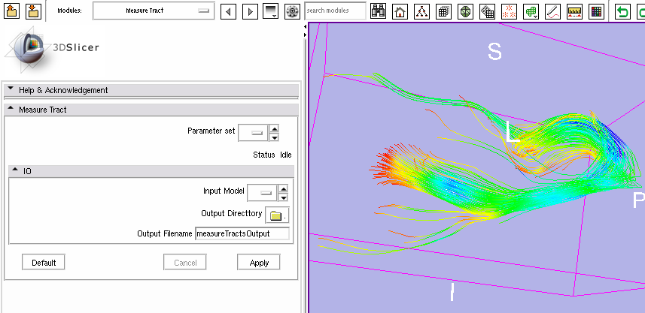
Slicer Module
-Runs in Slicer 3
-Run measures on current tracts open
-Saves to a CSV file you specify
-Easy to install to Slicer

Slide 5
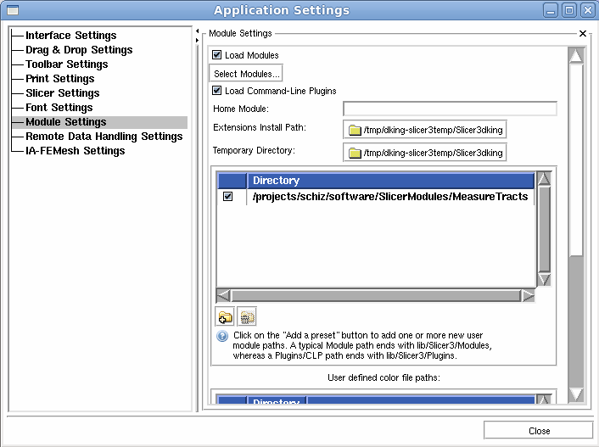
Using the Slicer Module
To Install:
-Open Slicer3
-View > Application Settings
-Click “Module Settings”
-Click the Add Folder icon
-Close Window
-Restart Slicer

Slide 6
Using the Slicer Module
To Run:
5) Specify the output directory and
name your output
6) Click apply
1) Click “Modules” drop-down menu
2) Click “Diffusion” -> ”Measure Tracts”
3) Load .vtk data
4) Under Input Model select your data
Use the same output file for multiple tracts and the Measure Tracts Module will add
the new data to the end of your existing data so you can continue to add to your
data for bulk analysis.

