Slide 1
Speech Perception in Noise and Ideal Time-Frequency Masking
DeLiang Wang
Oticon A/S, Denmark
On leave from Ohio State University, USA

Slide 2
Outline of presentation
Background
  Ideal binary time-frequency mask
  Speech masking in perception
Three experiments on ideal binary masking with normal-hearing listeners
  Two on multitalker mixtures
  One on speech-noise mixtures

Slide 3
Auditory scene analysis (Bregman’90)
Listeners are able to parse the complex mixture of sounds arriving at the ears in order to retrieve a mental representation of each sound source
  Ball-room problem, Helmholtz, 1863 (“complicated beyond conception”)
  Cocktail-party problem (Cherry’53): The challenge of constructing a machine that has cocktail-party processing capability
Two conceptual processes of auditory scene analysis (ASA):
  Segmentation. Decompose the acoustic mixture into sensory elements (segments)
  Grouping. Combine segments into groups (streams), so that segments in the same group likely originate from the same environmental source

Slide 4
Computational auditory scene analysis
Computational ASA (CASA) systems approach sound separation based on ASA principles
Different from traditional sound separation approaches, such as speech enhancement, beamforming with a sensor array, and independent component analysis

Slide 5
Ideal binary mask as the putative goal of CASA
Key idea is to retain parts of a target sound that are stronger than the acoustic background, or to mask interference by the target
  What a target is depends on intention, attention, etc.
Within a local time-frequency (T-F) unit, the ideal binary mask is 1 if target energy is stronger than interference energy, and 0 otherwise (Hu & Wang’01; Roman et al.’03)
  It does not actually separate the mixture!
  Local 0-dB SNR criterion for mask generation
  Earlier studies use binary masks as an output representation (Brown & Cooke’94; Wang and Brown’99; Roweis’00), but do not suggest the explicit notion of the ideal binary mask

Slide 6
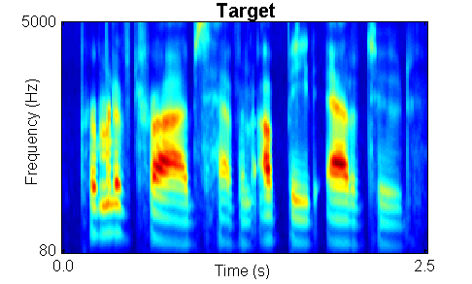
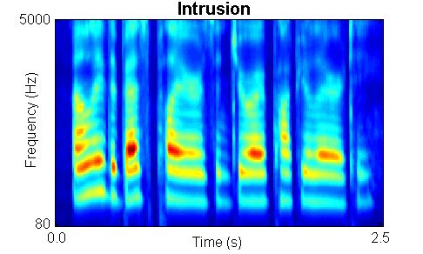

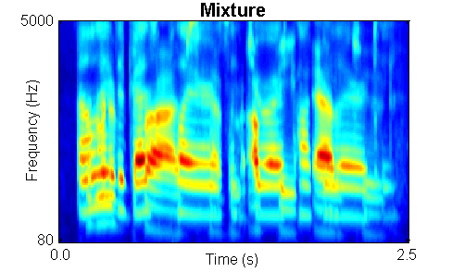
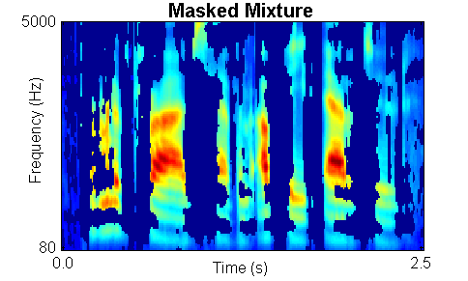
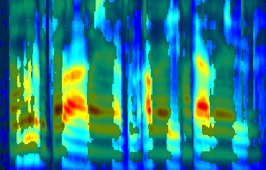
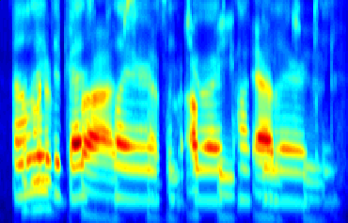
Ideal binary mask illustration

Slide 7
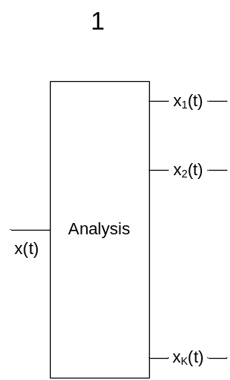
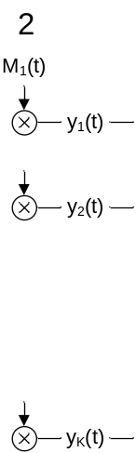
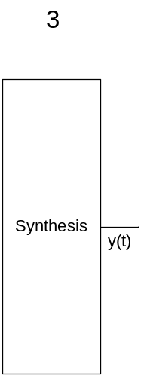
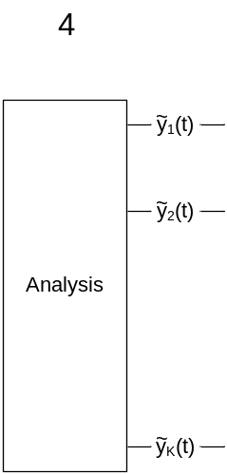
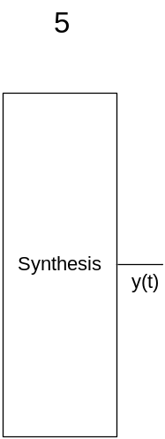
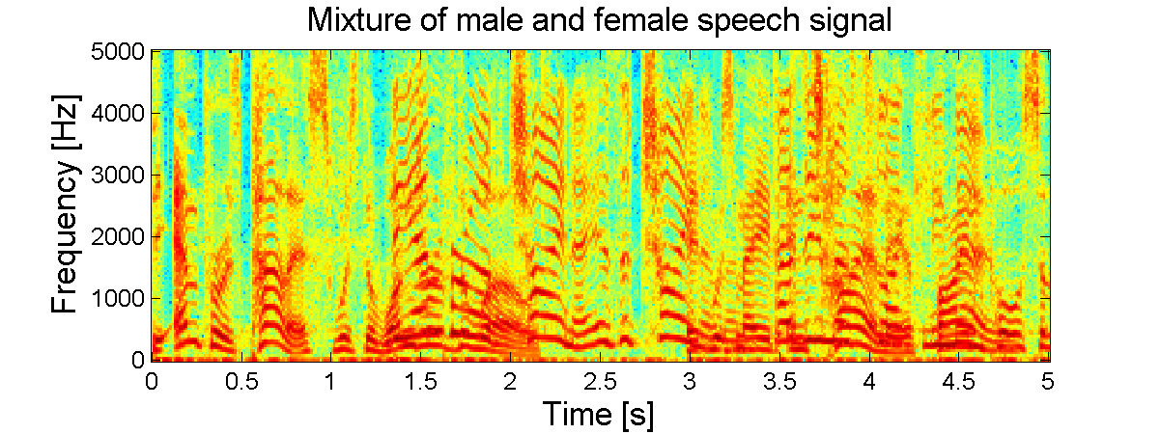
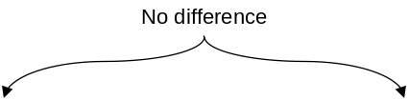
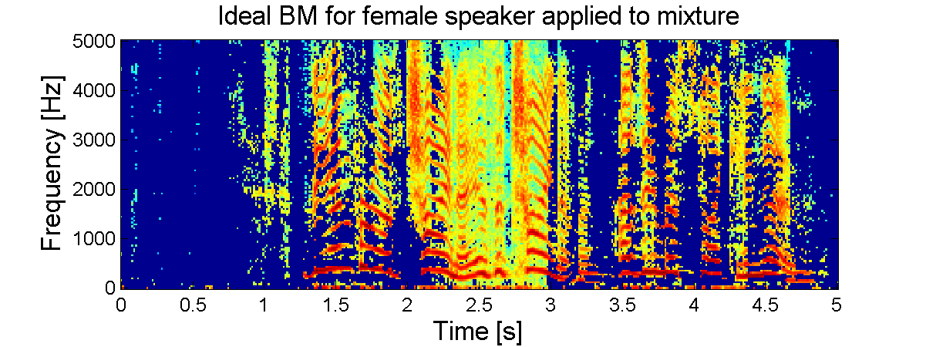
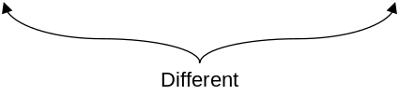
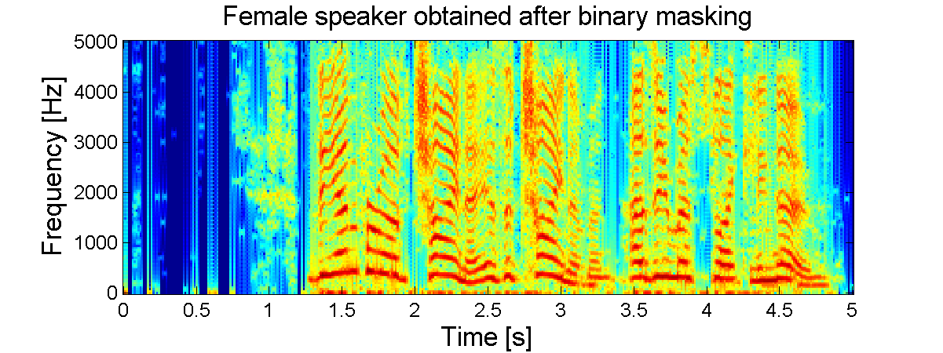
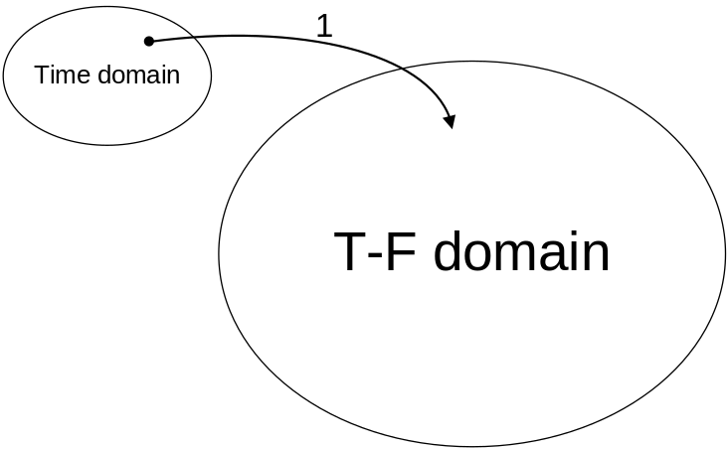
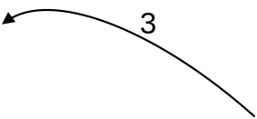
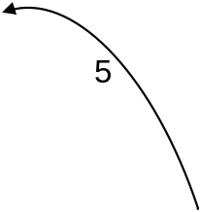
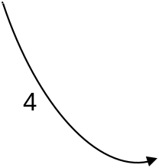

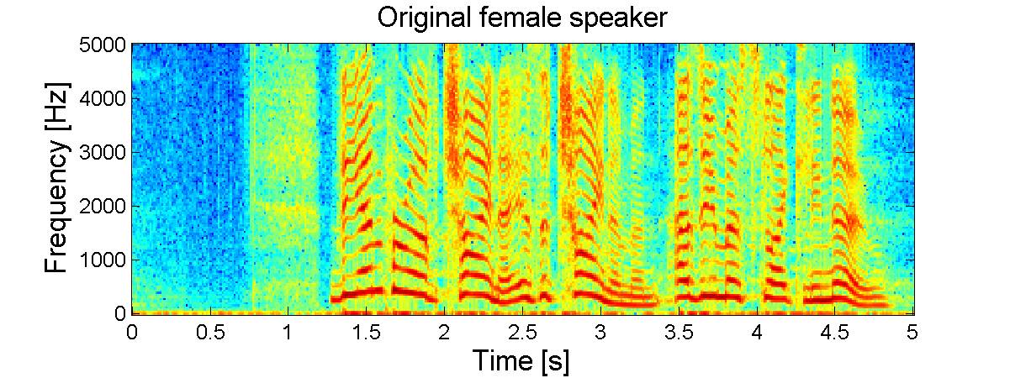
Masking not as discontinuous as it appears

Slide 8


Resemblance to visual occlusion

Slide 9
Properties of ideal binary masks
Consistent with the auditory masking phenomenon
  Drullman (1995) finds no intelligibility difference whether noise is removed or kept in target-stronger T-F regions
Optimality: The ideal binary mask is the optimal binary mask from the perspective of SNR gain
Flexibility: With the same mixture, the definition leads to different masks depending on what target is
Well-definedness: An ideal mask is well-defined no matter how many intrusions are in the scene or how many targets need to be segregated
Ideal binary masks provide a highly effective front-end for automatic speech recognition (Cooke et al.’01; Roman et al.’03)
  ASR performance degrades gradually with deviations from the ideal mask (Roman et al.’03)

Slide 10
Speech-on-speech masking
Speech masking: A target speech signal is overwhelmed by a competing speech signal, causing degraded intelligibility of the target speech by a listener
Energetic masking
  Spectral overlap of target and interfering speech, making the target inaudible
  Competition at the periphery of the auditory system
Informational masking
  Target and interference are both audible, but the listener is unable to hear the target
  Closely related with ASA: Voice characteristics, spatial cues, etc.
Notes:
In-depth look at the phenomenon of speech-on-speech masking using the behavioral approach
Energetic
target and interfering speech overlap in time and frequency, and one or both speech signals rendered acoustically inaudible.
Mechanism is better understood, there is competition at the periphery of the auditory system. Overlapping excitation patterns in the cochlea
Intelligibility degrades monotonically with decreasing SNR
Informational Masking
At the stimulus and peripheral level, signal and interference audible, but listener unable to disentangle the elements of target from similar sounding distracter signal.

Slide 11
Isolating informational masking
Energetic and informational masking coexist in speech perception, making it difficult to study one form of masking
Brungart and Simpson (2002) isolate informational masking using across-ear effect
Arbogast et al. (2002) divide speech signal into envelope modulated sine waves, or separate frequency bands
Notes:
Brungart and Simpson (2001)’s experiments show coexistence of informational and energetic masking.
They have also isolated informational masking using across-ear effect when listening to two talkers in one ear experience informational masking from third signal in the opposite ear (Brungart and Simpson, 2002)
Arbogast et al. (2002) divide speech signal into 15 log spaced, envelope modulated sinewaves. Assign some to target and some to interference: intelligible speech with no spectral overlaps

Slide 12
Isolating energetic masking
The ideal binary mask provides a potential methodology to remove informational masking, hence isolating energetic masking
  Eliminate portions of the target dominated by interfering speech, hence accounting for the loss of target information due to energetic masking
  Retain only acoustically detectable portions of target speech
  Perform “ideal” time-frequency segregation, hence eliminating informational masking
Notes:
Create a continuous noise signal that match long-term average spectrum of speech
Further approach to divide “speech-spectrum-shaped” noise into number of bands and modulate with natural speech envelopes
However, noise signal too “speech-like” and reintroduce informational masking (Brungart et al. 2004)
Alternatively, use Ideal Binary Mask to remove informational masking
Eliminate portions of stimulus dominated by the interfering speech.
Retain only portions of target speech acoustically detectable in the presence of interfering speech

Slide 13
Ideal mask methodology
Process the original target speech and masker(s) signals through a bank of fourth-order gammatone filters (Patterson et al.’88), resulting in the cochleagram representation
Generate the ideal mask matrix by comparing target and masker energy at each T-F unit of the filter output before mixing
  Criteria other than 0 dB LC are possible
Synthesize new speech stimulus based on the resulting mask of a matrix of binary weights, and the gammatone output of the speech mixture

Slide 14
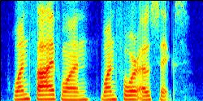
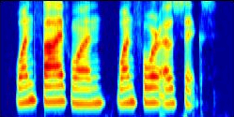
Cochleagram: Auditory peripheral model
Spectrogram
Plot of log energy across time and frequency (linear frequency scale)
Cochleagram
Cochlear filtering by the gammatone filterbank (or other models of cochlear filtering), followed by a stage of nonlinear rectification; the latter corresponds to hair cell transduction by either a hair cell model or simple compression operations (log and cubic root)
Quasi-logarithmic frequency scale, and filter bandwidth is frequency-dependent
Widely used in CASA
Spectrogram
Cochleagram

Slide 15
Effects of local SNR criteria
Positive LC (local SNR criterion) values
  Only retain T-F units where target is strong relative to interference
  Further remove target information, caused by the energetic masking by the interference
  As a result, the target signal would become less audible
    Performance degradation due to energetic masking by the interfering signal as T-F units with not-so-strong target energy are removed
  Performance would show “true” energetic effects without confounding with informational masking

Slide 16
Effects of local SNR criteria
Negative LC values
  Retain more T-F units in a mixture, even those units where the target is “very” weak compared to the masker
  Build up the effects of informational masking by the interference because the processing retains units where interference is audible and becomes stronger than the target
  Performance would degrade, and it would be interesting to see at what point the performance becomes equal that of the original mixture

Slide 17
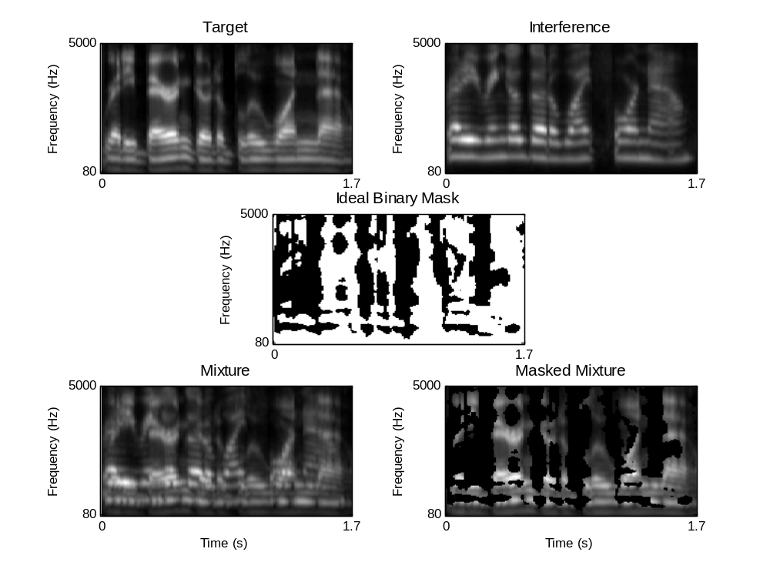

Original ideal mask – 0 dB LC
“Ready Baron go to blue 1 now”
“Ready Ringo go to white 4 now”

Slide 18
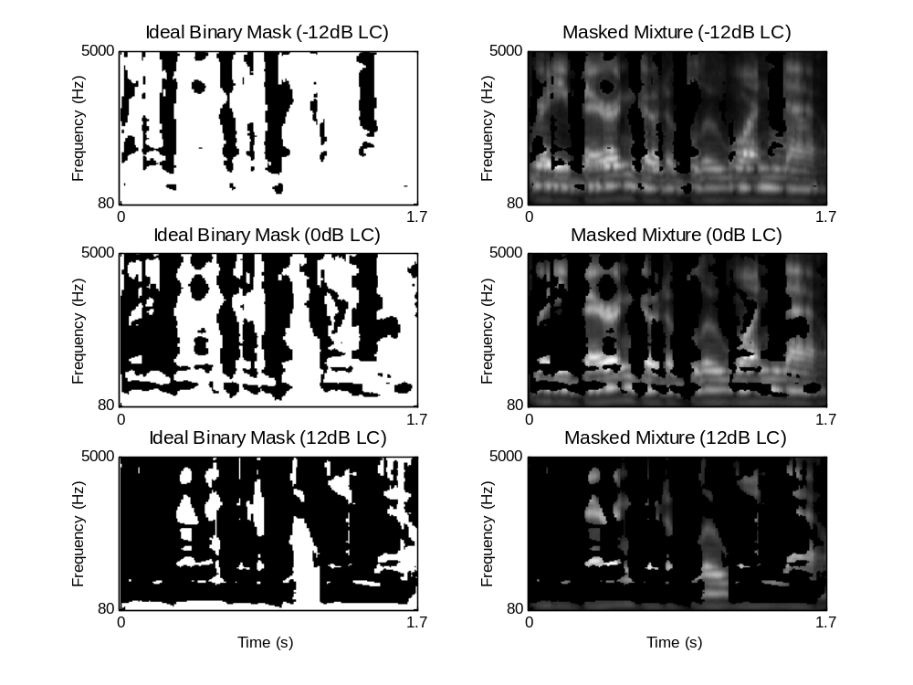
Varying LC values
Positive 12-dB LC corresponds to each T-F unit being assigned “1” if the target energy in that unit is 12 dB greater than interference energy and “0” otherwise

Slide 19
Experimental setup
Two, three, or four simultaneous talkers. One of them is the target utterance. All the talkers are normalized to be equally loud, or 0 dB target-to-masker ratio (TMR = 0 dB)
Nine listeners with normal hearing
Stimuli: CRM (coordinate response measure) corpus
  Form: “Ready (call sign) go to (color) (number) now”
  Call Signs: “arrow”, “BARON”, “charlie”, “eagle”, “hopper,” “laker”, “ringo”, “tiger”
  Colors: “blue”, “green”, “red”, “white”
  Numbers: 1 through 8
  Target phrase contains the call sign “Baron” and masking phrase contains a randomly selected call sign other than “Baron”

Slide 20

Experiment 1
Experiment 1 uses same-talker utterances
  Typical stimulus: 2-talkers (2-utterances)

Slide 21
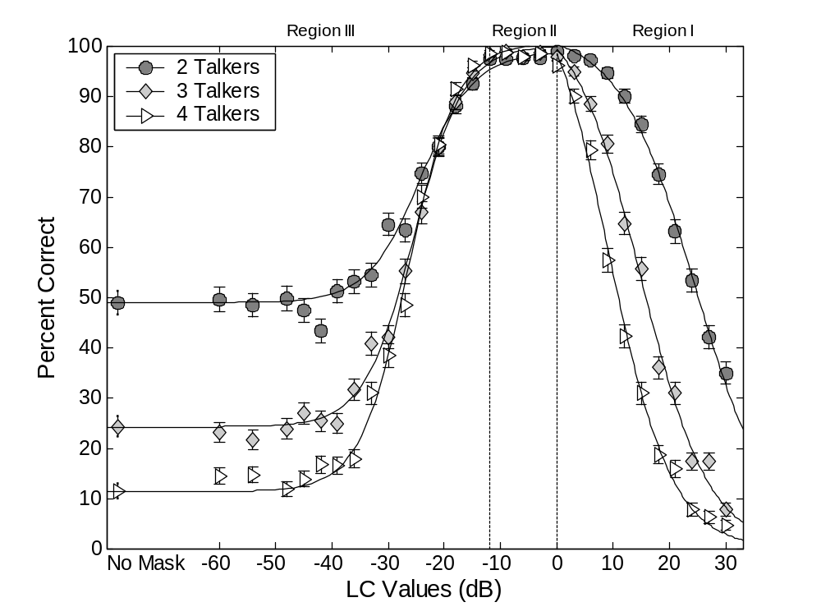
Experiment 1 results
4-T
2-T
2-T
3-T

Slide 22
Three distinct regions of performance
Region I: Positive LC – Masking by removing target energy: Energetic masking
  Each ΔdB increase above 0 dB in LC eliminates the same T-F units as fixing LC to 0 dB while reducing overall SNR by ΔdB
  Hence the performance in Region I indicates the effect of energetic masking on multitalker speech perception with the corresponding reduction of overall SNR
Region II: Near perfect performance for LC from -12 dB LC to 0 dB, centering at -6 dB
  Not centering at 0 dB – the optimal LC from the SNR gain standpoint
Region III: Below -12 dB LC – Masking by adding back interference: Informational masking

Slide 23
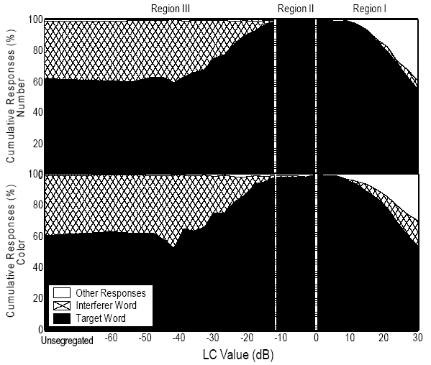
Error analysis for the two-talker case
Supporting the hypothesis that Region I errors are due to energetic masking and Region III errors are due to informational masking

Slide 24
Experiment 2
Interfering speech signal was from the same talker, same-sex talker(s), or different-sex talker(s) compared to the target signal
What portion of the release from masking is attributed to energetic and informational masking when there are different characteristics between target and masker?

Slide 25
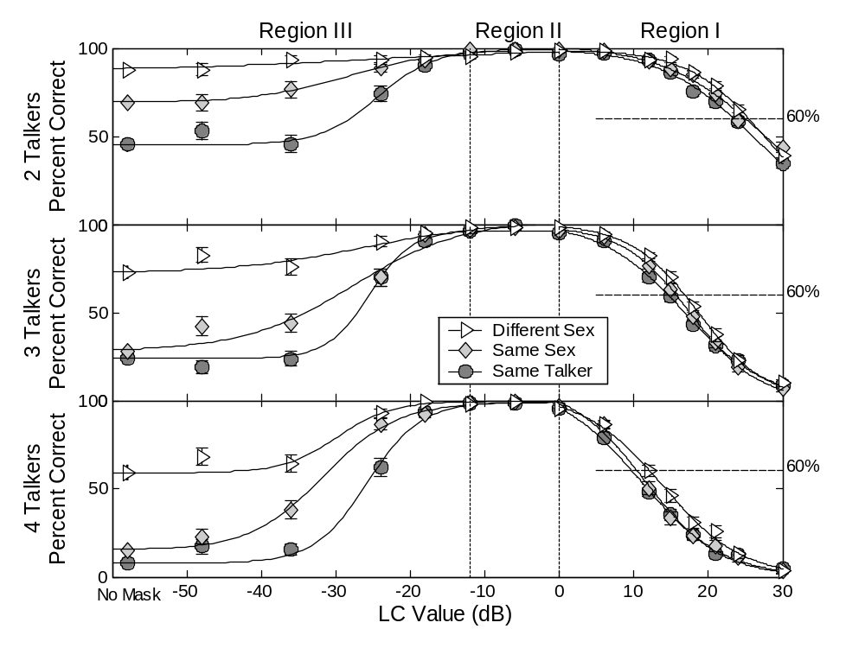
Experiment 2 results

Slide 26
Experiment 3: Speech perception in noise
What effect does the ideal binary mask have on the intelligibility of speech in continuous noise?
Masking by continuous noise is considered primarily energetic masking
Two types of noise were employed: speech-shaped noise and speech-modulated noise (to further match the envelope of a nontarget phrase)
Two methods of ideal mask generation to test the equivalence between varying overall SNR and varying corresponding LC values
  Method 1: Fix overall SNR to 0 dB while varying LC in the positive range
  Method 2: Fix LC to 0 dB while varying overall SNR in the negative range
Notes:
Interfering speech signals were from the same talker as the target, but vary in number of simultaneous voices from 2 to 19
Fill in the gaps with more speakers?
This experiment tests the resilience of the ideal binary mask as the mixture becomes more of that in a cocktail party, test the “orthogonality” of speech in time-frequency domain

Slide 27
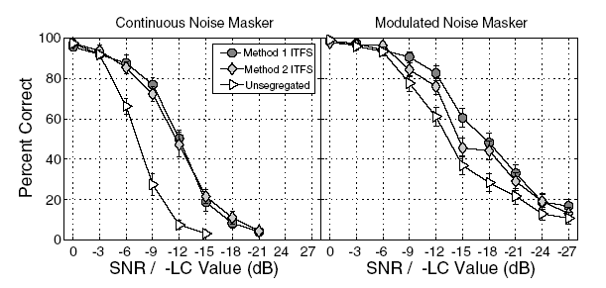
Experiment 3 results
Methods 1 and 2 produce very similar results, supporting the equivalence of varying overall SNR and LC values
Benefit from ideal binary masking (2-5 dB) is much smaller than with speech maskers
Consistent with the hypothesis that ideal masking mainly removes informational masking
Notes:
Interfering speech signals were from the same talker as the target, but vary in number of simultaneous voices from 2 to 19
Fill in the gaps with more speakers?
This experiment tests the resilience of the ideal binary mask as the mixture becomes more of that in a cocktail party, test the “orthogonality” of speech in time-frequency domain

Slide 28
Conclusions from experiments
Applying the ideal binary mask (or ideal T-F segregation) leads to dramatic increase in speech intelligibility in multitalker conditions
Informational masking effects dominate performance in the CRM task
Similarities between the voice characteristics of the target and interfering talkers have minor effect on energetic masking
Continuous noise masker results in a much greater increase in energetic masking
  In this case, the ideal binary mask leads to smaller performance gain compared to multitalker situations
Notes:
Adding additional talkers to a multitalker stimulus results in a greater increase in energetic masking than would be predicted from the overall decrease in the signal-to-noise ratio of the stimulus

Slide 29
Limitations and related work
The small lexicon of the CRM corpus. Tests with larger vocabulary corpus are needed for firmer conclusions
Non-simultaneous masking is not considered
Performance on hearing-impaired listeners?
Notes:
Effects of energetic masking is partially because of small word set

Slide 30
What about hearing-impaired listeners?
Anzalone et al. (2006) recently tested a different version of the ideal binary mask on both normal-hearing and hearing-impaired listeners
Their tests use HINT sentences mixed with speech-shaped noise
Ideal masking leads to 9 dB SRT (speech reception threshold) reduction for hearing impaired listeners (left) and more than 7 dB for normal hearing listeners
  Hearing impaired listeners are not as sensitive to binary processing artifacts compared to normal hearing listeners
Notes:
Adding additional talkers to a multitalker stimulus results in a greater increase in energetic masking than would be predicted from the overall decrease in the signal-to-noise ratio of the stimulus

Slide 31
Acknowledgment
Joint work with Douglas Brungart, Peter Chang, and Brian Simpson
Subject of a 2006 JASA paper

