Slide 1
From Auditory Masking to Supervised Separation: A Tale of Improving Intelligibility of Noisy Speech for Hearing-impaired Listeners
DeLiang Wang
Perception & Neurodynamics Lab
Ohio State University

Slide 2
Acknowledgments
Joint work with
  Eric Healy and Sarah Yoho Leopold
  Jitong Chen and Yuxuan Wang
Funding provided by NIDCD and AFOSR

Slide 3
Outline of presentation
Auditory masking and binary masking
  Ideal binary mask
  Separation as classification
DNN based mask estimation
  Speech intelligibility tests on hearing impaired listeners
Discussion: CI processing

Slide 4

Auditory masking phenomenon
Definition: “The process by which the threshold of audibility for one sound is raised by the presence of another (masking) sound” (American Standards Association, 1960)
  A basic phenomenon in auditory perception
  Roughly speaking, a strong sound masks a weaker one within a critical band

Slide 5
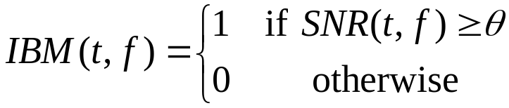
Ideal binary mask as a separation goal
Motivated by the auditory masking phenomenon and auditory scene analysis, we suggested the ideal binary mask as a main goal of CASA (Hu & Wang, 2001; 2004)
The idea is to retain parts of a mixture where the target sound is stronger than the acoustic background, and discard the rest
Definition of the ideal binary mask (IBM)
  θ: A local SNR criterion (LC) in dB
  Optimal SNR: Under certain conditions the IBM with θ = 0 dB is the optimal binary mask in terms of SNR gain (Li & Wang’09)
  Maximal articulation index (AI) in a simplified version (Loizou & Kim’11)
  It does not actually separate the mixture!

Slide 6
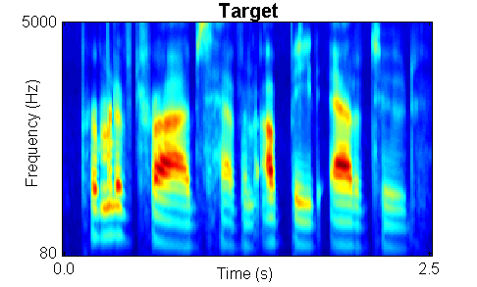
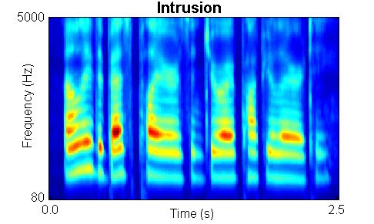

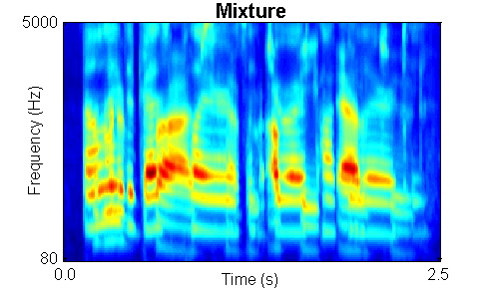
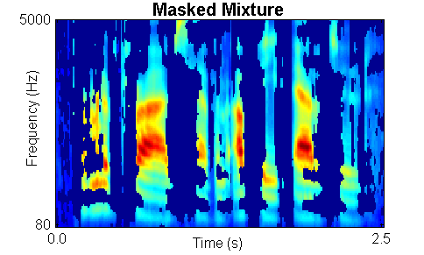
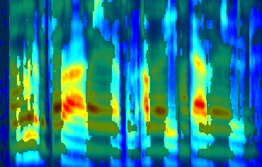
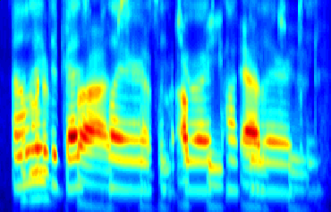
IBM illustration

Slide 7
Subject tests of ideal binary masking
IBM separation leads to dramatic speech intelligibility improvements
  Improvement for stationary noise is above 7 dB for normal-hearing (NH) listeners (Brungart et al.’06; Li & Loizou’08; Cao et al.’11; Ahmadi et al.’13), and above 9 dB for hearing-impaired (HI) listeners (Anzalone et al.’06; Wang et al.’09)
  Improvement for modulated noise is significantly larger than for stationary noise
With the IBM as the goal, the speech separation problem becomes a binary classification problem
  This new formulation opens the problem to a variety of pattern classification methods
Notes:
Brungart and Simpson (2001)’s experiments show coexistence of informational and energetic masking.
They have also isolated informational masking using across-ear effect when listening to two talkers in one ear experience informational masking from third signal in the opposite ear (Brungart and Simpson, 2002)
Arbogast et al. (2002) divide speech signal into 15 log spaced, envelope modulated sinewaves. Assign some to target and some to interference: intelligible speech with no spectral overlaps

Slide 8
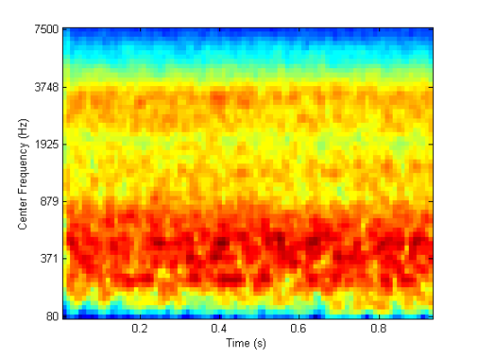

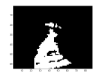
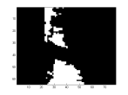
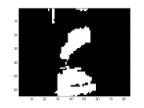
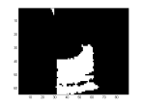
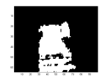
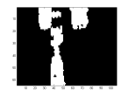
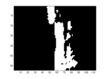
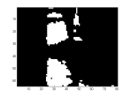
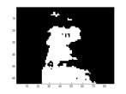
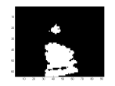
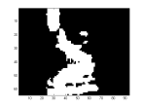
Speech perception of noise with binary gains
Wang et al. (2008) found that, when LC is chosen to be the same as the input SNR, nearly perfect intelligibility is obtained when input SNR is -∞ dB (i.e. the mixture contains noise only with no target speech)
IBM modulated noise for ???
Speech shaped noise
Notes:
Create a continuous noise signal that match long-term average spectrum of speech
Further approach to divide “speech-spectrum-shaped” noise into number of bands and modulate with natural speech envelopes
However, noise signal too “speech-like” and reintroduce informational masking (Brungart et al. 2004)
Alternatively, use Ideal Binary Mask to remove informational masking
Eliminate portions of stimulus dominated by the interfering speech.
Retain only portions of target speech acoustically detectable in the presence of interfering speech

Slide 9
Outline of presentation
Auditory masking and binary masking
  Ideal binary mask
  Separation as classification
DNN based mask estimation
  Speech intelligibility tests on hearing impaired listeners
Discussion: CI processing

Slide 10
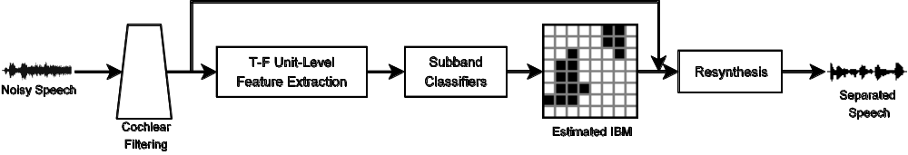
DNN for IBM estimation (Wang & Wang’13)
Why deep neural network (DNN)?
  Automatically learn more abstract features as the number of layers increases
  More abstract features tend to be more invariant to superficial variations
Wang and Wang (2013) first introduced DNN to address the speech separation problem
  DNN is used as an IBM estimator, performing feature learning from raw acoustic features

Slide 11
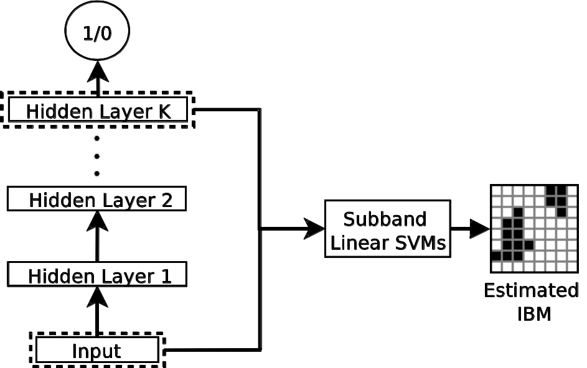
DNN as subband classifier (Wang & Wang’13)

Slide 12
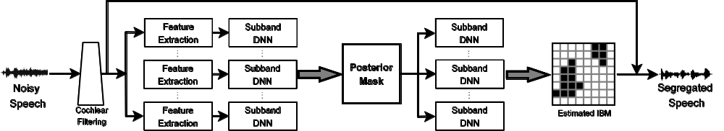
Speech intelligibility evaluation
We subsequently tested speech intelligibility of hearing-impaired (HI) listeners (Healy et al.’13)
  A very challenging problem: “The interfering effect of background noise is the single greatest problem reported by hearing aid wearers” (Dillon’12)
Two stage DNN training to incorporate time-frequency (T-F) context in classification

Slide 13
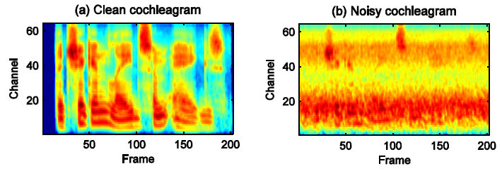
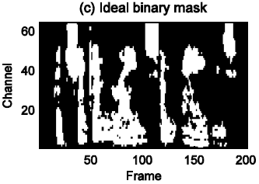
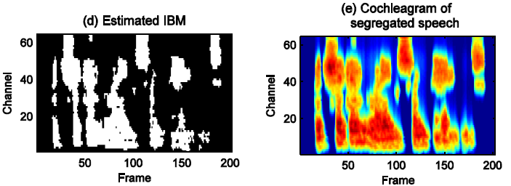
An illustration
  A HINT sentence mixed with speech-shaped noise at -5 dB SNR

Slide 14
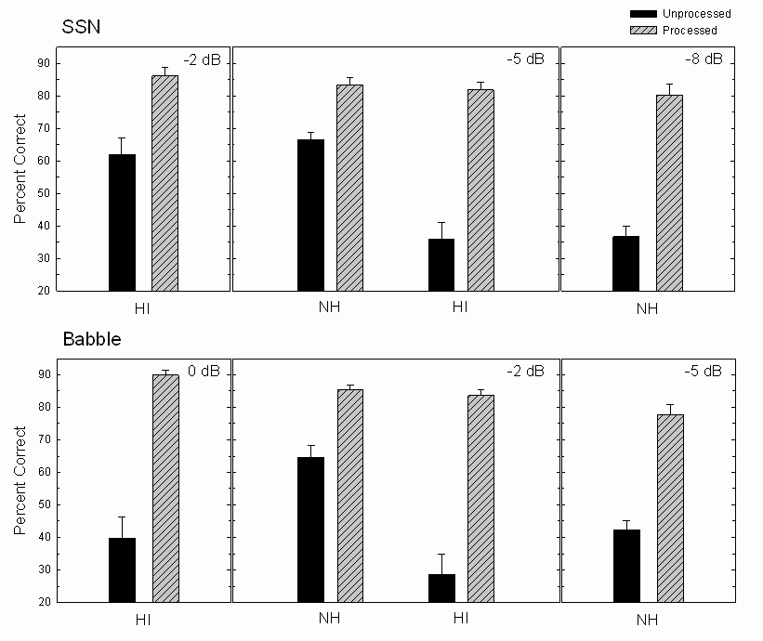

Results and sound demos
Both HI and NH listeners showed intelligibility improvements
HI subjects with separation outperformed NH subjects without separation

Slide 15
Generalization to new noise segments
While previous results are impressive, a major limitation is that training and test noise samples were drawn from the same noise segments
  Speech utterances were different
  Noise samples were randomized
We have recently addressed this limitation through extensive training (Healy et al.’15)
  Estimation of the ideal ratio mask (IRM) using DNN
  Frame-level estimation rather than subband classification
  Training on the first 8 minutes of two nonstationary noises (20-talker babble and cafeteria noise) and test on the last 2 minutes of the noises
  Noise perturbation (Chen et al.’14) is used to enrich noise samples for training

Slide 16
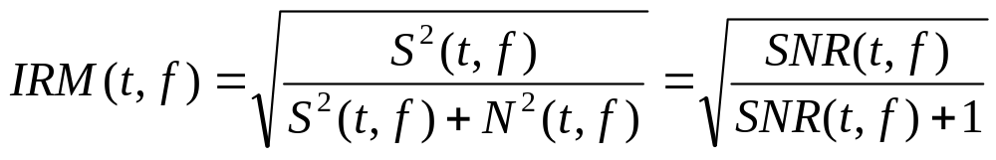
Ideal ratio mask
Definition of the IRM (Srinivasan et al.’06)
  Closely related to the Wiener filter
  Recent examination shows that the IRM performs better than the IBM for objective speech quality, and similarly in terms of predicted intelligibility (Wang et al.’14)

Slide 17
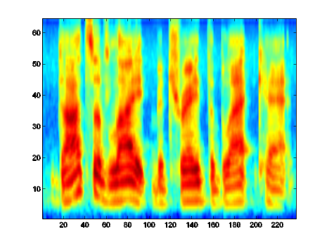
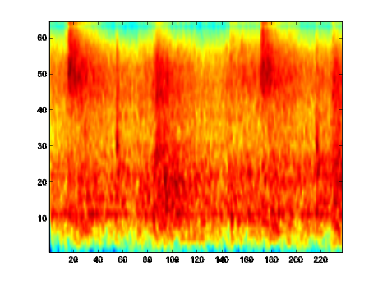
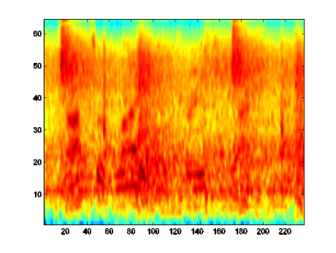
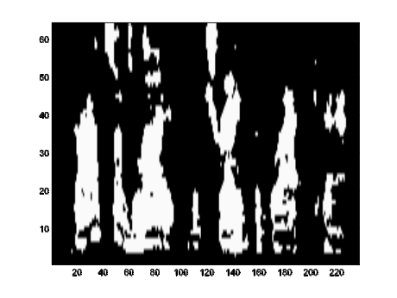
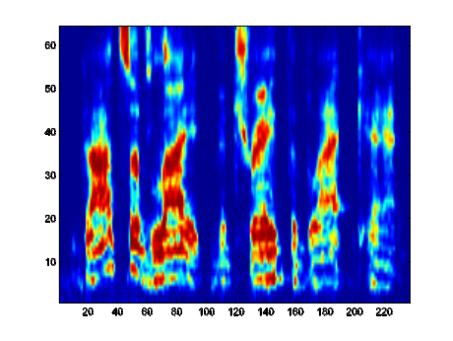
IRM versus IBM: sound demo
speech
noise
mixture
IBM
IRM

Slide 18
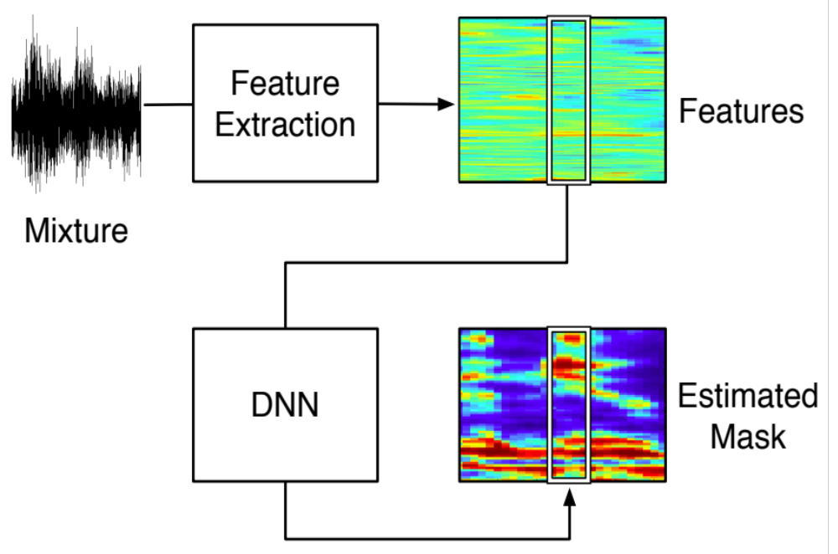
DNN based IRM estimation

Slide 19
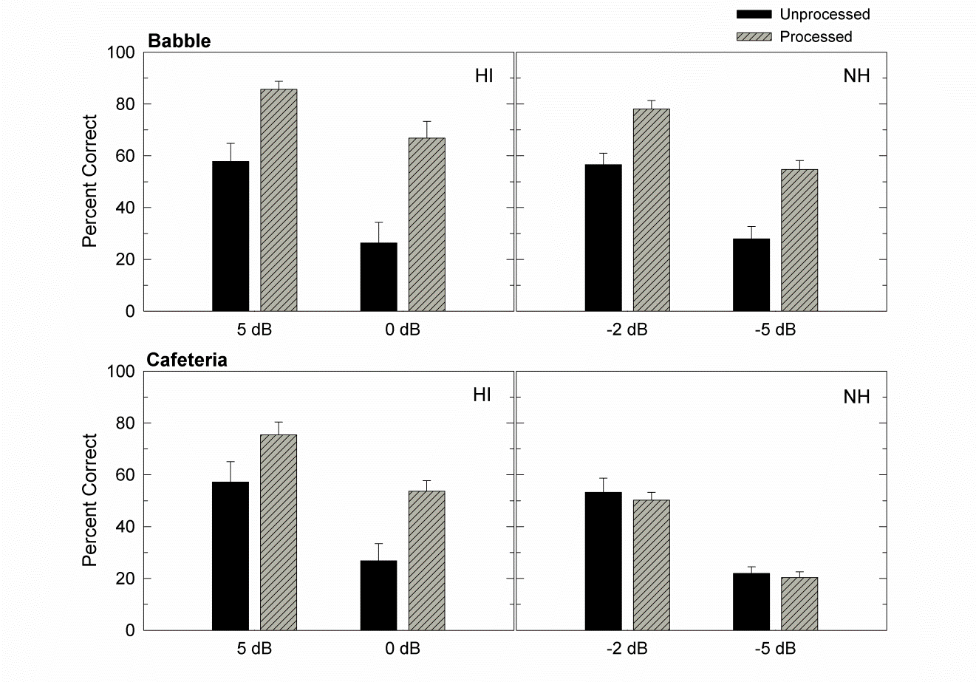
Results and demos
HI listeners showed intelligibility improvements with both noises at both SNRs
NH listeners showed intelligibility improvements for babble noise, but not for cafeteria noise

Slide 20
Outline of presentation
Auditory masking and binary masking
  Ideal binary mask
  Separation as classification
DNN based mask estimation
  Speech intelligibility tests on hearing impaired listeners
Discussion: CI processing

Slide 21
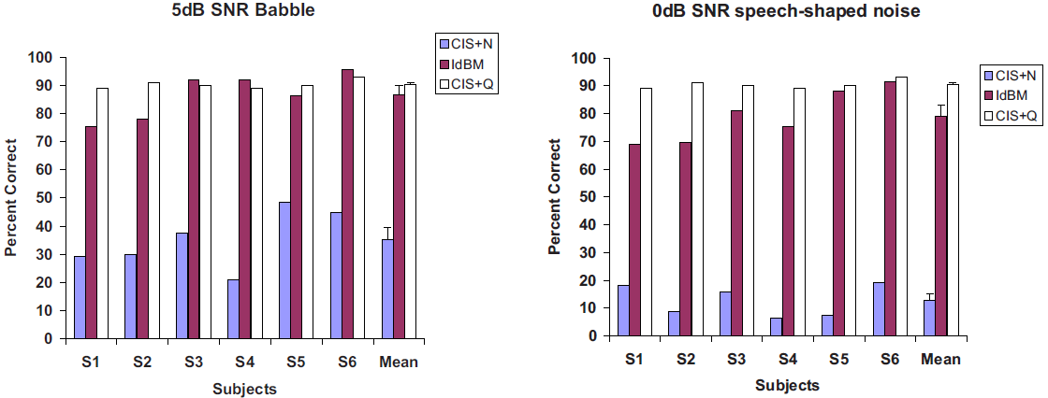
Cochlear implant processing
Loizou’s group did a lot of work in CI processing
  Ideal binary masking is a natural channel selection strategy and very effective for improving speech intelligibility (Hu & Loizou’08)
  Effective for reverberation suppression (Kokkinakis et al.’11), and combined reverberation and noise (Hazrati & Loizou’12)
  Mask estimation produces substantial intelligibility improvements (Hu & Loizou’10; Hazrati et al.’13)
Hu & Loizou’08

Slide 22
Cochlear implants versus hearing aids
Speech intelligibility of CI users degrade at higher SNRs (about 5-10 dB higher) than hearing aid (HA) users
  CI users likely benefit more from masking algorithms than HA users
Speech processors are more powerful in CIs
Speech quality is less of a concern, and IBM and IRM processing are almost equally effective for CI users in both intelligibility and quality (Koning et al.’15)
These factors suggest that CIs are a more favorable platform for masking algorithms
Although not studied yet, DNN-based mask estimation should be very promising for CIs

Slide 23
Conclusion
From auditory masking to the IBM notion, to classification for speech separation
This new formulation enables the use of supervised learning
  It shifts workload to the training stage, and often operates efficiently after training
  Extensive training with DNN is a promising direction
The first demonstrations of substantial speech intelligibility improvement in noise for HI listeners

