Slide 1
Auditory Segmentation and Unvoiced Speech Segregation
DeLiang Wang & Guoning Hu
Perception & Neurodynamics Lab
The Ohio State University

Slide 2
Outline of presentation
Introduction
  Auditory scene analysis
  Unvoiced speech problem
Auditory segmentation based on event detection
Unvoiced speech segregation
Summary

Slide 3
Speech segregation
In a natural environment, speech is usually corrupted by acoustic interference. Speech segregation is critical for many applications, such as automatic speech recognition and hearing prosthesis
Most speech separation techniques, e.g. beamforming and blind source separation via independent analysis, require multiple sensors. However, such techniques have clear limits
  Suffer from configuration stationarity
  Can’t deal with single-microphone mixtures
Most speech enhancement developed for monaural situation can deal with only stationary acoustic interference

Slide 4
Auditory scene analysis (ASA)
The auditory system shows a remarkable capacity in monaural segregation of sound sources in the perceptual process of auditory scene analysis (ASA)
ASA takes place in two conceptual stages (Bregman’90):
  Segmentation. Decompose the acoustic signal into ‘sensory elements’ (segments)
  Grouping. Combine segments into streams so that the segments of the same stream likely originate from the same source

Slide 5
Computational auditory scene analysis
Computational ASA (CASA) approaches sound separation based on ASA principles
CASA successes: Monaural segregation of voiced speech
A main challenge is segregation of unvoiced speech, which lacks the periodicity cue

Slide 6
Unvoiced speech
Speech sounds consist of vowels and consonants, the latter are further composed of voiced and unvoiced consonants
For English, the relative frequencies of different phoneme categories are (Dewey’23):
  Vowels: 37.9%
  Voiced consonants: 40.3%
  Unvoiced consonants: 21.8%
In terms of time duration, unvoiced consonants account for about 1/5 in American English
Consonants are crucial for speech recognition

Slide 7
Ideal binary mask as CASA goal
Key idea is to retain parts of a target sound that are stronger than the acoustic background, or to mask interference by the target
  Broadly consistent with auditory masking and speech intelligibility results
Within a local time-frequency (T-F) unit, the ideal binary mask is 1 if target energy is stronger than interference energy, and 0 otherwise
  Local 0 SNR criterion for mask generation

Slide 8
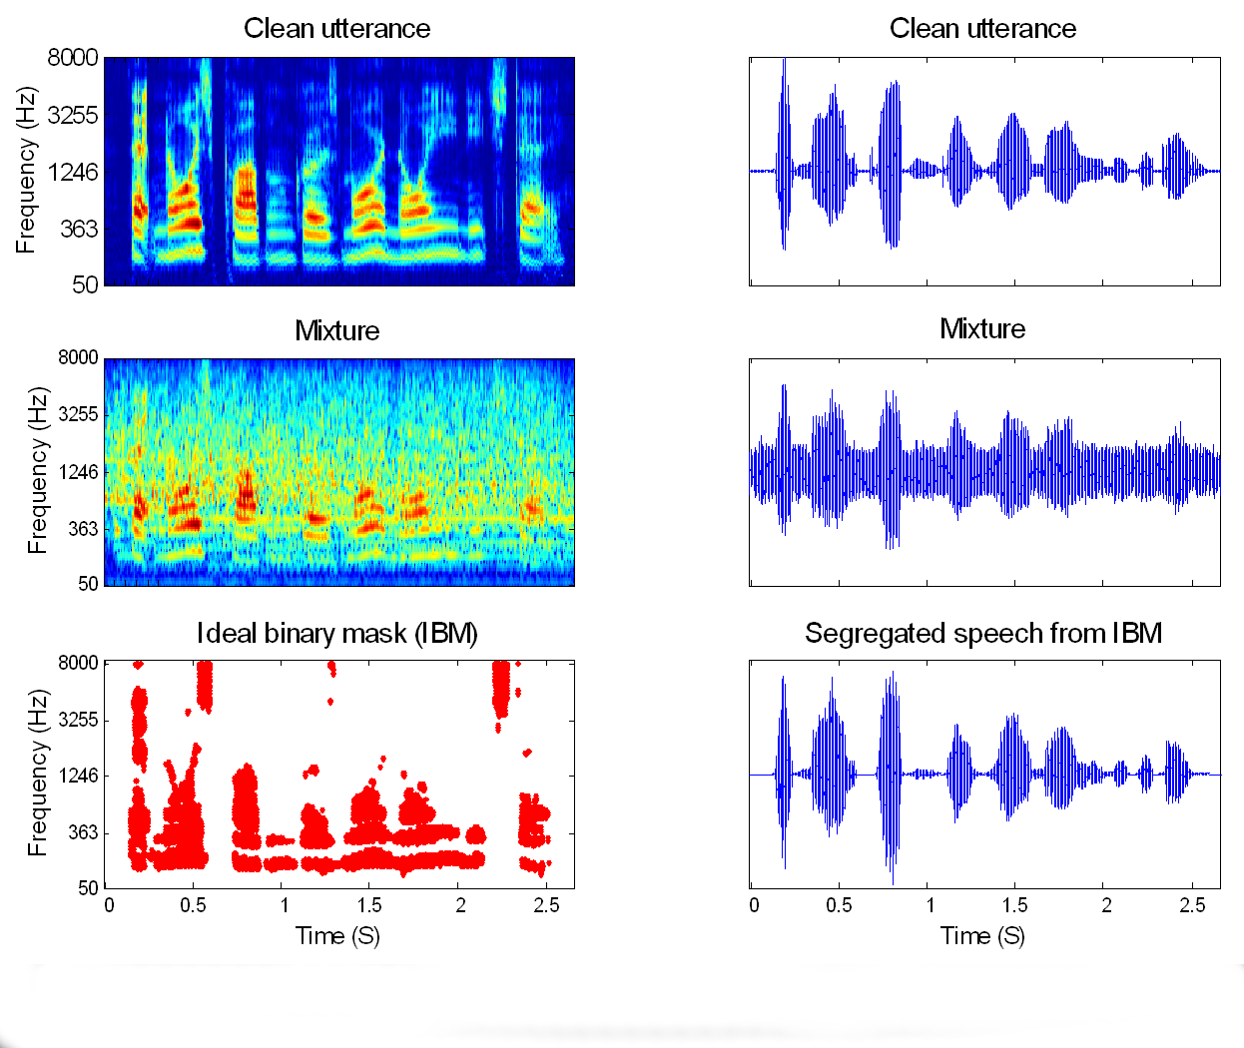

Ideal binary masking illustration
Utterance: “That noise problem grows more annoying each day”
Interference: Crowd noise with music (0 SNR)

Slide 9
Outline of presentation
Introduction
  Auditory scene analysis
  Unvoiced speech problem
Auditory segmentation based on event detection
Unvoiced speech segregation
Summary

Slide 10
Auditory segmentation
Our approach to unvoiced speech segregation breaks the problem into two stages: segmentation and grouping
  This presentation is mainly about segmentation
The task of segmentation is to decompose an auditory scene into contiguous T-F regions, each of which should contain signal from the same event
  It should work for both voiced and unvoiced sounds
This is equivalent to identifying onsets and offsets of individual T-F regions, which generally correspond to sudden changes of acoustic energy
Our segmentation strategy is based on onset and offset analysis of auditory events

Slide 11
What is an auditory event?
To define an auditory event, two perceptual effects need to be considered:
  Audibility
  Auditory masking
We define an auditory event as a collection of the audible T-F regions from the same sound source that are stronger than combined intrusions
Hence the computational goal of segmentation is to produce segments, or contiguous T-F regions, of an auditory event
  For speech, a segment corresponds to a phone

Slide 12
Cochleogram as a peripheral representation
We decompose an acoustic input using a gammatone filterbank
  128 filters centered from 50 Hz to 8 kHz
  Filtering is performed in 20-ms time frames with 10-ms frame shift
The intensity output forms what we call a cochleogram

Slide 13
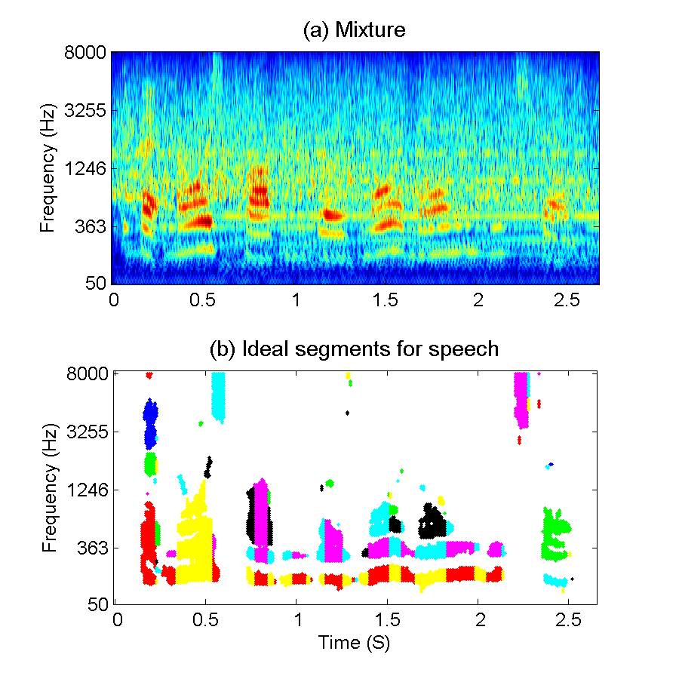
Cochleogram and ideal segments

Slide 14
Scale-space analysis for auditory segmentation
From a computational standpoint, auditory segmentation is similar to image segmentation
  Image segmentation: Finding bounding contours of visual objects
  Auditory segmentation: Finding onset and offset fronts of segments
Our onset/offset analysis employs scale-space theory, which is a multiscale analysis commonly used in image segmentation
Our proposed system performs the following computations:
  Smoothing
  Onset/offset detection and matching
  Multiscale integration

Slide 15
Smoothing
For each filter channel, the intensity is smoothed over time to reduce the intensity fluctuation
An event tends to have onset and offset synchrony in the frequency domain. Consequently the intensity is further smoothed over frequency to enhance common onsets and offsets in adjacent frequency channels
Smoothing is done via dynamic diffusion

Slide 16
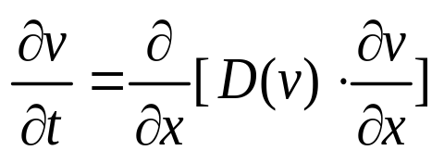
Smoothing via diffusion
A one-dimensional diffusion of a quantity v across the spatial dimension x is governed by:
D is a function controlling the diffusion process. As t increases, v gradually smoothes over x
The diffusion time t is called the scale parameter and the smoothed v values at different times compose a scale space

Slide 17

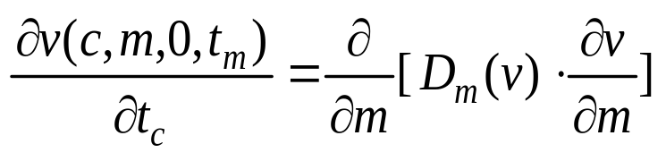
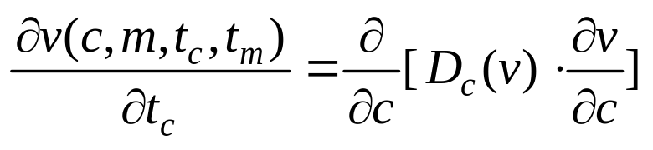
Diffusion
Let the input intensity be the initial value of v, and let v diffuse across time frames, m, and filter channels, c, as follows:
  I(c, m) is the logarithmic intensity in channel c at frame m

Slide 18

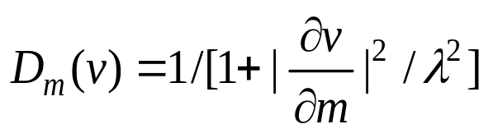
Diffusion, continued
Two forms of D_{m}(v) are employed in the time domain:
  D_{m}(v) = 1, which reduces to Gaussian smoothing:
  Perona-Malik (’90) anisotropic diffusion:
  Compared with Gaussian smoothing, the Perona-Malik model may identify onset and offset positions bettter
In the frequency domain, D_{c}(v) = 1

Slide 19
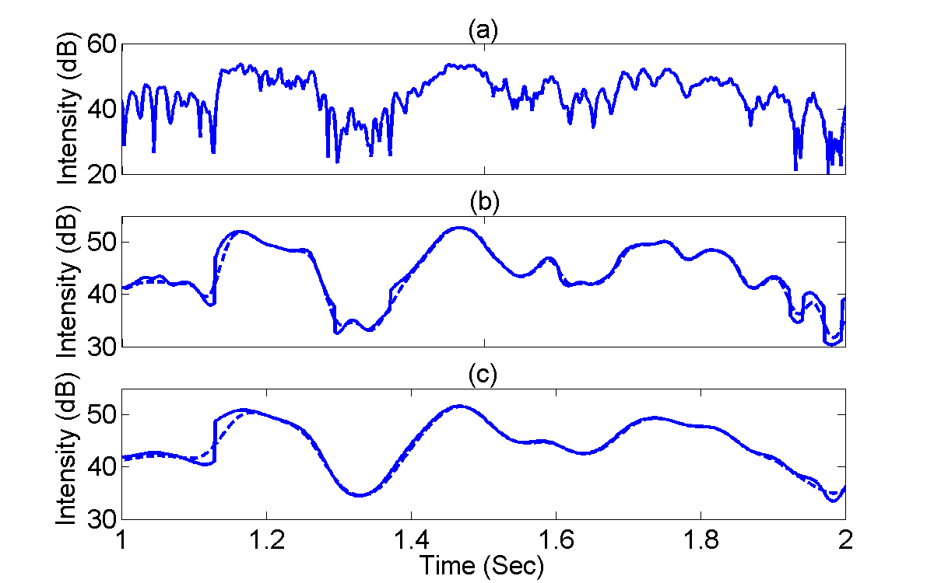
Diffusion results
Top: Initial intensity. Middle and bottom: Two scales for Gaussian smoothing (dash line) and anisotropic diffusion (solid line)

Slide 20
Onset/offset detection and matching
At each scale, onset and offset candidates are detected by identifying peaks and valleys of the first-order time-derivative of v
Detected candidates are combined into onset and offset fronts, which form vertical curves
Individual onset and offset fronts are matched to yield segments

Slide 21
Multiscale integration
The system integrates segments generated with different scales iteratively:
  First, it produces segments at a coarse scale (more smoothing)
  Then, at a finer scale, it locates more accurate onset and offset positions for these segments. In addition, new segments may be produced
The advantage of multiscale integration is that it analyzes an auditory scene at different levels of detail so as to detect and localize auditory segments at appropriate scales

Slide 22
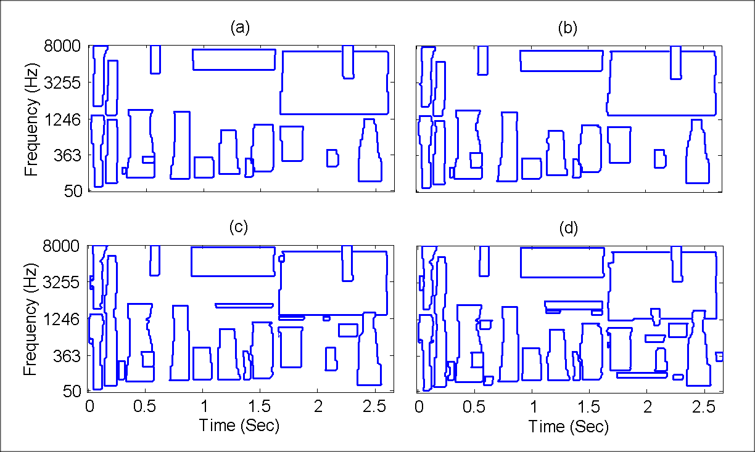
Segmentation at different scales
Input: Mixture of speech and crowd noise with music
Scales (t_{c,} t_{m}) are: (a). (32, 200); (b). (18, 200); (c). (32, 100). (d). (18, 100)

Slide 23
Evaluation
How to quantitatively evaluate segmentation results is a complex issue, since one has to consider various types of mismatch between a collection of ideal segments and that of computed segments
Here we adapt a region-based definition by Hoover et al. (’96), originally proposed for evaluating image segmentation systems
Based on the degree of overlapping (defined by threshold θ), we label a T-F region as belonging to one of the five classes
  Correct
  Under-segmented. Under-segmentation is not really an error because it produces larger segments – good for subsequent grouping
  Over-segmented
  Missing
  Mismatching

Slide 24
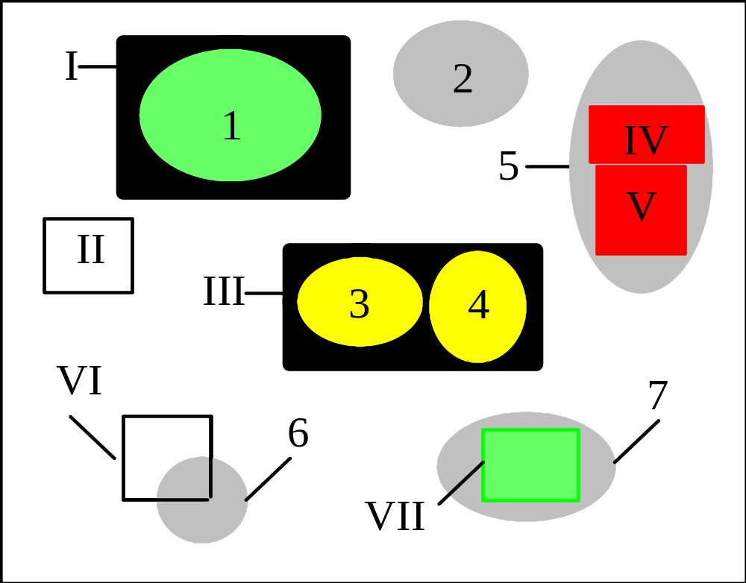
Illustration of different classes
Ovals (Arabic numerals) indicate ideal segments and rectangles (Roman numerals) computed segments. Different colors indicate different classes

Slide 25
Quantitative measures
Let E_{C}, E_{U}, E_{O}, E_{M}, and E_{I} be the summated energy in all the regions labeled as correct, under-segmented, over-segmented, missing, and mismatching respectively. Let E_{GT} be the total energy of all ideal segments and E_{S} that of all estimated segments
  The percentage of correctness: P_{C} = E_{C} / E_{GT} ×100%.
  The percentage of under-segmentation: P_{U} = E_{U} / E_{GT} ×100%.
  The percentage of over-segmentation: P_{O} = E_{O} / E_{GT} ×100%.
  The percentage of mismatch, P_{I} = E_{I} / E_{S} ×100%.
  The percentage of missing, P_{M} = (1 − P_{C} − P_{U} − P_{O}) × 100%.

Slide 26
Evaluation corpus
20 utterances from the TIMIT database
10 types of intrusion: white noise, electrical fan, rooster crowing and clock alarm, traffic noise, crowd in playground, crowd with music, crowd clapping, bird chirping and waterflow, wind, and rain

Slide 27
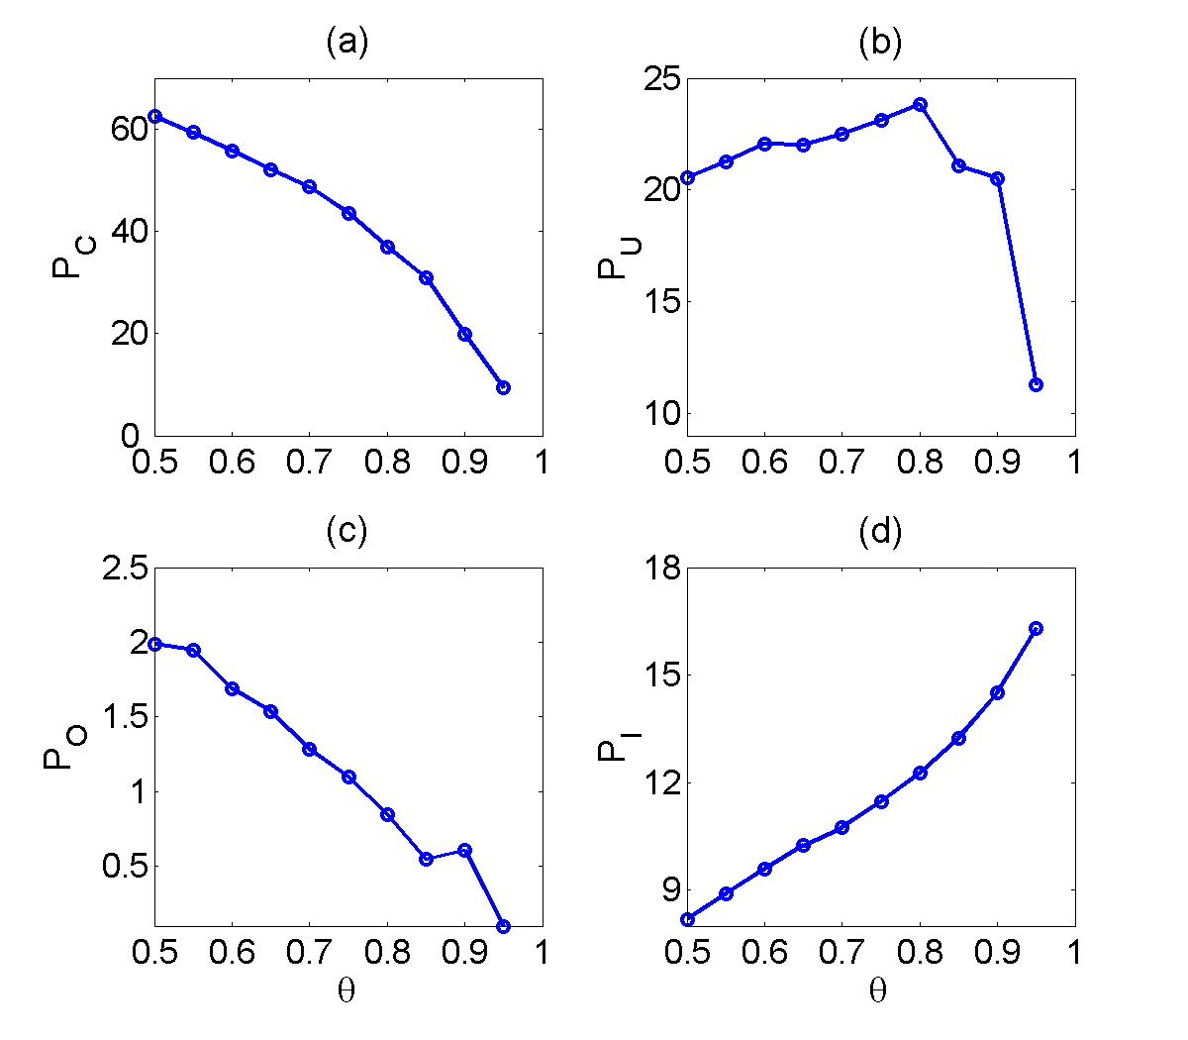
Results on all phonemes
Results are with respect to θ, with 0 dB mixtures and anisotropic diffusion

Slide 28
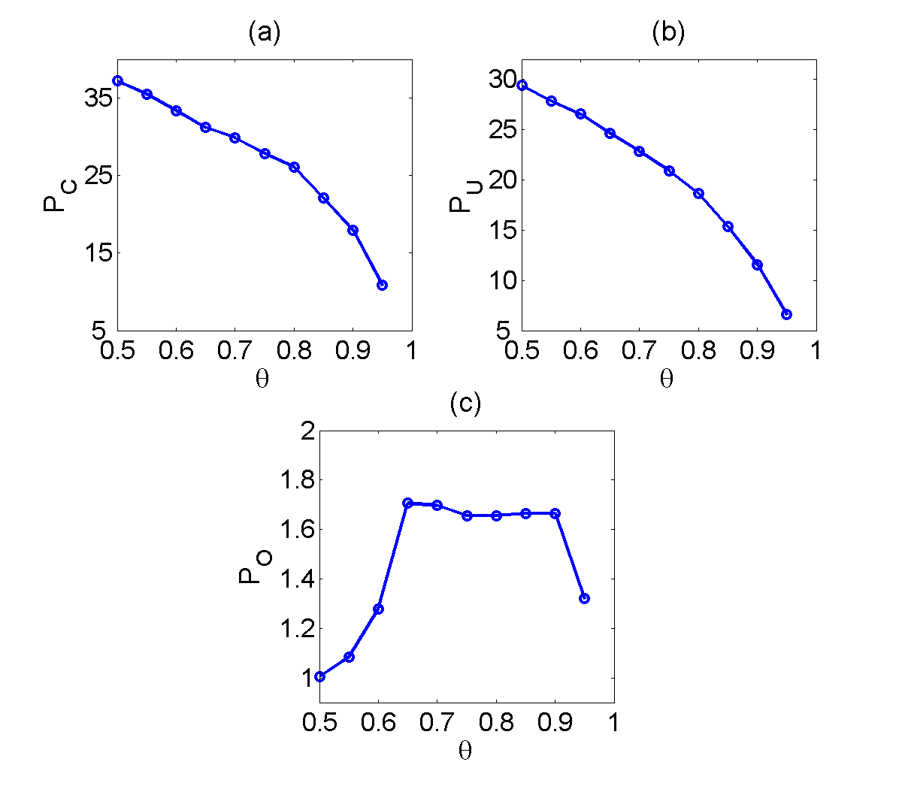
Results on stops, fricatives, and affricates

Slide 29
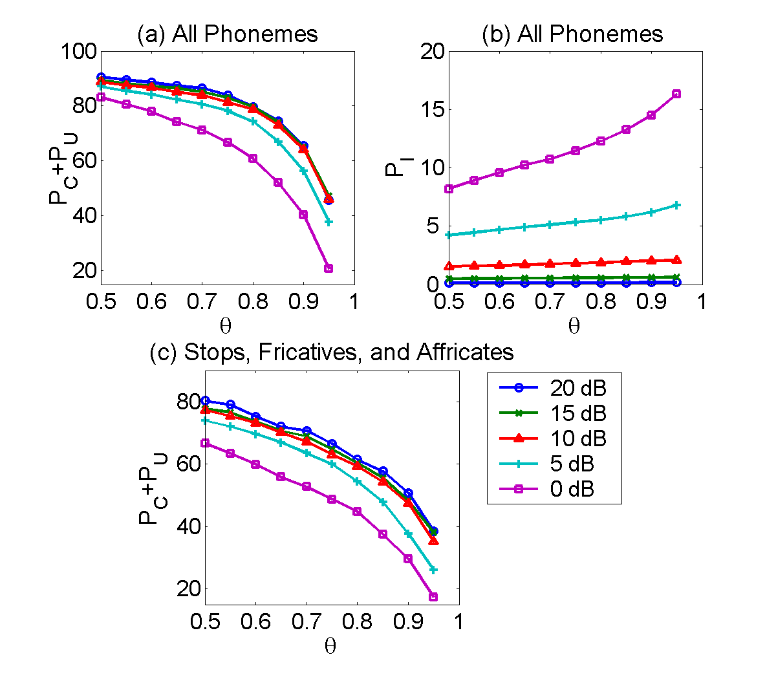
Results with different mixture SNRs
P_{C} and P_{U} are combined here since P_{U} is not really error

Slide 30
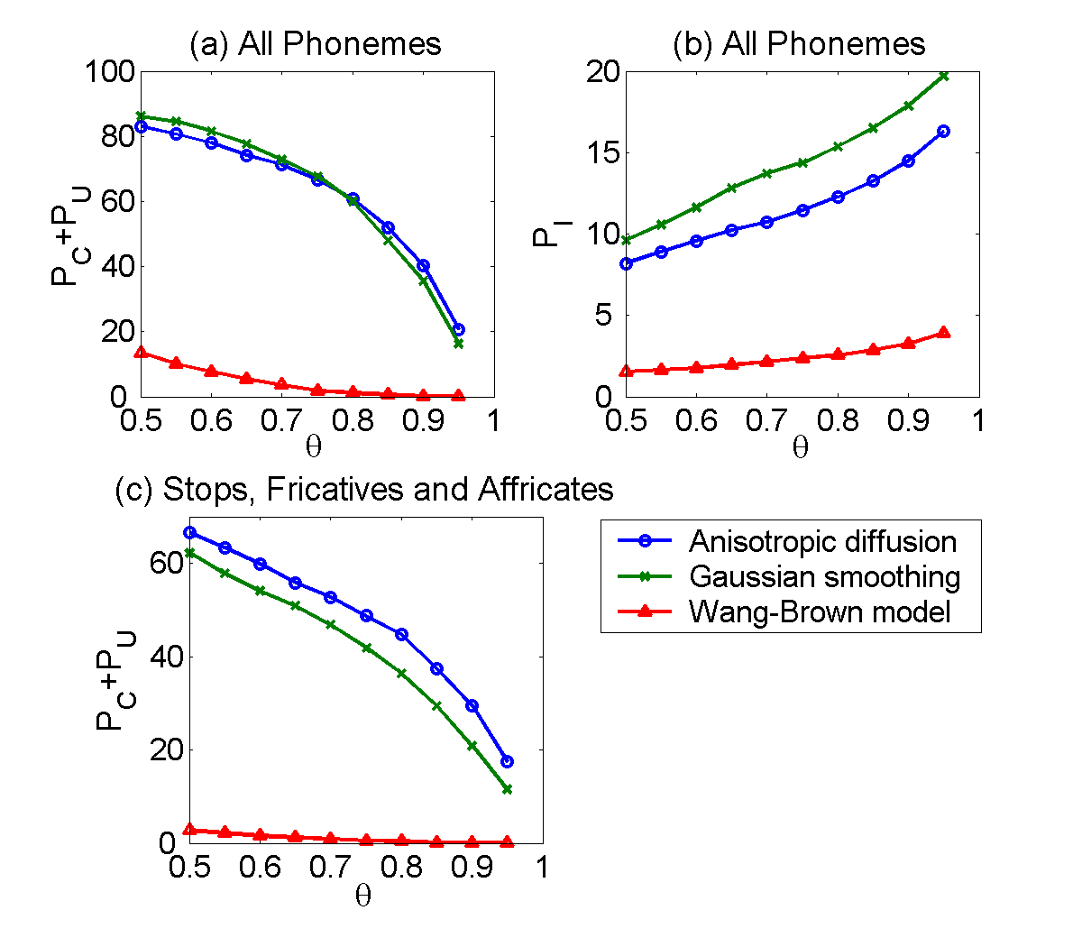
Comparisons
Comparisons are made between anisotropic diffusion and Gaussian smoothing, as well as with the Wang-Brown model (1999), which deals with mainly with voiced segments using cross-channel correlation. Mixtures are at 0 dB SNR

Slide 31
Outline of presentation
Introduction
  Auditory scene analysis
  Unvoiced speech problem
Auditory segmentation based on event detection
Unvoiced speech segregation
Summary

Slide 32
Speech segregation
The general strategy for speech segregation is to first segregate voiced speech using the pitch cue, and then deal with unvoiced speech
Voiced speech segregation is performed using our recent model (Hu & Wang’04):
  The model generates segments for voiced speech using cross-channel correlation and temporal continuity
  It groups segments according to periodicity and amplitude modulation
To segregate unvoiced speech, we perform auditory segmentation, and then group segments that correspond to unvoiced speech

Slide 33
Segment classification
For nonspeech interference, grouping is in fact a classification task – to classify segments as either speech or non-speech
The following features are used for classification:
  Spectral envelope
  Segment duration
  Segment intensity
Training data
  Speech: Training part of the TIMIT database
  Interference: 90 natural intrusions including street noise, crowd noise, wind, etc.
A Gaussian mixture model is trained for each phoneme, and for interference as well which provides the basis for a likelihood ratio test

Slide 34
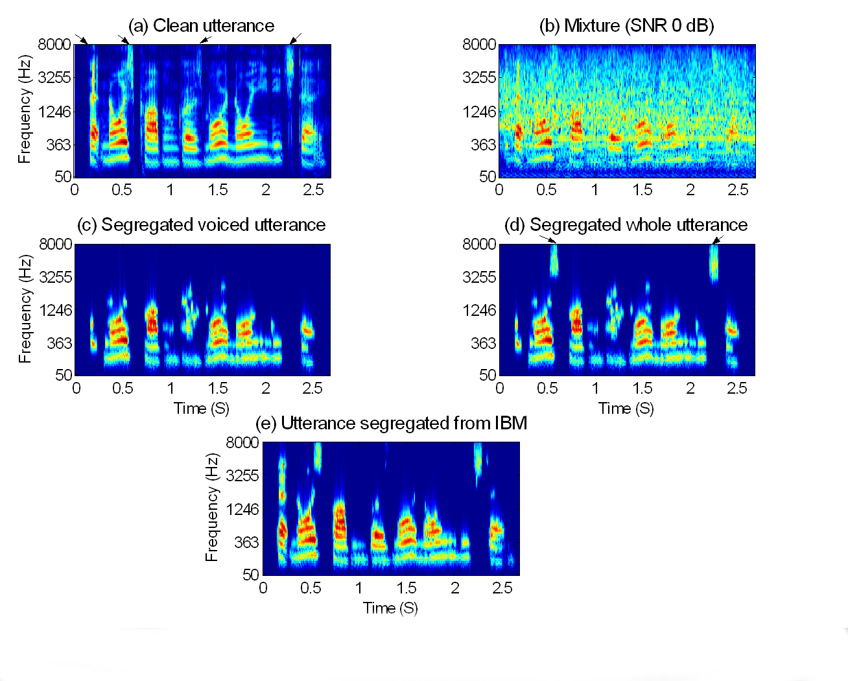
Demo for fricatives and affricates
Utterance: “That noise problem grows more annoying each day”
Interference: Crowd noise with music (IBM: Ideal binary mask)

Slide 35
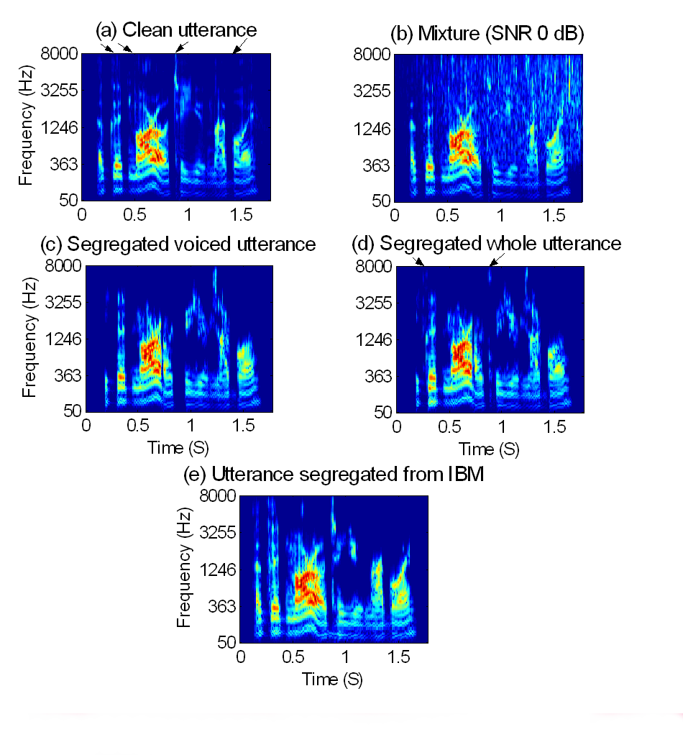
Demo for stops
Utterance: “A good morrow to you, my boy”
Interference: Rain

Slide 36
Summary
We have proposed a model for auditory segmentation, based on a multiscale analysis of onsets and offsets
Our model segments both voiced and unvoiced speech sounds
The general strategy for unvoiced (and voiced) speech segregation is to first perform segmentation and then group segments using various ASA cues
Sequential organization of segments into streams is not addressed
How well can people organize unvoiced speech?

