Slide 1
Computational Auditory Scene Analysis and Its Potential Application to Hearing Aids
DeLiang Wang
Perception & Neurodynamics Lab
Ohio State University

Slide 2
Outline of presentation
Auditory scene analysis
Fundamentals of computational auditory scene analysis (CASA)
CASA for speech segregation
Subject tests
Assessment

Slide 3
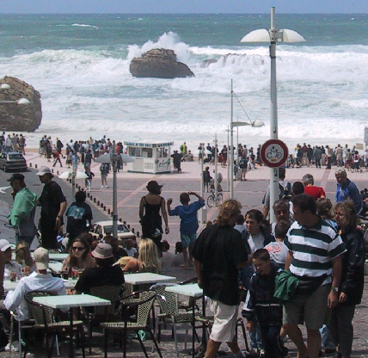

Real-world audition
What?
Speech
  message
  speaker
    age, gender, linguistic origin, mood, …
Music
Car passing by
Where?
Left, right, up, down
How close?
Channel characteristics
Environment characteristics
Room reverberation
Ambient noise

Slide 4
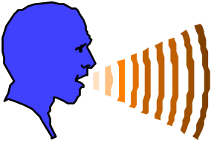

Sources of intrusion and distortion
additive noise from
other sound sources
channel distortion
reverberation from
surface reflections

Slide 5
Cocktail party problem
Term coined by Cherry
  “One of our most important faculties is our ability to listen to, and follow, one speaker in the presence of others. This is such a common experience that we may take it for granted; we may call it ‘the cocktail party problem’…” (Cherry, 1957)
  “For ‘cocktail party’-like situations… when all voices are equally loud, speech remains intelligible for normal-hearing listeners even when there are as many as six interfering talkers” (Bronkhorst & Plomp, 1992)
Ball-room problem by Helmholtz
  “Complicated beyond conception” (Helmholtz, 1863)

Slide 6
Auditory scene analysis
Listeners are capable of parsing an acoustic scene (a sound mixture) to form a mental representation of each sound source – stream – in the perceptual process of auditory scene analysis (Bregman, 1990)
  From acoustic events to perceptual streams
Two conceptual processes of ASA:
  Segmentation. Decompose the acoustic mixture into sensory elements (segments)
  Grouping. Combine segments into streams, so that segments in the same stream originate from the same source

Slide 7

Simultaneous organization
Simultaneous organization groups sound components that overlap in time. ASA cues for simultaneous organization:
  Proximity in frequency (spectral proximity)
  Common periodicity
    Harmonicity
    Fine temporal structure
  Common spatial location
  Common onset (and to a lesser degree, common offset)
  Common temporal modulation
    Amplitude modulation (AM)
    Frequency modulation (Demo: )

Slide 8
Sequential organization
Sequential organization groups sound components across time. ASA cues for sequential organization:
  Proximity in time and frequency
    Temporal and spectral continuity
  Common spatial location; more generally, spatial continuity
  Smooth pitch contour
    Smooth format transition?
  Rhythmic structure

Slide 9
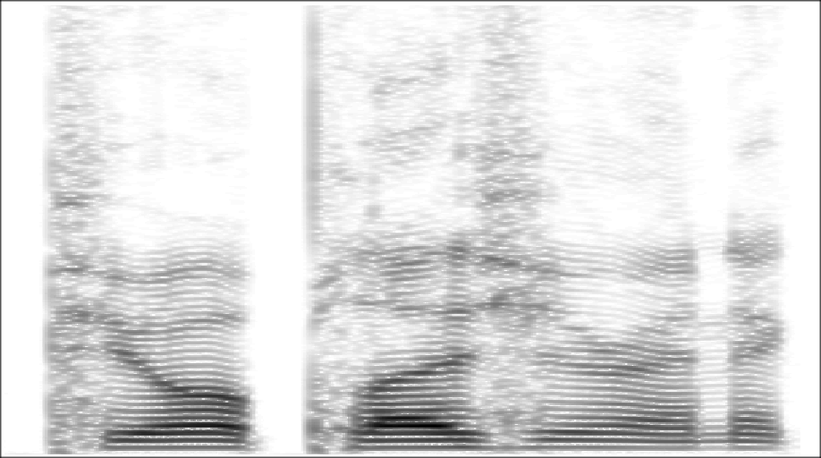
Organisation in speech: Spectrogram
“… pure pleasure … ”
continuity
onset
synchrony
offset
synchrony
harmonicity
Notes:
Some other cues we can’t see easily eg same vocal tract

Slide 10
Outline of presentation
Auditory scene analysis
Fundamentals of computational auditory scene analysis (CASA)
CASA for speech segregation
Subject tests
Assessment

Slide 11
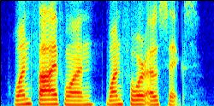
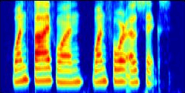
Cochleagram: Auditory spectrogram
Spectrogram
Plot of log energy across time and frequency (linear frequency scale)
Cochleagram
Cochlear filtering by the gammatone filterbank (or other models of cochlear filtering), followed by a stage of nonlinear rectification; the latter corresponds to hair cell transduction by either a hair cell model or simple compression operations (log and cube root)
Quasi-logarithmic frequency scale, and filter bandwidth is frequency-dependent
A waveform signal can be constructed (inverted) from a cochleagram
Spectrogram
Cochleagram

Slide 12
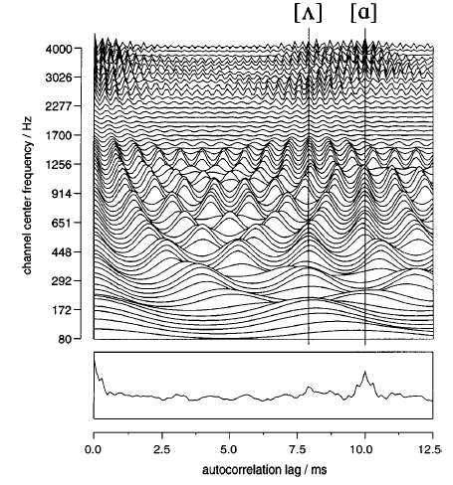
Correlogram
Short-term autocorrelation of the output of each frequency channel of the cochleagram
Peaks in summary correlogram indicate pitch periods (F0)
A standard model of pitch perception
Correlogram & summary correlogram of a double vowel, showing F0s

Slide 13
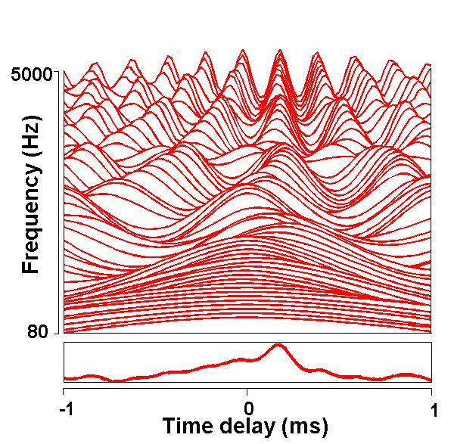
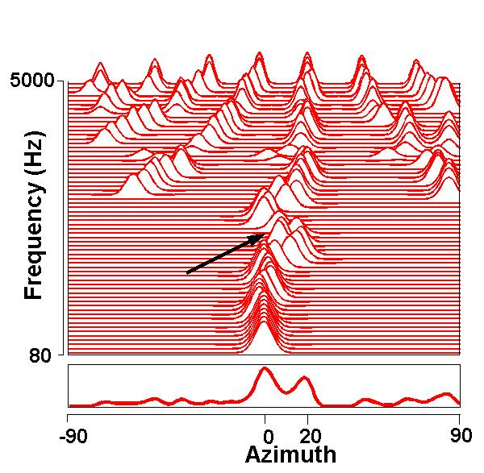
Cross-correlogram
Cross-correlogram (within one frame) in response to two speech sources presented at 0º and 20º.
Skeleton cross-correlogram sharpens cross-correlogram, making peaks in the azimuth axis more pronounced
Notes:
Note that this has actually had precedence effect processing built in prior to CC

Slide 14
Ideal binary mask
A main CASA goal is to retain parts of a target sound that are stronger than the acoustic background, or to mask interference by the target
  What a target is depends on intention, attention, etc.
Within a local time-frequency (T-F) unit, the ideal binary mask is 1 if the SNR within the unit exceeds a local criterion (LC) or threshold, and 0 otherwise (Hu & Wang, 2001)
  Consistent with the auditory masking phenomenon: A stronger signal masks a weaker one within a critical band
  Optimality: Under certain conditions the ideal binary mask with 0 dB LC is the optimal binary mask for SNR gain
  It doesn’t actually separate the mixture!

Slide 15
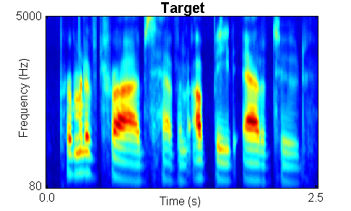
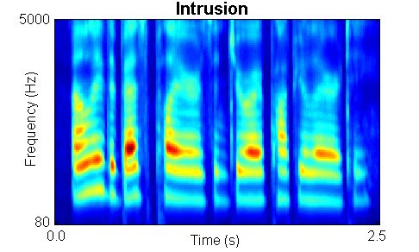
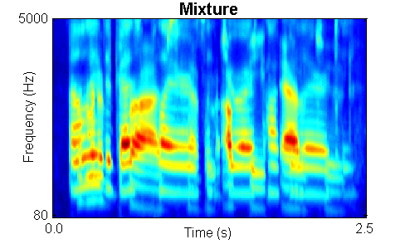
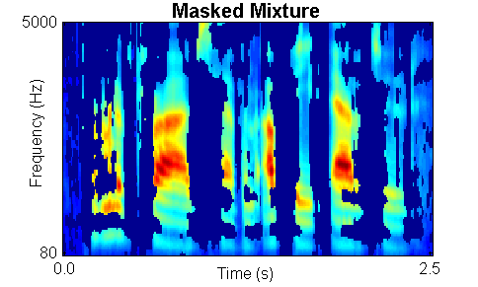
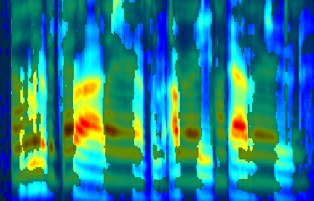
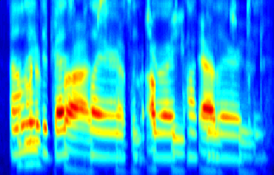
Ideal binary mask illustration

Slide 16
Outline of presentation
Auditory scene analysis
Fundamentals of computational auditory scene analysis (CASA)
CASA for speech segregation
  Voiced speech segregation
  Unvoiced speech segregation
Subject tests
Assessment

Slide 17
CASA systems for speech segregation
A substantial literature that can be broadly divided into monaural and binaural systems
Monaural CASA systems for speech segregation are based on harmonicity, onset/offset, AM/FM, and trained models (Weintraub, 1985; Brown & Cooke, 1994; Ellis, 1996; Hu & Wang, 2004)
Binaural CASA systems for speech segregation are based sound localization and location-based grouping (Lyon, 1983; Bodden, 1993; Liu et al., 2001; Roman et al., 2003)

Slide 18
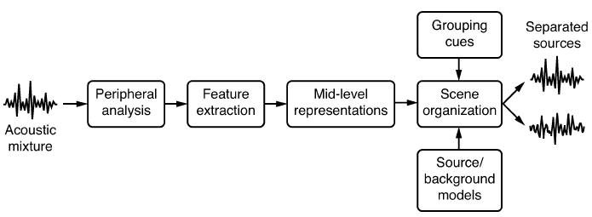
CASA system architecture
  Typical architecture of CASA systems

Slide 19
Voiced speech segregation
For voiced speech, lower harmonics are resolved while higher harmonics are not
For unresolved harmonics, the envelopes of filter responses fluctuate at the fundamental frequency of speech
A voiced segregation model by Hu and Wang (2004) applies different grouping mechanisms for low-frequency and high-frequency signals:
  Low-frequency signals are grouped based on periodicity and temporal continuity
  High-frequency signals are grouped based on amplitude modulation and temporal continuity

Slide 20
Pitch tracking
Pitch periods of target speech are estimated from an initially segregated speech stream based on dominant pitch within each frame
Estimated pitch periods are checked and re-estimated using two psychoacoustically motivated constraints:
  Target pitch should agree with the periodicity of the T-F units in the initial speech stream
  Pitch periods change smoothly, thus allowing for verification and interpolation

Slide 21
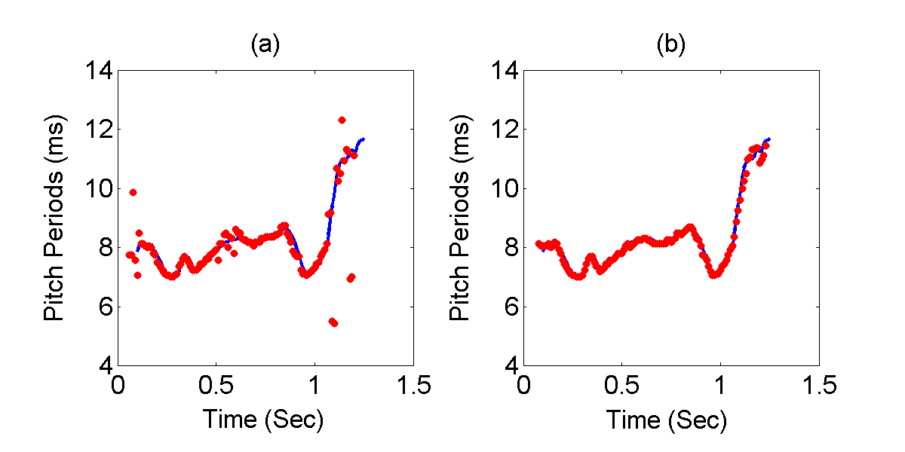
Pitch tracking example
(a) Dominant pitch (Line: pitch track of clean speech) for a mixture of target speech and ‘cocktail-party’ intrusion
(b) Estimated target pitch

Slide 22
T-F unit labeling & final segregation
In the low-frequency range:
  A T-F unit is labeled by comparing the periodicity of its autocorrelation with the estimated target pitch
In the high-frequency range:
  Due to their wide bandwidths, high-frequency filters respond to multiple harmonics. These responses are amplitude modulated due to beats and combinational tones (Helmholtz, 1863)
  A T-F unit in the high-frequency range is labeled by comparing its AM rate with the estimated target pitch
Finally, other units are grouped according to temporal and spectral continuity

Slide 23
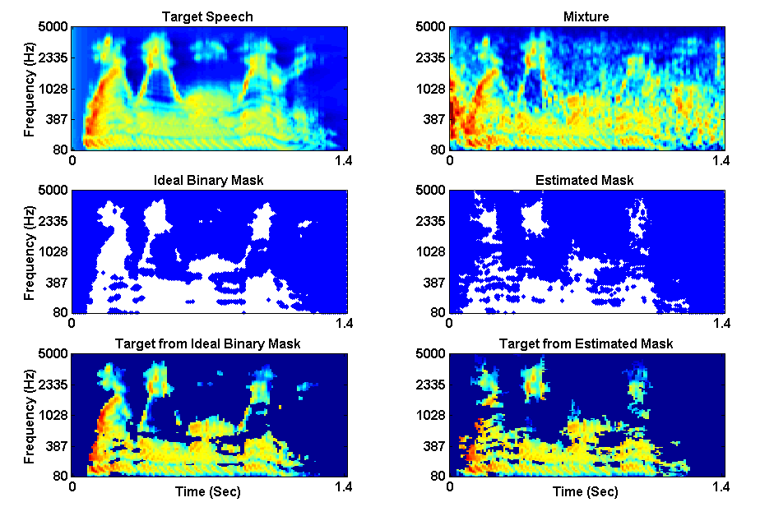
Voiced speech segregation example

Slide 24
Unvoiced speech segregation
Unvoiced speech constitutes about 20-25% of all speech sounds
Unvoiced speech is more difficult to segregate than voiced speech
  Voiced speech is highly structured, whereas unvoiced speech lacks harmonicity and is often noise-like
  Unvoiced speech is usually much weaker than voiced speech and therefore more susceptible to interference
A model by Hu and Wang (2008) performs unvoiced speech segregation using auditory segmentation and segment classification
  Segmentation is based on multiscale onset/offset analysis
  Classification of each segment is based on Bayesian classification of acoustic-phonetic features

Slide 25
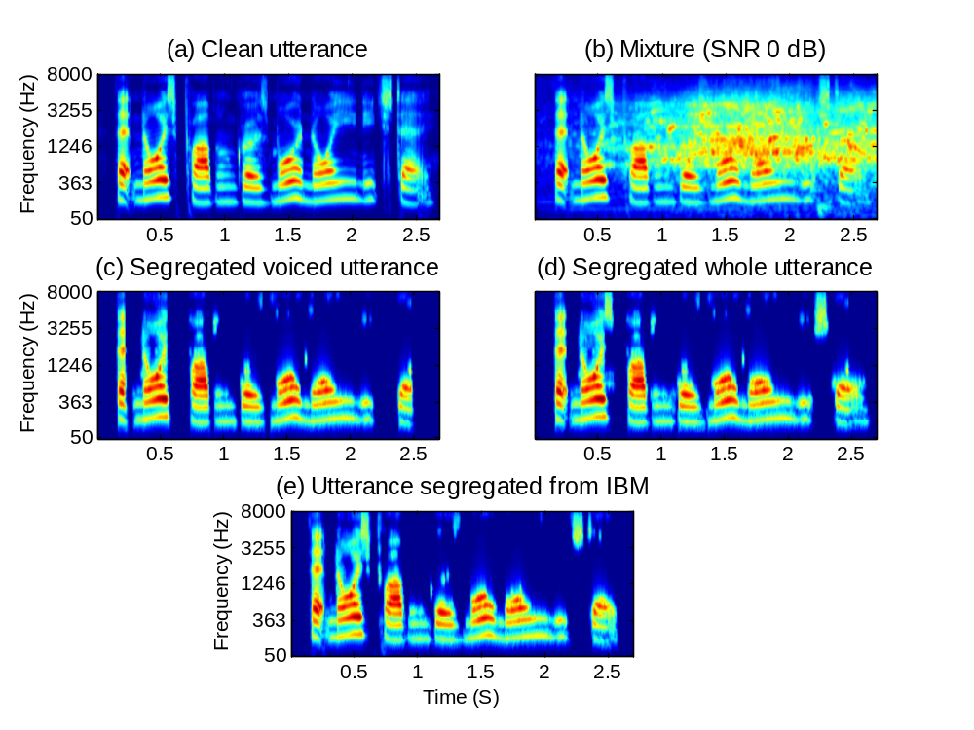
Example of segregation
Utterance: “That noise problem grows more annoying each day”
Interference: Crowd noise in a playground (IBM: Ideal binary mask)

Slide 26
Outline of presentation
Auditory scene analysis
Fundamentals of computational auditory scene analysis (CASA)
CASA for speech segregation
Subject tests
Assessment

Slide 27
Subject tests of ideal binary masking
Recent studies found large speech intelligibility improvements by applying ideal binary masking for normal-hearing (Brungart et al., 2006, Anzalone et al., 2006; Li & Loizou, 2008; Wang et al., 2008), and hearing-impaired (Anzalone et al., 2006; Wang et al., 2008) listeners
  Improvement for stationary noise is above 7 dB for NH listeners, and above 9 dB for HI listeners
  Improvement for modulated noise is significantly larger than for stationary noise
See our poster today on tests with both NH and HI listeners
Notes:
Brungart and Simpson (2001)’s experiments show coexistence of informational and energetic masking.
They have also isolated informational masking using across-ear effect when listening to two talkers in one ear experience informational masking from third signal in the opposite ear (Brungart and Simpson, 2002)
Arbogast et al. (2002) divide speech signal into 15 log spaced, envelope modulated sinewaves. Assign some to target and some to interference: intelligible speech with no spectral overlaps

Slide 28
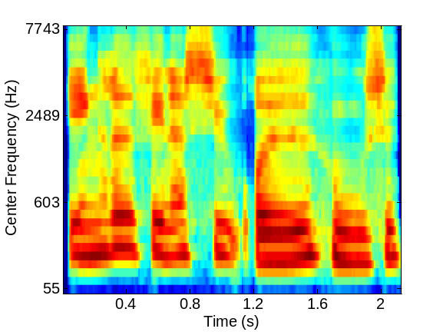
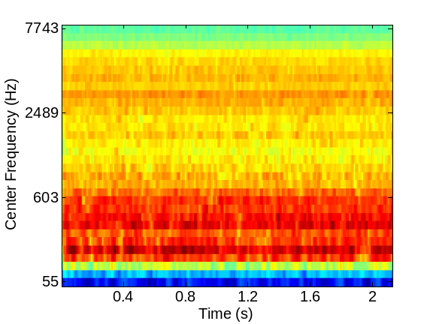
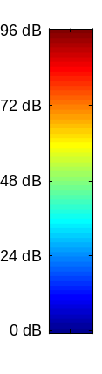
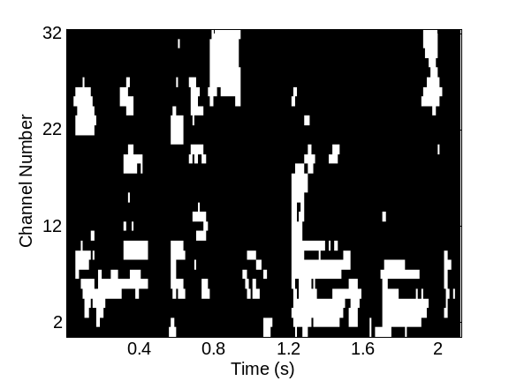
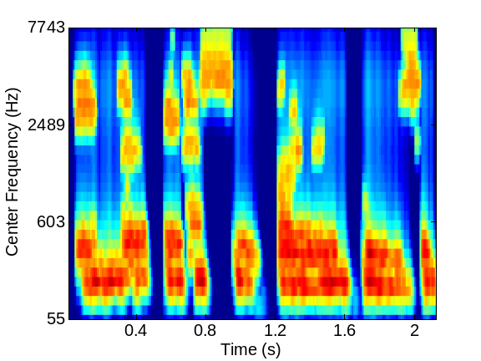
Speech perception of noise with binary gains
Is there an optimal LC that is independent of input SNR?
Wang et al. (2008) found that, when LC is chosen to be the same as the input SNR, nearly perfect intelligibility is obtained when input SNR is -∞ dB (i.e. the mixture contains noise only with no target speech)
Notes:
Create a continuous noise signal that match long-term average spectrum of speech
Further approach to divide “speech-spectrum-shaped” noise into number of bands and modulate with natural speech envelopes
However, noise signal too “speech-like” and reintroduce informational masking (Brungart et al. 2004)
Alternatively, use Ideal Binary Mask to remove informational masking
Eliminate portions of stimulus dominated by the interfering speech.
Retain only portions of target speech acoustically detectable in the presence of interfering speech

Slide 29
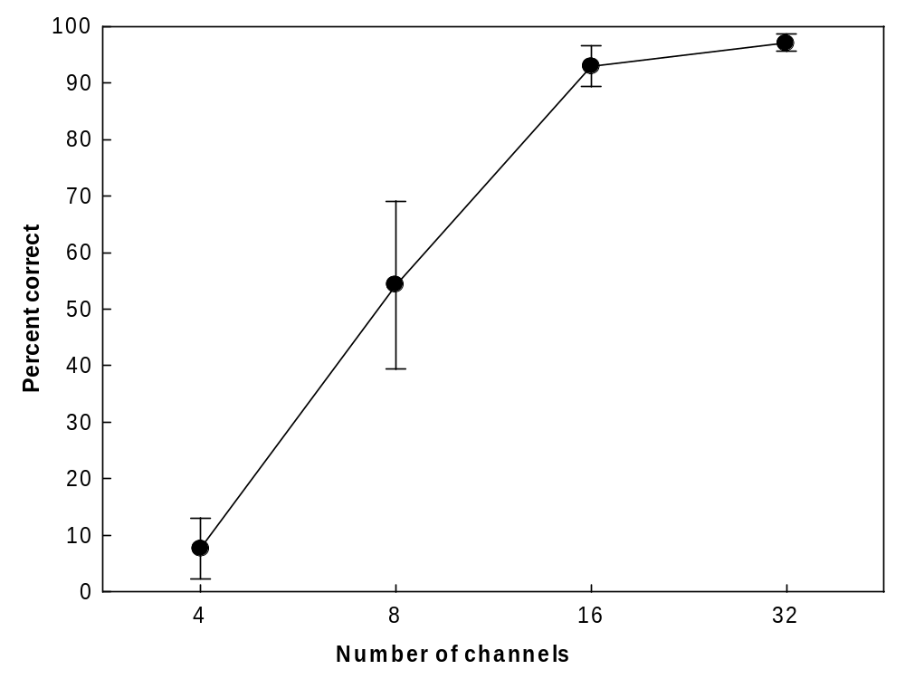
Wang et al.’08 results
Mean numbers for the 4 conditions: (97.1%, 92.9%, 54.3%, 7.6%)
Despite a great reduction of spectrotemporal information, a pattern of binary gains is apparently sufficient for human speech recognition
Our results extend the observation of intelligible vocoded noise in significant ways
  Only binary gains (envelopes)
  Masks are computed from local comparisons between target and interference, not target itself

Slide 30
Outline of presentation
Auditory scene analysis
Fundamentals of computational auditory scene analysis (CASA)
CASA for speech segregation
Subject tests
Assessment

Slide 31
Assessment of CASA for hearing prosthesis
Few CASA systems were developed for the hearing aid application
Hearing aid processing poses a number of constraints
  Real-time processing with processing delays of just a few milliseconds
  Amount of online training, if needed, has to be small
  Limited number of frequency bands

Slide 32
Assessment of monaural CASA systems
Monaural algorithms involve complex operations for feature extraction, segmentation, grouping, or significant amounts of training
They are either too complex or too limited in performance to be directly applicable to hearing aid design
  Certain aspects could be useful, e.g. environment classification and voice detection
In longer term, monaural CASA research is promising
  It is based on principles of auditory perception
  Not subject to fundamental limitations of spatial filtering (beamforming)
    Configuration stationarity
    Room reverberation

Slide 33
Assessment of binaural CASA systems
Many binaural (two-microphone) systems produce a T-F mask based on classification or clustering
  Good performance after seconds of training data
  Unfortunately, retraining is needed for a configuration change, limiting their prospect of applying to hearing aids
  Room reverberation likely poses further difficulties for such algorithms
T-F masking algorithms based on beamforming hold promise for hearing aid design (e.g. Roman et al., 2006)
  Both fixed and adaptive beamformers have been implemented in hearing aids
  Beamforming in combination with T-F masking is likely effective for improving speech intelligibility

Slide 34
Conclusion
CASA approaches the problem of sound separation using perceptual principles, and represents a new paradigm for solving the cocktail party problem
Recent intelligibility tests show that ideal binary masking provides large benefits to both NH and HI listeners
Current CASA systems pay little attention to processing constraints of hearing aids, doubtful for direct application to hearing aid design
In longer term, CASA research (particularly monaural systems) promises to deliver intelligibility benefits

Slide 35

Further information on CASA
2006 CASA book edited by D.L. Wang & G.J. Brown and published by Wiley-IEEE Press
  A 10-chapter book with a coherent and comprehensive treatment of CASA

