Slide 1
Supervised Speech Separation
DeLiang Wang
Perception & Neurodynamics Lab
Ohio State University
& Northwestern Polytechnical University

Slide 2
Outline of tutorial
Introduction
Training targets
Separation algorithms
Concluding remarks

Slide 3

Sources of speech interference and distortion
additive noise from
other sound sources
channel distortion
reverberation from
surface reflections
Notes:
3

Slide 4
Traditional approaches to speech separation
Speech enhancement
Monaural methods by analyzing general statistics of speech and noise
Require a noise estimate
Spatial filtering with a microphone array
Beamforming
Extract target sound from a specific spatial direction
Independent component analysis
Find a demixing matrix from multiple mixtures of sound sources
Computational auditory scene analysis (CASA)
Based on auditory scene analysis principles
Feature-based (e.g. pitch) versus model-based (e.g. speaker model)
Notes:
4

Slide 5
Supervised approach to speech separation
Data driven, i.e. dependency on a training set
Features
Training targets
Learning machines
Born out of CASA
Time-frequency masking concept has led to the formulation of speech separation as a supervised learning problem
A recent trend fueled by the success of deep learning
Notes:
5

Slide 6
Supervised approach to speech separation
Data driven, i.e. dependency on a training set
Features
Training targets
Learning machines: deep neural networks
Born out of CASA
Time-frequency masking concept has led to the formulation of speech separation as a supervised learning problem
A recent trend fueled by the success of deep learning
Notes:
6

Slide 7
Ideal binary mask as a separation goal
Motivated by the auditory masking phenomenon and auditory scene analysis, we suggested the ideal binary mask as a main goal of CASA (Hu & Wang, 2001; 2004)
The idea is to retain parts of a mixture where the target sound is stronger than the acoustic background, and discard the rest
The definition of the ideal binary mask (IBM)
θ: A local SNR criterion (LC) in dB, which is typically chosen to be 0 dB
Optimal SNR: Under certain conditions the IBM with θ = 0 dB is the optimal binary mask in terms of SNR (Li & Wang’09)
Maximal articulation index (AI) in a simplified version (Loizou & Kim’11)

Slide 8
Subject tests of ideal binary masking
Ideal binary masking leads to dramatic speech intelligibility improvements
Improvement for stationary noise is above 7 dB for normal-hearing (NH) listeners, and above 9 dB for hearing-impaired (HI) listeners
Improvement for modulated noise is significantly larger than for stationary noise
With the IBM as the goal, the speech separation problem becomes a binary classification problem
This new formulation opens the problem to a variety of supervised classification methods
Notes:
Brungart and Simpson (2001)’s experiments show coexistence of informational and energetic masking.
They have also isolated informational masking using across-ear effect when listening to two talkers in one ear experience informational masking from third signal in the opposite ear (Brungart and Simpson, 2002)
Arbogast et al. (2002) divide speech signal into 15 log spaced, envelope modulated sinewaves. Assign some to target and some to interference: intelligible speech with no spectral overlaps

Slide 9
Deep neural networks
Deep neural networks (DNNs) usually refer to multilayer perceptrons with two or more hidden layers
Why deep?
As the number of layers increases, more abstract features are learned and they tend to be more invariant to superficial variations
Deeper model increasingly benefits from bigger training data
Superior performance in practice if properly trained (e.g., convolutional neural networks)
Hinton et al. (2006) suggest to unsupervisedly pretrain a DNN using restricted Boltzmann machines (RBMs)
However, recent practice suggests that RBM pretraining is not needed if large training data exists

Slide 10
Part II: Training targets
What supervised training aims to learn is important for speech separation/enhancement
Different training targets lead to different mapping functions from noisy features to separated speech
Different targets may have different levels of generalization
A recent study (Wang et al.’14) examines different training targets (objective functions)
Masking based targets
Mapping based targets
Other targets
Notes:
10

Slide 11
Background
While the IBM is first used in supervised separation (see Part III), the quality of separated speech is a persistent issue
What are alternative targets?
Target binary mask (TBM) (Kjems et al.’09; Gonzalez & Brookes’14)
Ideal ratio mask (IRM) (Srinivasan et al.’06; Narayanan & Wang’13; Hummersone et al.’14)
STFT spectral magnitude (Xu et al.’14; Han et al.’14)

Slide 12
Different training targets
TBM: similar to the IBM except that interference is fixed to speech-shaped noise (SSN)
IRM
β is a tunable parameter, and a good choice is 0.5
With β = 0.5, the IRM becomes a square root Wiener filter, which is the optimal estimator of the power spectrum of the target signal

Slide 13
Different training targets (cont.)
Gammatone frequency power spectrum (GF-POW)
FFT-MAG of clean speech
FFT-MASK

Slide 14
Illustration of various training targets
Factory noise at -5 dB

Slide 15
Evaluation methodology
Learning machine: DNN with 3 hidden layers, each with 1024 units
Target speech: TIMIT corpus
Noises: SSN + four nonstationary noises from NOISEX
Training and testing on different segments of each noise
Trained at -5 and 0 dB, and tested at -5, 0, and 5 dB
Evaluation metrics
STOI: standard metric for predicted speech intelligibility
PESQ: standard metric for perceptual speech quality
SNR

Slide 16
Comparisons
Comparisons among different training targets
Comparisons with different approaches
Speech enhancement (Hendriks et al.’10)
Supervised NMF: ASNA-NMF (Virtanen et al.’13), trained and tested in the same way as supervised separation

Slide 17
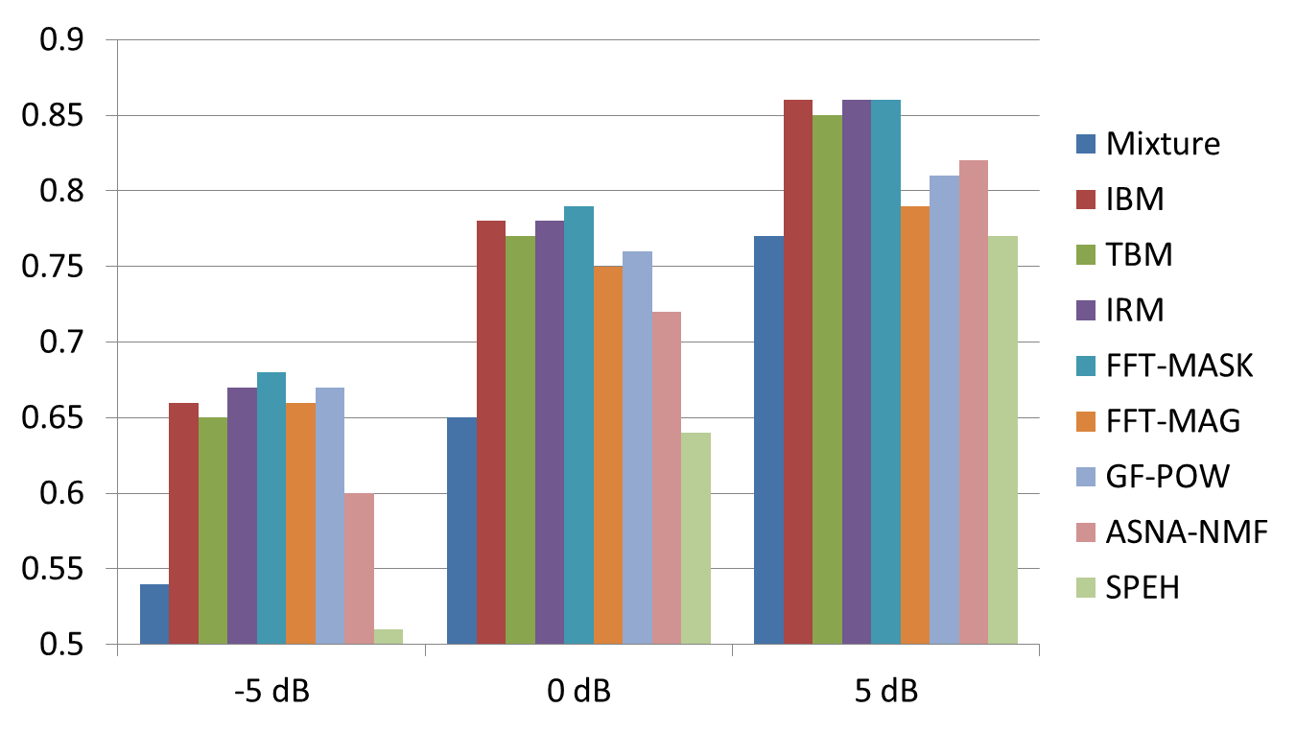
STOI comparison for factory noise
Spectral mapping
NMF & SPEH
Masking

Slide 18
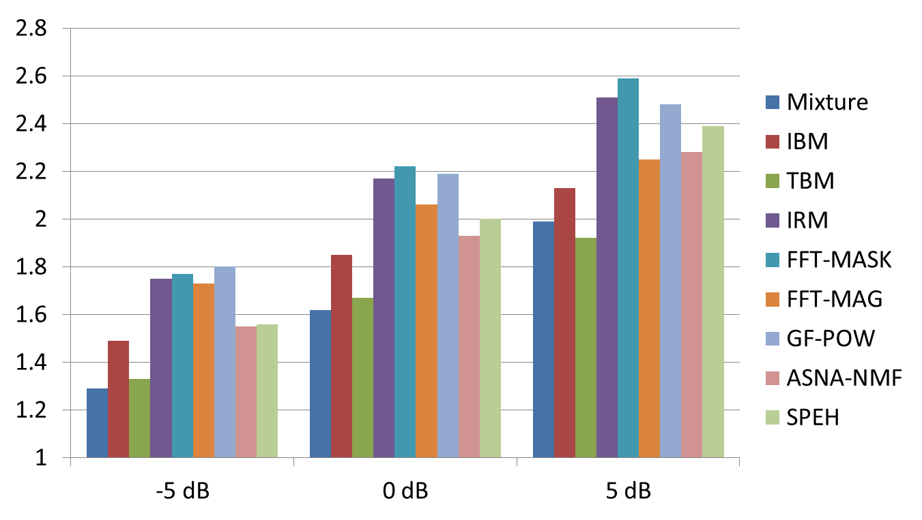
PESQ comparison for factory noise
Spectral mapping
Masking
NMF & SPEH

Slide 19
Summary among different targets
Among the two binary masks, IBM estimation performs better in PESQ than TBM estimation
Ratio masking performs better than binary masking for speech quality
IRM, FFT-MASK, and GF-POW produce comparable PESQ results
FFT-MASK is better than FFT-MAG for estimation
Many-to-one mapping in FFT-MAG vs. one-to-one mapping in FFT-MASK, and the latter should be easier to learn
Estimation of spectral magnitudes or their compressed version tends to magnify estimation errors

Slide 20
Other targets: signal approximation
In signal approximation (SA), training aims to estimate the IRM but the error is measured against the spectral magnitude of clean speech (Weninger et al.’14)
RM(t, f) denotes an estimated IRM
This objective function maximizes SNR
Jin & Wang (2009) proposed an earlier version in conjunction with IBM estimation
There is some improvement over direct IRM estimation

Slide 21
Phase-sensitive target
Phase-sensitive target is an ideal ratio mask (FFT mask) that incorporates the phase difference, θ, between clean speech and noisy speech (Erdogan et al.’15)
Because of phase sensitivity, this target leads to a better estimate of clean speech than the FFT mask
It does not directly estimate phase

Slide 22
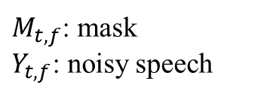
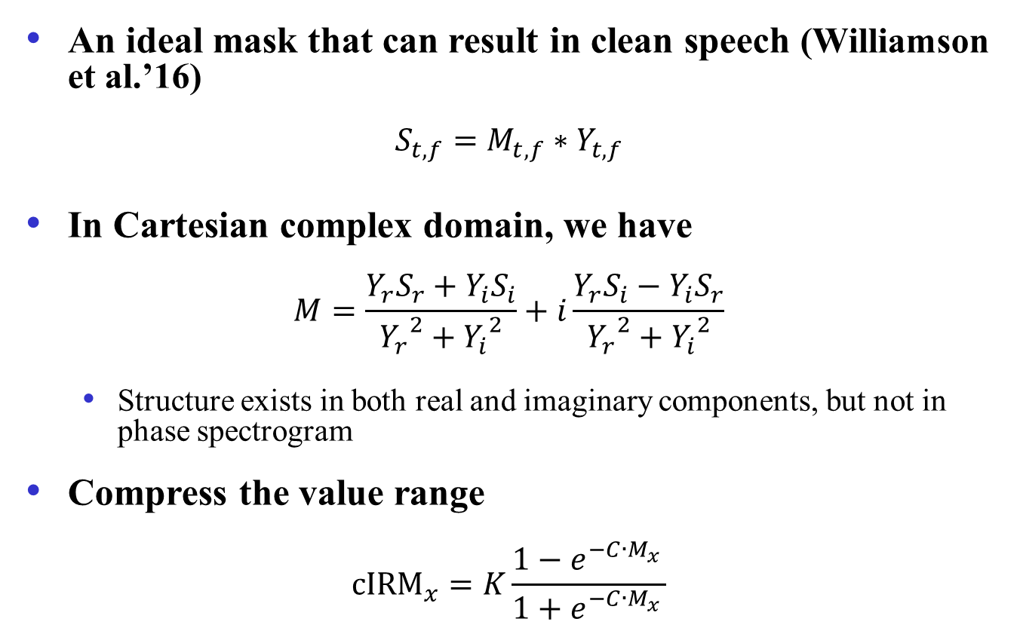
Complex Ideal Ratio Mask (cIRM)
An ideal mask that can result in clean speech (Williamson et al.’16)
$$S_{t,f}=M_{t,f}∗Y_{t,f}$$
In Cartesian complex domain, we have
$$M=\frac{Y_{r}S_{r}+Y_{i}S_{i}}{{Y_{r}}^{2}+{Y_{i}}^{2}}+i\frac{Y_{r}S_{i}−Y_{i}S_{r}}{{Y_{r}}^{2}+{Y_{i}}^{2}}$$
Structure exists in both real and imaginary components, but not in phase spectrogram
Compress the value range
$${cIRM}_{x}=K\frac{1−e^{−C∙{M_{x}}_{}^{ }}}{1+e^{−C∙{M_{x}}_{}^{ }}}$$
$M_{t,f}$: mask
$Y_{t,f}$: noisy speech
x ∊ {r, i}

Slide 23
Part III. DNN-based separation algorithms
Separation methods
Time-frequency (T-F) masking
Binary: classification
Ratio: regression or function approximation
Spectral mapping
Separation task
Speech-nonspeech separation
Two-talker separation
Notes:
23

Slide 24
DNN as subband classifier
Y. Wang & Wang (2013) first introduced DNN to address the speech separation problem
DNN is used for as a subband classifier, performing feature learning from raw acoustic features
Classification aims to estimate the IBM

Slide 25
DNN as subband classifier

Slide 26
Extensive training with DNN
Training on 200 randomly chosen utterances from both male and female IEEE speakers, mixed with 100 environmental noises at 0 dB (~17 hours long)
Six million fully dense training samples in each channel, with 64 channels in total
Evaluated on 20 unseen speakers mixed with 20 unseen noises at 0 dB

Slide 27
DNN-based separation results
Comparisons with a representative speech enhancement algorithm (Hendriks et al.’10)
Using clean speech as ground truth, on average about 3 dB SNR improvements
Using IBM separated speech as ground truth, on average about 5 dB SNR improvements

Slide 28
Speech intelligibility evaluation
Healy et al. (2013) subsequently evaluated the classifier on speech intelligibility of hearing-impaired listeners
A very challenging problem: “The interfering effect of background noise is the single greatest problem reported by hearing aid wearers” (Dillon’12)
Two stage DNN training to incorporate T-F context in classification

Slide 29
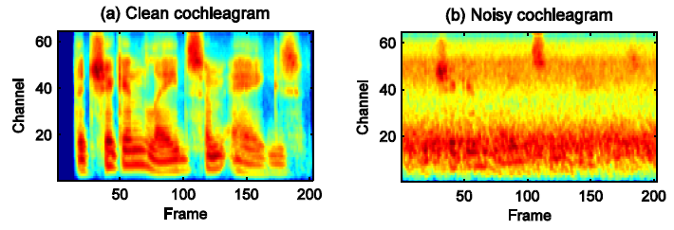
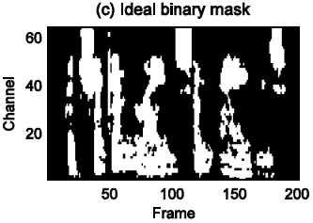
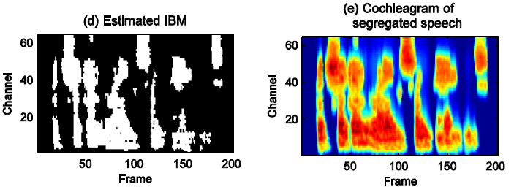
Separation illustration
A HINT sentence mixed with speech-shaped noise at -5 dB SNR

Slide 30
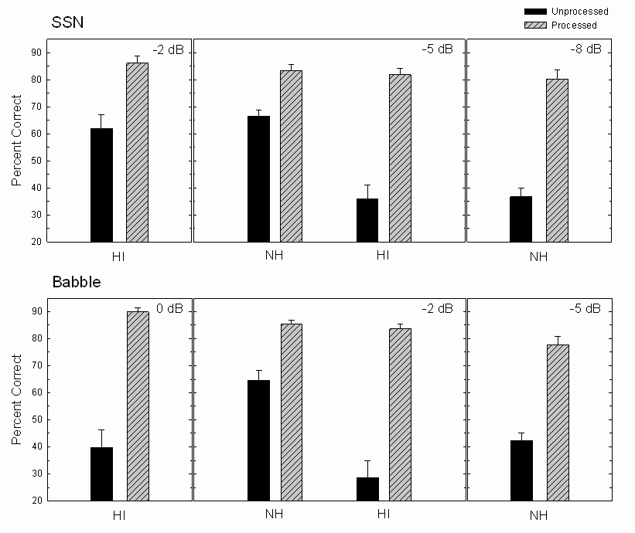


Results and sound demos
Both HI and NH listeners showed intelligibility improvements
HI subjects with separation outperformed NH subjects without separation

Slide 31
Generalization to new noises
While previous speech intelligibility results are impressive, a major limitation is that training and test noise samples were drawn from the same noise segments
Speech utterances were different
Noise samples were randomized
Chen et al. (2016) have recently addressed this limitation through large-scale training for IRM estimation

Slide 32
Large-scale training
Training set consisted of 560 IEEE sentences mixed with 10,000 (10K) non-speech noises (a total of 640,000 mixtures)
The total duration of the noises is about 125 h, and the total duration of training mixtures is about 380 h
Training SNR is fixed to -2 dB
The only feature used is the simple T-F unit energy
DNN architecture consists of 5 hidden layers, each with 2048 units
Test utterances and noises are both different from those used in training

Slide 33
STOI performance at -2 dB input SNR
 | Babble | Cafeteria | Factory | Babble2 | Average
Unprocessed | 0.612 | 0.596 | 0.611 | 0.611 | 0.608
100-noise model | 0.683 | 0.704 | 0.750 | 0.688 | 0.706
10K-noise model | 0.792 | 0.783 | 0.807 | 0.786 | 0.792
Noise-dependent model | 0.833 | 0.770 | 0.802 | 0.762 | 0.792
The DNN model with large-scale training provides similar results to noise-dependent model

Slide 34
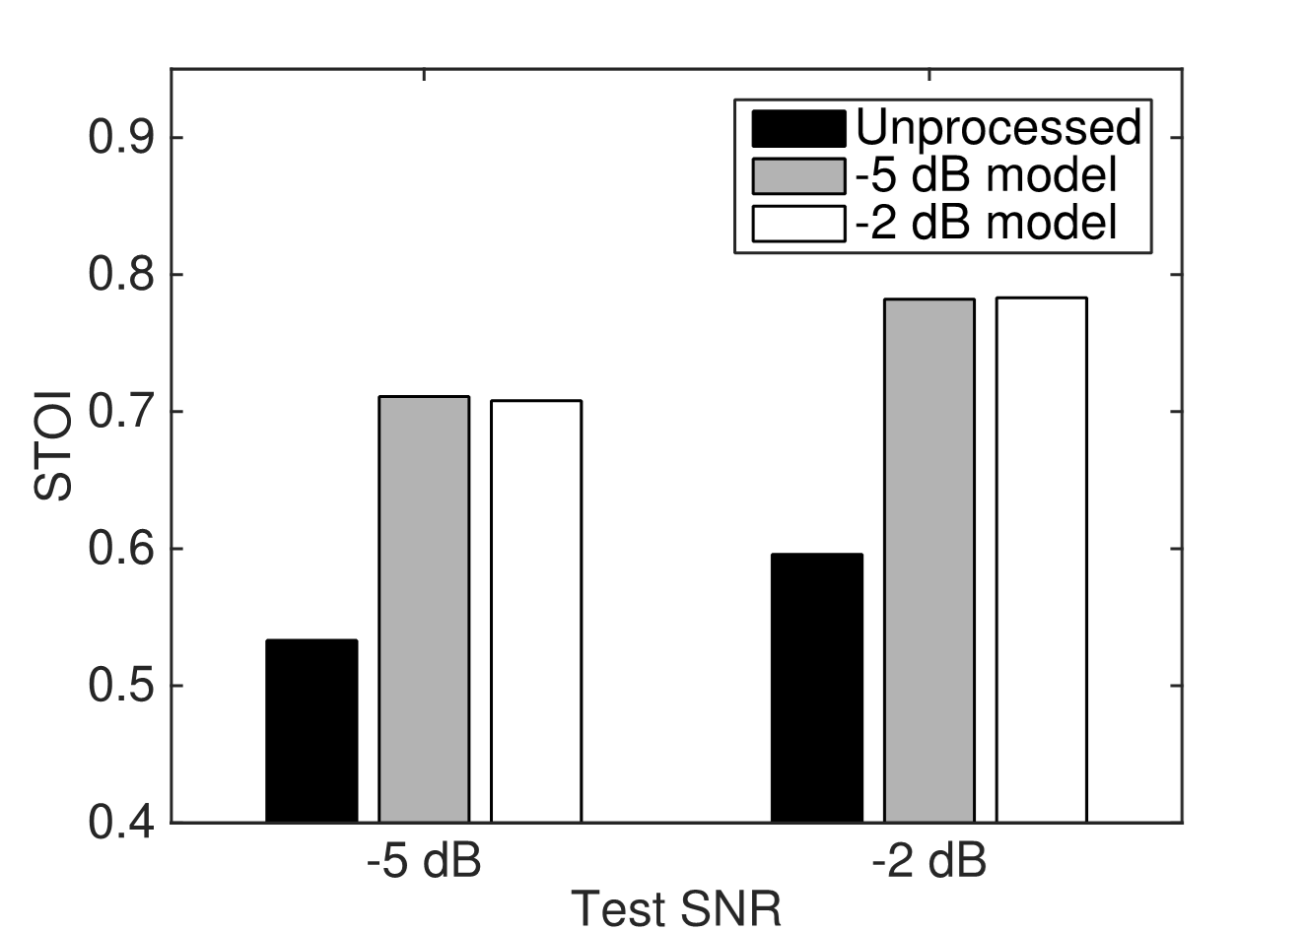
Benefit of large-scale training
Invariance to training SNR

Slide 35
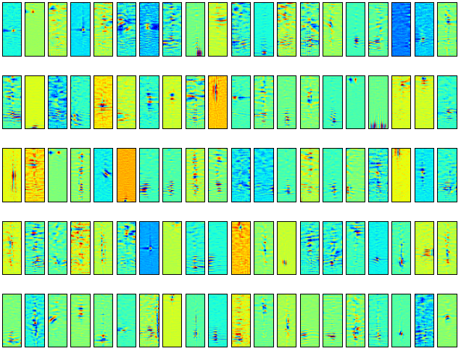
Learned speech filters
Visualization of 100 units from the first hidden layer
Abscissa: 23 time frames; ordinate: 64 frequency channels
Formant
transition?
Harmonics?

Slide 36
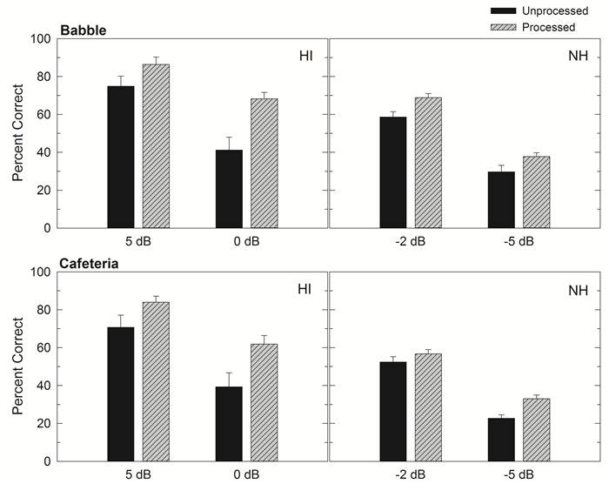

Results and demos
Both NH and HI listeners received benefit from algorithm processing in all conditions, with larger benefits for HI listeners

Slide 37
DNN as spectral magnitude estimator
Xu et al. (2014) proposed a DNN-based enhancement algorithm
DNN (with RBM pretraining) is trained to map from log-power spectra of noisy speech to those of clean speech
More input frames and training data improve separation results

Slide 38
Xu et al. results in PESQ
With trained noises
Subscript in DNN denotes number of hidden layers
With two untrained noises (A: car; B: exhibition hall)

Slide 39
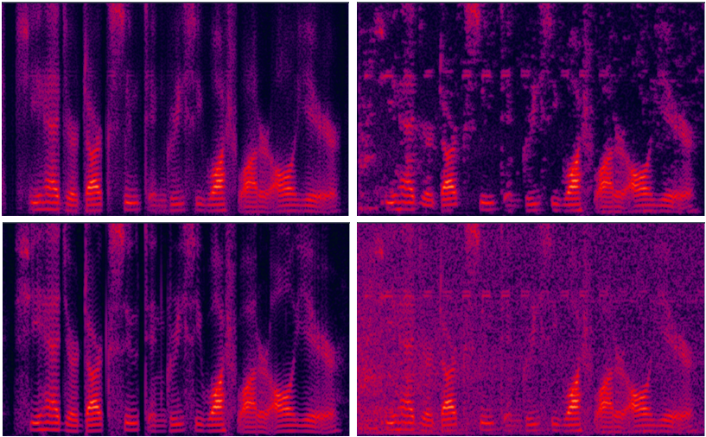
Xu et al. demo
Street noise at 10 dB (upper left: DNN; upper right: log-MMSE; lower left: clean; lower right: noisy)

Slide 40
DNN for two-talker separation
Huang et al. (2014; 2015) proposed a two-talker separation method based on DNN, as well as RNN (recurrent neural network)
Mapping from an input mixture to two separated speech signals
Using T-F masking to constrain target signals
Binary or ratio

Slide 41
Network architecture and training objective
A discriminative training objective maximizes signal-to-interference ratio (SIR)

Slide 42

Huang et al. results
DNN and RNN perform at about the same level
About 4-5 dB better in terms of SIR than NMF, while maintaining better SDRs and SARs (input SIR is 0 dB)
Demo at https://sites.google.com/site/deeplearningsourceseparation
Mixture
Binary masking
Separated
Talker 1
Talker 1
Ratio masking
Separated
Talker 2
Talker 2

Slide 43
Binaural separation of reverberant speech
Jiang et al. (2014) use binaural (ITD and ILD) and monaural (GFCC) features to train a DNN classifier to estimate the IBM
DNN-based classification produces excellent results in low SNR, reverberation, and different spatial configurations
The inclusion of monaural features improves separation performance when target and interference are close, potentially overcoming a major hurdle in beamforming and other spatial filtering methods

Slide 44
Part VI: Concluding remarks
Formulation of separation as classification or mask estimation enables the use of supervised learning
Advances in DNN-based speech separation in the last few years are impressive
Large improvements over unprocessed noisy speech and related approaches
This approach has yielded the first demonstrations of speech intelligibility improvement in noise

Slide 45
Concluding remarks (cont.)
Supervised speech processing represents a major current trend
Signal processing provides an important domain for supervised learning, and it in turn benefits from rapid advances in machine learning
Use of supervised processing goes beyond speech separation and recognition
Multipitch tracking (Huang & Lee’13, Han & Wang’14)
Voice activity detection (Zhang et al.’13)
Dereverberation (Han et al.’15)
SNR estimation (Papadopoulos et al.’14)

Slide 46
Resources and acknowledgments
DNN toolbox for speech separation
http://www.cse.ohio-state.edu/pnl/DNN_toolbox
Thanks to Jitong Chen and Donald Williamson for their assistance in the tutorial preparation

