Slide 1
Robust Automatic Speech Recognition by Transforming Binary Uncertainties
DeLiang Wang
(Jointly with Dr. Soundar Srinivasan)
Oticon A/S, Denmark
(On leave from Ohio State University, USA)

Slide 2
Outline of presentation
Background
  The robustness problem in automatic speech recognition (ASR)
  Binary time-frequency (T-F) masking for speech separation
  Binary T-F masking for speech recognition
Model description
  Uncertainty decoding for robust ASR
  Supervised learning for uncertainty transformation from spectral to cepstral domain
Evaluation

Slide 3
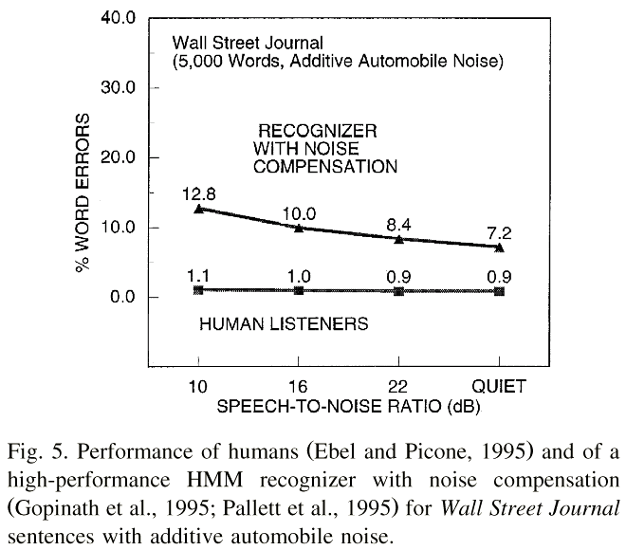


Human versus machine speech recognition
Speech with additive car noise
  At 10 dB
  At 0 dB
Human word error rate at 0 dB SNR (signal-to-noise ratio) is still around 1% as opposed to 40% for recognizers with noise compensation
From Lippmann (1997)
Notes:
Unlike the situation in this room, …
Perhaps the most important problem.
At SNR of 0 dB 40% with noise adaptation; note noise adaptation is unrealistic.

Slide 4
The robustness problem
In natural environments, target speech occurs simultaneously with other interfering sounds
Robustness is a problem of mismatch between training and test (operating) conditions
Achieving robustness to various forms of interference and distortion is one of the most important challenges facing ASR today (Allen’05)
Notes:
Unlike the situation in this room, …
Perhaps the most important problem.
At SNR of 0 dB 40% with noise adaptation; note noise adaptation is unrealistic.

Slide 5
Approaches to robust ASR
Robust feature extraction
  E.g., cepstral mean normalization
Source-driven: Source enhancement or separation
  E.g., spectral subtraction + ASR
Model-driven: Recognizing speech based on models of speech and noise
The performance of the above approaches is inadequate under realistic conditions
Notes:
It is generally believed that ….
The approaches to robust ASR can be divided into 3 broad categories.
The first category of approach consists of algorithms that derive features to minimize the effect of distortion.
Minimize distortion at the source. Enhanced speech is deemed to be clean and recognized using conventional means.
for example, speech enhancement algorithms often assume noise is stationary and do not perform under non-stationary conditions.

Slide 6
Auditory scene analysis
Robustness of human listening is by means of auditory scene analysis (ASA) (Bregman’90)
ASA refers to the perceptual process of organizing an acoustic mixture into (subjective) streams that correspond to different sound sources in the mixture
  Two kinds of ASA: Primitive and schema-driven
Primitive ASA: Innate mechanisms based on “bottom-up”, source independent cues such as pitch and spatial location of a sound source
Schema-based ASA: “Top-down” mechanisms based on acquired, source-dependent knowledge
Notes:
onset-offset, amplitude and frequency modulations.
The second type is schema-based ASA. What is a schema? According to Bregman…

Slide 7
Computational auditory scene analysis
Computational auditory scene analysis (CASA) aims to achieve sound separation based on ASA principles (Wang & Brown’06)
  CASA makes relatively minimal assumptions about interference and strives for robust performance under a variety of noisy conditions
Many of the CASA systems produce binary time-frequency masks as output
Notes:
Inspired by the robust human ability in sound segregation, computational auditory scene analysis systems ....
Unlike traditional signal processing approaches, …..
However, existing …..
But we know from psychophysical studies on ….
And sometimes provides the dominant basis for auditory organization such as when parts of sounds are obliterated by noise.

Slide 8
Binary T-F masks for speech separation
In both CASA and ICA (independent component analysis), recent speech separation algorithms compute binary T-F masks in the linear spectral domain that aim to retain those T-F units of a noisy speech signal that contain more speech energy than noise energy
Underlying these algorithms is the notion of ideal T-F mask

Slide 9
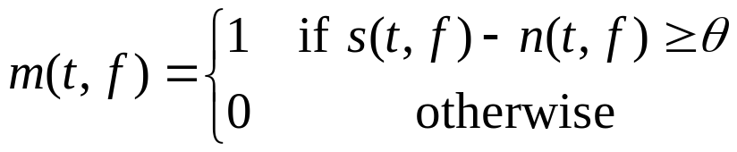
Ideal binary mask
Auditory masking phenomenon: In a narrowband, a stronger signal masks a weaker one
Motivated by the auditory masking phenomenon we have suggested ideal binary mask as a main goal of CASA (Hu & Wang’01; Roman et al.’01)
The definition of an ideal binary mask
  s(t, f ): Target energy in unit (t, f ), and n(t, f ): Noise energy
  θ: A local SNR criterion in dB, which is typically chosen to be 0 dB
  Optimality: The ideal binary mask with θ = 0 dB is the optimal binary mask from the perspective of SNR gain
  It does not actually separate the mixture!

Slide 10
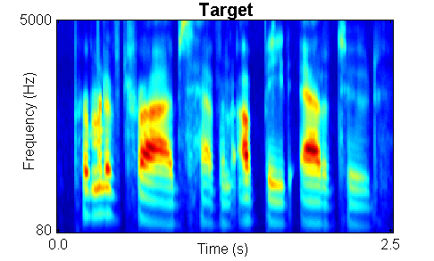
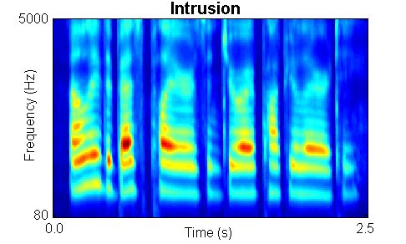

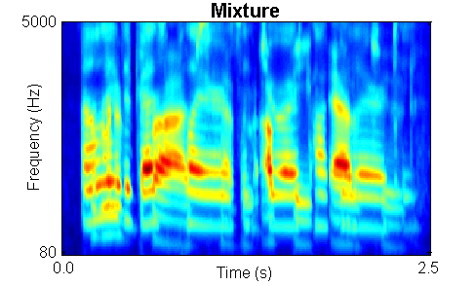
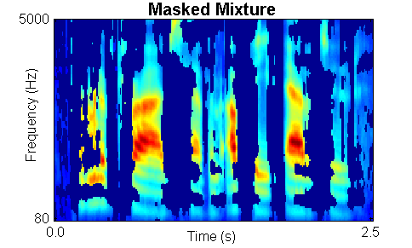
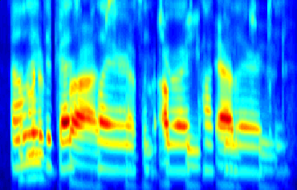
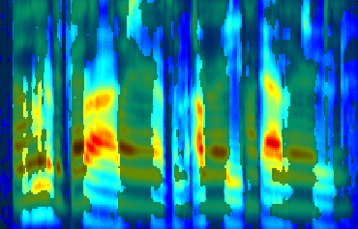
Ideal binary mask illustration
Recent psychophysical tests show that the ideal binary mask results in dramatic speech intelligibility improvements (Brungart et al.’06; Anzalone et al.’06)

Slide 11
Binary T-F masks for ASR
Direct recognition of the resynthesized signal from a binary mask gives poor performance because of the distortions – introduced by binary T-F masking – to speech features used in ASR
For application to speech recognition, binary masks are typically coupled with missing-data ASR

Slide 12
Missing-data ASR
The aim of ASR is to assign an acoustic vector X to a class C so that the posterior probability P(C|X) is maximized: P(C|X) ∝ P(X|C) P(C)
  If components of X are unreliable or missing, one cannot compute P(X|C) as usual
The missing-data method for ASR (Cooke et al.’01) uses a binary T-F mask to label interference-dominant T-F regions as missing (unreliable) during recognition
The method adapts a hidden Markov model (HMM) classifier to cope with missing features
  Partition X into reliable parts X_{r} and unreliable parts X_{u}
  Use marginal distribution P(X_{r}|C) in recognition

Slide 13
Drawbacks of missing-data ASR
Recognition is performed in T-F or spectral domain
  Clean speech recognition accuracy in the cepstral domain is higher
  Recognition performance drops significantly as vocabulary size increases (Srinivasan et al.’06)
Raj et al. (2004) perform recognition in cepstral domain after reconstruction of missing T-F units using a trained speech prior model
  However, errors in reconstruction affect ASR performance

Slide 14
Outline of presentation
Background
  The robustness problem in automatic speech recognition (ASR)
  Binary time-frequency (T-F) masking for speech separation
  Binary T-F masking for speech recognition
Model description
  Uncertainty decoding for robust ASR
  Supervised learning for uncertainty transformation from spectral to cepstral domain
Evaluation

Slide 15
Noise-robust speech recognition
For source-driven methods to robust ASR, performance of a preprocessor varies widely across time frames
Local knowledge of preprocessing uncertainty in the acoustic model can be used to improve the overall ASR accuracy (Deng et al.’05)
  Current methods estimate the uncertainty in either log-spectral domain or cepstral domain
Notes:
1. And feature dimension.

Slide 16
A supervised learning approach to cepstral uncertainty estimation
In the binary mask framework, we propose a two-step approach to estimate the uncertainty of reconstructed cepstra
The first step uses the information in a speech prior to estimate the uncertainty of reconstructed spectra
The second step uses a supervised learning approach to transform the spectral uncertainty into the cepstral domain
  Analytical form of this nonlinear transformation is unknown
  The task is to transform uncertainty encoded by a binary T-F mask into the real-valued uncertainty of reconstructed cepstra
Notes:
(Yang et. al., 2005)

Slide 17
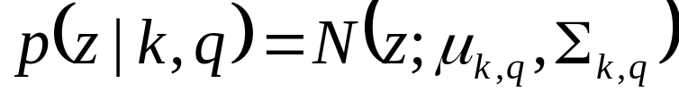

Evaluation of acoustic probability in ASR
Observation density in each state of HMM-based ASR is typically modeled as Gaussian mixtures (GMM). The probability of an observed clean speech feature vector is then evaluated over each mixture component:
  z: clean speech feature used in training
  q: an HMM state; k: mixture component
When speech is corrupted by noise, a preprocessor is used to produce an estimate of clean speech, , and then evaluate the above probability

Slide 18
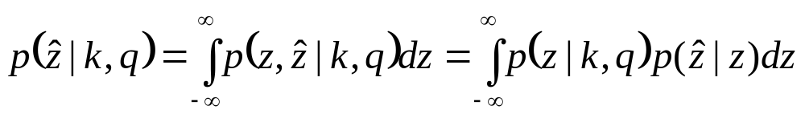

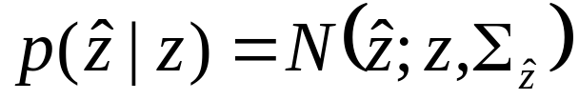
Uncertainty decoding
Uncertainty decoding (Deng et al.’05) accounts for varied accuracies (uncertainties) of enhanced features by considering joint density between clean and enhanced features and then integrating (marginalizing) the joint density over clean feature values
with the assumption that is independent of mixture component and
Notes:
Assume the true speech vector has mean equal to the estimated speech value and an error that is zero mean Gaussian with variance in the estimation process.

Slide 19
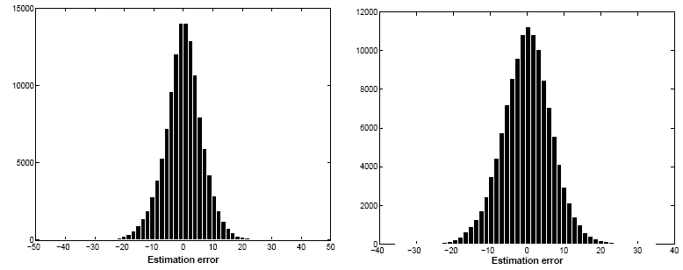
Error histogram of enhanced features
4th order (left) and 11th (right) order cepstral coefficients, as estimated by spectral subtraction
Notes:
Assume the true speech vector has mean equal to the estimated speech value and an error that is zero mean Gaussian with variance in the estimation process.

Slide 20
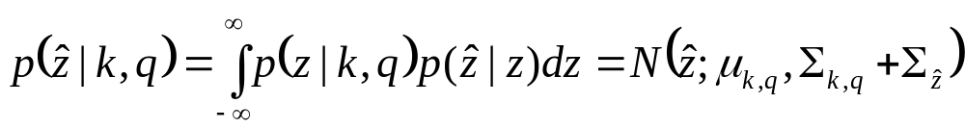
Uncertainty decoding (cont.)
When noisy speech is processed by unbiased enhancement algorithms, Deng et al. (2005) show that:
The uncertainty from preprocessor increases the variance of a Gaussian mixture component
  Hence enhanced features with larger uncertainty are expected to contribute less to the overall likelihood
Effect of uncertainty
Notes:
Assume the true speech vector has mean equal to the estimated speech value and an error that is zero mean Gaussian with variance in the estimation process.

Slide 21
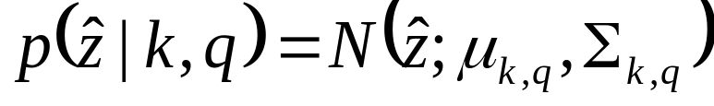
Two special cases
When there is no uncertainty:
  This amounts to evaluation using enhanced features directly
When there is complete uncertainty, the feature makes no contribution to the overall likelihood, corresponding to missing-data marginalization
Notes:
Assume the true speech vector has mean equal to the estimated speech value and an error that is zero mean Gaussian with variance in the estimation process.

Slide 22
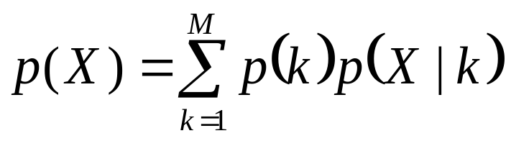
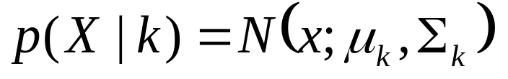
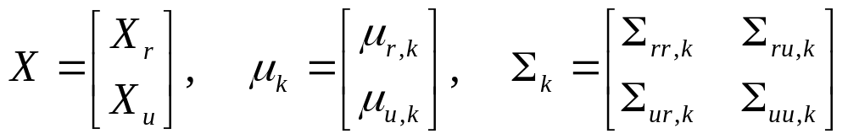
Reconstruction of missing T-F units
Raj et al. (2004) employ a GMM as the prior speech model to reconstruct missing T-F values
We propose to use the speech prior to estimate the uncertainty of the reconstructed spectra
where
Notes:
1. Following the work of …

Slide 23
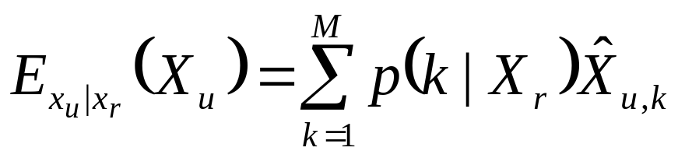
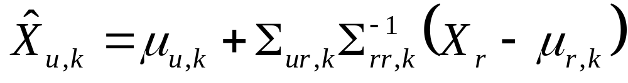
Mean of reconstruction
Minimum mean square error estimation leads to
By Bayesian formula the expected value of a mixture component in unreliable T-F units can be computed as (Ghahramani & Jordan’93)
Notes:
1. Following the work of …

Slide 24

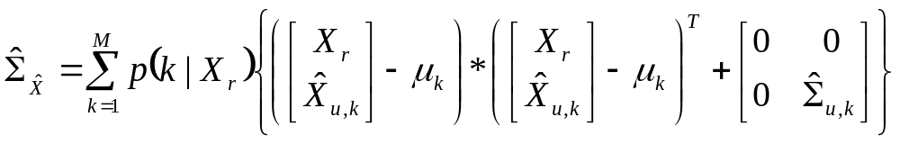
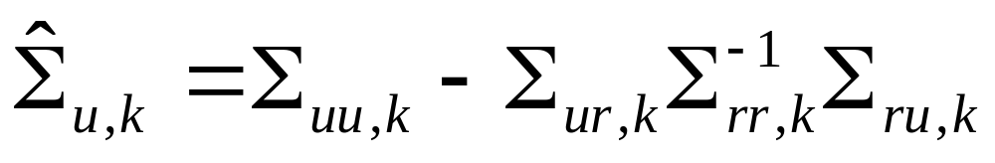
Variance of reconstruction
By a similar derivation, we find the variance of the reconstructed spectral vector
where
Notes:
1. Following the work of …

Slide 25
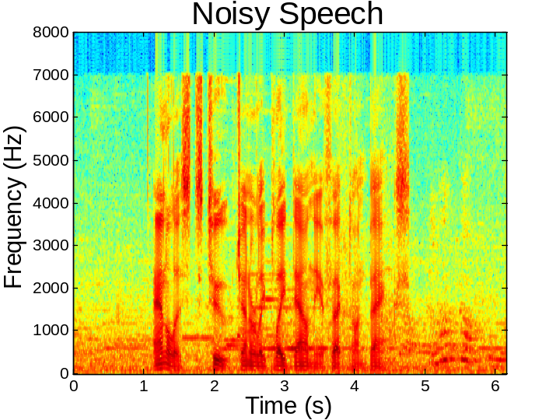
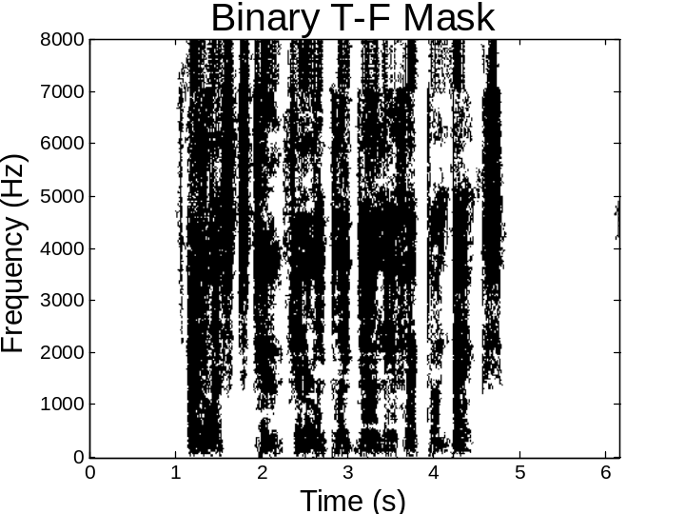
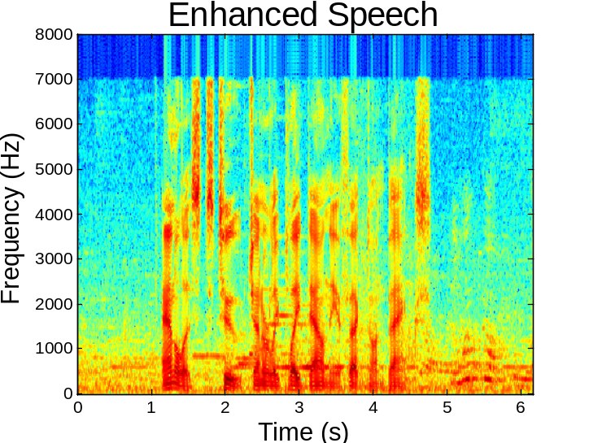
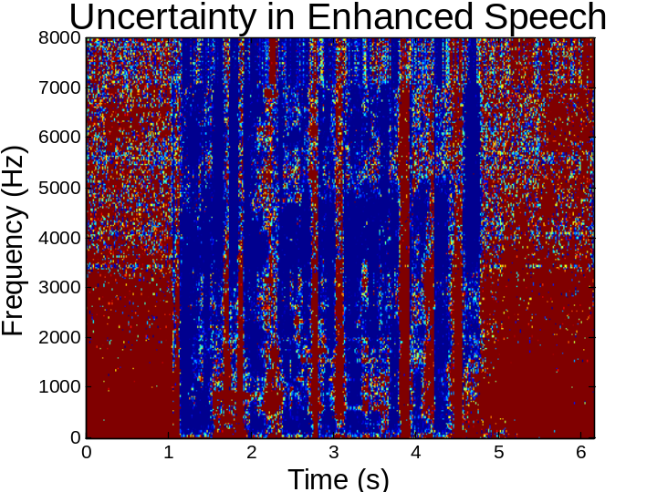
Spectral domain uncertainties
Notes:
1. Here is how the uncertainties appear in the spectral domain.

Slide 26
From spectral domain variance to cepstral domain uncertainty
We use regression trees to perform supervised transformation from spectral variance to cepstral uncertainty
  Regression trees are a flexible, nonparametric approach for regression analysis
  Our earlier study shows that a multilayer perceptron can also be used for the task, but gives slightly worse performance
Input: Spectral domain variance values
Output: Estimate of the squared difference between reconstructed and clean cepstra
  12 Mel-frequency cepstral coefficients + log frame energy
  Static, delta, and acceleration features are estimated, resulting in a 39-dimensional vector of uncertainties
Notes:
1. We perform non-parametric transformation using regression trees.

Slide 27
Regression tree training
A set of 39 regression trees is used, each corresponding to a single feature
Static, delta, and acceleration dimensions are independently estimated
  Although one can learn to transform just the static dimension and compute the delta and acceleration dimensions accordingly, earlier investigation finds that the difference dimensions tend to be more robust than the static dimension
  We perform independent training for the three dimensions which better captures the intrinsic robustness of difference features
Notes:
1. We perform non-parametric transformation using regression trees.

Slide 28
Other training details
The speech prior used in spectral reconstruction is modeled as a mixture of 1024 Gaussians
For regression tree training, we only use a small (40 utterances) development subset corresponding to restaurant noise
  No training on other noise sources
  Use ideal binary T-F masks that retain those T-F units of the noisy speech signal if the local SNR is greater than or equal to 5 dB
Regression tree size is determined by cross validation

Slide 29
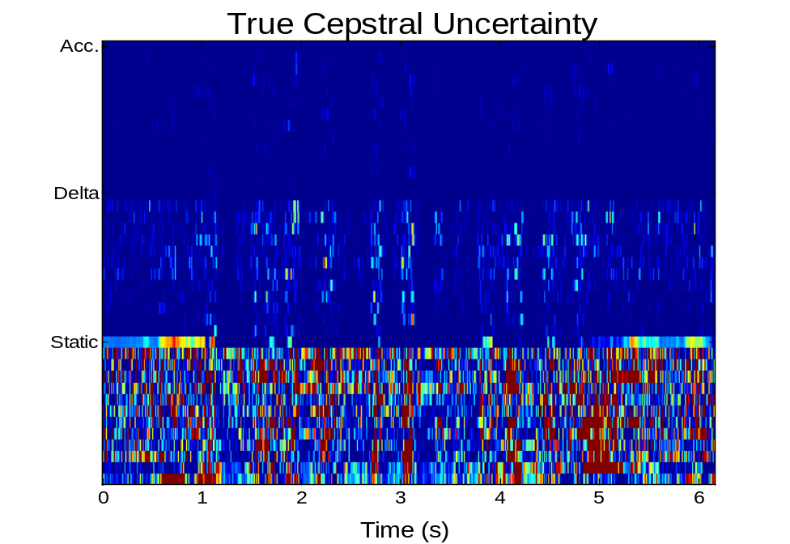
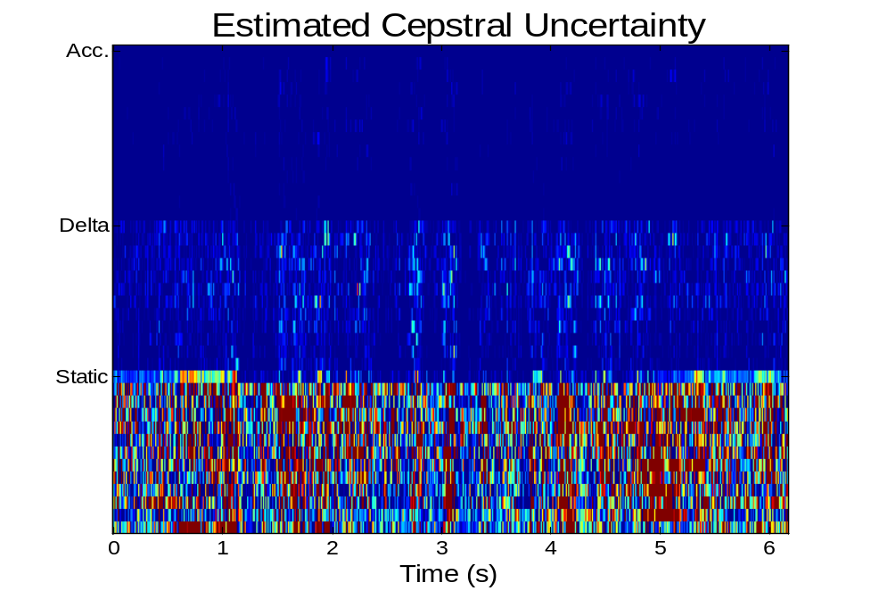
Cepstral domain uncertainties
Delta and acceleration dimensions have smaller uncertainties
Estimated uncertainties are close to the true ones
Notes:
1. Why the dynamic coeffts are more uncertain?

Slide 30
Outline of presentation
Background
  The robustness problem in automatic speech recognition (ASR)
  Binary time-frequency (T-F) masking for speech separation
  Binary T-F masking for speech recognition
Model description
  Uncertainty decoding for robust ASR
  Supervised learning for uncertainty transformation from spectral to cepstral domain
Evaluation

Slide 31
Evaluation setup
The estimated cepstral domain uncertainties are used in the uncertainty decoder for recognition
  The uncertainty increases the variance of Gaussian mixture components in the acoustic model
Aurora 4: A 5000 word closed vocabulary recognition task
Cross-word triphone acoustic models with 4 Gaussians per state using the “Clean Sennheiser training set”
The bigram language model and the dictionary are the same as the ones used in the Aurora 4 baseline evaluations
  The word error rate for clean speech is 10.5%
Test sets contain 6 noise sources (5 dB to 15 dB SNRs)
Notes:
Bigram language model from the Aurora 4 baseline evaluations (Parihar and Picone, 2002).

Slide 32
Experiments with spectral subtraction
Estimate noise spectrum from noisy speech (first and last frames)
Generate a binary T-F mask by labeling a T-F unit as 1 if the local SNR exceeds a threshold; it is labeled 0 otherwise
System | Test Set Word Error Rate (%)
 | Car | Babble | Restaurant | Street | Airport | Train
Baseline | 57.5 | 55.4 | 55.4 | 63 | 54.1 | 65.9
Enhanced Speech | 23.3 | 47.3 | 54.6 | 50.4 | 50.5 | 49.1
Uncertainty Decoding | 21.8 | 43.4 | 48.8 | 49.5 | 42.2 | 47.1
Relative error rate reduction over enhanced speech is 7.9%, and large improvement over the baseline
Notes:
The pitch estimate is derived from Praat (Boersma and Weenink, 2002).
The system shows a robust performance when tested with a variety of noise intrusions.

Slide 33
Experiments with a CASA system
Given a target pitch contour, the voiced speech segregation system of Hu and Wang (2004) produces a binary mask which retains T-F units whose periodicity resembles the detected pitch
System | Test Set Word Error Rate (%)
 | Car | Babble | Restaurant | Street | Airport | Train
Baseline | 57.5 | 55.4 | 55.4 | 63 | 54.1 | 65.9
Enhanced Speech | 31.1 | 45.5 | 50.4 | 51.6 | 53.2 | 53.2
Uncertainty Decoding | 27.5 | 42 | 46.9 | 51.5 | 47.1 | 49.2
Relative error rate reduction over enhanced speech is 7.6%, and again large improvement over the baseline
Notes:
The pitch estimate is derived from Praat (Boersma and Weenink, 2002).
The system shows a robust performance when tested with a variety of noise intrusions.

Slide 34
Experiments with ideal binary mask
This gives the ceiling performance of the proposed method
System | Test Set Word Error Rate (%)
 | Car | Babble | Restaurant | Street | Airport | Train
Enhanced Speech | 14.7 | 22 | 25.2 | 29 | 19.6 | 26
Estimated UD | 14 | 21 | 22 | 24.9 | 17.5 | 25.7
Ideal UD | 14 | 20.1 | 22.2 | 25.1 | 16.8 | 24.9
Ideal binary masks lead to excellent ASR performance
The performance between estimated uncertainties and ideal uncertainties is statistically indistinguishable
Even in this case, an error rate reduction of 8.75% is achieved over enhanced speech
Notes:
The pitch estimate is derived from Praat (Boersma and Weenink, 2002).
The system shows a robust performance when tested with a variety of noise intrusions.

Slide 35
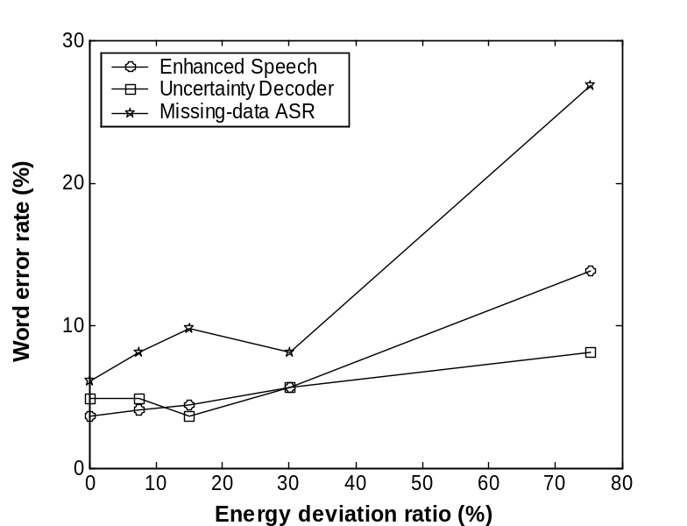
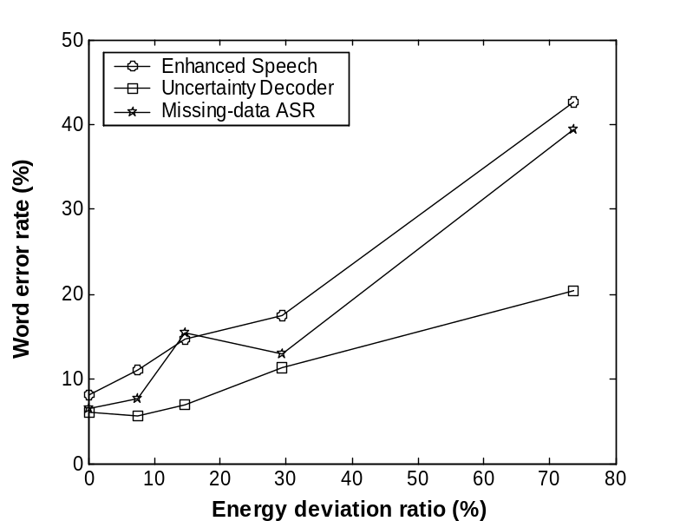
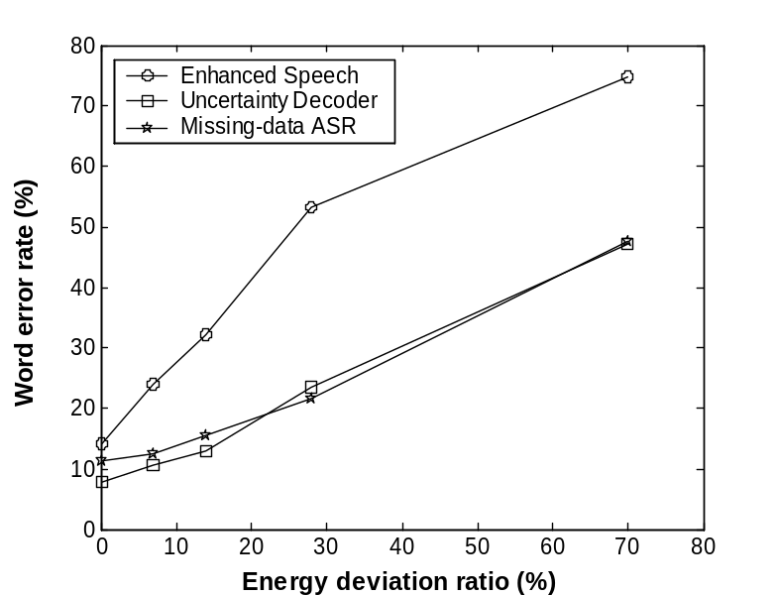
Uncertainty decoding vs. missing-data ASR
SNR = 10 dB
SNR = 5 dB
Given vocabulary-size limitation of missing-data ASR, this comparison is on a small-vocabulary, digit recognition task
Investigate robustness to deviations from ideal binary mask
SNR = 0 dB
Notes:
1. Recall that the primary motivation for this study was to examine an alternative to missing-data ASR. Hence, we now compare the performance of the two recognizers on the digit recognition task with factory noise and evaluate their robustness to deviations from the ideal binary mask at 3 different SNRs.

Slide 36
Conclusion
We have presented a general solution to the problem of estimating the uncertainty of cepstral features from binary T-F mask based separation systems
  The solution reconstructs unreliable T-F units, computes uncertainty in the spectral domain, and then learns to transform the uncertainty into the cepstral domain
The estimated uncertainty provides significant reductions in word error rate compared to conventional recognition on the enhanced cepstra and baseline ASR
Our algorithm compares favorably with the missing-data algorithm
  A key advantage of the proposed algorithm is that it performs well for both small- and large-vocabulary recognition tasks
Unlike model-driven approaches, our system does not require a noise model and hence is applicable under various noise conditions

