Slide 1
A Hidden Markov Model Framework for Multi-target Tracking
DeLiang Wang
Perception & Neurodynamics Lab
Ohio State University

Slide 2
Outline
Problem statement
Multipitch tracking in noisy speech
  Multipitch tracking in reverberant environments
Binaural tracking of moving sound sources
Discussion & conclusion

Slide 3
Multi-target tracking problem
Multi-target tracking is a problem of detecting multiple targets of interest over time, with each target being dynamic (time-varying) in nature
The input to a multi-target tracking system is a sequence of observations, often noisy
Multi-target tracking occurs in many domains, including radar/sonar applications, surveillance, and acoustic analysis

Slide 4
Approaches to the problem
Statistical signal processing has been heavily employed for the multi-target tracking problem
In a very broad sense, statistical methods can be viewed Bayesian tracking or filtering
  Prior distribution describing the state of dynamic targets
  Likelihood (observation) function describing state-dependent sensor measurements, or observations
  Posterior distribution describing the state given the observations. This is the output of the tracker, computed by combining the prior and the likelihood

Slide 5
Kalman filter
Perhaps the most widely used approach for tracking is a Kalman filter
  For linear state and observation models, and Gaussian perturbations, the Kalman filter gives a recursive estimate of the state sequence that is optimal in the least squares sense
  The Kalman filter can be viewed as a Bayesian tracker

Slide 6
General Bayesian tracking
When the assumptions of the Kalman filter are not satisfied, a more general framework is needed
For multiple targets, multiple hypothesis tracking or unified tracking can be formulated in the Bayesian framework (Stone et al.’99)
Such general formulations, however, require an exponential number of evaluations, hence computationally infeasible
  Approximations and hypothesis pruning techniques are necessary in order to make use of these methods

Slide 7
Domain of acoustic signal processing
Domain knowledge can provide powerful constraints to the general problem of multi-target tracking
We consider the domain of acoustic/auditory signal processing, in particular
  Multipitch tracking in noisy environments
  Multiple moving-source tracking
In this domain, hidden Markov model (HMM) is a dominant framework, thanks to its remarkable success in automatic speech recognition

Slide 8
HMM for multi-target tracking
We have explored and developed a novel HMM framework for multi-target tracking for the problems of pitch and moving sound tracking (Wu et al., IEEE T-SAP’03; Roman & Wang, IEEE T-ASLP’08; Jin & Wang, OSU Tech. Rep.’09)
Let’s first consider the problem of multi-pitch tracking

Slide 9
What is pitch?
“The attribute of auditory sensation in terms of which sounds may be ordered on a musical scale.” (American Standards Association)
Periodic sound: pure tone, voiced speech (vowel, voiced consonant), music
Aperiodic sound with pitch sensation, e.g. comb-filtered noise

Slide 10
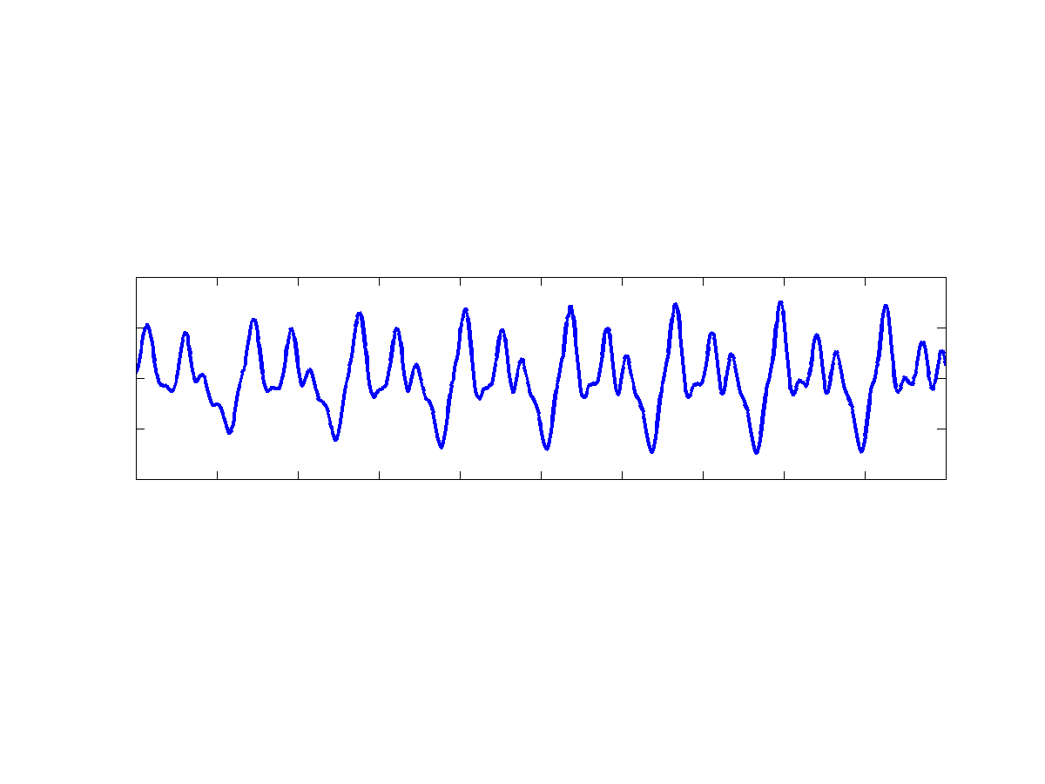
Pitch of a periodic signal
Fundamental Frequency
(period)
Pitch Frequency
(period)
d

Slide 11
Applications of pitch tracking
Computational auditory scene analysis (CASA)
  Source separation in general
Automatic music transcription
Speech coding, analysis, speaker recognition and language identification

Slide 12
Existing pitch tracking algorithms
Numerous pitch tracking, or pitch determination algorithms (PDAs), have been proposed (Hess’83; de Cheveigne’06)
  Time-domain
  Frequency-domain
  Time-frequency domain
Most PDAs are designed to detect single pitch in noisy speech
Some PDAs are able to track two simultaneous pitch contours. However, their performance is limited in the presence of broadband interference

Slide 13
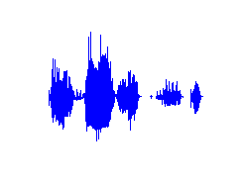
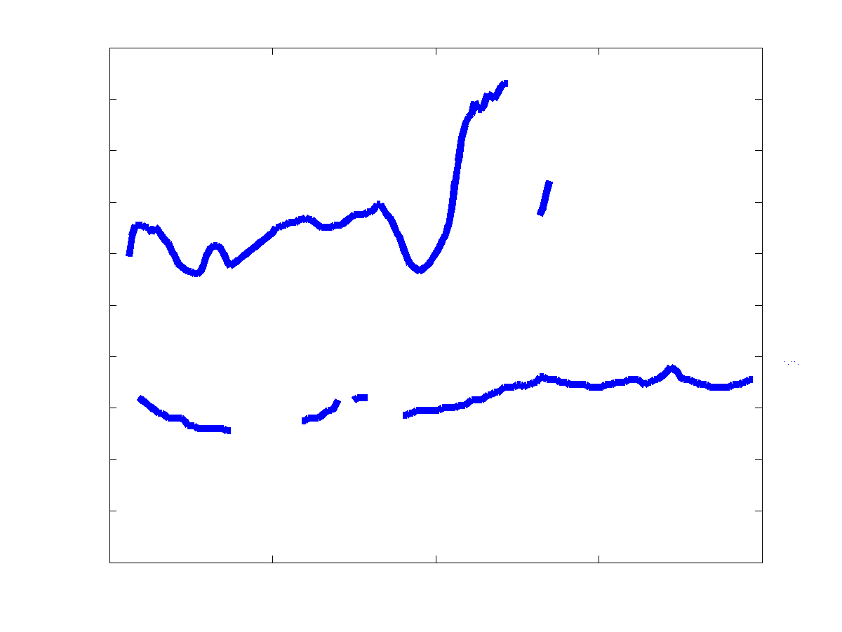
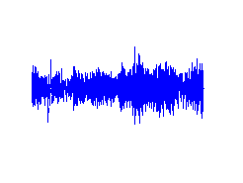
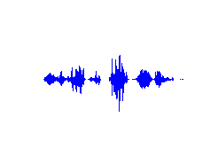
Multipitch tracking in noisy environments
Voiced signal
Output pitch tracks
Background
noise
Multipitch
tracking
Voiced signal

Slide 14

Diagram of Wu et al.’03
Normalized Correlogram
Channel Selection
Speech/
Interference
Cochlear
Filtering
HMM-based Multipitch Tracking
Channel
Integration
Continuous
Pitch Tracks

Slide 15
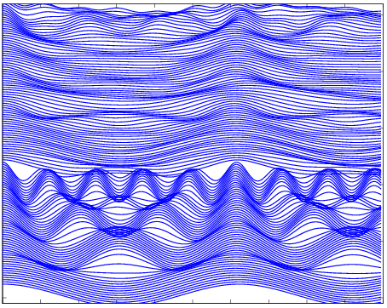
Periodicity extraction using correlogram
Normalized Correlogram
High frequency
Frequency channels
Low frequency
Delay
Response to clean speech

Slide 16
Channel selection
Some frequency channels are masked by interference and provide corrupting information on periodicity. These corrupted channels are excluded from pitch determination (Rouat et al.’97)
Different strategies are used for selecting valid channels in low- and high-frequency ranges

Slide 17
HMM formulation
Normalized Correlogram
Channel Selection
Speech/
Interference
Cochlear
Filtering
HMM-based Multipitch Tracking
Channel
Integration
Continuous
Pitch Tracks

Slide 18
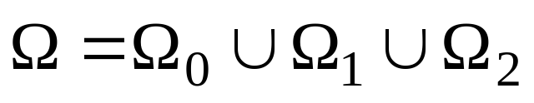


Pitch state space
The state space of pitch is neither a discrete nor continuous space in a traditional sense, but a mix of the two (Tokuda et al.’99)
Considering up to two simultaneous pitch contours, we model the pitch state space as a union of three subspaces:
  Zero-pitch subspace is an empty set:
  One-pitch subspace:
  Two-pitch subspace:

Slide 19

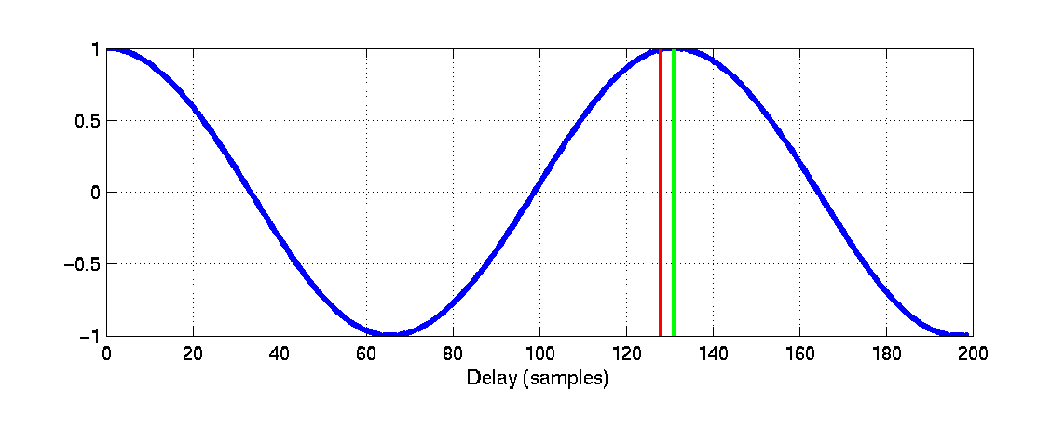
How to interpret correlogram probabilistically?
The correlogram dominates the modeling of pitch perception (Licklider’51), and is commonly used in pitch detection
We examine the relative time lag between the true pitch period and the lag of the closest peak
True pitch delay (d)
Peak delay (l)

Slide 20
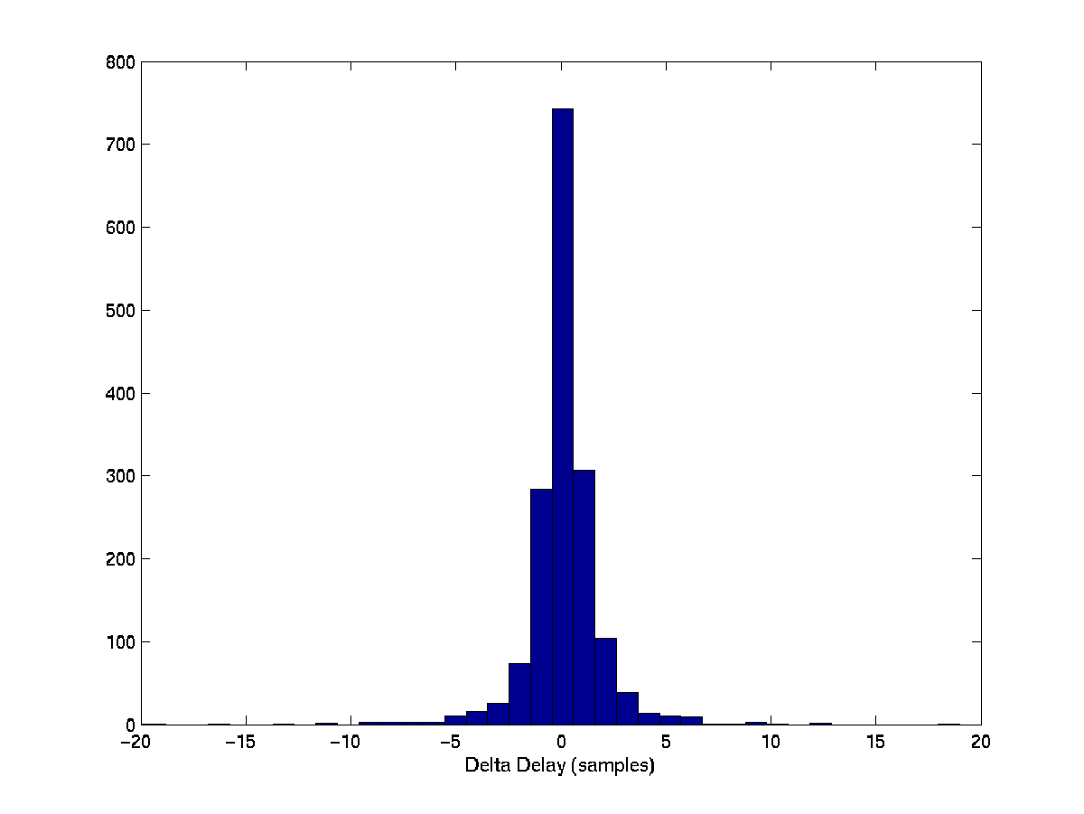

Relative time lag statistics
histogram from natural speech for one channel

Slide 21
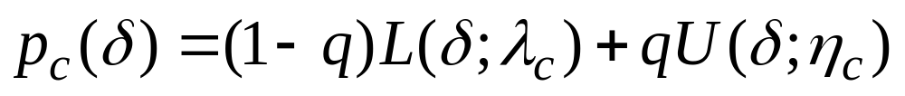
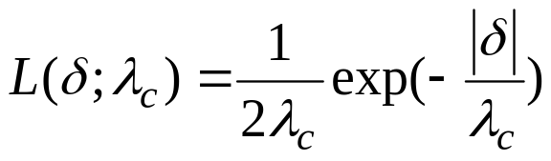
Modeling relative time lags
From the histogram data, we find that a mixture of a Laplacian and a uniform distribution is appropriate
  q is a partition coefficient
  The Laplacian models a pitch event and the uniform models “background noise”
  The parameters are estimated using ML from a small corpus of clean speech utterances

Slide 22
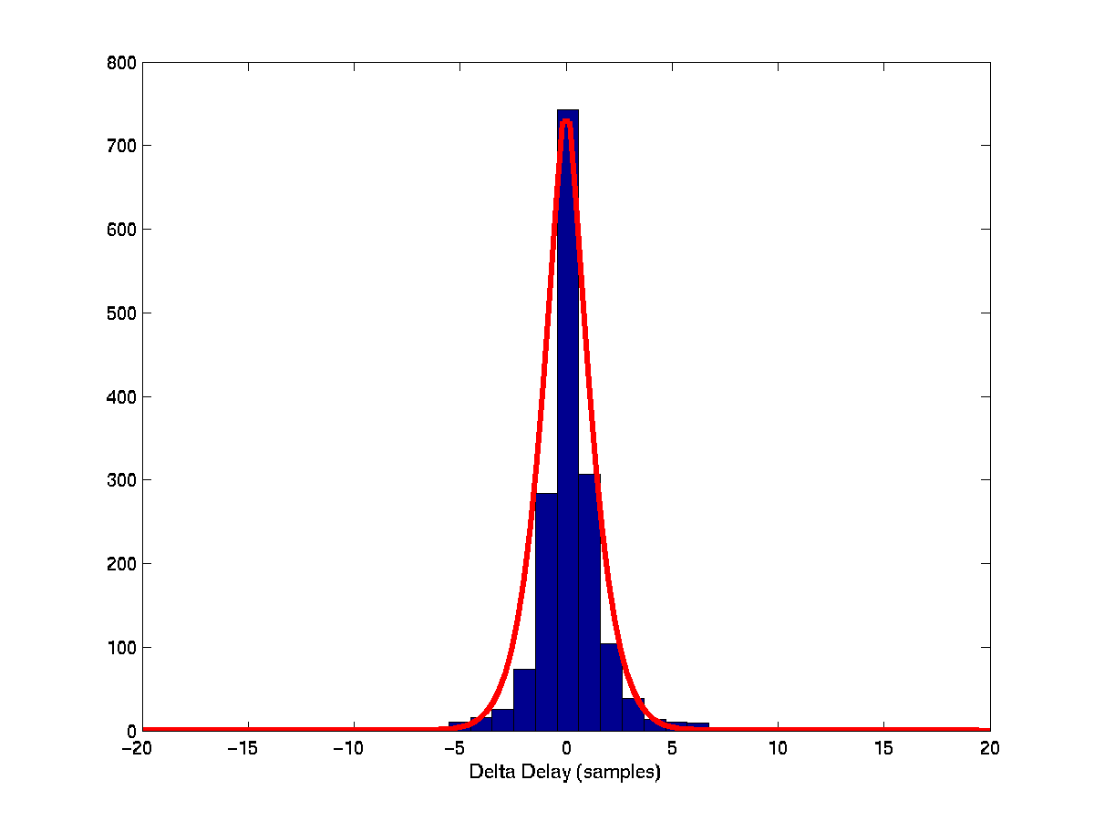

Modeling relative time-lag statistics
Estimated probability distribution of
(Laplacian plus uniform distribution)

Slide 23

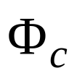
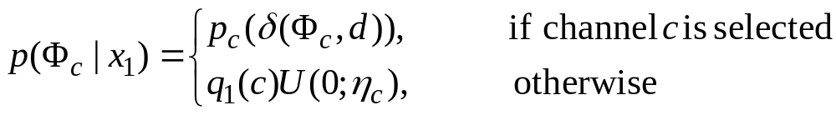
One-pitch hypothesis
First consider one-pitch state subspace, i.e.
For a given channel, c, let denote the set of correlogram peaks
  If c is not selected, the probability of background noise is assigned

Slide 24
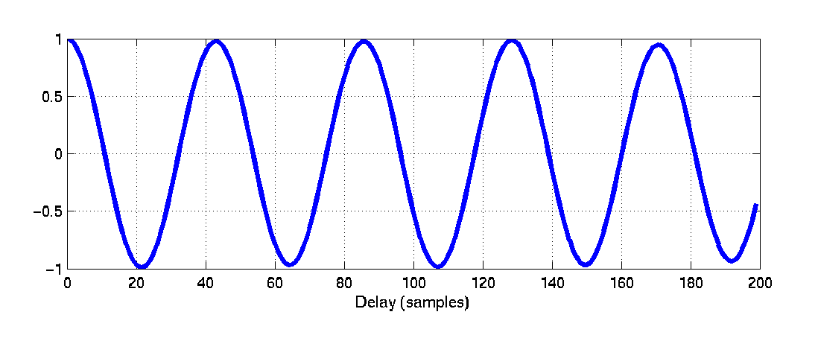

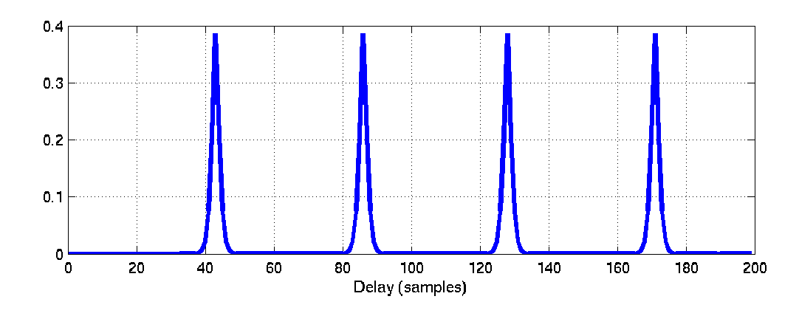
One-channel observation probability
Normalized Correlogram

Slide 25
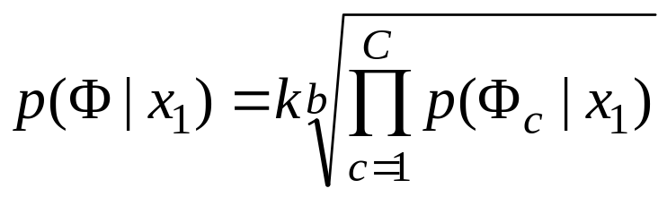
Integration of channel observation probabilities
How to integrate the observation probabilities of individual channels to form a frame-level probability?
Modeling joint probability is computationally prohibitive. Instead,
  First we assume channel independence and take the product of observation probabilities of all channels
  Then flatten (smooth) the product probability to account for correlated responses of different channels, or to correct the probability overshoot phenomenon (Hand & Hu’01)

Slide 26

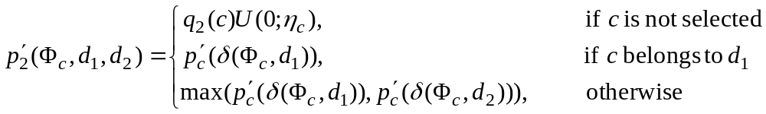

Two-pitch hypothesis
Next consider two-pitch state subspace, i.e.
If channel energy is dominated by one source, d₁
  denotes relative time-lag distribution from two-pitch frames

Slide 27
Two-pitch hypothesis (cont.)
By a similar channel integration scheme, we finally obtain
  This gives the larger of the two assuming either d₁ or d₂ dominates

Slide 28

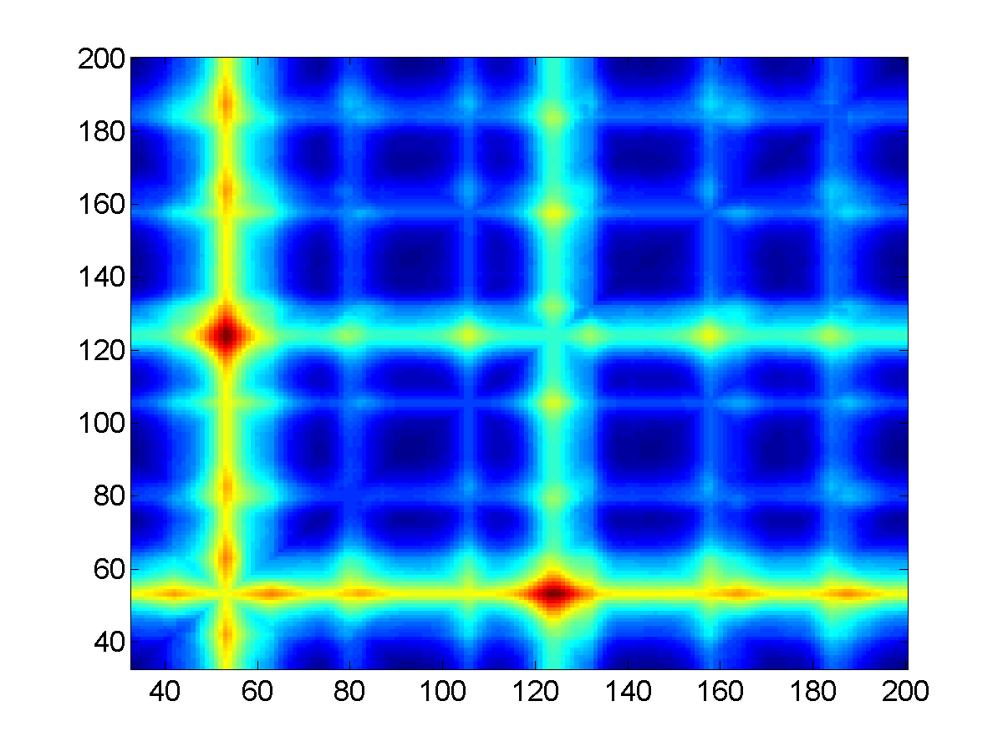
Two-pitch integrated observation probability
Pitch Delay 2
Pitch Delay 1

Slide 29


Zero-pitch hypothesis
Finally consider zero-pitch state subspace, i.e.
We simply give it a constant likelihood

Slide 30
HMM tracking
Observed
signal
Observation probability
Pitch state
space
Pitch dynamics
One time frame

Slide 31
Prior (prediction) and posterior probabilities
Prior probability
for time frame m
Assuming pitch
period d for
time frame m-1
d
Observation probability
for time frame m
Posterior probability
for time frame m
d
d

Slide 32
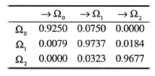
Transition probabilities
Transition probabilities consist of two parts:
  Jump probabilities between pitch subspaces
  Pitch dynamics within the same subspace
Jump probabilities are again estimated from the same small corpus of speech utterances
  They need not be accurate as long as diagonal values are high

Slide 33
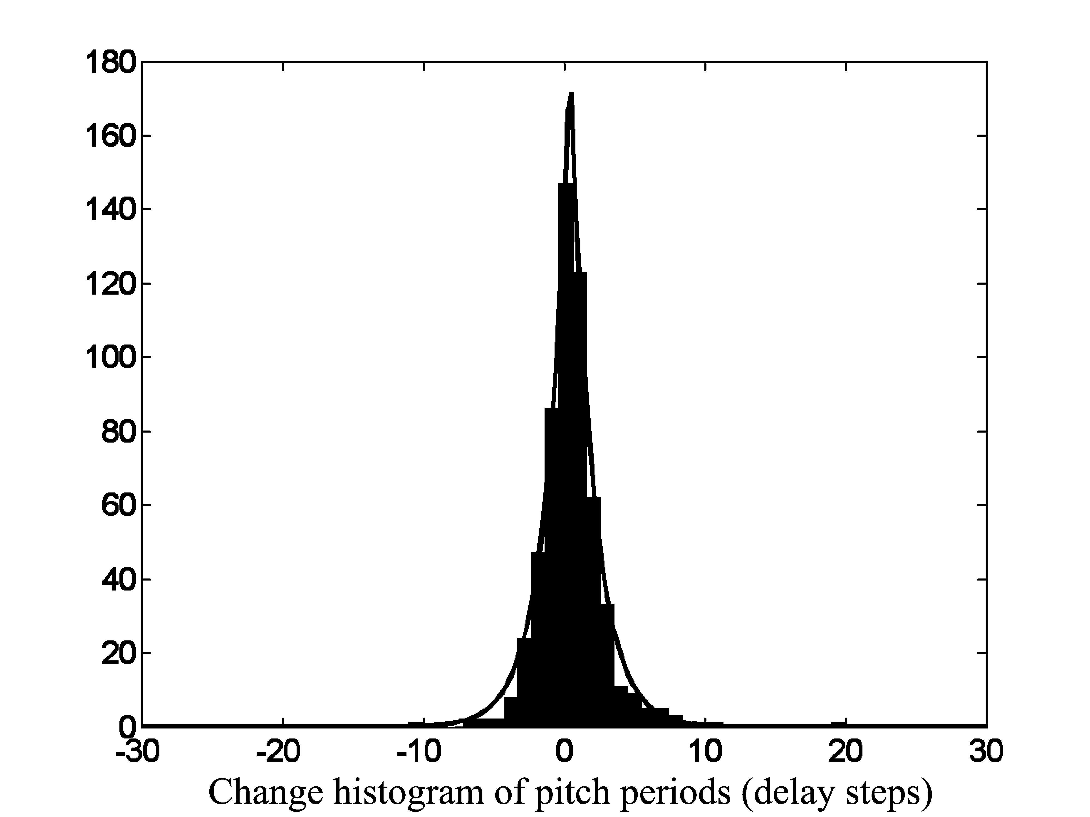
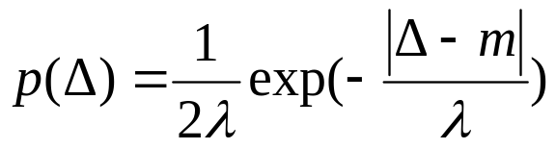
Pitch dynamics in consecutive time frames
Pitch continuity is best modeled by a Laplacian
Derived distribution consistent with the pitch declination phenomenon in natural speech (Nooteboom’97)

Slide 34
Search and efficient implementation
Viterbi algorithm is used to find the optimal sequence of pitch states
To further improve computational efficiency, we employ
  Pruning: search only in a neighborhood of a previous pitch point
  Beam search: search for a limited number of most probable state sequences
  Search for pitch periods near local peaks

Slide 35
Evaluation results
The Wu et al. algorithm was originally evaluated on mixtures of 10 speech utterances and 10 interferences (Cooke’93), which have a variety including broadband noise, speech, music, and environmental sounds
The system generates good results, substantially better than alternative systems
  The performance is confirmed by subsequent evaluations by others using different corpora

Slide 36
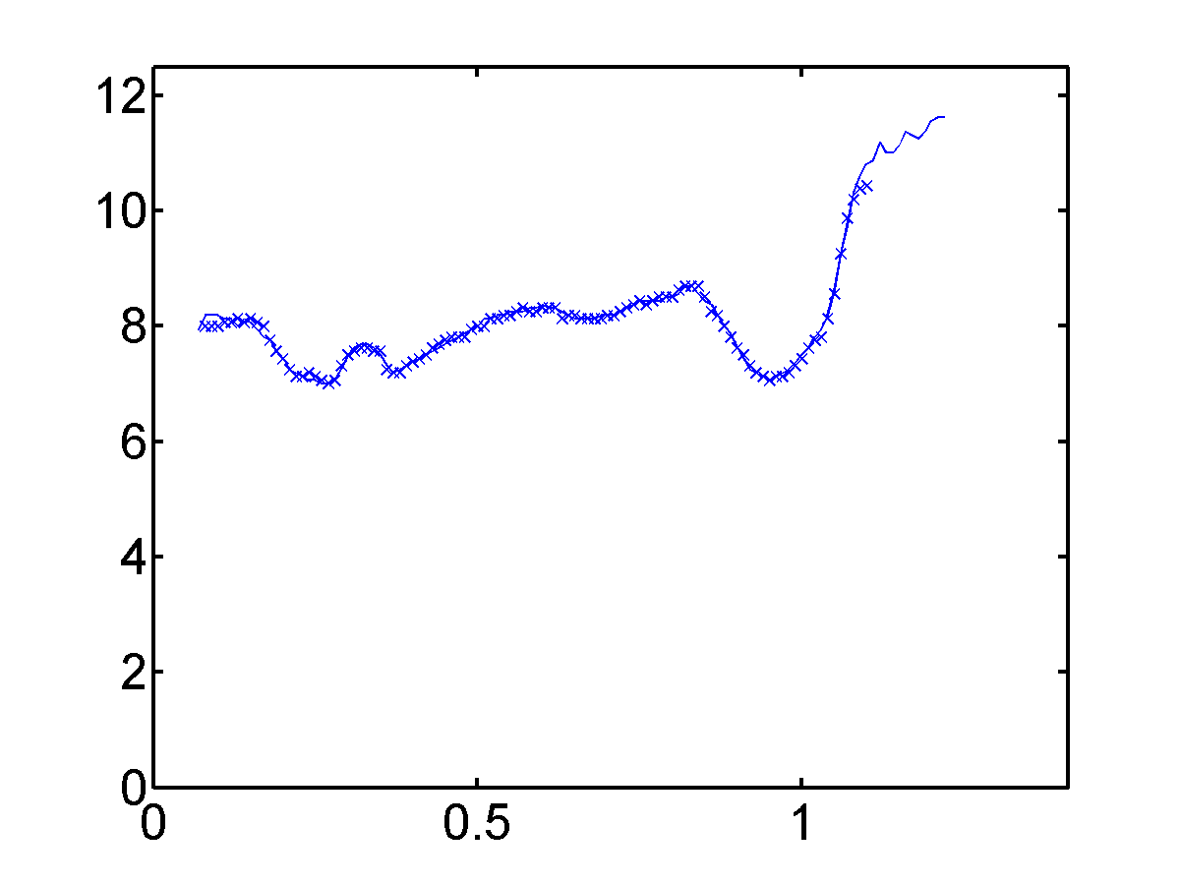
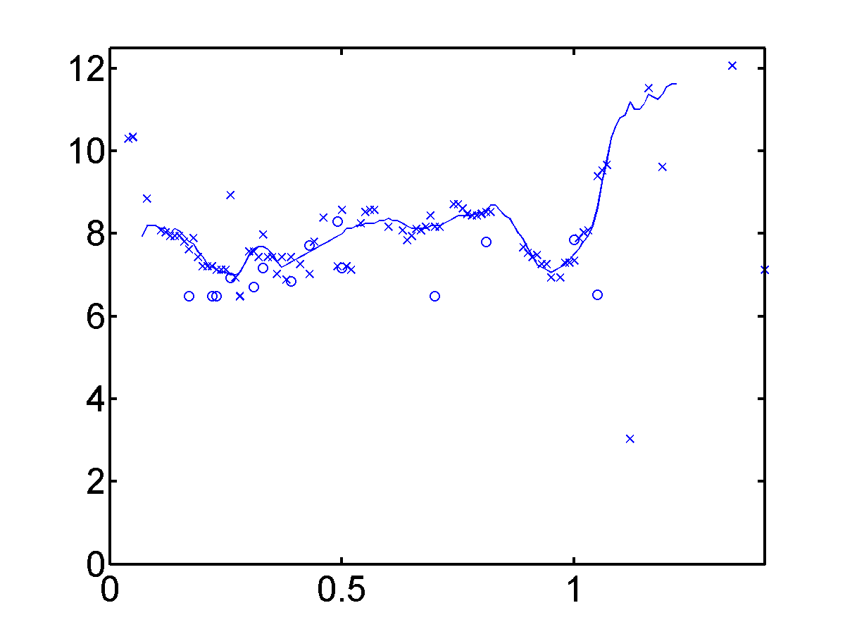

Example 1: Speech and white noise
Wu et al.’03
Tolonen & Karjalainen’00
Pitch Period (ms)
Time (s)
Time (s)

Slide 37
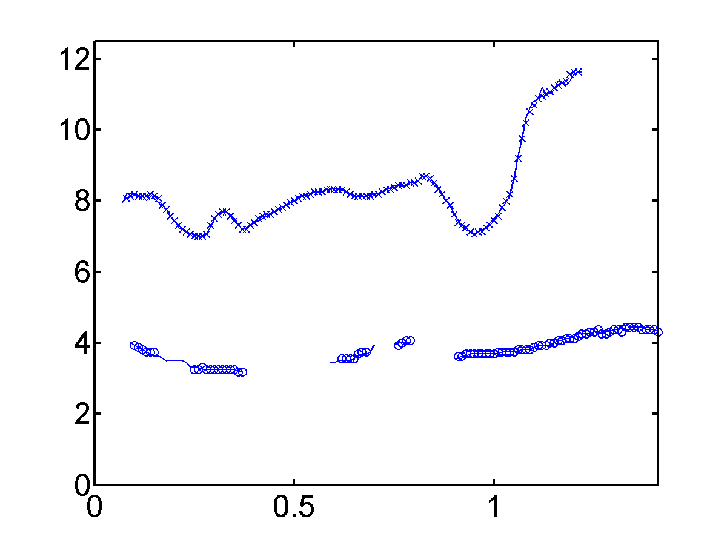
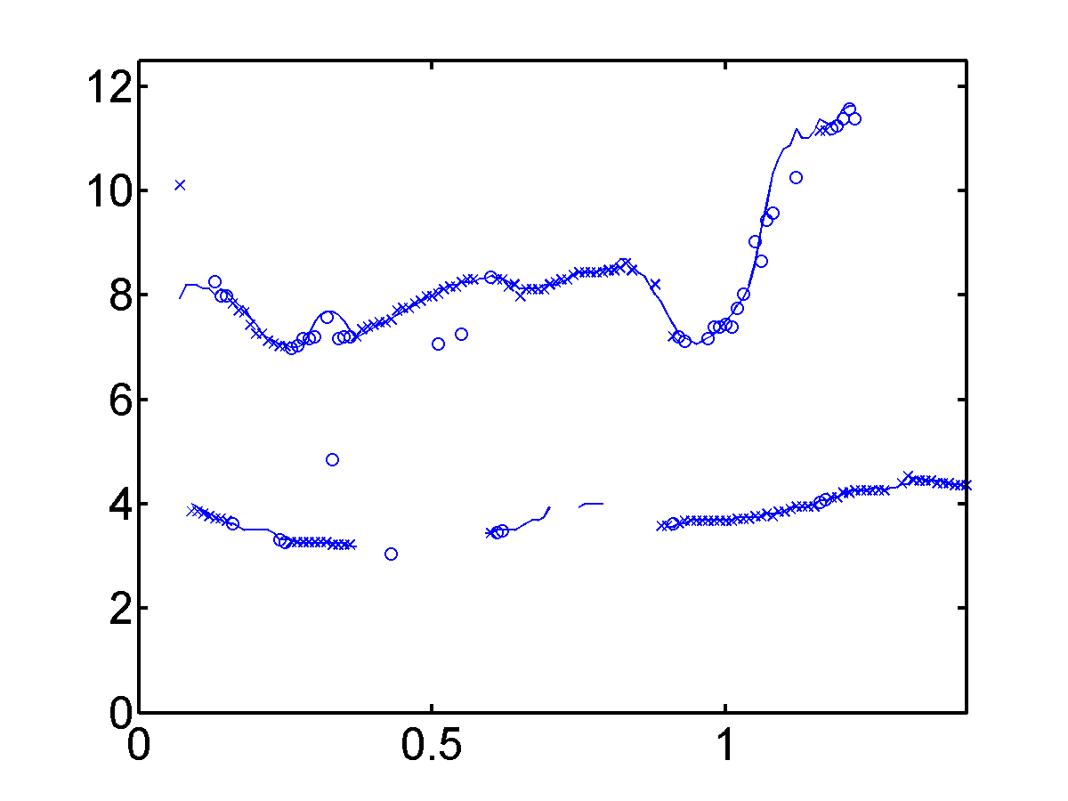
Example 2: Two utterances
Wu et al.’03
Tolonen & Karjalainen’00
Pitch Period (ms)
Time (s)
Time (s)

Slide 38
Outline
Problem statement
Multipitch tracking in noisy speech
  Multipitch tracking in reverberant environments
Binaural tracking of moving sound sources
Discussion & conclusion

Slide 39
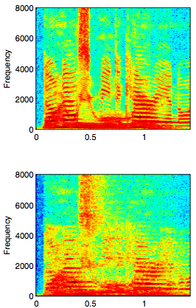
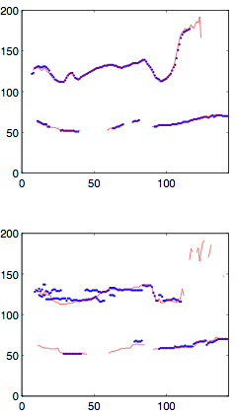
Multipitch tracking for reverberant speech
Room reverberation degrades harmonic structure, making pitch tracking harder
Mixture of
two anechoic
utterances
Corresponding
reverberant
mixture

Slide 40
What is pitch of a reverberant speech signal?
Laryngograph provides ground truth pitch for anechoic speech. However, it does not account for fundamental alteration to the signal by room reverberation
True to the definition of signal periodicity and considering the use of pitch for speech segregation, we suggest to track the fundamental frequency of the quasi-periodic reverberant signal itself, rather than its corresponding anechoic signal (Jin & Wang’09)
  We use a semi-automatic pitch labeling technique (McGonegal et al.’75) to generate reference pitch by examining waveform, autocorrelation, and cepstrum

Slide 41
HMM for multipitch tracking in reverberation
We have recently applied the HMM framework of Wu et al.’03 to reverberant environments (Jin & Wang’09)
The following changes are made to account for reverberation effects:
  A new channel selection method based on cross-channel correlation
  Observation probability is formulated based on a pitch saliency measure, rather than relative time-lag distribution which is very sensitive to reverberation
  These changes result in a simpler HMM model!
Evaluation and comparison with Wu et al.’03 and Klapuri’08 show that this system is robust to reverberation, and gives better performance

Slide 42
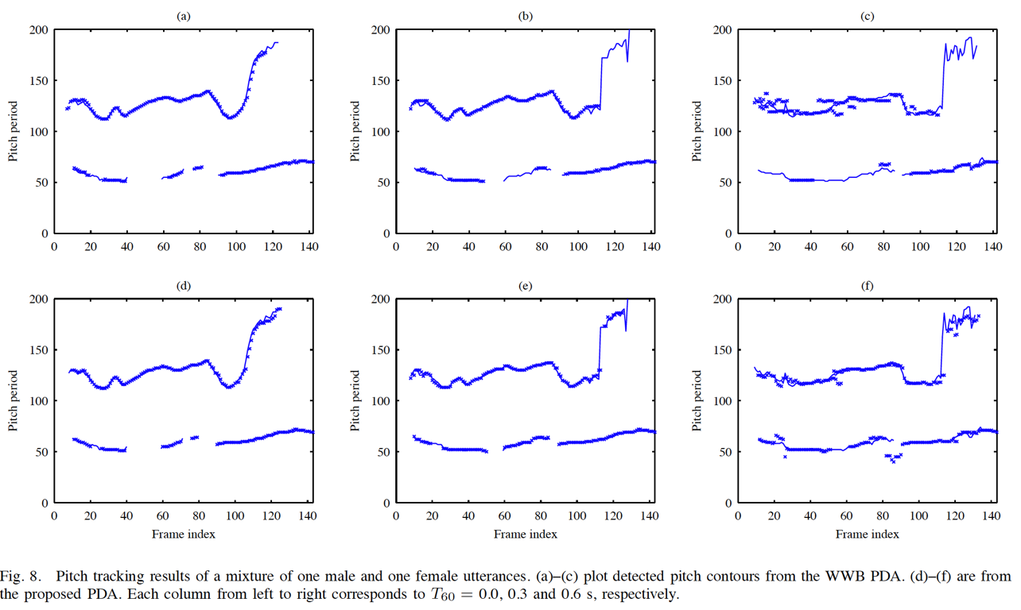
Two-utterance example
Upper: Wu et al.’03; lower: Jin & Wang’09
Reverberation time is 0.0 s (left), 0.3 s (middle), 0.6 s (right)

Slide 43
Outline
Problem statement
Multipitch tracking in noisy speech
  Multipitch tracking in reverberant environments
Binaural tracking of moving sound sources
Discussion & conclusion

Slide 44
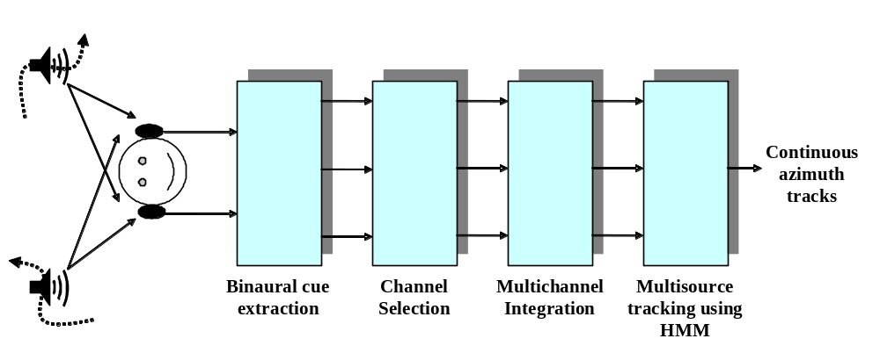
HMM for binaural tracking of moving sources
Roman & Wang (2008)
Binaural cues (observations) are ITD (interaural time difference) and IID (interaural intensity difference)
The HMM framework is similar to that of Wu et al.’03

Slide 45
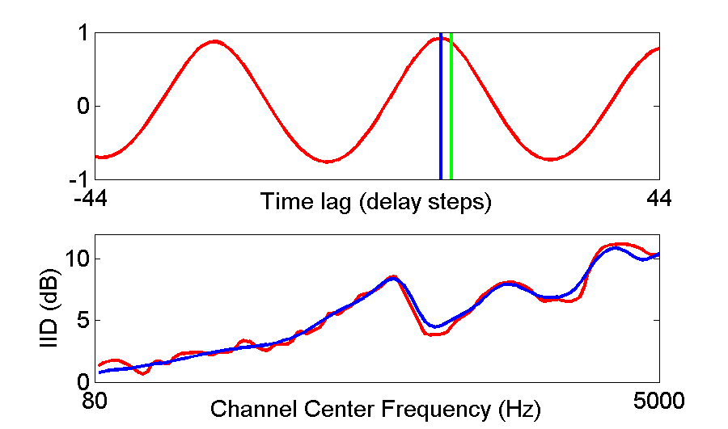
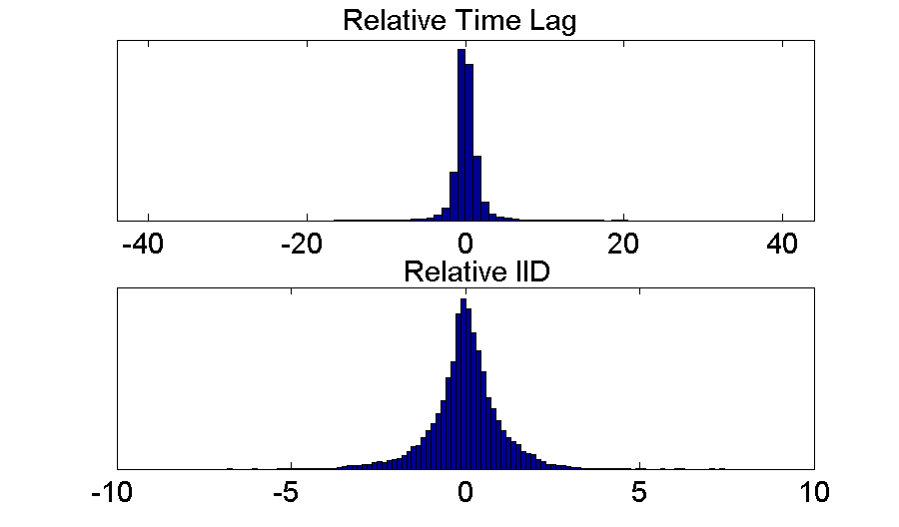
Likelihood in one-source subspace
Actual ITD
Reference ITD
Joint distribution of ITD-IID deviations for one channel:

Slide 46
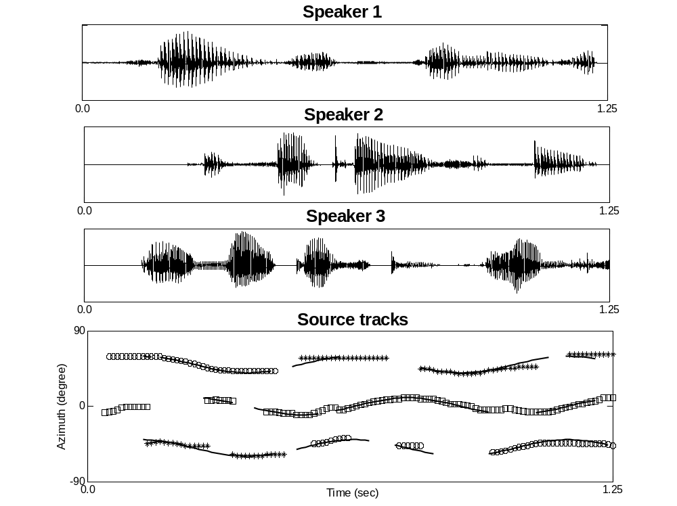
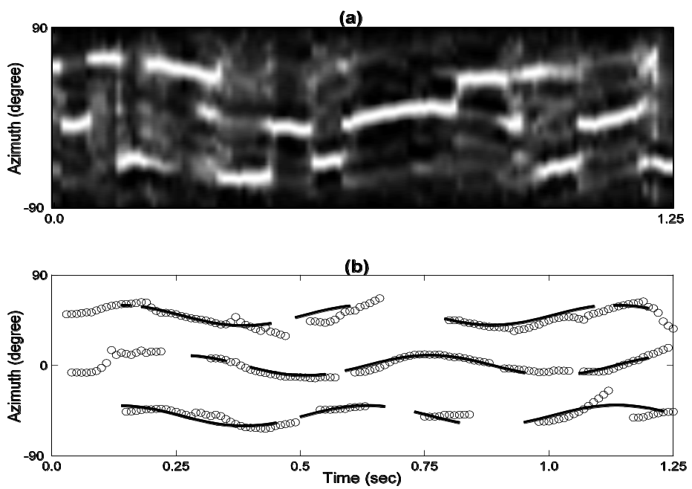
Three-source illustration and comparison
Kalman filter output

Slide 47
Summary of moving source tracking
The HMM framework automatically provides the number of active sources at a given time
Compared to a Kalman filer approach, the HMM approach produces more accurate tracking
Localization of multiple stationary sources is a special case
The proposed HMM model represents the first CASA study addressing moving sound sources

Slide 48
General discussion
The HMM framework for multi-target tracking is a form of Bayesian inference (tracking) that is broader than Kalman filtering
  Permits nonlinearity and non-Gaussianity
  Yields the number of active targets at all times
  Corpus-based training for parameter estimation
  Efficient search
Our work has investigated up to two (pitch) or three (moving sources) target tracks in the presence of noise
  Extension to more than three is straightforward theoretically, but complexity becomes an issue increasingly
  However, for the domain of auditory processing, little need to track more than 2-3 targets due to limited perceptual capacity

Slide 49
Conclusion
We have proposed an HMM framework for multi-target tracking
  State space consists of a discrete set of subspaces, each being continuous
  Observations (likelihoods) are derived in time-frequency domains: Correlogram for pitch and cross-correlogram for azimuth
We have applied this framework to tracking multiple pitch contours and multiple moving sources
The resulting algorithms perform reliably and outperform related systems
The proposed framework appears to have general utility for acoustic (auditory) signal processing

Slide 50
Collaborators
Mingyang Wu, Guy Brown
Nicoleta Roman
Zhaozhang Jin

Slide 51
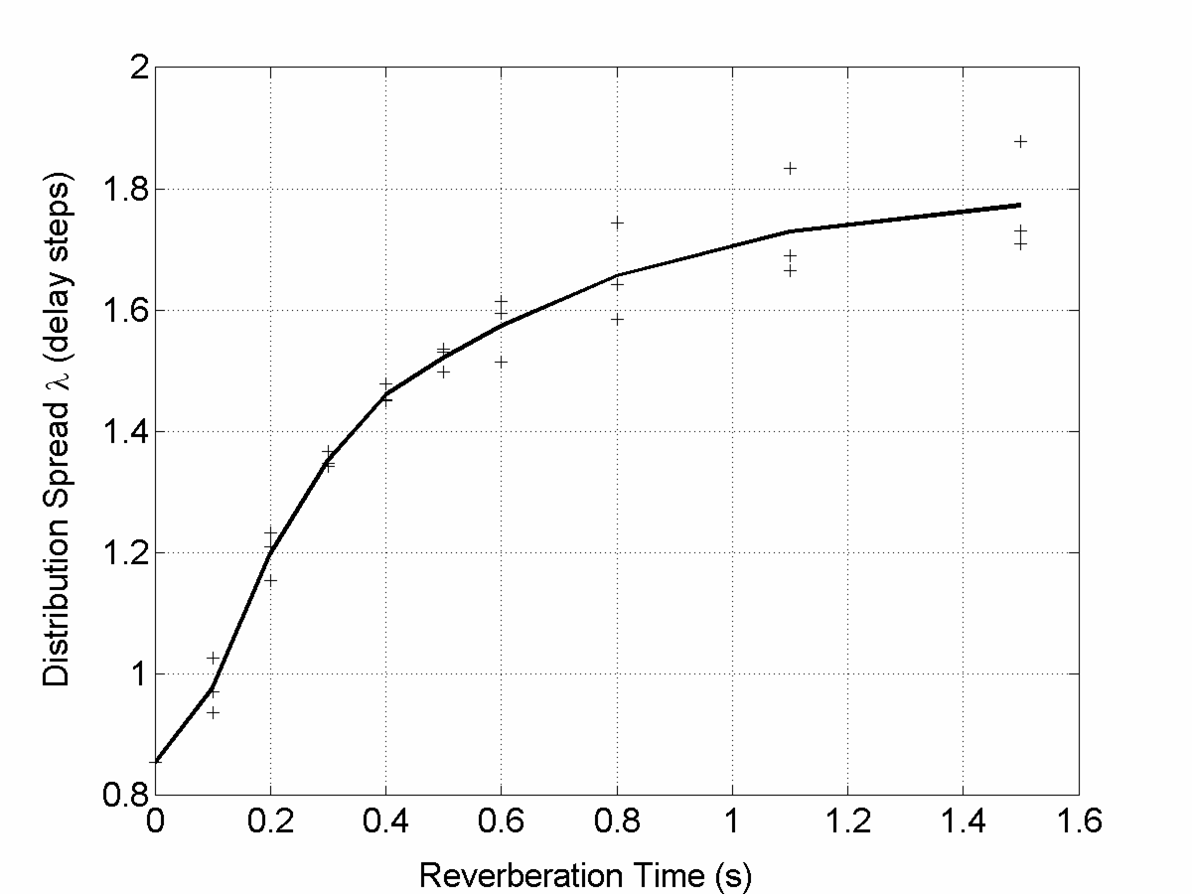
A monotonic relationship
This relationship of the distribution spread, λ, with respect to reverberation time (from detected pitch) yields a blind estimate of the room reverberation time up to 0.6 sec (Wu & Wang’06)

Slide 52
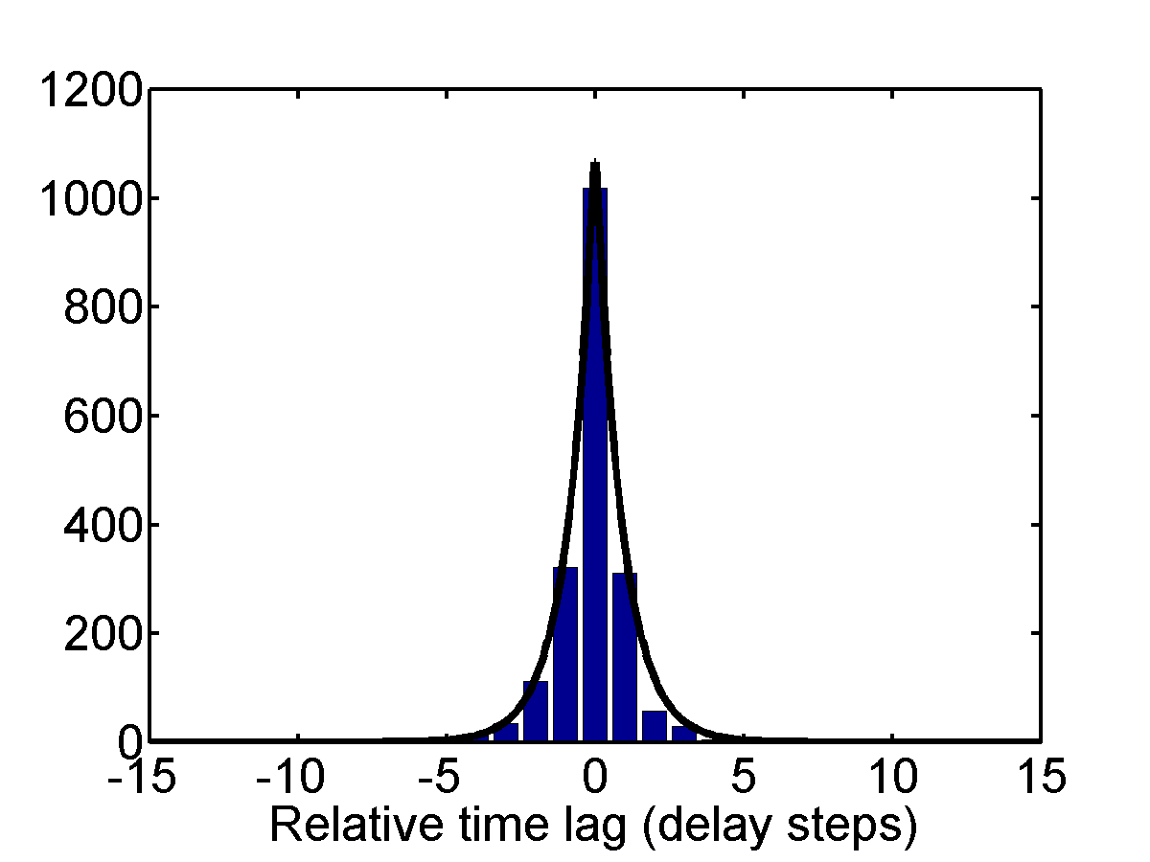
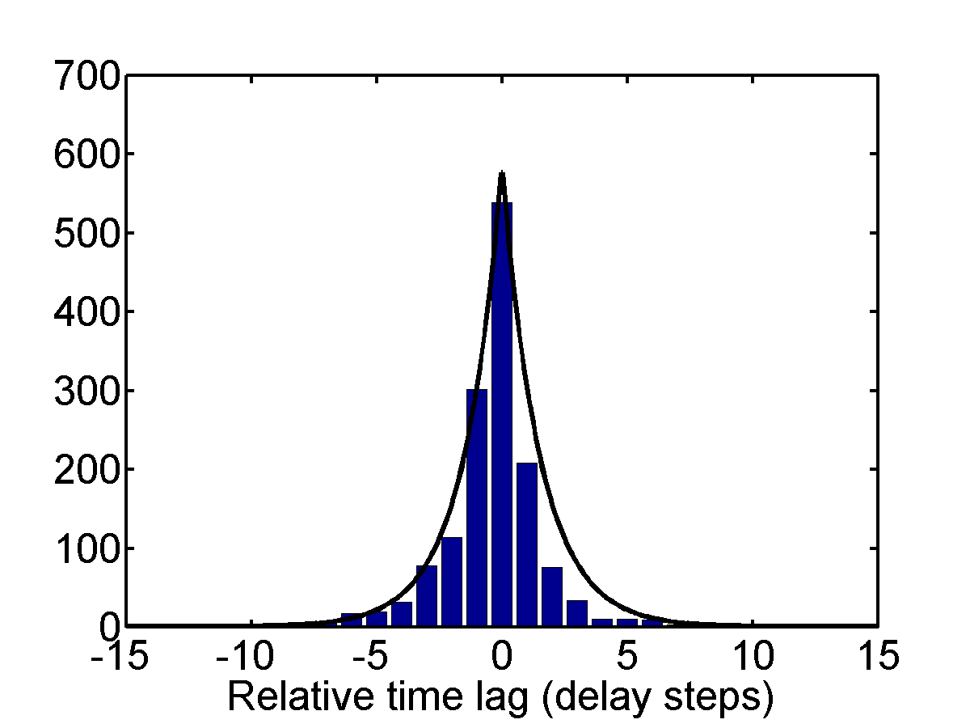
A byproduct: Reverberation time estimation
Relative time-lag distribution is sensitive to room reverberation, which increases the distribution spread
Clean speech
Reverberant speech

