Slide 1
Speech Segregation Based on Sound Localization
DeLiang Wang & Nicoleta Roman
The Ohio State University, U.S.A.
Guy J. Brown
University of Sheffield, U.K.

Slide 2
Outline of presentation
Background & objective
Description of a novel approach
Evaluation
  Using SNR and ASR measures
  Speech intelligibility measure
  A comparison with an existing model
Summary

Slide 3
Cocktail-party problem
How to model a listener’s remarkable ability to selectively attend to one talker while filtering out other acoustic interferences?
The auditory system performs auditory scene analysis (Bregman 1990) using various cues, including fundamental frequency, onset/offset, location, etc.
Our study focuses on location cues:
  Interaural time difference (ITD)
  Interaural intensity difference (IID)

Slide 4
Background
Auditory masking phenomenon:
  In a narrowband, a stronger signal masks a weaker one.
In the case of multiple sources, generally one source dominates in a local time-frequency region.
Our computational goal for speech segregation is to identify a time-frequency (T-F) binary mask, in order to extract the T-F units dominated by target speech.

Slide 5
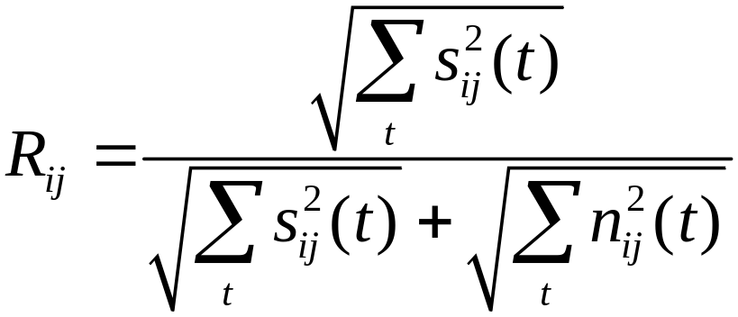
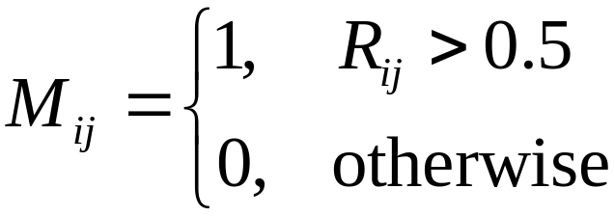
Ideal binary mask
An ideal binary mask is defined as follows (s: signal; n: noise):
  Relative strength:
  Binary mask:
So our research aims at computing, or estimating, the ideal binary mask.

Slide 6
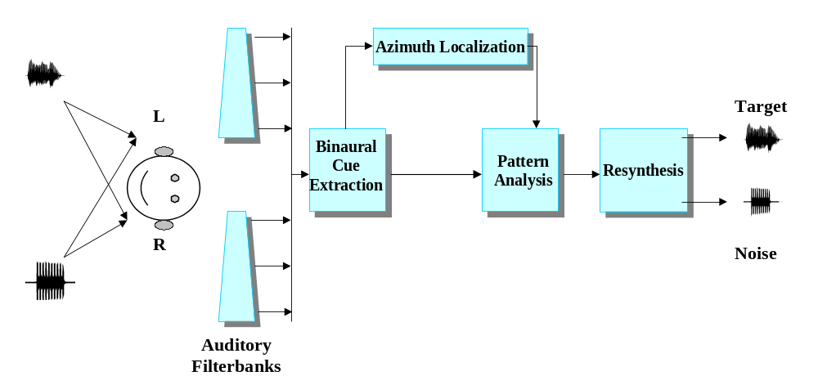
Model architecture

Slide 7
Head-Related transfer function
Pinna, torso and head function acoustically as a linear filter whose transfer function depends on the direction of and distance to a sound source.
We use a catalogue of HRTF measurements collected by Gardner and Martin (1994) from a KEMAR dummy head under anechoic conditions.

Slide 8
Auditory periphery
128 gammatone filters for the frequency range 80 Hz - 5 kHz to model cochlear filtering.
Adjusted the gains of the gammatone filters to simulate the middle ear transfer function.
A simple model of auditory nerve: Half-wave rectification and square-root operation (to simulate saturation)

Slide 9
Azimuth localization
Cross-correlation mechanism for ITD detection (Jeffress 1948).
Frequency-dependent nonlinear transformation from the time-delay axis to the azimuth axis.
Sharpening of the cross-correlogram with a similar effect as the lateral inhibition mechanism, resulting in skeleton cross-correlogram.
Locations are identified as peaks in the skeleton cross-correlogram.

Slide 10
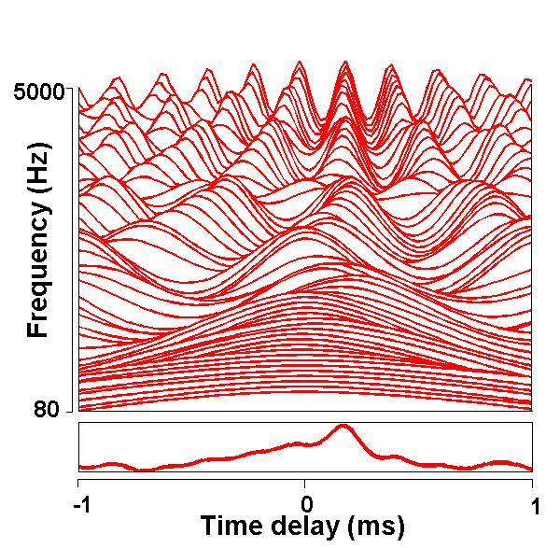
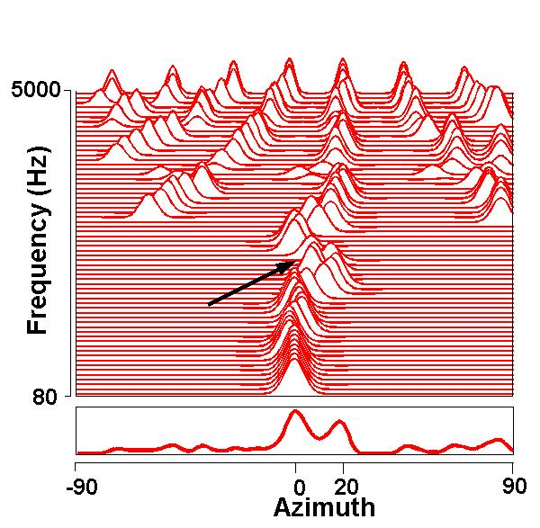
Azimuth localization: Example (Target: 0^{ο}, Noise: 20^{ο})
Conventional cross-correlogram for one frame
Skeleton cross-correlogram

Slide 11
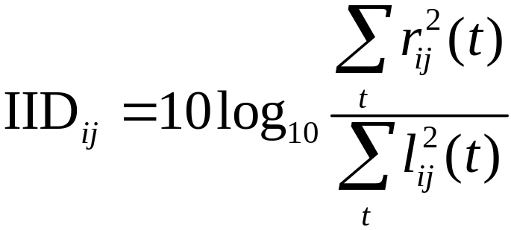
Binaural cue extraction
Interaural time difference
  Cross-correlation mechanism.
  To resolve the multiple-peak problem at high frequencies, ITD is estimated as the peak in the cross-correlation pattern within a period centering at ITD_{target}
Interaural intensity difference: Ratio of right-ear energy to left-ear energy.

Slide 12
Ideal binary mask estimation
For narrowband stimuli, we observe that systematic changes of extracted ITD and IID values occur as the relative strength of the original signals changes. This interaction produces characteristic clustering in the joint ITD-IID space.
The core of our model lies in deriving the statistical relationship of the relative strength and the values of the binaural cues.
We employ utterances from the TIMIT corpus for training, and the same corpus and that collected by Cooke (1993) for testing.

Slide 13
Theoretical analysis
We perform a theoretical analysis with two pure tones to derive the relationship between ITD and IID values and the relative strength between them.
The main conclusion is that both ITD and IID values shift systematically as the relative strength changes.
The theoretical results from pure tones match closely with the corresponding data from real speech.

Slide 14
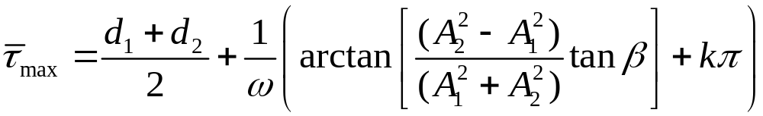
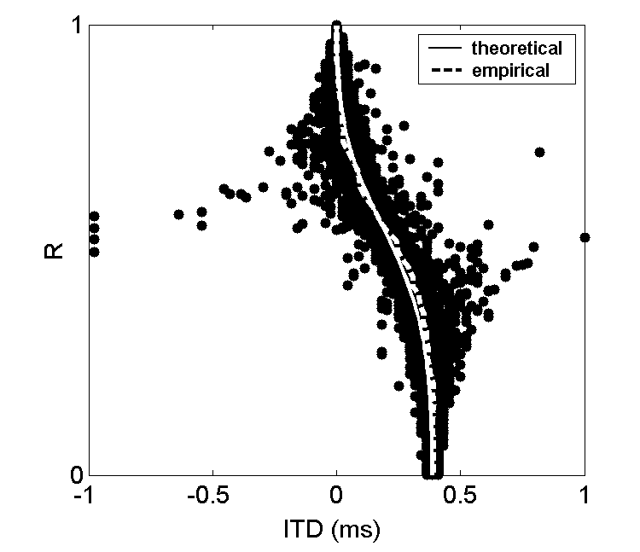
2-source configuration: ITD
Theoretical Mean ITD:
One channel data
(CF: 500 Hz)

Slide 15
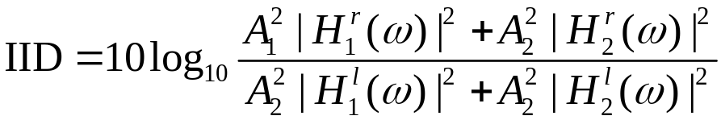
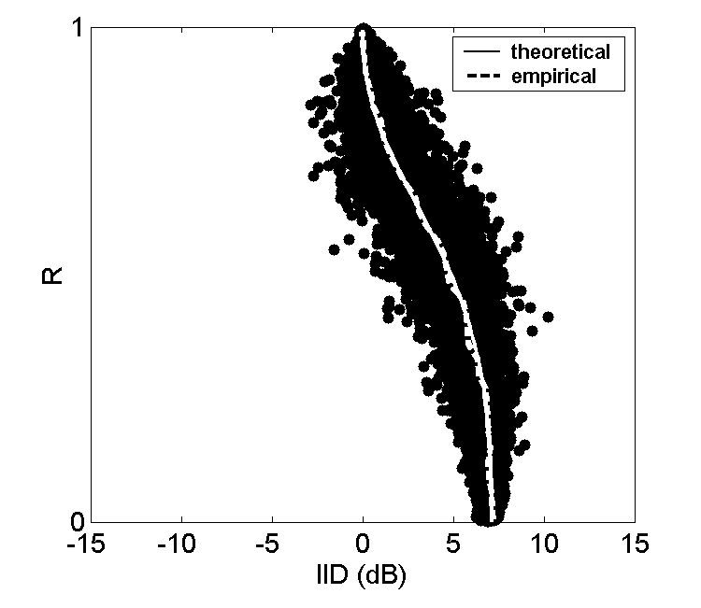
2-source configuration: IID
Theoretical Mean IID:
One channel data
(CF: 2.5 kHz)

Slide 16
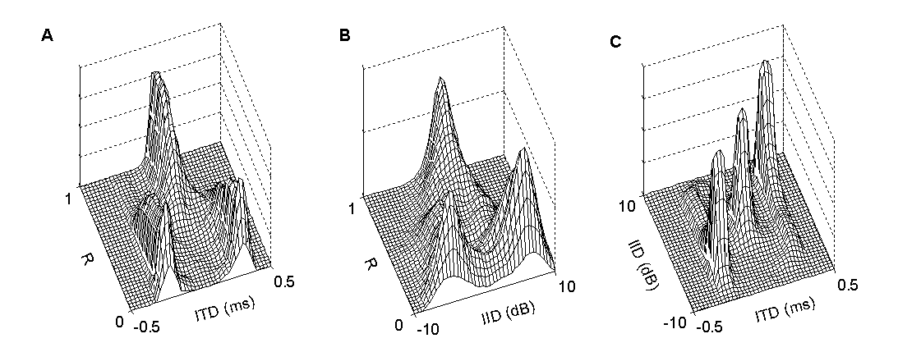
3-source configuration
Data histograms for one channel (CF: 1.5 kHz) from speech sources with target at 0^{ο} and two intrusions at -30^{ο} and 30^{ο}
- Clustering in the joint ITD-IID space

Slide 17
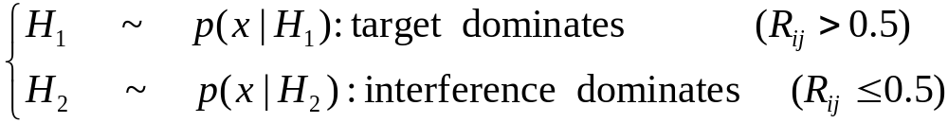
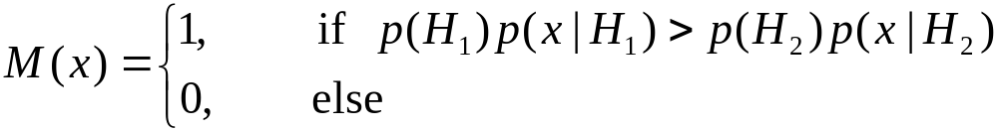
Pattern classification
Independent supervised learning for different spatial configurations and different frequency bands in the joint ITD-IID feature space.
Define:
Decision rule (MAP):

Slide 18

Pattern classification (Cont.)
Nonparametric method for the estimation of probability densities : Kernel Density Estimation.
We employ the least squares cross-validation method (Sain et al. 1994) to determine optimal smoothing parameters.

Slide 19
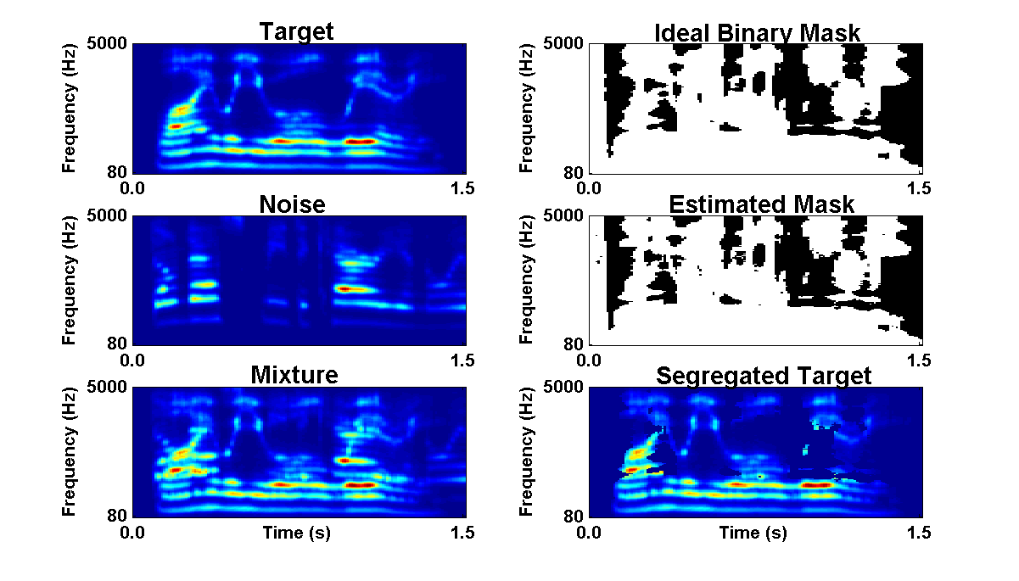

Example (Target: 0º, Noise: 30º)
Target
Noise
Mixture
Ideal binary mask
Result

Slide 20
Demo: 2-source configuration
(Target: 0º, Noise: 30º)
Noise | Mixture | Segregated target
White Noise
‘Cocktail Party’
Rock Music
Siren
Female Speech
Target

Slide 21
Demo: 3-source configuration (Target: 0º, Noise1: -30º, Noise2: 30º)
Noise1 | Mixture | Segregated target
‘Cocktail-party’
Female Speech
Target
Noise2

Slide 22
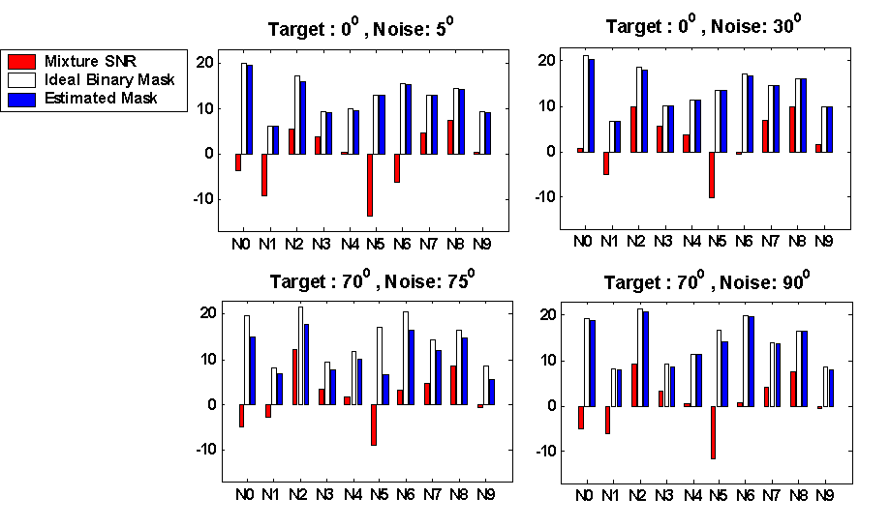
Systematic evaluation: 2-source
SNR (dB)
Average SNR gain (at the better ear) ranges from 13.7 dB for upper two panels to 5 dB for lower left panel

Slide 23
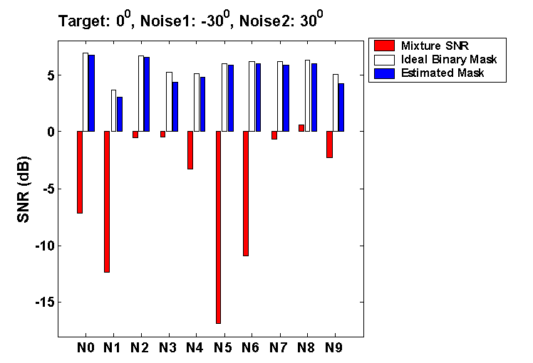
3-source configuration
Average SNR gain is 11.3 dB

Slide 24
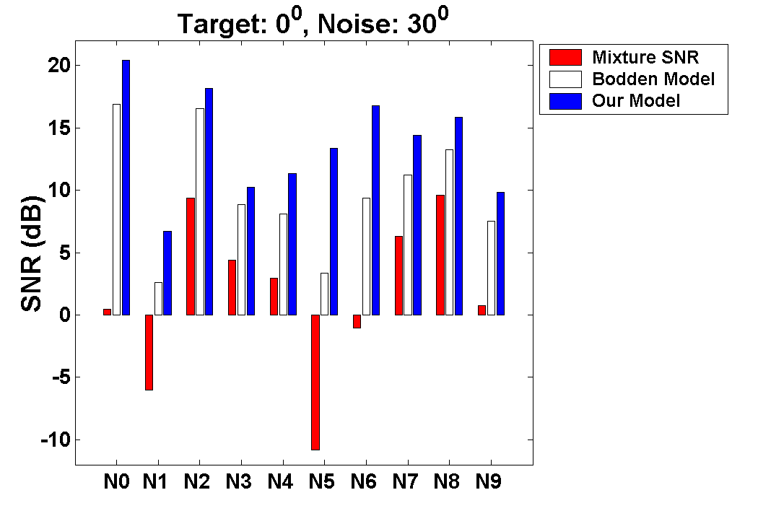
Comparison with Bodden model
We have implemented and compared with the Bodden model (1993), which estimates a Wiener filter for segregation. Our system produces 3.5 dB average improvement.

Slide 25
ASR evaluation
We employ the missing-data technique for robust speech recognition developed by Cooke et al. (2001). The decoder uses only acoustic features indicated as reliable in a binary mask.
The task domain is recognition of connected digits and both training and testing are performed on the left ear signal using the male speaker dataset from TIDigits database.

Slide 26
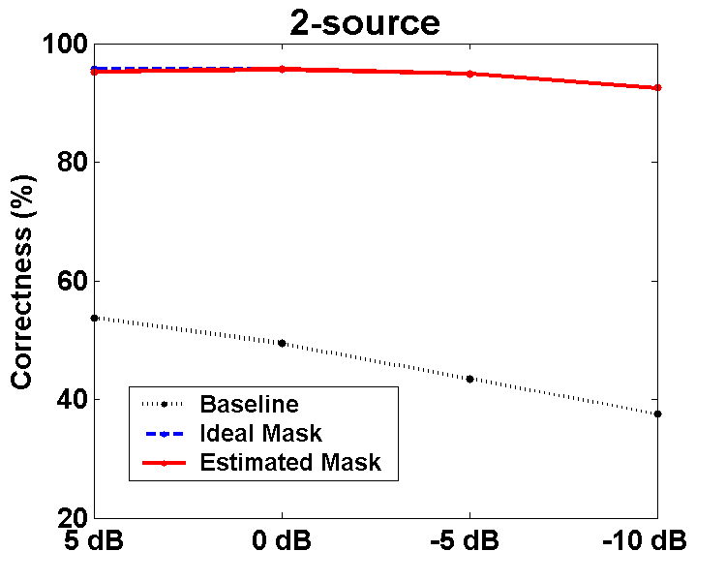
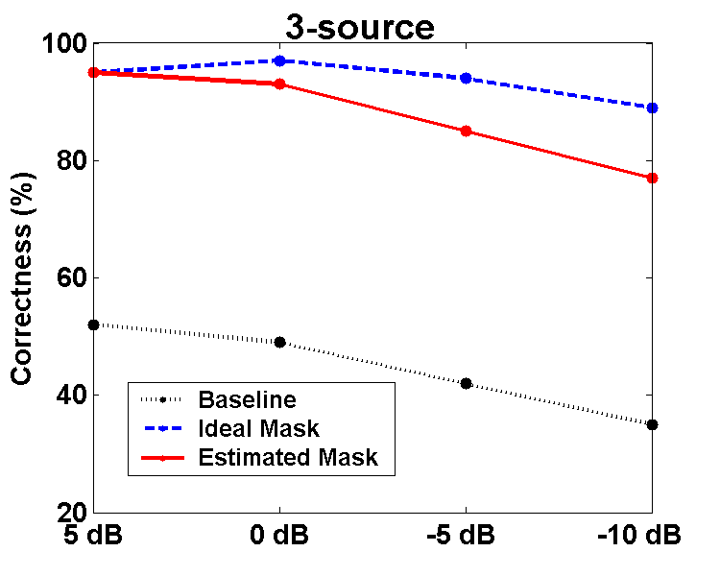
ASR evaluation: Results
Target at 0^{ο}
Intrusion (male speech) at 30^{ο}
Target at 0^{ο}
Two intrusions at 30^{ο} and -30^{ο}

Slide 27
Speech intelligibility tests
We employ the Bamford-Kowal-Bench sentence database that contains short semantically predictable sentences as target. The score is evaluated as the percentage of keywords correctly identified.
In the unprocessed condition, binaural signals are convolved with HRTF and presented dichotically to the listener. In the processed condition, our algorithm is used to reconstruct the target signal at the better ear and results are presented diotically.

Slide 28
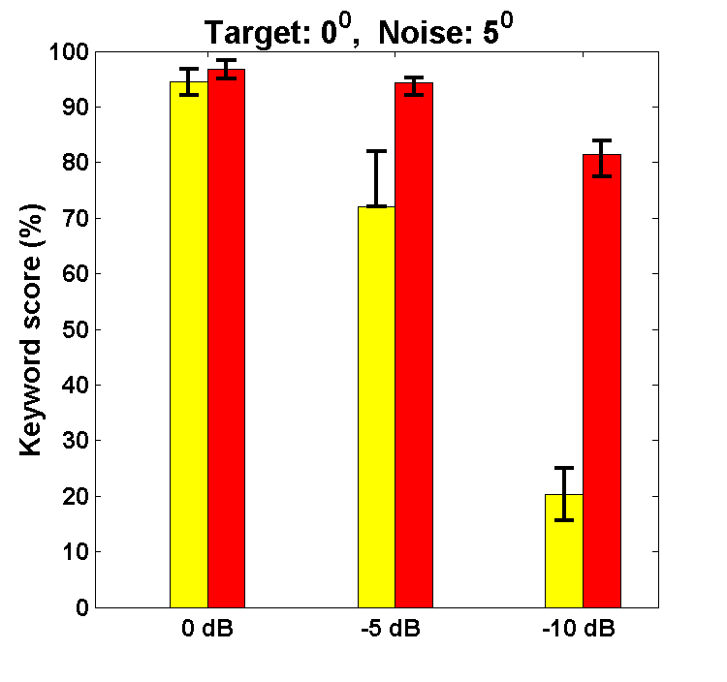
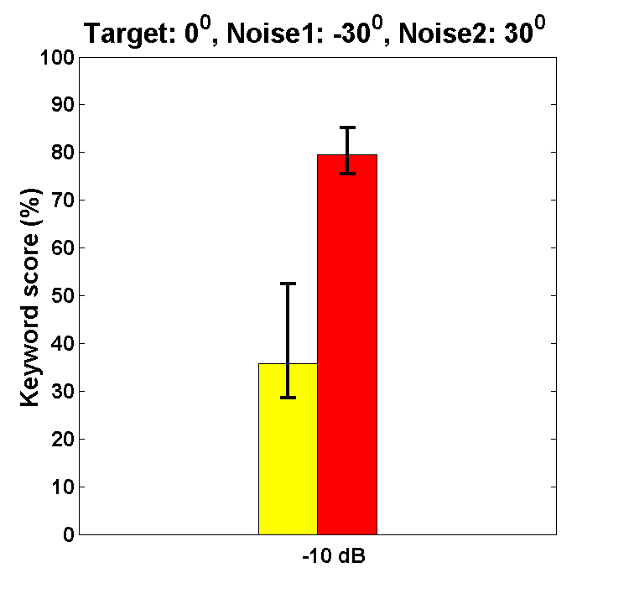
Speech intelligibility results
Unprocessed
Segregated
Two-source (0^{ο}, 5^{ο}) condition
Interference: babble noise
Three-source (0^{ο}, 30^{ο} , -30^{ο}) condition
Interference: male utterance & female utterance

Slide 29
Summary
We have proposed a classification-based approach to speech segregation in the joint ITD-IID feature space.
Evaluation using both SNR and ASR measures shows that our model estimates ideal binary masks very well.
The system produces substantial ASR and speech intelligibility improvements in noisy conditions.
Our work shows that computed location cues can be very effective for across-frequency grouping
Future work needs to address reverberant and moving conditions

Slide 30
Acknowledgement
Work supported by AFOSR and NSF

