Slide 1
Cocktail Party Processing
DeLiang Wang
(Jointly with Guoning Hu)
Perception & Neurodynamics Lab
Ohio State University

Slide 2
Outline of presentation
Introduction
Voiced speech segregation based on pitch tracking and amplitude modulation analysis
Unvoiced speech segregation based on auditory segmentation and segment classification

Slide 3
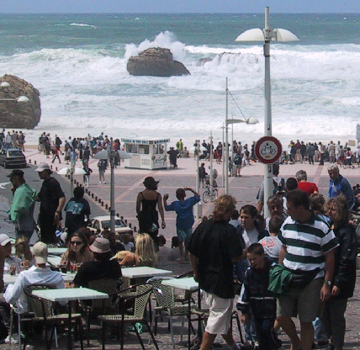

Real-world audition
What?
Speech
  message
  speaker
    age, gender, linguistic origin, mood, …
Music
Car passing by
Where?
Left, right, up, down
How close?
Channel characteristics
Environment characteristics
Room reverberation
Ambient noise

Slide 4
Speech segregation problem
In a natural environment, target speech is usually corrupted by acoustic interference, creating a speech segregation problem
  Also known as cocktail-party problem (Cherry’53) or ball-room problem (Helmholtz, 1863)
  Speech segregation is critical for many applications, such as automatic speech recognition and hearing prosthesis
Most speech separation techniques, e.g. beamforming and independent component analysis, require multiple sensors. However, such techniques have clear limits
  Suffer from configuration stationarity
  Can’t deal with situations where multiple sounds originate from same or close directions
Most speech enhancement approaches developed for monaural situation deal with only stationary acoustic interference
“No machine has yet been constructed to do just that [solving the cocktail party problem].” (Cherry’57)

Slide 5
Auditory scene analysis
Listeners parse the complex mixture of sounds arriving at the ears in order to form a mental representation of each sound source
This perceptual process is called auditory scene analysis (Bregman’90)
Two conceptual processes of auditory scene analysis (ASA):
  Segmentation. Decompose the acoustic mixture into sensory elements (segments)
  Grouping. Combine segments into groups, so that segments in the same group likely originate from the same environmental source

Slide 6
Computational auditory scene analysis
Computational auditory scene analysis (CASA) approaches sound separation based on ASA principles
  Feature based approaches
  Model based approaches
CASA has made significant advances in speech separation using monaural and binaural analysis
CASA challenges
  Reliable pitch tracking of noisy speech
  Unvoiced speech
  Room reverberation
This presentation focuses on monaural analysis
  Monaural segregation is likely more fundamental

Slide 7
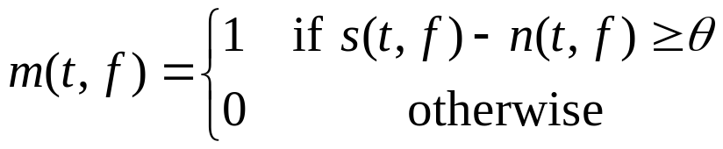
Ideal binary mask as CASA goal
Auditory masking phenomenon: In a narrowband, a stronger signal masks a weaker one
Motivated by the auditory masking phenomenon we have suggested the ideal binary mask as a main goal of CASA
The definition of the ideal binary mask
  s(t, f ): Target energy in unit (t, f )
  n(t, f ): Noise energy
  θ: A local SNR criterion in dB, which is typically chosen to be 0 dB
  Optimality: Under certain conditions the ideal binary mask with θ = 0 dB is the optimal binary mask from the perspective of SNR gain
  It does not actually separate the mixture!

Slide 8
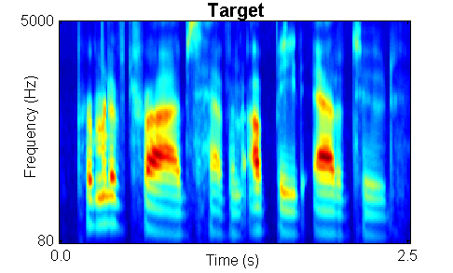
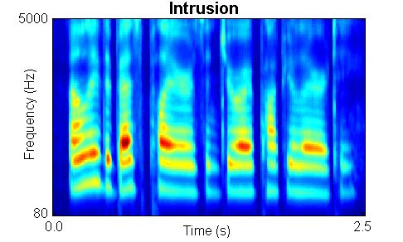
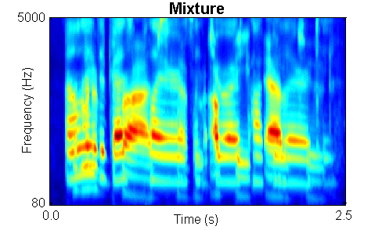
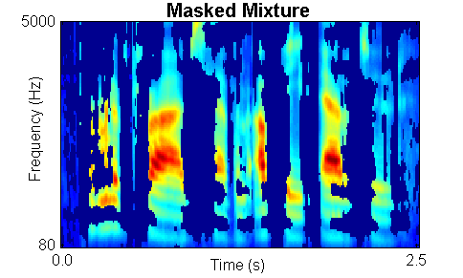
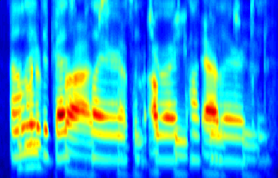
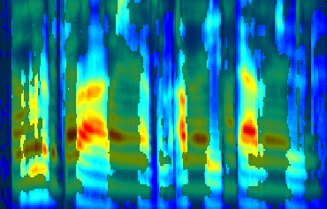
Ideal binary mask illustration
Recent psychophysical tests show that the ideal binary mask results in dramatic speech intelligibility improvements (Brungart et al.’06; Li & Loizou’08)

Slide 9
Outline of presentation
Introduction
Voiced speech segregation based on pitch tracking and amplitude modulation analysis
Unvoiced speech segregation based on auditory segmentation and segment classification

Slide 10
Voiced speech segregation
For voiced speech, lower harmonics are resolved while higher harmonics are not
For unresolved harmonics, the envelopes of filter responses fluctuate at the fundamental frequency of speech
Our voiced segregation model (Hu & Wang’04) applies different grouping mechanisms for low-frequency and high-frequency signals:
  Low-frequency signals are grouped based on periodicity and temporal continuity
  High-frequency signals are grouped based on amplitude modulation (AM) and temporal continuity

Slide 11
Pitch tracking
Pitch periods of target speech are estimated from an initially segregated speech stream based on dominant pitch within each frame
Estimated pitch periods are checked and re-estimated using two psychoacoustically motivated constraints:
  Target pitch should agree with the periodicity of the time-frequency units in the initial speech stream
  Pitch periods change smoothly, thus allowing for verification and interpolation

Slide 12
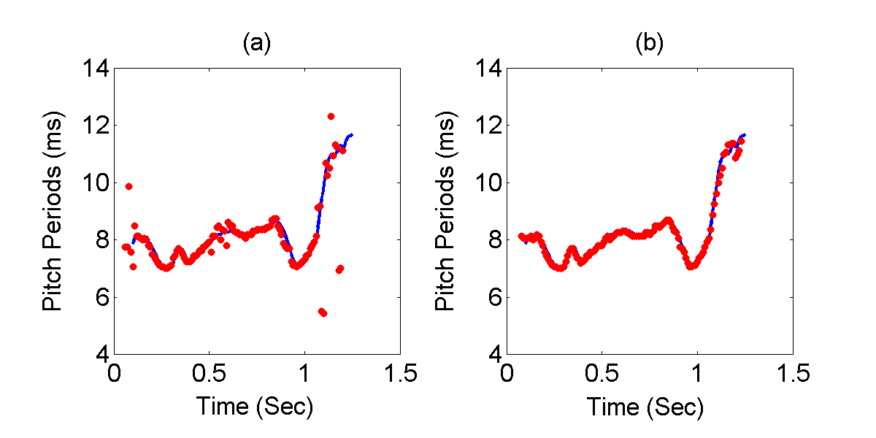
Pitch tracking example
(a) Dominant pitch (Line: pitch track of clean speech) for a mixture of target speech and ‘cocktail-party’ intrusion
(b) Estimated target pitch

Slide 13
T-F unit labeling and grouping
In the low-frequency range:
  A time-frequency (T-F) unit is labeled by comparing the periodicity of its autocorrelation with the estimated target pitch
In the high-frequency range:
  Due to their wide bandwidths, high-frequency filters respond to multiple harmonics. These responses are amplitude modulated due to beats and combinational tones (Helmholtz, 1863)
  A T-F unit in the high-frequency range is labeled by comparing its AM rate with the estimated target pitch
Labeled units are further grouped according to spectral and temporal continuity

Slide 14
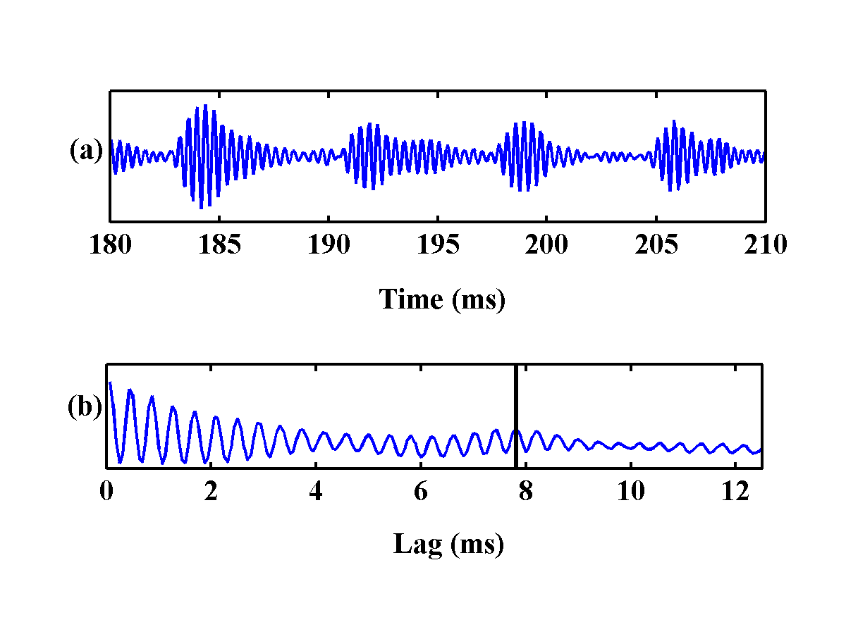
AM example
(a) The output of a gammatone filter (center frequency: 2.6 kHz) in response to clean speech
(b) The corresponding autocorrelation function

Slide 15
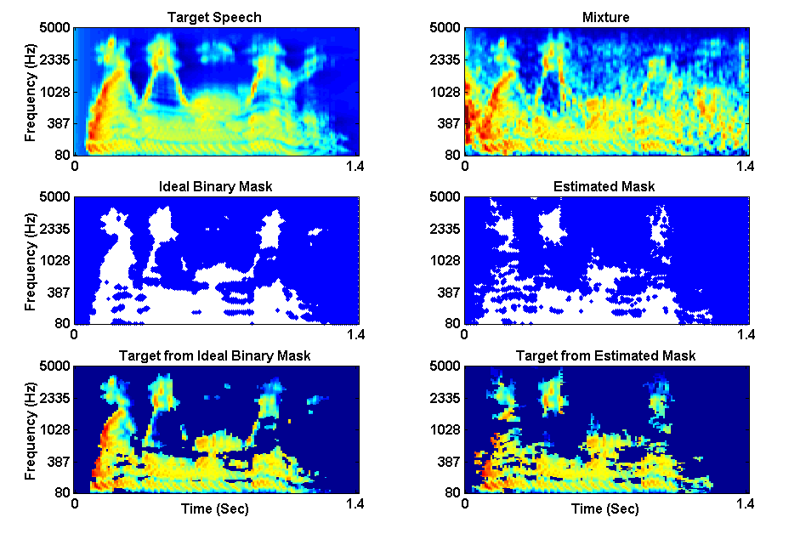
Voiced speech segregation example

Slide 16
Outline of presentation
Introduction
Voiced speech segregation based on pitch tracking and amplitude modulation analysis
Unvoiced speech segregation based on auditory segmentation and segment classification

Slide 17
Unvoiced speech
Speech sounds consist of vowels and consonants; consonants further consist of voiced and unvoiced consonants
For English, unvoiced speech sounds come from the following consonant categories:
  Stops (plosives)
    Unvoiced: /p/ (pool), /t/ (tool), and /k/ (cake)
    Voiced: /b/ (book), /d/ (day), and /g/ (gate)
  Fricatives
    Unvoiced: /s/(six), /sh/ (sheep), /f/ (fix), and /th/ (this)
    Voiced: /z/ (zoo), /zh/ (pleasure), /v/ (vine), and /dh/ (that)
    Mixed: /h/ (high)
  Affricates (stop followed by fricative)
    Unvoiced: /ch/ (chicken)
    Voiced: /jh/ (orange)
We refer to the above consonants as expanded obstruents

Slide 18
How much speech is unvoiced?
Relative frequencies of unvoiced speech
  For written English, the relative occurrence frequency of unvoiced consonants is 21.0% (Dewey’23)
  For telephone conversations, the relative frequency of unvoiced consonants is 24.0% (French et al.’30; Fletcher’53)
  In the TIMIT corpus, we found that the relative frequency of unvoiced consonants is 23.1%
Relative durations of unvoiced speech
  To get an estimate on durations in conversational speech, we use median durations from a transcribed subset of the Switchboard corpus (Greenberg et al.’96) and then insert them to occurrence frequencies in telephone conversations
  We performed a similar study on the TIMIT corpus
  We found that the relative durations are 26.2% for conversations and 25.6% for TIMIT

Slide 19
Unvoiced speech segregation
Unvoiced speech constitutes a significant portion of all speech sounds
  It carries crucial information for speech intelligibility
Unvoiced speech is more difficult to segregate than voiced speech
  Voiced speech is highly structured, whereas unvoiced speech lacks harmonicity and is often noise-like
  Unvoiced speech is usually much weaker than voiced speech and therefore more susceptible to interference

Slide 20
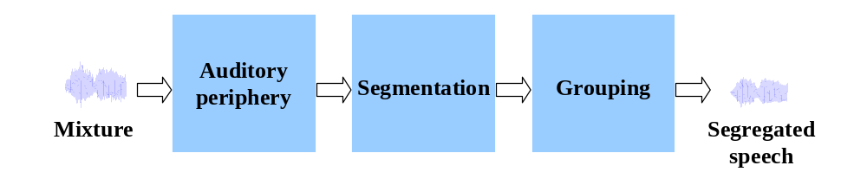
Processing stages of the proposed model

Slide 21
Auditory periphery
Our system models cochlear filtering by decomposing the input in the frequency domain with a bank of gammatone filters
In each filter channel, the output is divided into 20-ms time frames with 10-ms overlapping between consecutive frames
This processing results in a two-dimensional cochleagram

Slide 22
Auditory segmentation
Auditory segmentation is to decompose an auditory scene into contiguous T-F regions (segments), each of which should contain signal mostly from the same sound source
  The definition of segmentation applies to both voiced and unvoiced speech
This is equivalent to identifying onsets and offsets of individual T-F segments, which correspond to sudden changes of acoustic energy
Our segmentation is based on a multiscale onset/offset analysis (Hu & Wang’07)
  Smoothing along time and frequency dimensions
  Onset/offset detection and onset/offset front matching
  Multiscale integration

Slide 23
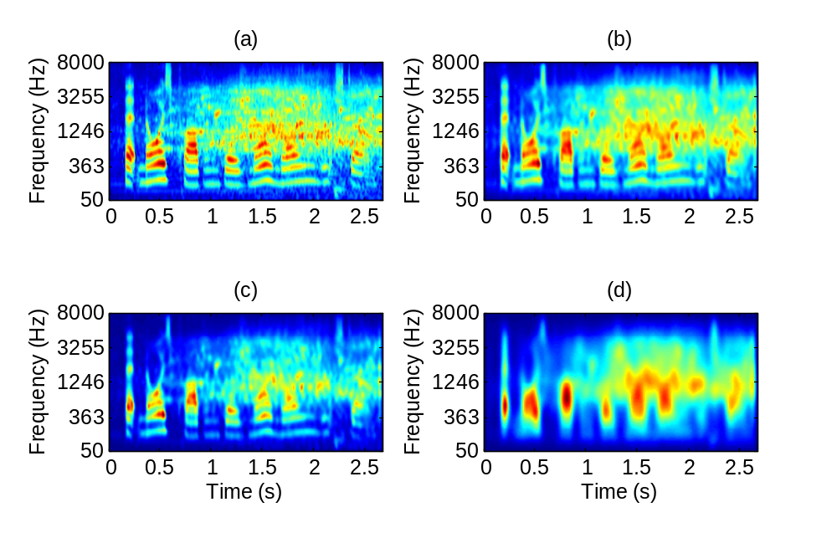
Smoothed intensity
Utterance: “That noise problem grows more annoying each day”
Interference: Crowd noise in a playground. Mixed at 0 dB SNR
Scale in freq. and time: (a) (0, 0), initial intensity. (b) (2, 1/14). (c) (6, 1/14). (d) (6, 1/4)

Slide 24
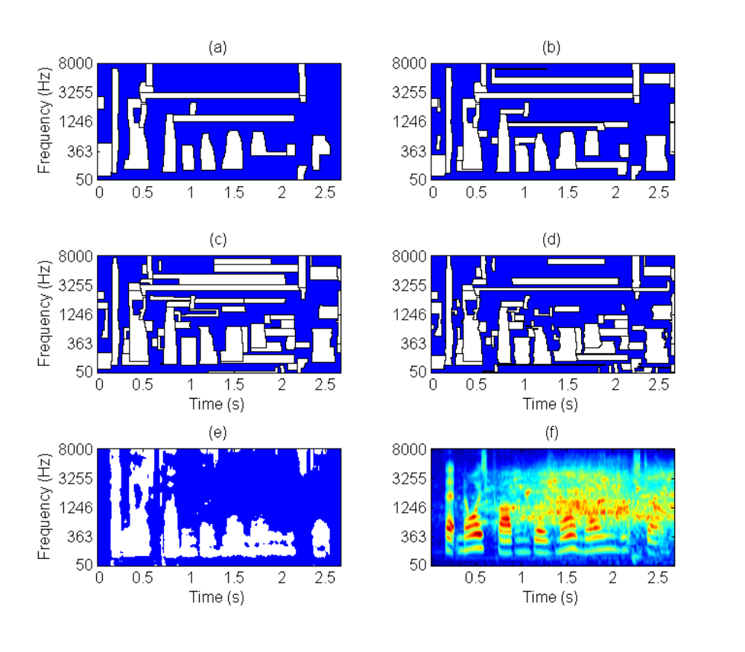
Segmentation result
The bounding contours of estimated segments from multiscale analysis. The background is represented by blue:
One scale analysis
Two-scale analysis
Three-scale analysis
Four-scale analysis
The ideal binary mask
The mixture

Slide 25
Grouping
Apply auditory segmentation to generate all segments for the entire mixture
Segregate voiced speech
Identify segments dominated by voiced target using segregated voiced speech
Identify segments dominated by unvoiced speech based on speech/nonspeech classification
  Assuming nonspeech interference due to the lack of sequential organization

Slide 26

Speech/nonspeech classification
A T-F segment is classified as speech if
  X_{s}: The energy of all the T-F units within segment s
  H₀: The hypothesis that s is dominated by expanded obstruents
  H₁: The hypothesis that s is interference dominant

Slide 27
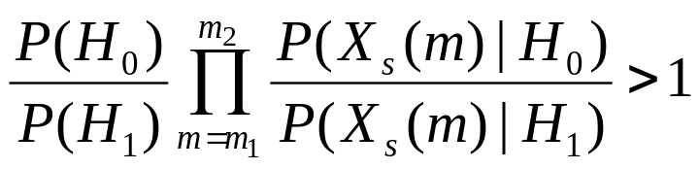
Speech/nonspeech classification (cont.)
By the Bayes rule, we have
  Since segments have varied durations, directly evaluating the above likelihoods is computationally infeasible
  Instead, we assume that each time frame within a segment is statistically independent given a hypothesis
  A multilayer perceptron is trained to distinguish expanded obstruents from nonspeech interference

Slide 28

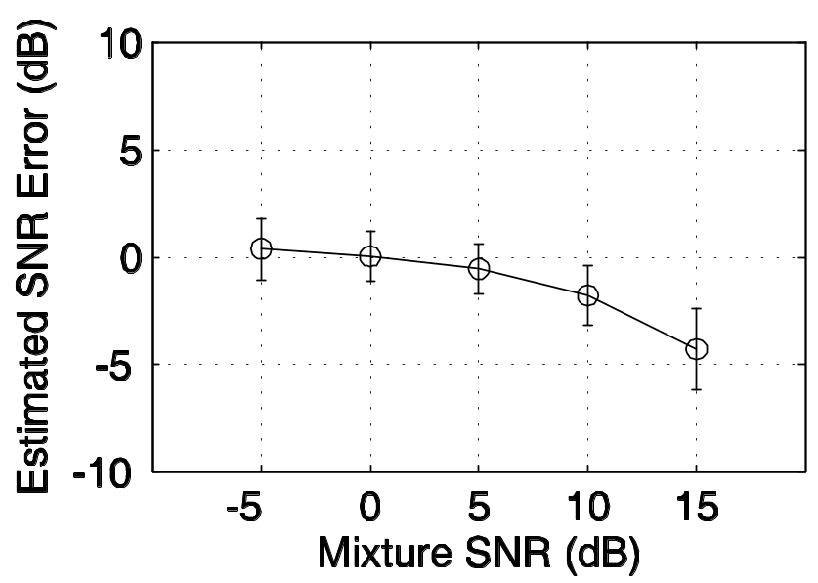
Speech/nonspeech classification (cont.)
The prior probability ratio of , is found to be approximately linear with respect to input SNR
Assuming that interference energy does not vary greatly over the duration of an utterance, earlier segregation of voiced speech enables us to estimate input SNR

Slide 29
Speech/nonspeech classification (cont.)
With estimated input SNR, each segment is then classified as either expanded obstruents or interference
Segments classified as expanded obstruents join the segregated voiced speech to produce the final output

Slide 30
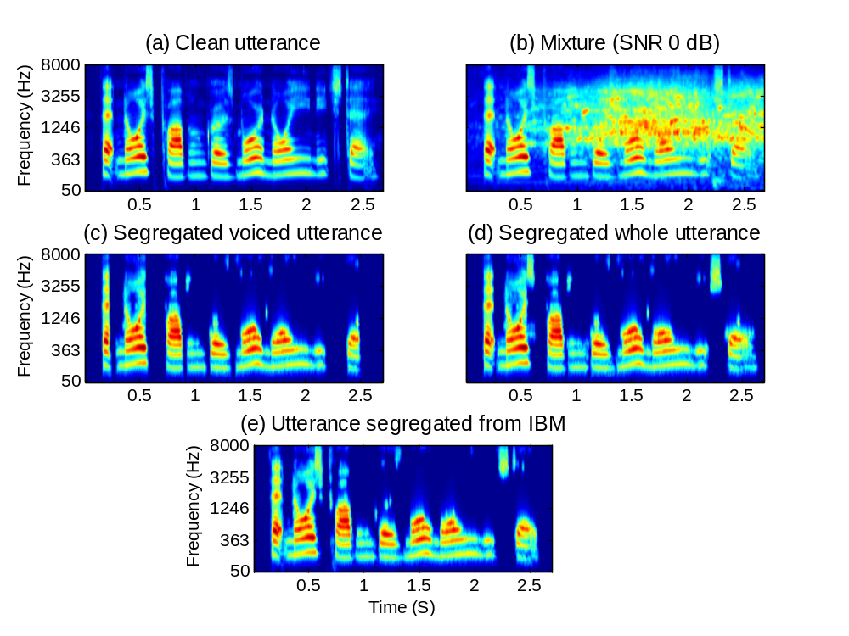
Example of segregation
Utterance: “That noise problem grows more annoying each day”
Interference: Crowd noise in a playground (IBM: Ideal binary mask)

Slide 31
Systematic evaluation
We evaluate our system by comparing the segregated target against the ideal binary mask
Specifically, we use two error measures:
  Percentage of energy loss, P_{EL}
  Percentage of noise residue, P_{NR}
Training and test data
  Speech: TIMIT corpus
  Interference: 100 intrusions, including environmental sounds and crowd noise

Slide 32
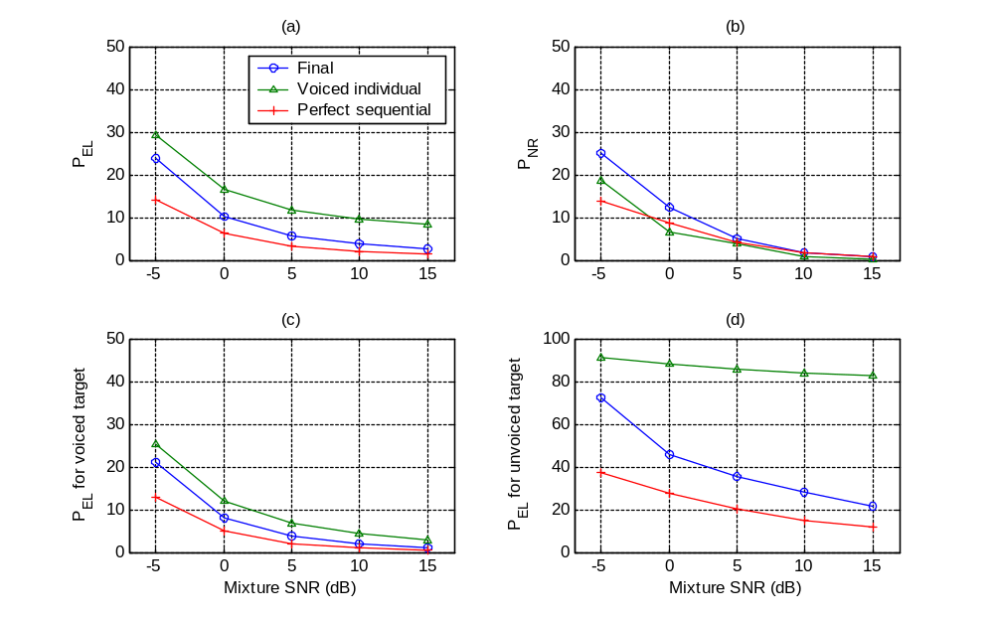
P_{EL} and P_{NR}
  Energy loss is substantially reduced due to grouping of unvoiced speech

Slide 33
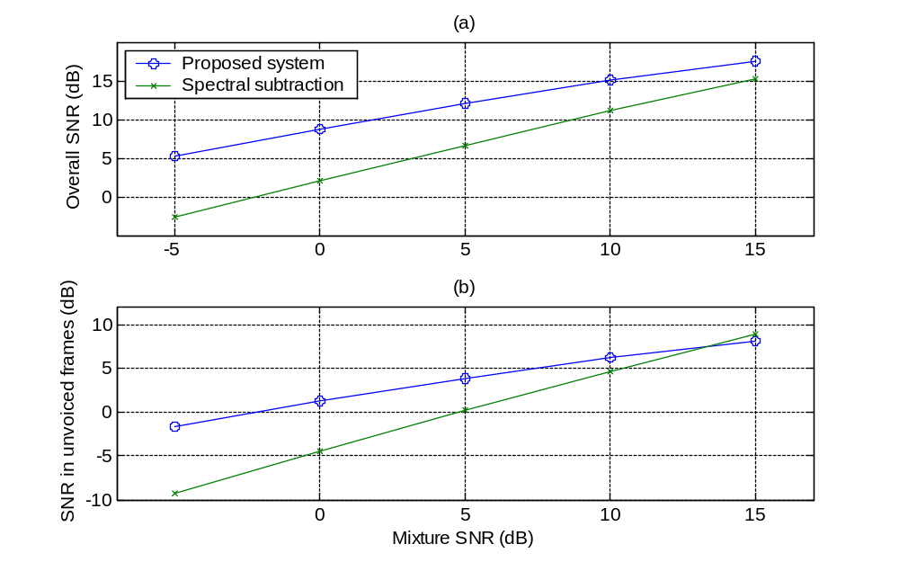
SNR of segregated target
  Compared to spectral subtraction assuming perfect speech pause detection

Slide 34
Conclusion
A CASA approach to monaural segregation of both voiced and unvoiced speech
  Segregation of voiced speech is based on pitch tracking and amplitude modulation analysis
    It provides an important foundation for unvoiced speech segregation
  Segregation of unvoiced speech is based on auditory segmentation and segment classification
    Unvoiced speech accounts for about 21-26% of speech in terms of occurrence frequency and duration
    The proposed model represents the first systematic study on unvoiced speech segregation
Although our system gives state-of-the-art performance, general cocktail party processor requires solutions to sequential organization and room reverberation

Slide 35

Further information on CASA
2006 CASA book edited by D.L. Wang & G.J. Brown and published by IEEE Press/Wiley
  A 10-chapter book with coherent, comprehensive, and up to date treatment of CASA

